Slide 1
Aerothermal Loadings on Lifted Winged Spacecrafts
David Ordaz Perez Timothy Takahashi, PhD 2023 Statewide Symposium
April 22, 2023

Slide 2
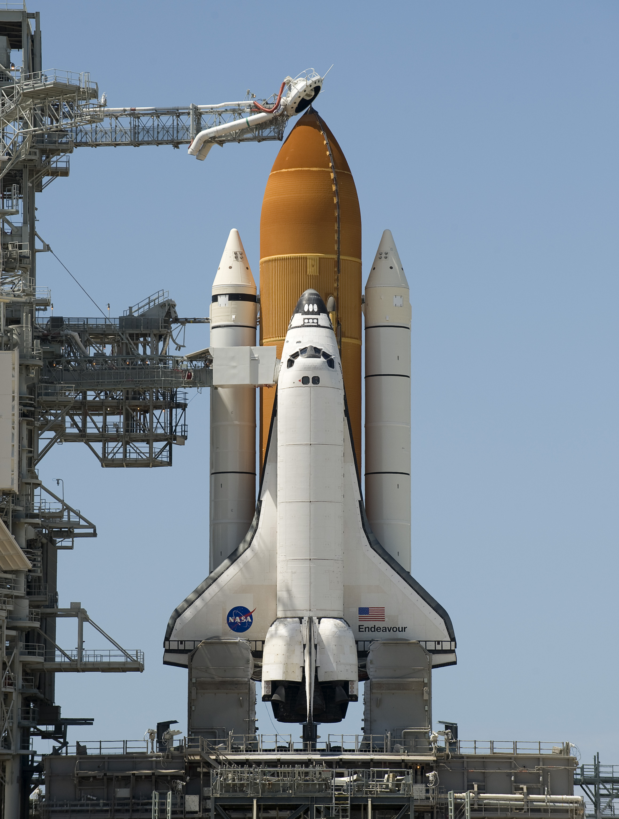
Agenda
Mission Statement
Critical Locations
Aerodynamics Background
Selected Locations
Methodology
Flight Trajectory
Heat Rate Analysis
Results
Conclusion
Source: NASA

Slide 3
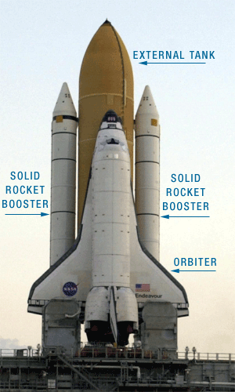
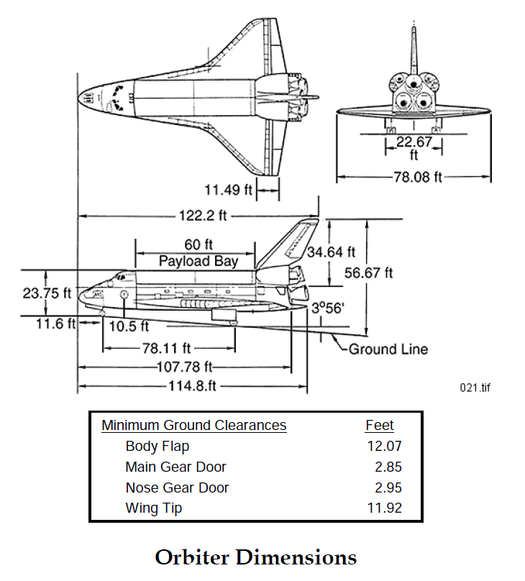
Mission Statement
Analyzing the Aerothermal Loadings on Space Shuttle Orbiter
Objectives
Calculate Ascent Trajectory from Flight Data
Calculate Heating Rate of Critical Locations
Source: NASA
Source: NASA
Full Configuration
Orbiter

Slide 4
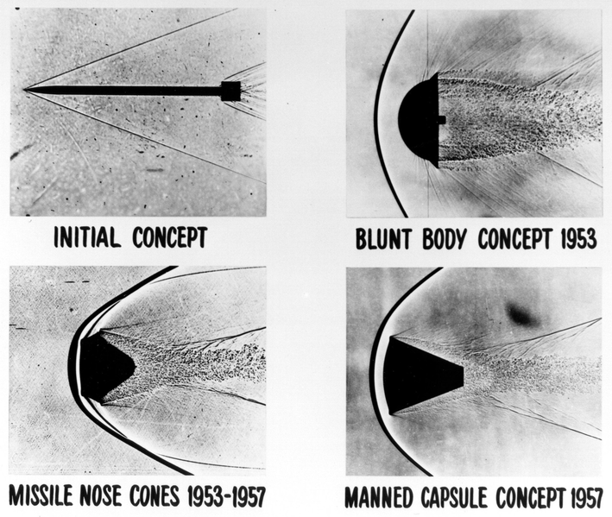
Critical Locations
Aerodynamics Background
Oblique Shock
Compressible Effects for M >> 1:
Shock waves are generated and cause disturbances
Bow shocks are created for blunt bodies which cause higher disturbances than oblique shock waves
Increase in drag forces
Increase in stagnation temperature
Bow Shock

Slide 5
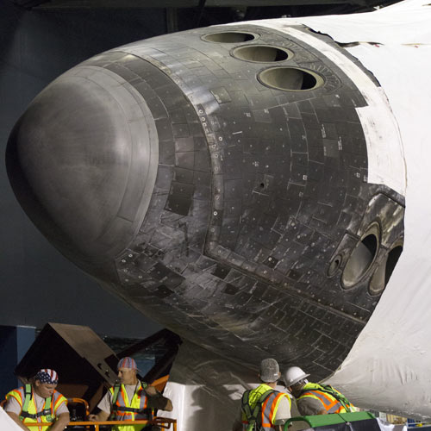
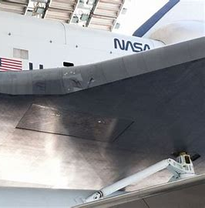
Critical Locations
Selected Space Shuttle Orbiter Locations
Nose Cone
Source: NASA
Leading Edge of Wing
Source: NASA
The nose cone is a blunt body that will experience significant temperature increase during supersonic flight

Slide 6
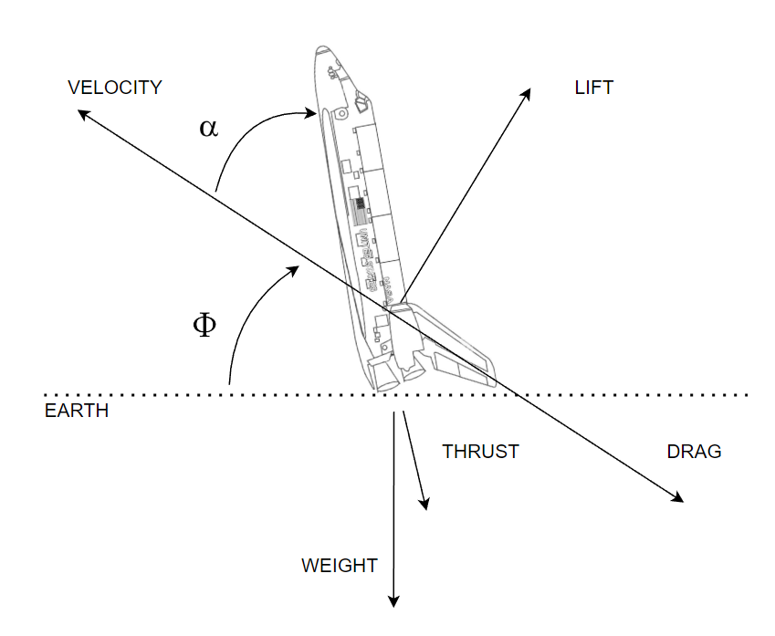
Methodology
Flight Trajectory
Equations for Modeling
$$φ=arctan\left(\frac{dAlt}{dX}\right)$$
$${Accel}_{vert}=$$
$$\frac{\left[Tsin\left(φ+α\right)−Dsin\left(φ\right)+Lcos\left(φ\right)+\frac{mV^{2}\cos^{2}\left(φ\right)}{R_{Earth}+Alt}\right]}{mass}$$
$${Accel}_{horz}=$$
$$\frac{\left[Tcos\left(φ+α\right)−Dcos\left(φ\right)+Lsin\left(φ\right)\right]}{mass}$$
Assumed low angles of attack
FORCE BODY DIAGRAM

Slide 7
Methodology
Heating Rate Analysis
Nose Cone
Modeled as a sphere
Equation:
$Q_{sphere}= \frac{17600}{\sqrt{r}}\sqrt{\frac{ρ}{ρ_{0}}}{(M\frac{a}{U_{co}})}^{3.15}$
where
M: Mach number of Orbiter
$\frac{ρ}{ρ_{0}}$: Reference density from sea level
$U_{co}$: Circular orbit velocity
A: Speed of Sound
R: Radius of sphere
Wing Leading Edge
Modeled as a swept cylinder
Equation:
$$Q_{sc}=Q_{sphere}∗\cos\left(sweep\right)$$
where
$Q_{sphere}$: Heating rate equation for sphere
Sweep: Leading edge sweep of Orbiter wing

Slide 8
Results
Heating Rate Analysis
The general shape of the heating curves are the same for the nose cone and leading edge, but their magnitudes differ. The nose cone experiences a higher heating rate than the leading edge.

Slide 9
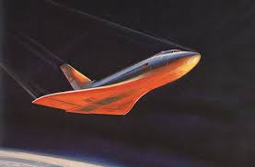
Conclusion
Final Remarks
At higher speeds and altitudes within the atmosphere, heating becomes an issue
Most of the heating issues will be around the blunt nose of the Orbiter
A computationally lean model was created to give a general idea of the heating
Future Work
Incorporate this model for the re-entry phase of the Orbiter’s mission
Higher heating rates are experienced
Source: NASA

Slide 10
Acknowledgements
Special Thanks To:
Timothy Takahashi
ASU/NASA Space Grant

