Slide 1


Effects of Structural Motion on
Swept Wing Aerodynamics
NASA Space Grant Undergraduate Research Symposium
April 22, 2023
Andrew Frisch
Air Force Office of Scientific Research (AFOSR)
Mentor: Dr. Jesse Little
Department of Aerospace and Mechanical Engineering

Slide 2
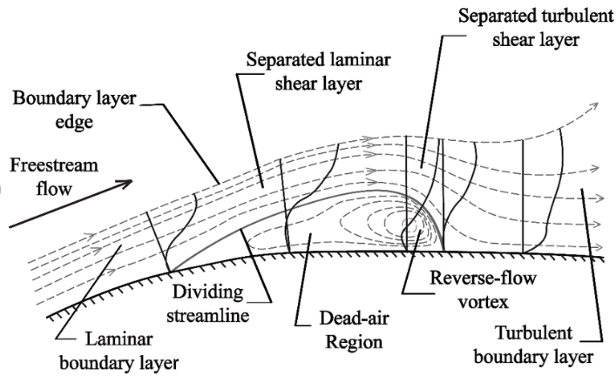
Laminar Separation Bubble (LSB)
Form in wall bounded flow when subjected to a strong adverse pressure gradient
Region of circulating air
Impacts aerodynamic performance
Reproduced from Horton [1]
[1]: Horton, H., “Laminar Separation Bubbles in Two and Three Dimensional Incompressible Flow,” Ph.D. thesis, University of London, 1968

Slide 3
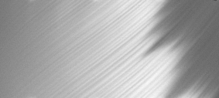
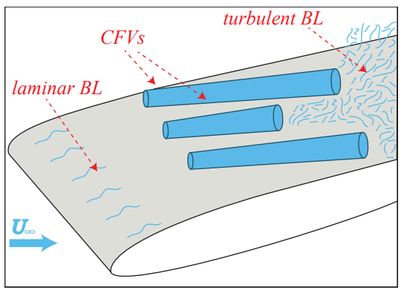
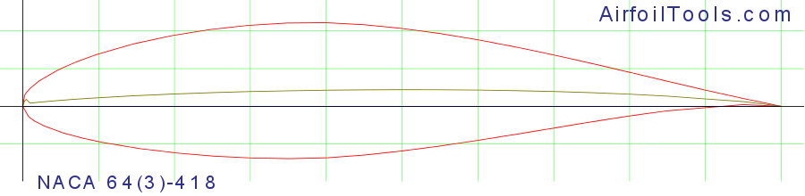
Crossflow Instability
Crossflow Vortices (CVs)
  Form in strong favorable pressure gradients
  Vortices nearly parallel to freestream
CVs promote early onset of non-linear effects and turbulent transition
Leading Edge
Trailing Edge
Z
Flow Direction
X
Infrared Thermography
Strong FPG

Slide 4
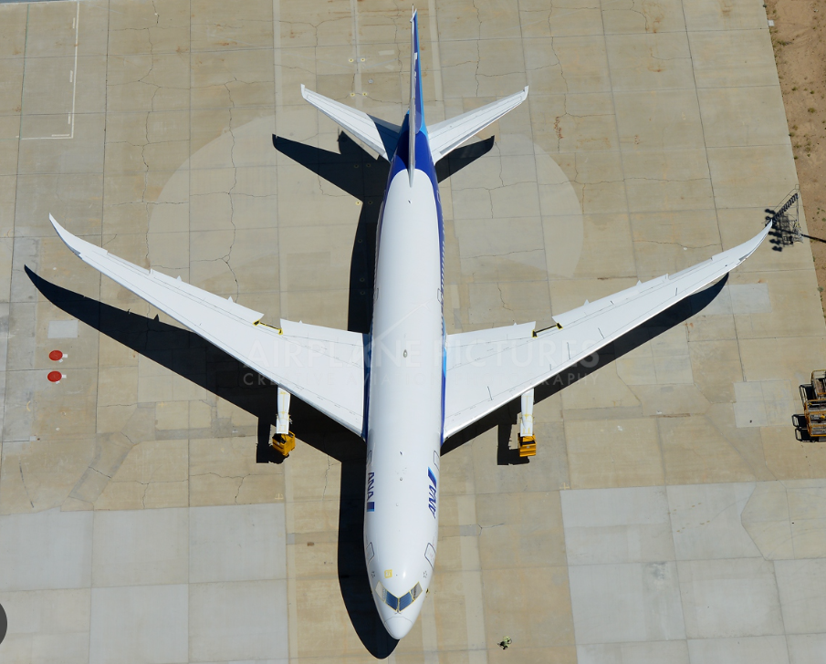
Research Motivation
Low speed flight in large aspect ratio vehicles
More composite materials in manufacturing lead to lower stiffness wings
Wing sweep is known to increase aerodynamic efficiency
Study LSBs and behavior surrounding structural motion
  Plunging
Sparse research on combined effect
of wing sweep and structural motion
Boeing 787 Dreamliner

Slide 5
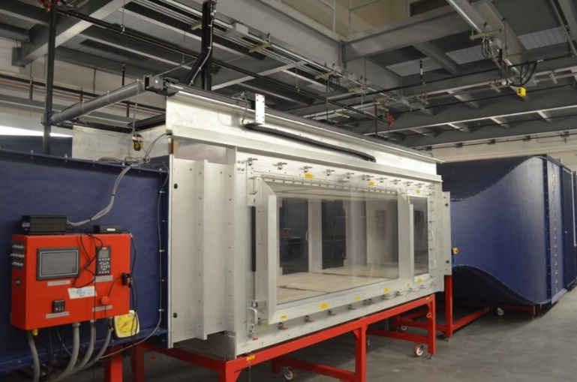
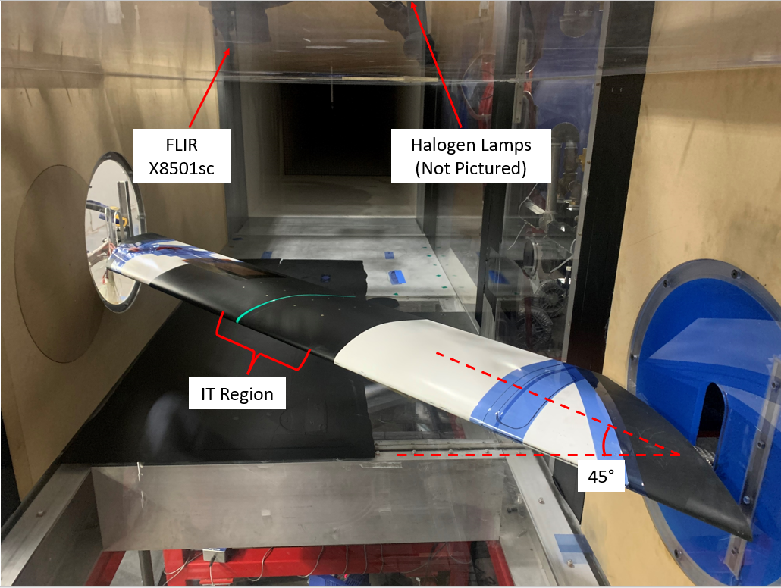
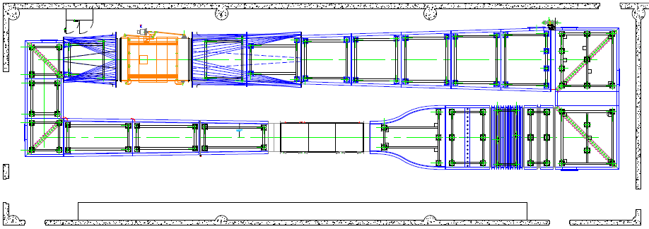

Experimental Setup
Arizona Low Speed Wind Tunnel (ALST)
  3ft x 4ft x 12ft test section
Modified NACA $64_{3}−618$
  Length = 1ft
Infrared Thermography (IT)
Particle Image Velocimetry (PIV)

Slide 6
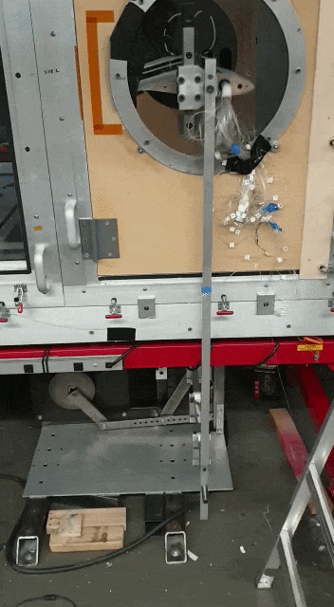
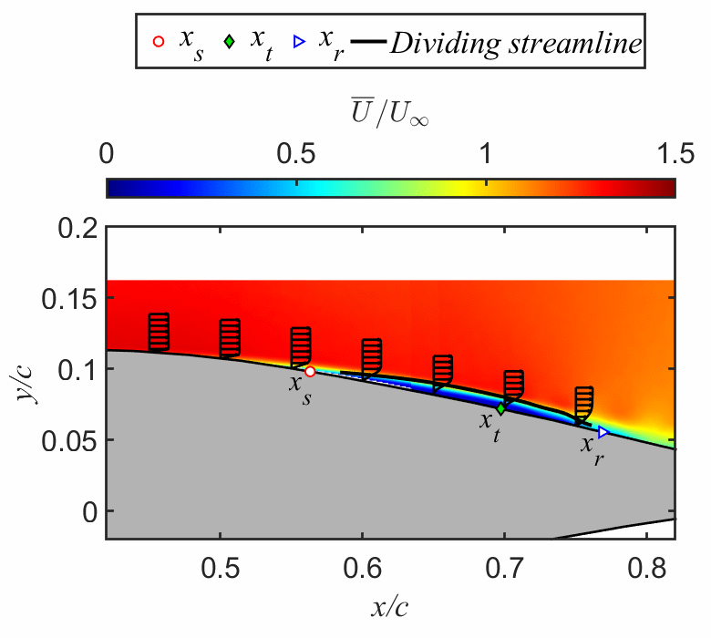
Results (Unsteady Unswept)
  Effective angle of attack change causes shift in LSB location
  Hysteresis: cyclical movement of LSB size and location
[2] Grille Guerra et al. (2022)
Notes:
Replace static swept with shaking gif

Slide 7
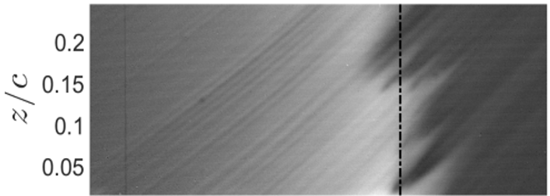

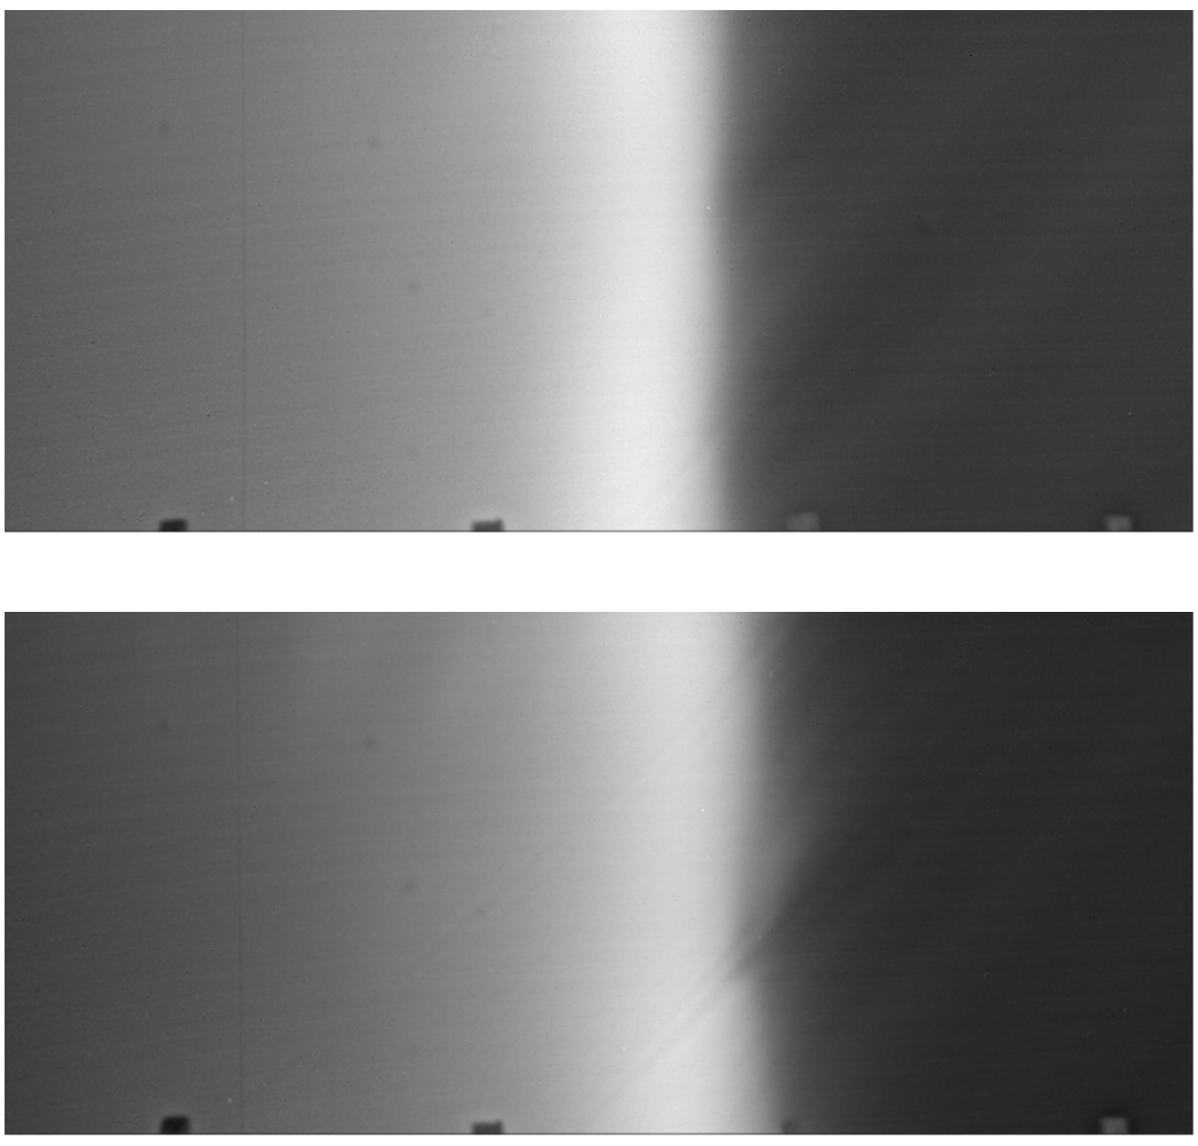
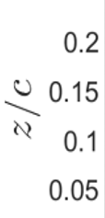
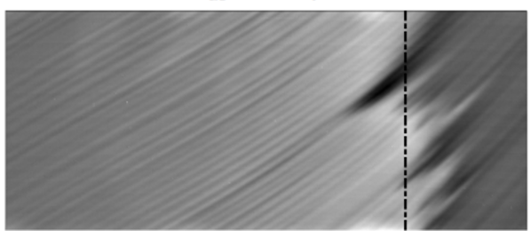
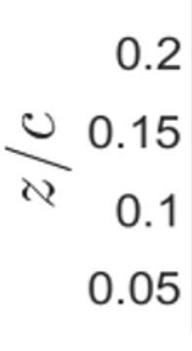


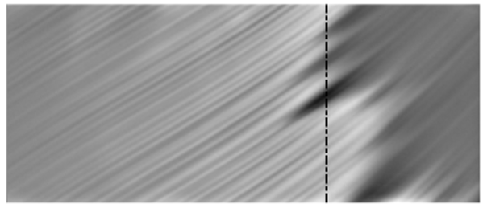


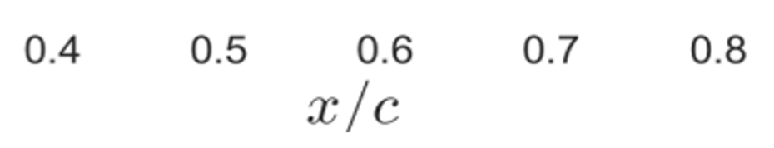

Results (Static Swept)
  Defined parameter space for presence of CVs
  CVs cause earlier transition onset
[3] Cotnoir et al. (2023)
Notes:
Get rid of all but first row and put swept transition location on this slide

Slide 8
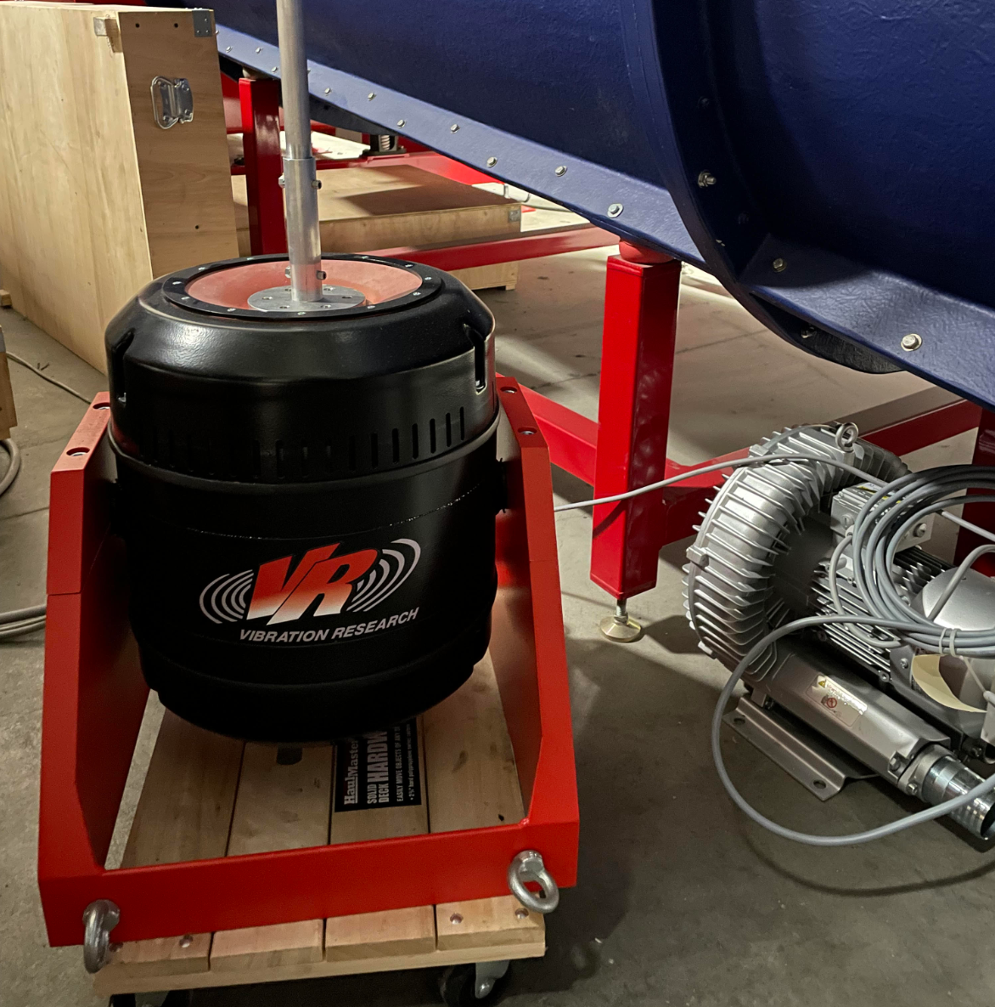
Future Work
Replace old shaker setup to accommodate swept shaking
2 independent VR4600 shakers
  Vibration amplitude capable of 1.77”
  Randomized vibrations
Two comparison methods:
  Shaking swept to static swept
  Shaking swept to shaking unswept
Investigate the combined effects of
  crossflow and unsteady aerodynamics

Slide 9
References
[1] Horton, H., “Laminar Separation Bubbles in Two and Three Dimensional Incompressible Flow,” Ph.D. thesis, University of London, 1968
[2] A. Grille Guerra, S. Hosseinverdi, J. Little, and H. F. Fasel. Unsteady Behavior of a Laminar Separation Bubble Subjected to Wing Structural Motion. AIAA SciTech Forum, pages 1–17, 2022. doi: 10.2514/6.2022-2331.
[3] Cotnoir, A., Borgmann, D., Little, J. C. Investigation of Cross-Flow and Laminar Separation Using Infrared Thermography. AIAA Scitech 2023 Forum, 2023.

Slide 10
Acknowledgements
Dr. Jesse Little, Research Professor
Alek Cotnoir, Graduate Student
David Borgmann, Ph.D Candidate
The AME Machine Shop Staff
The Arizona Space Grant Team
Air Force Office of Scientific Research
Department of Aerospace and Mechanical Engineering

Slide 11
Thank You

Slide 12
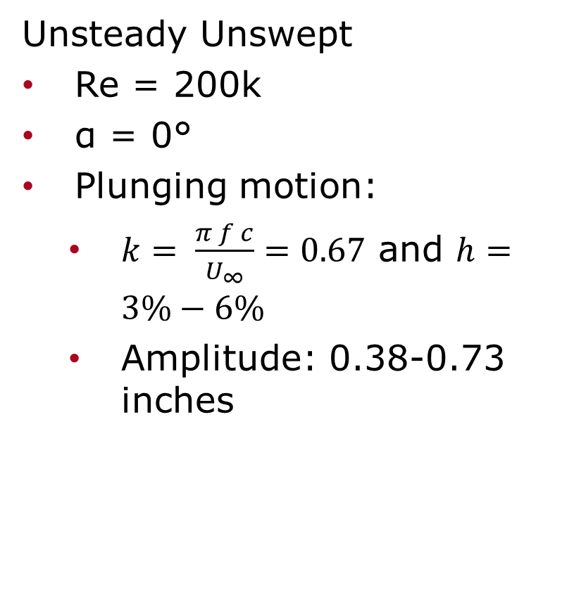
Experimental Setup
Static Swept
ReC = 200k, 400k, 600k
Sweep = 0°,35°,45°
-10°<α< 5°
Unsteady Unswept
Re = 200k
α = 0°
Plunging motion:
  $k= \frac{π f c}{U_{∞}}=0.67$ and $h=3\%−6\%$
  Amplitude: 0.38-0.73 inches
Notes:
Merge with 7 and get rid of shaking gif

Slide 13
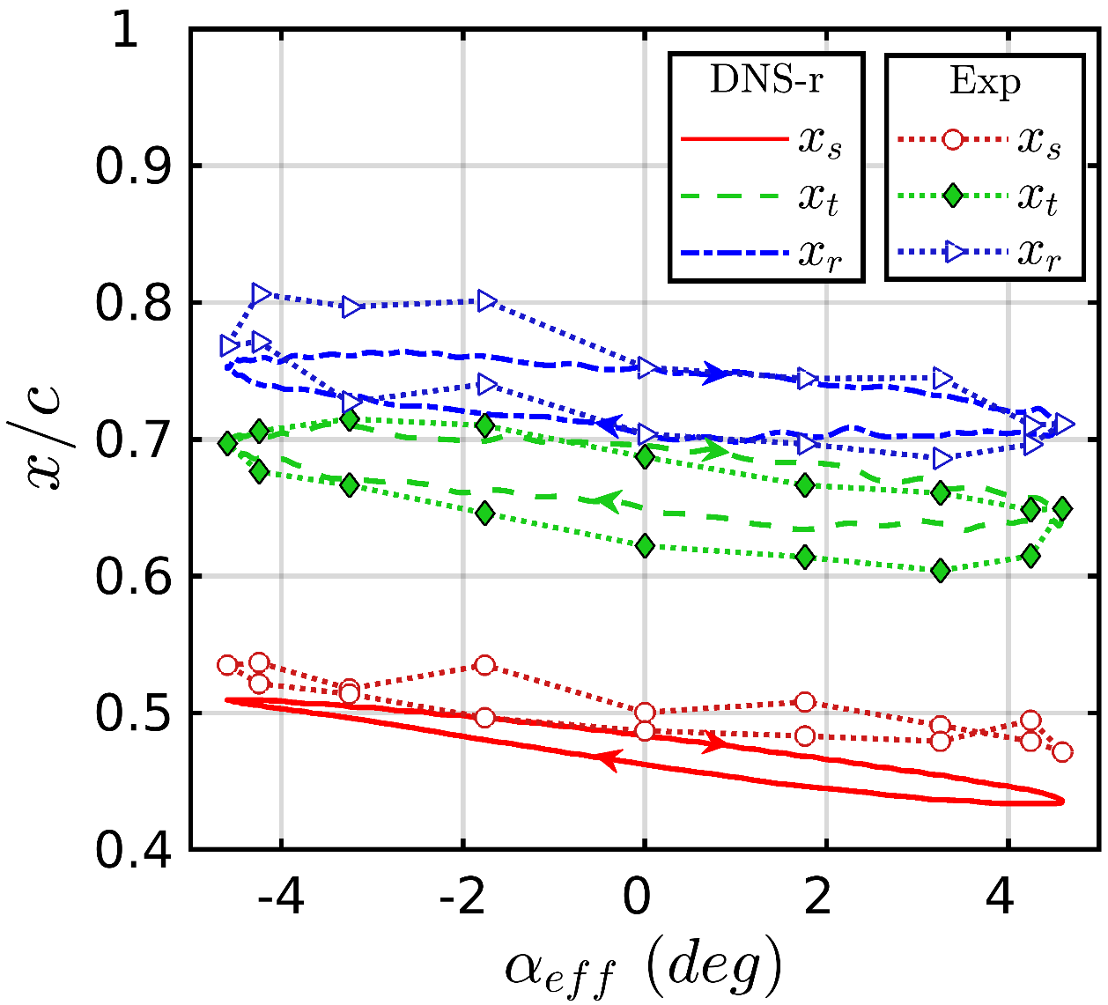
Results (Unsteady Unswept)
  Processed pressure data
  Shaking introduces hysteresis into the LSB location
[2] Grille Guerra et al. (2022)
Notes:
Replace static swept with shaking gif

