Slide 1
Photo-Induced Au versus Ag Deposition on Periodically Poled Lithium Niobate: Concentration Dependence
Veronica Meeks
Anna Zaniewski, Brandon Palafox,
Robert Nemanich
Arizona Space Grant Symposium
April 18th 2015

Slide 2
Motivation
High demand for metal nanostructures
Unique electrical and optical properties
Utilizing new technique of depositing gold nanoparticles onto periodically poled lithium niobate (PPLN) using ultraviolet (UV) light

Slide 3
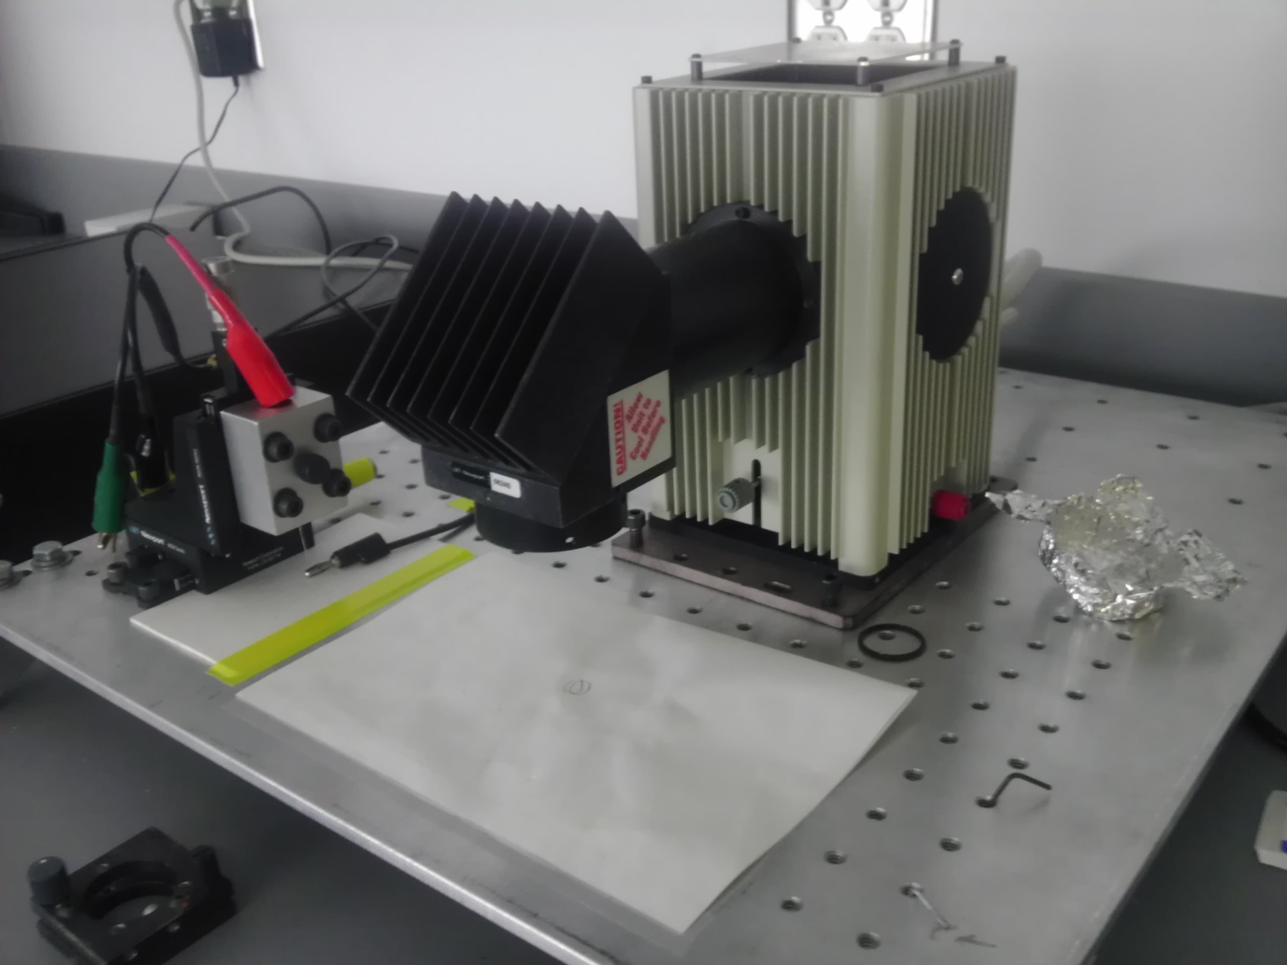

Production

Slide 4
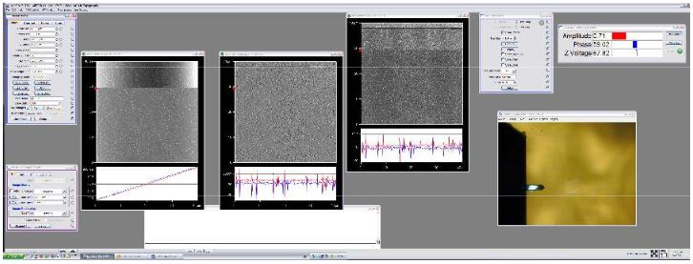
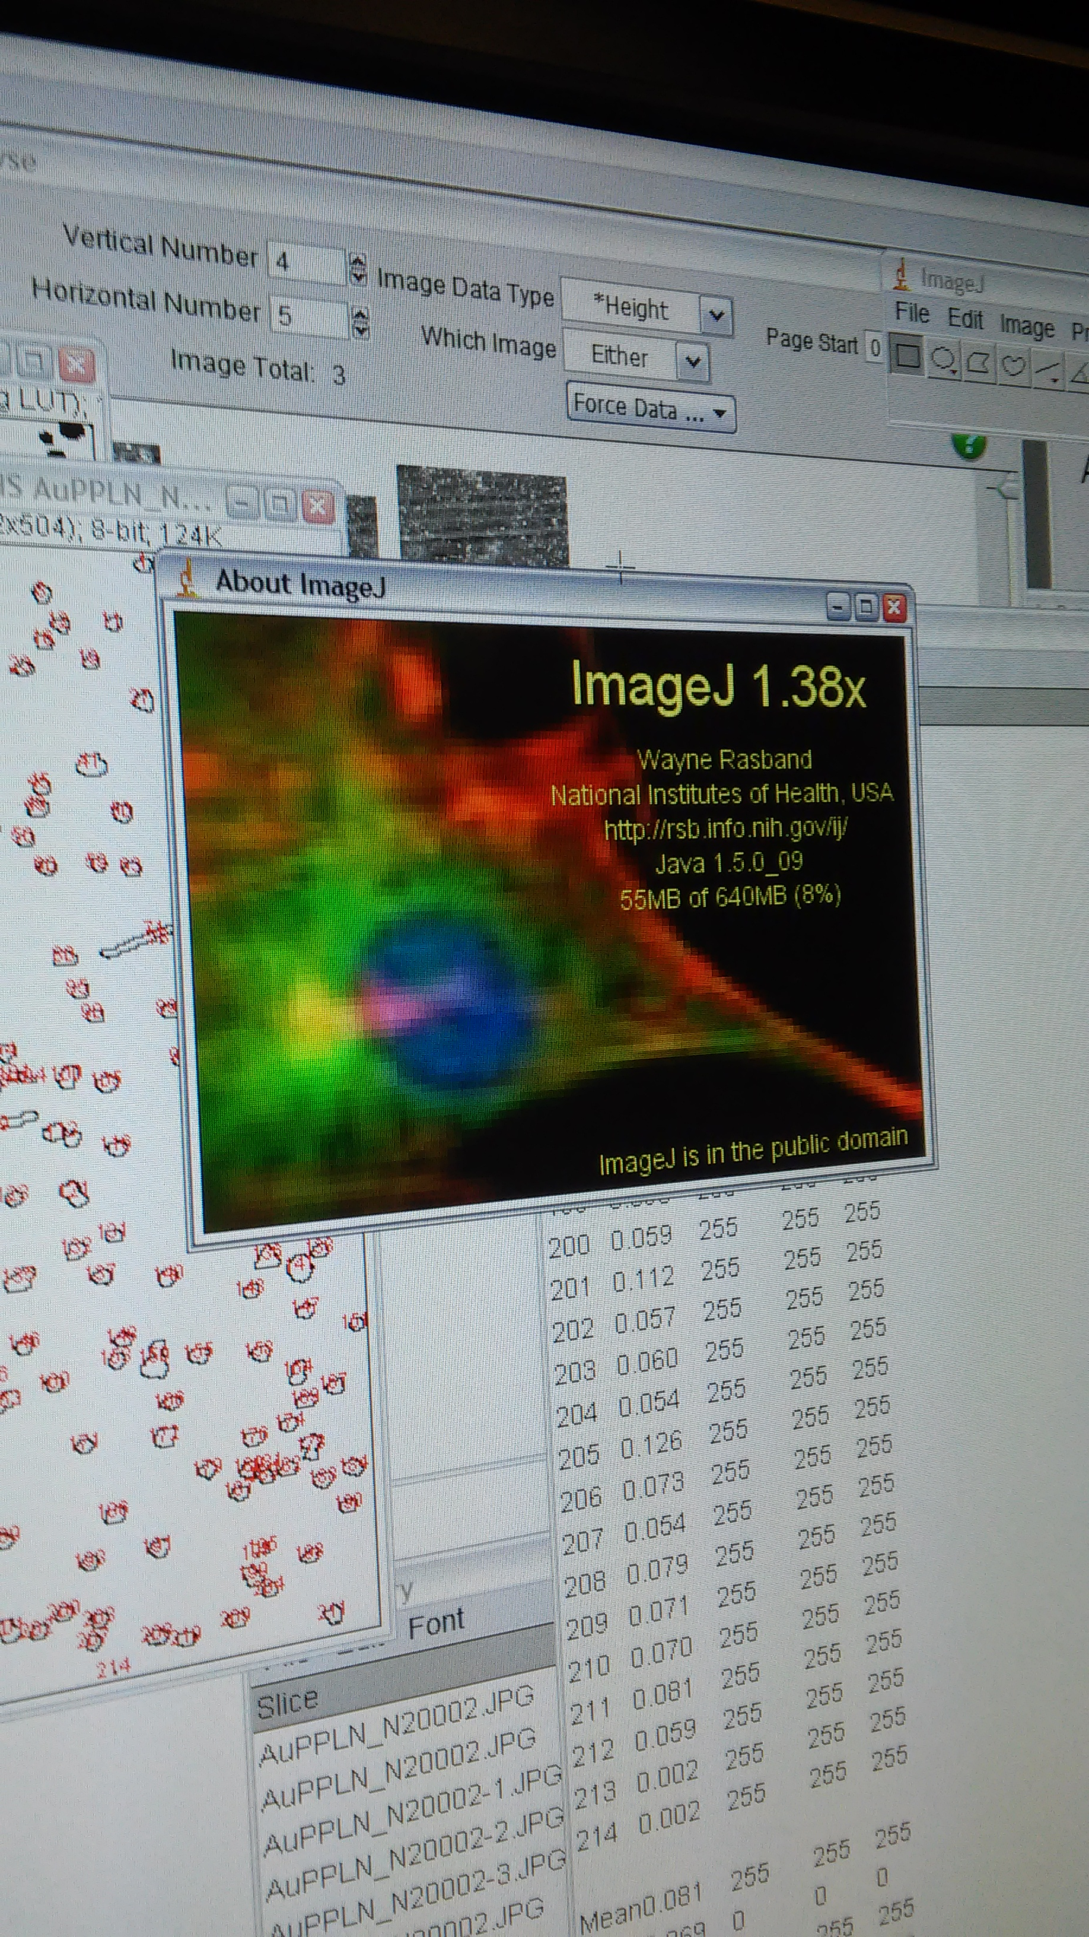
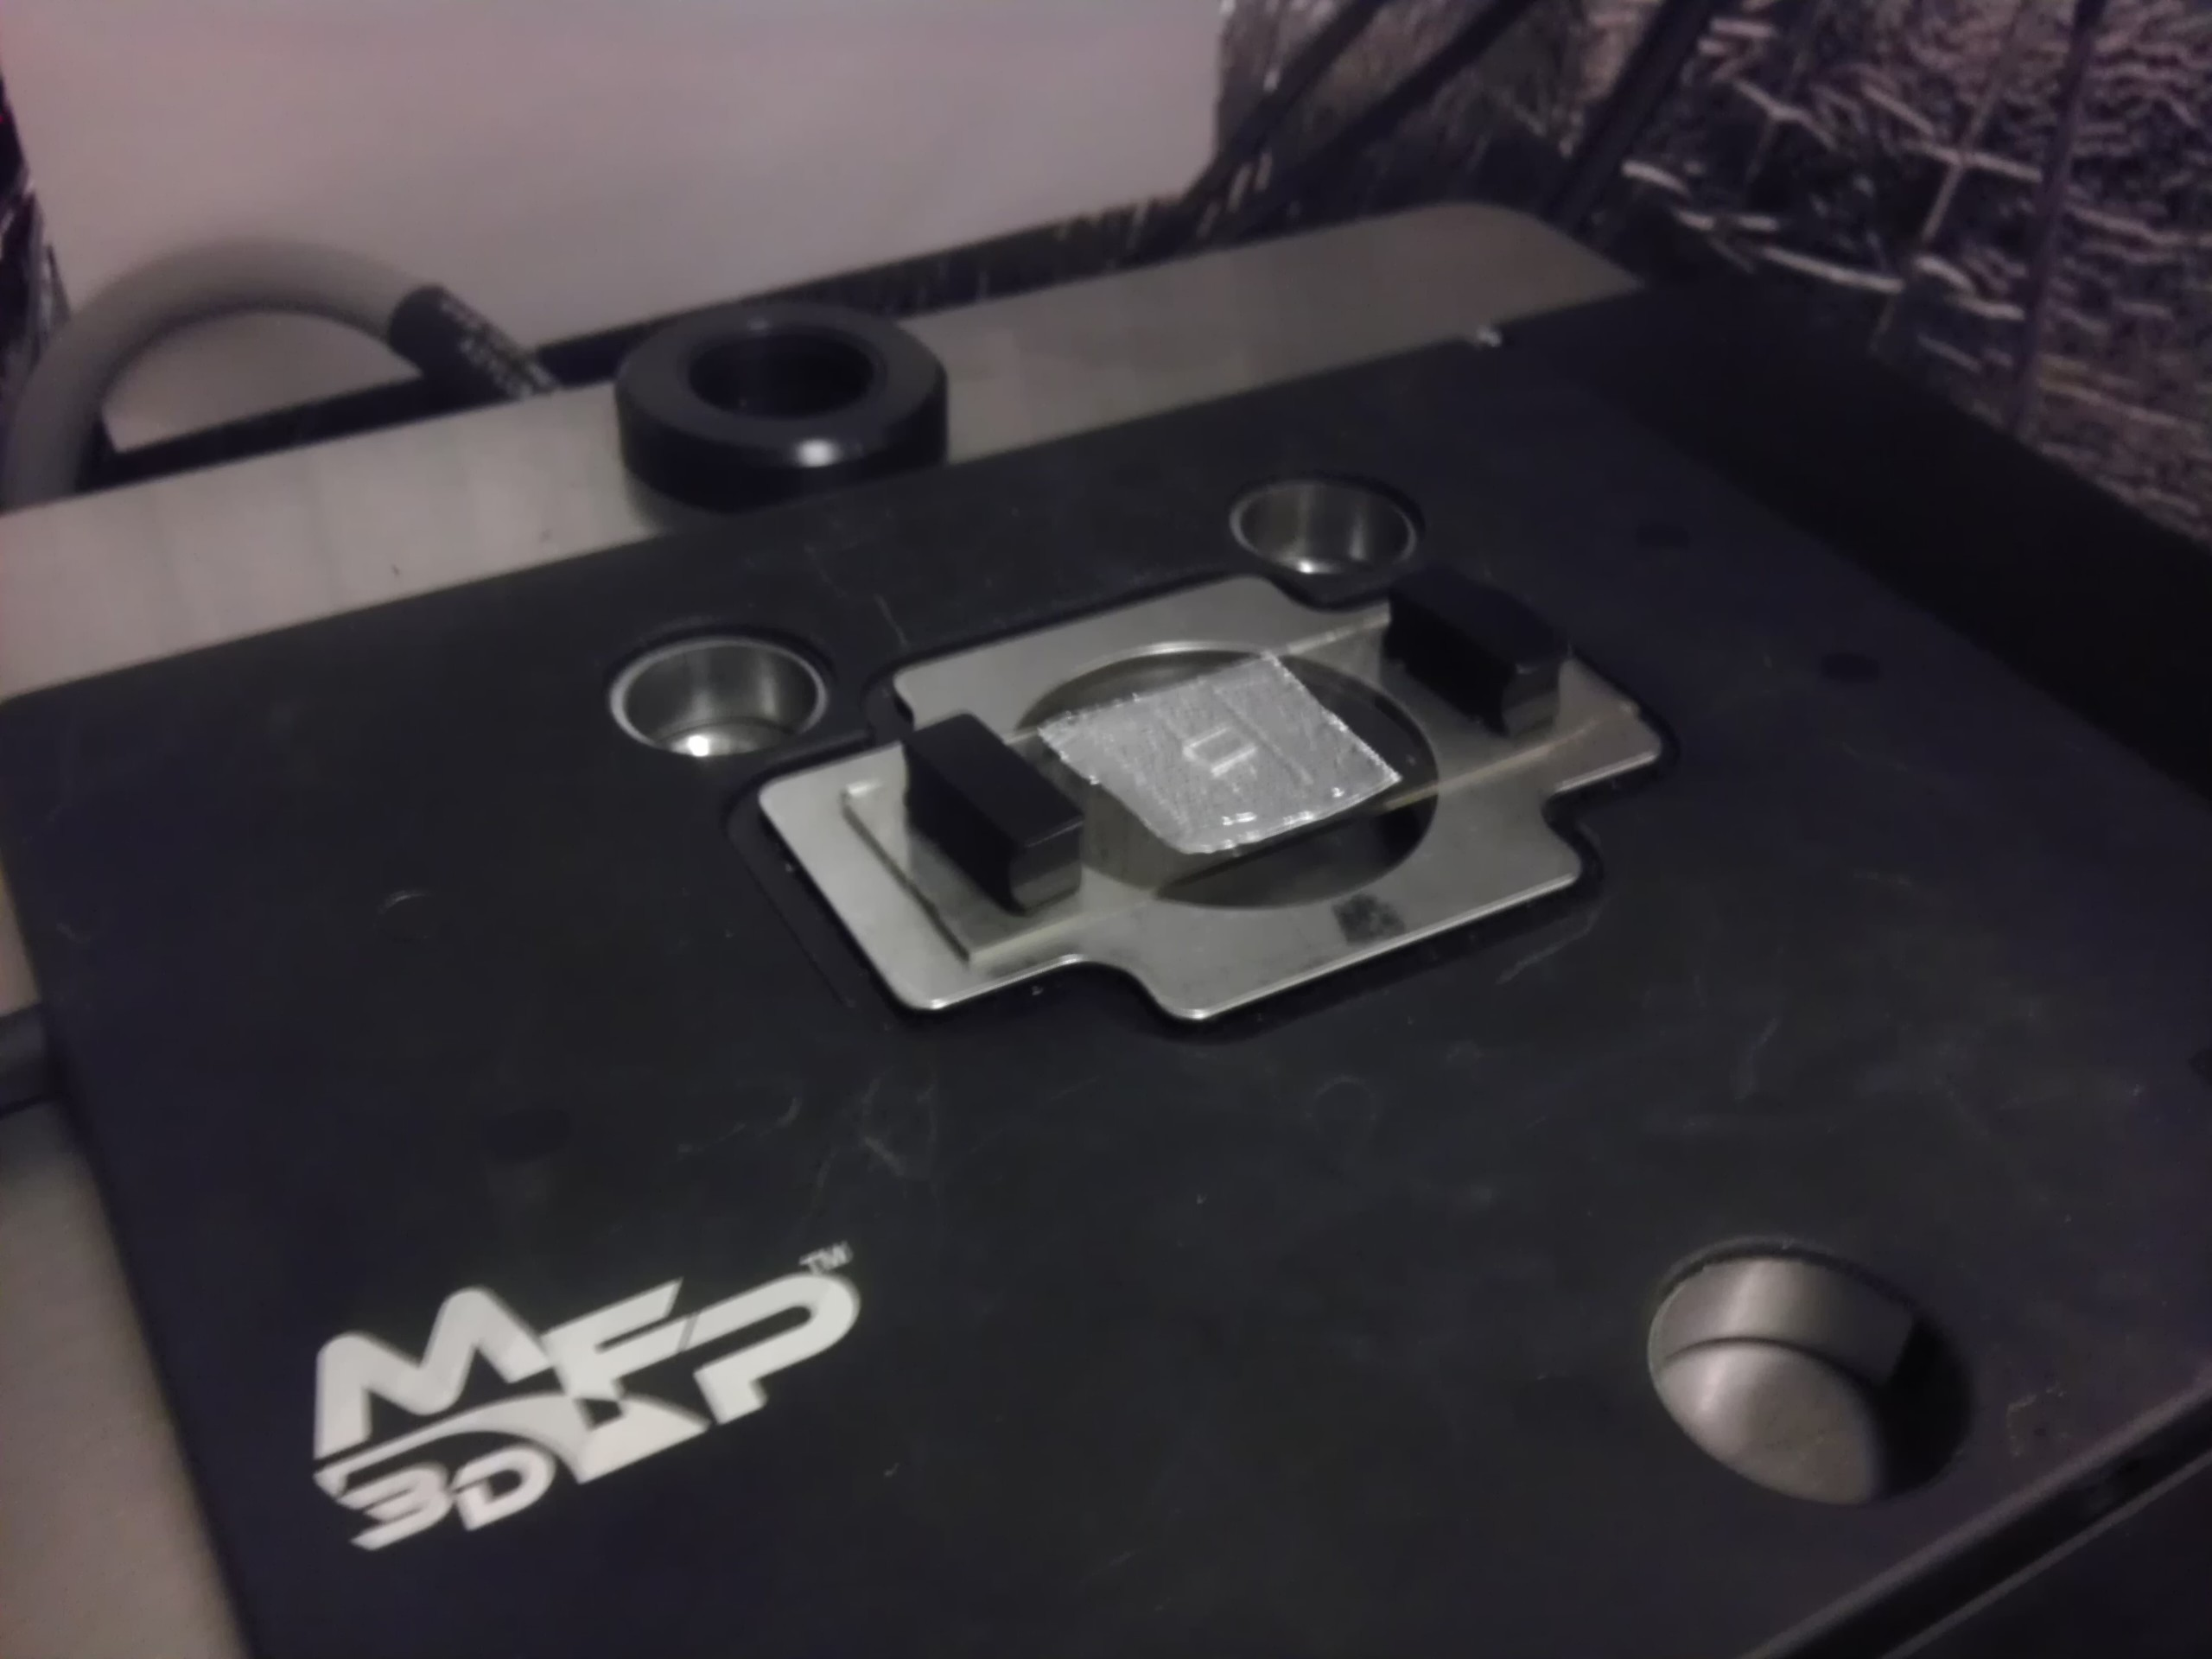
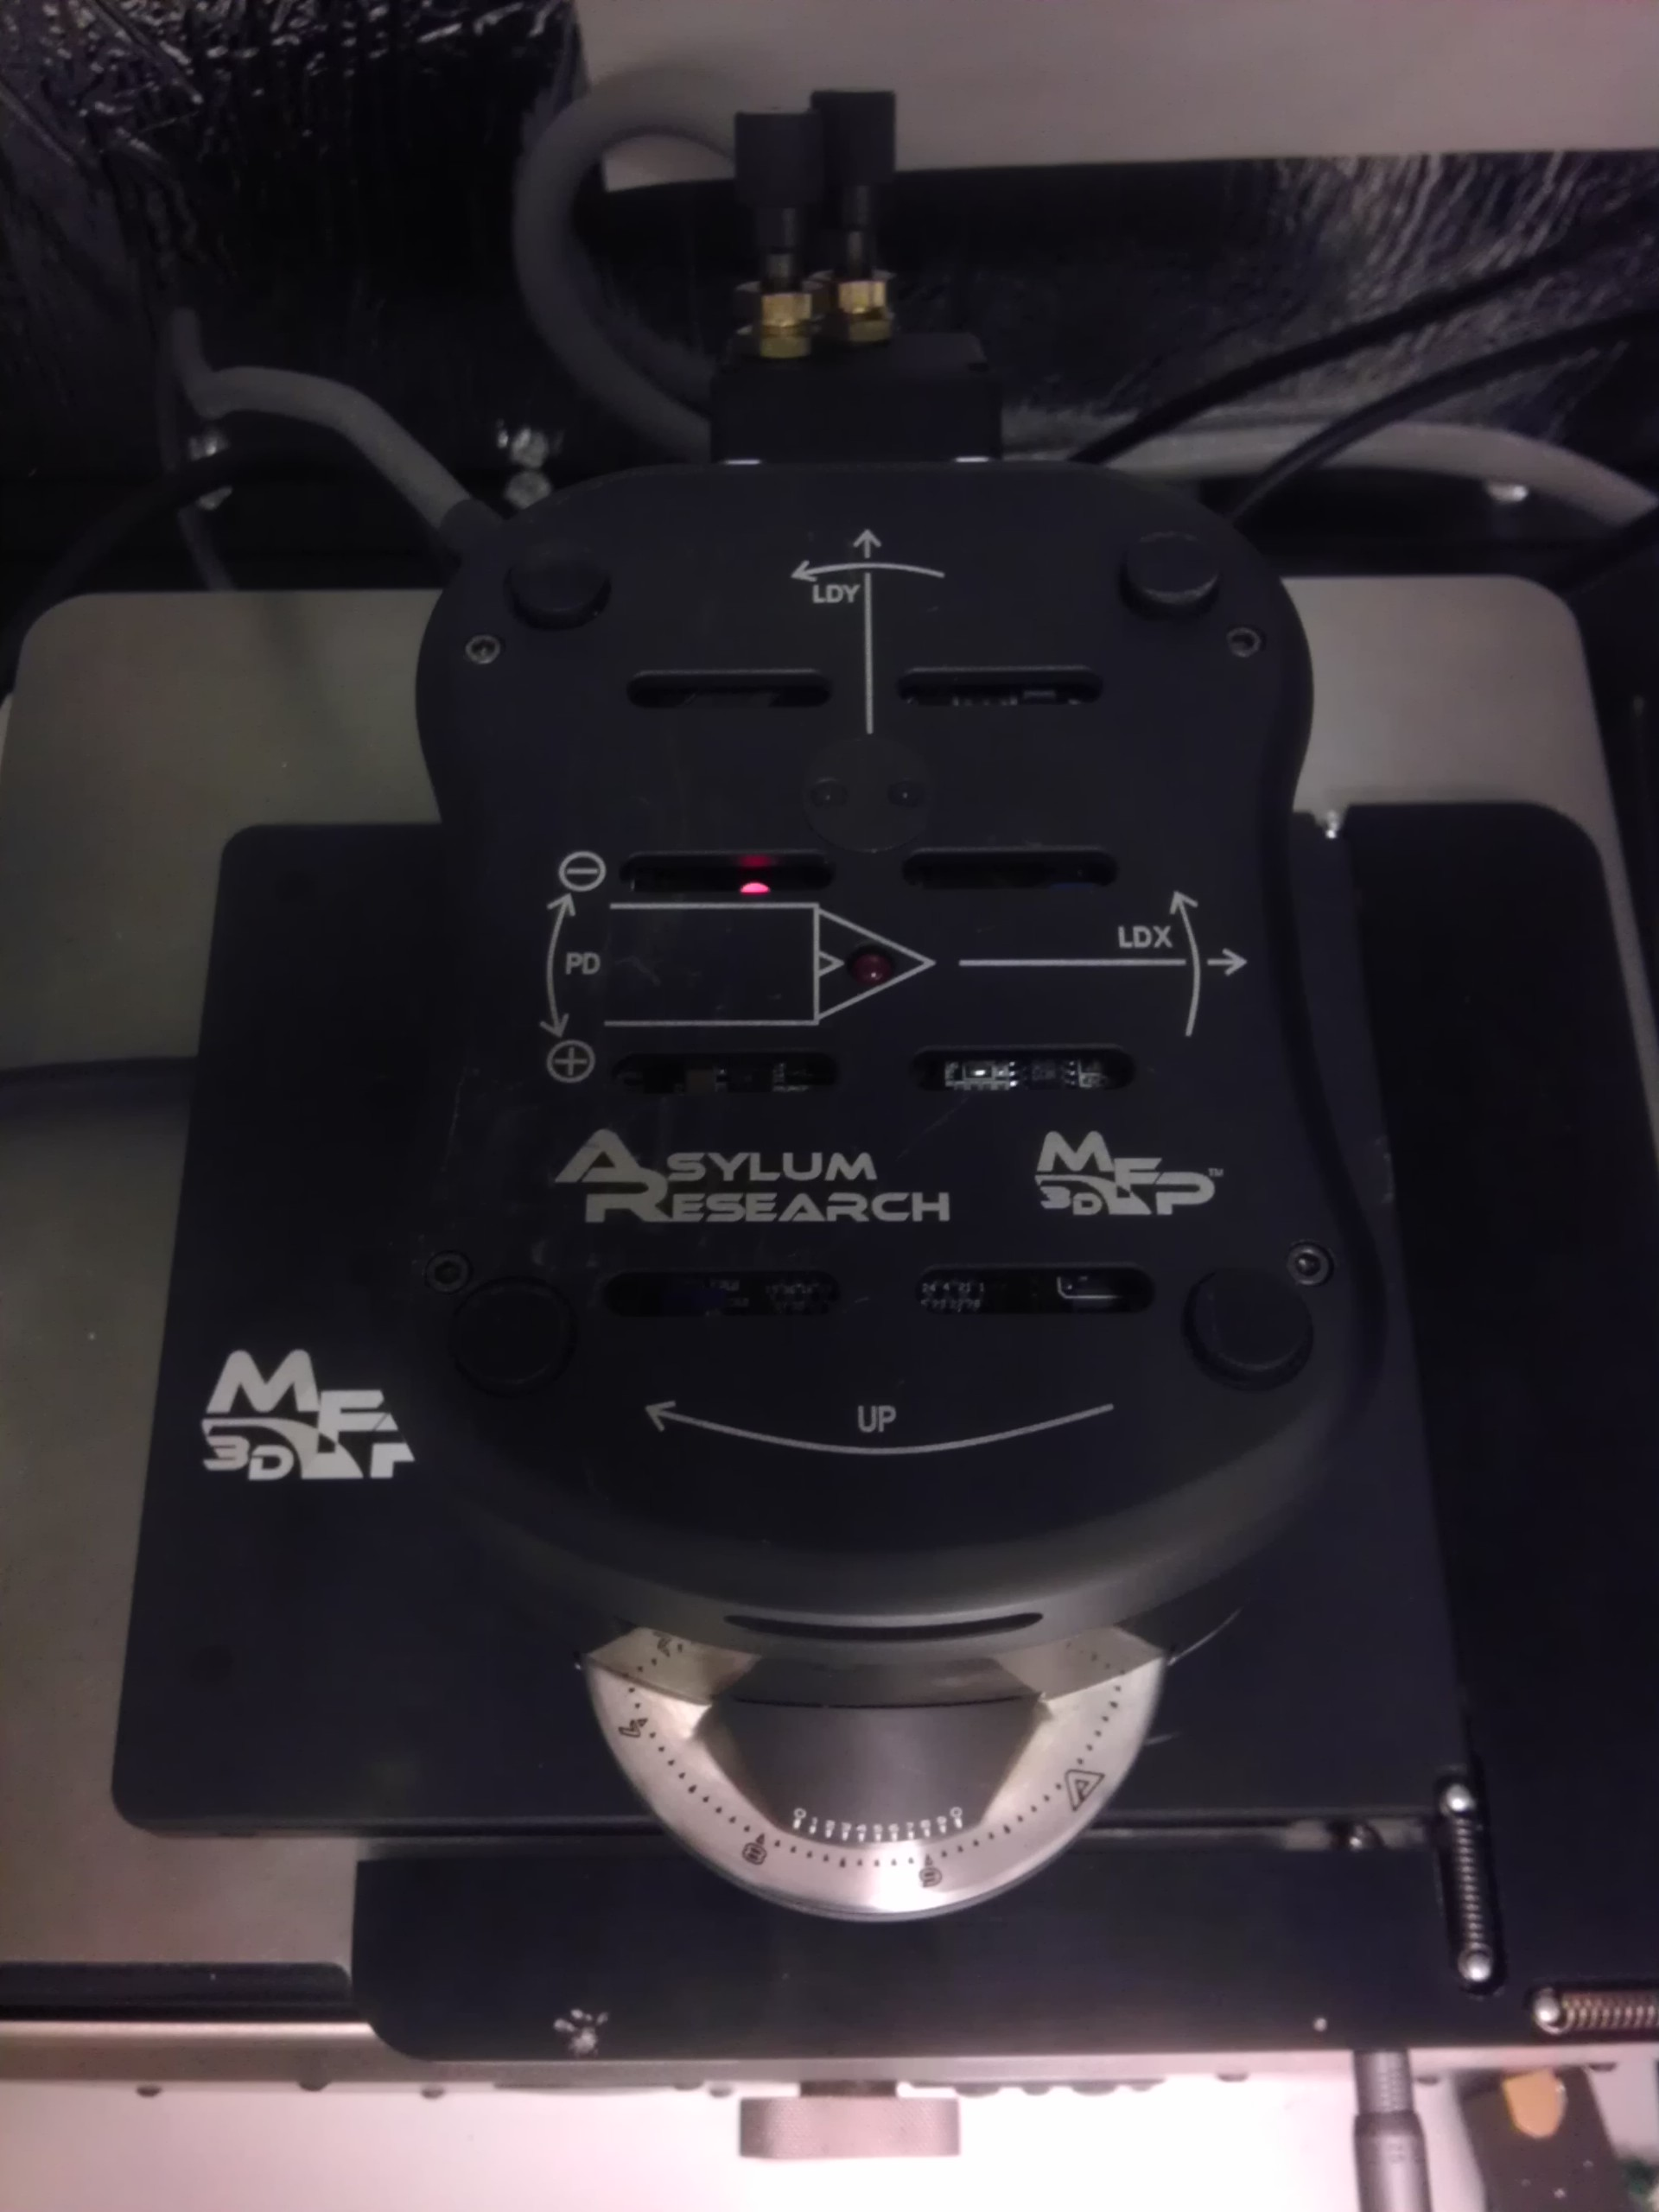
Analysis

Slide 5
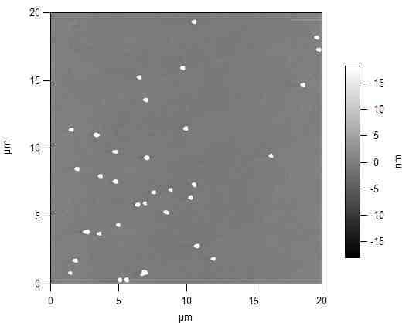
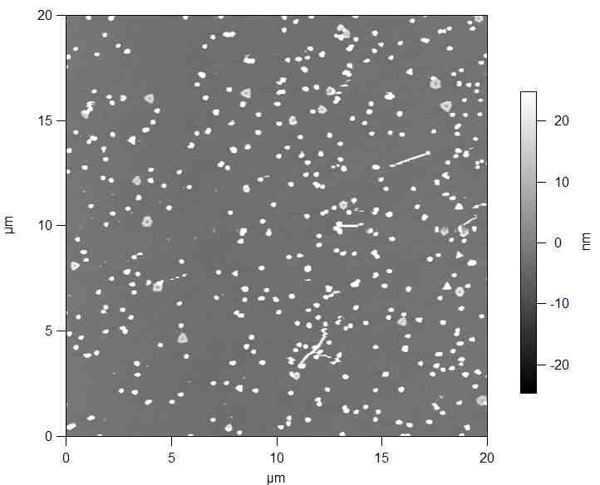
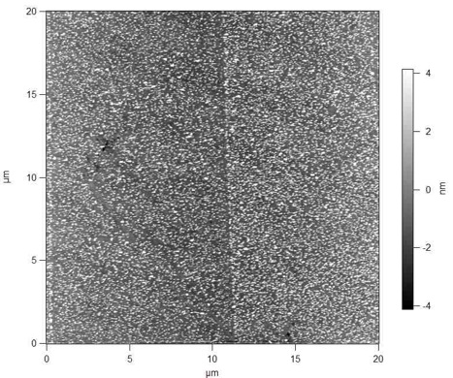
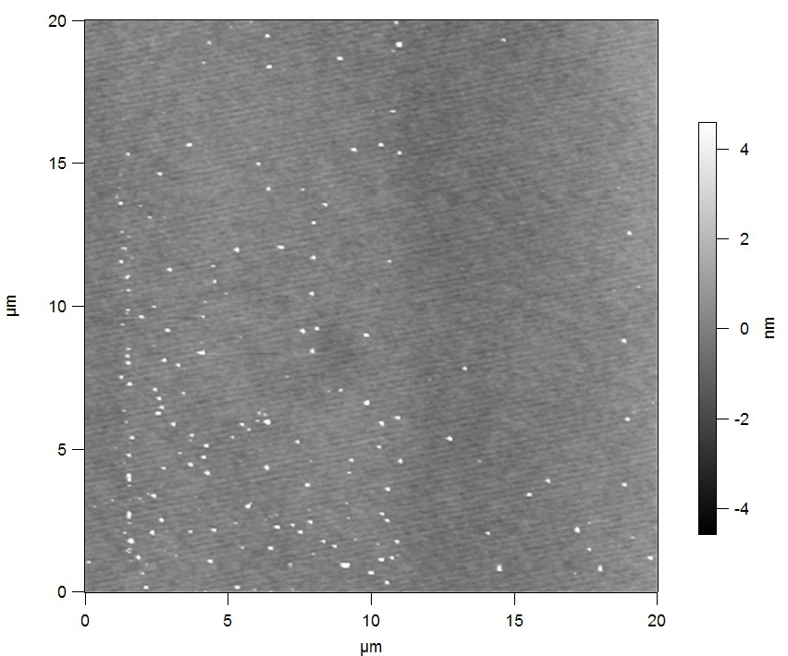
Results

Slide 6
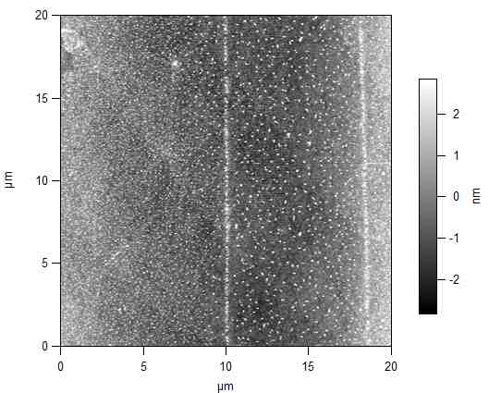
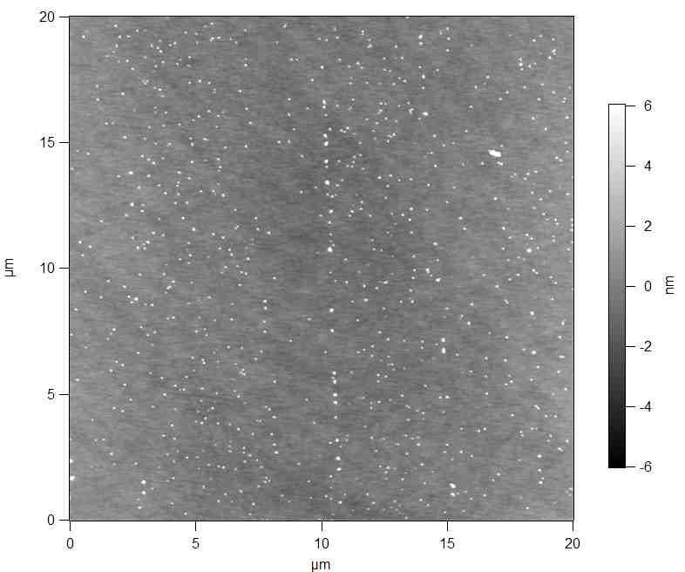
Interpretation
Gold Ion Reduction:
Silver Ion Reduction:

Slide 7
Next Steps
Looking into the physics of the gold concentration graph
Analyze deposition patterns of other metal solutions such as copper

Slide 8




Acknowledgments
In collaboration with Anna Zaniewski, Robert Nemanich, Brandon Palafox
Funding from ASU/NASA Space Grant Program and the National Science Foundation

