Slide 1


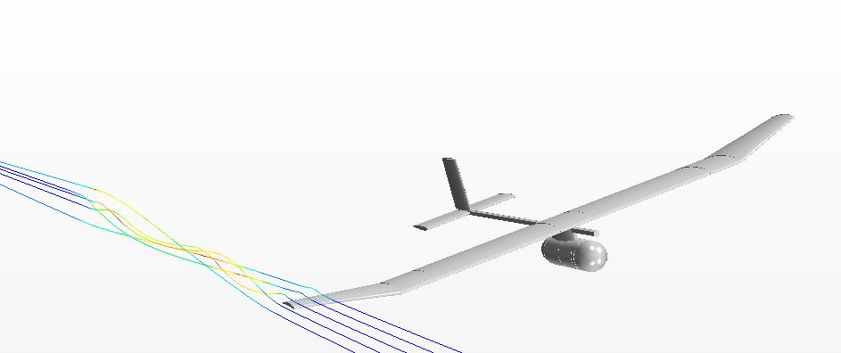


Analysis of Winglets for Low Reynolds UAV Flight Regimes
Aaron C. Pigott
Embry-Riddle Aeronautical University

Slide 2
Introduction and Overview
Introduction
  Goal: Optimization of winglet sweep using STAR-CCM+
Overview
  Boeing AerosPACE
  UAV Design
  Why Winglets?
  Winglet Design
  The Mesh
  The Physics
  Results
  Conclusion

Slide 3
Boeing AerosPACE
Collaborative senior design project with Boeing, Brigham Young University, Embry-Riddle Aeronautical University, Georgia Institute of Technology, Purdue University, and Tuskegee University
Objective: Successfully collaborate and design a hand-launchable Search and Rescue UAV
Winglet Analysis performed on Boeing AerosPACE UAV

Slide 4
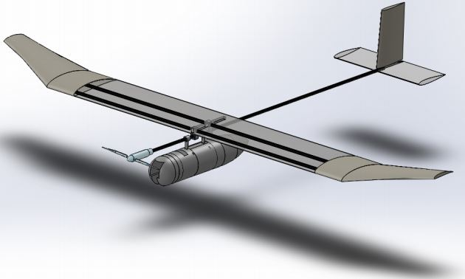
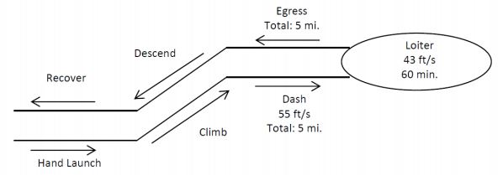
UAV Design
Length: 58.5 in.
Span: 92.8 in.
AR: 9
Main Wing Chord: 11.4 in

Slide 5
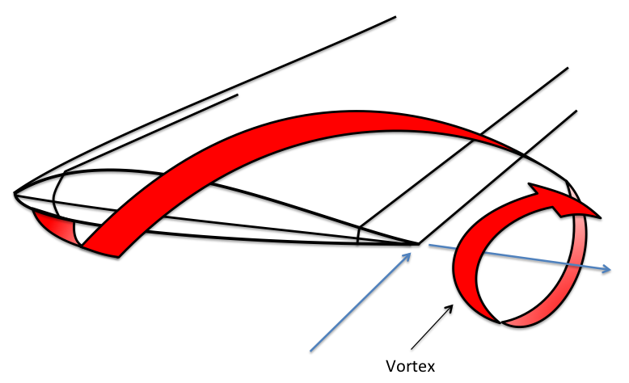
Why Winglets?
Wingtip vortices cause induced drag
Induced drag reduces aircraft range and endurance
Winglets minimize wingtip vortices

Slide 6
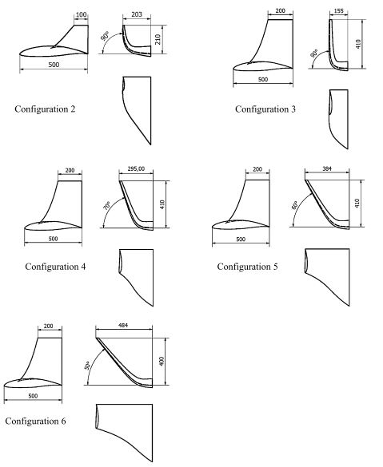
Winglet Design
P. Panagiotou, P. Kaparos, and K. Yakinthos found that a winglet with 50° cant angle is optimum at Re 1.2 million
This study uses 50° cant angle and varies sweep of winglet

Slide 7
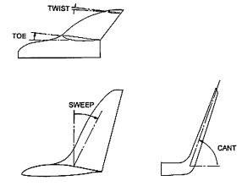
Winglet Design
Baseline: Schumann Tips
Case 1: No Winglet
Case 2: 30° Sweep
Case 3: 45° Sweep
Case 4: 60° Sweep
Case 2, 3, and 4:
  50 degree cant angle
  11.4 inches tall (equal to wing chord)
  0 toe and 0 twist angle

Slide 8
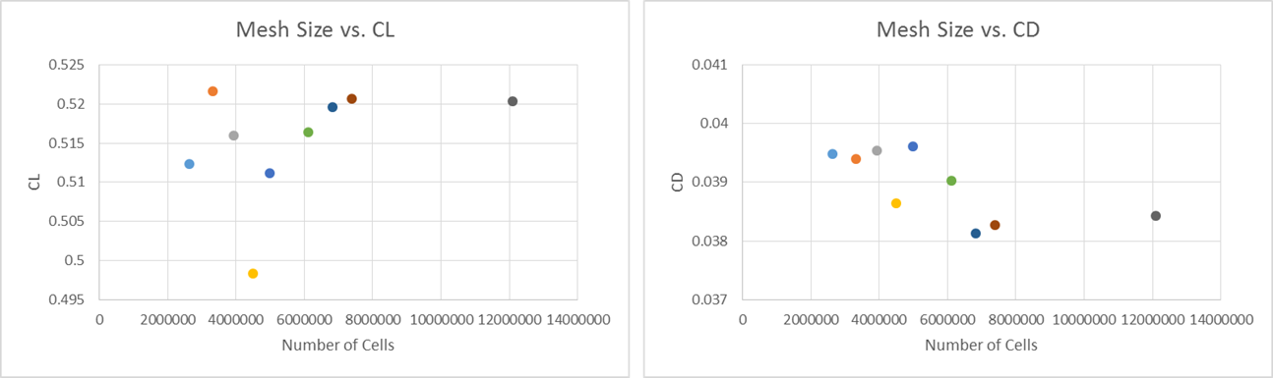
Mesh Independence Study
Incrementally changed base size to ensure solution was mesh-independent
7 million cell mesh selected based on results

Slide 9
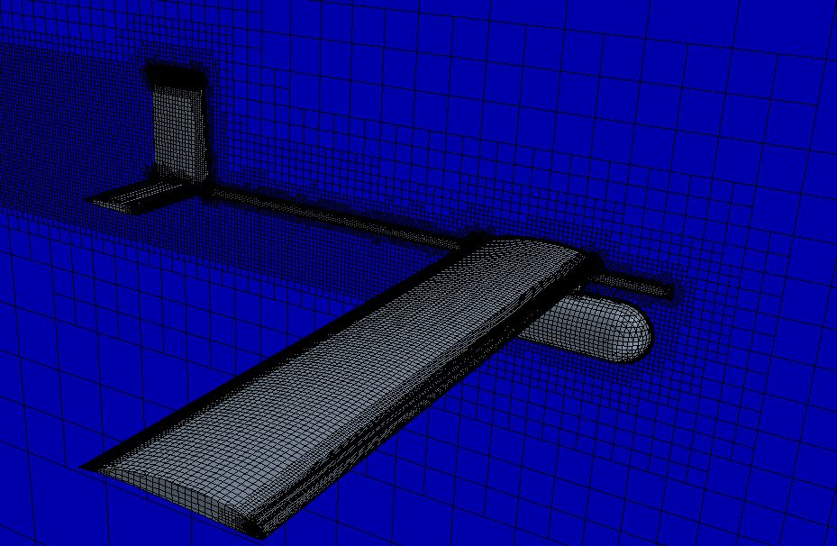
Meshing Models
Mesh Base Size: .009m
Mesh Size: 7 million cells
Prism Layer Mesher
  Prism Layer Thickness: .007m
  Prism Layer Stretching: 1.2
Surface Remesher
Trimmer

Slide 10
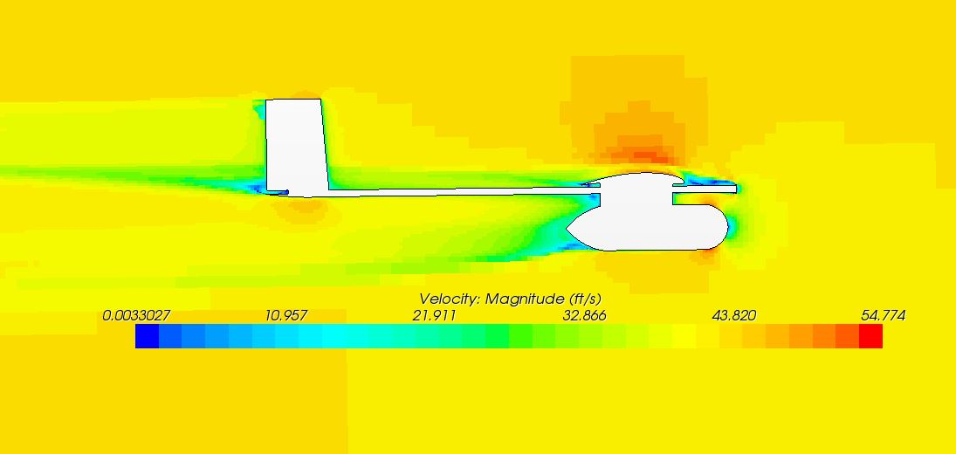
Physics Models
Steady
Constant Density
Segregated Flow
K-Omega Turbulence
Air conditions in Prescott, AZ to compare to wind tunnel data

Slide 11
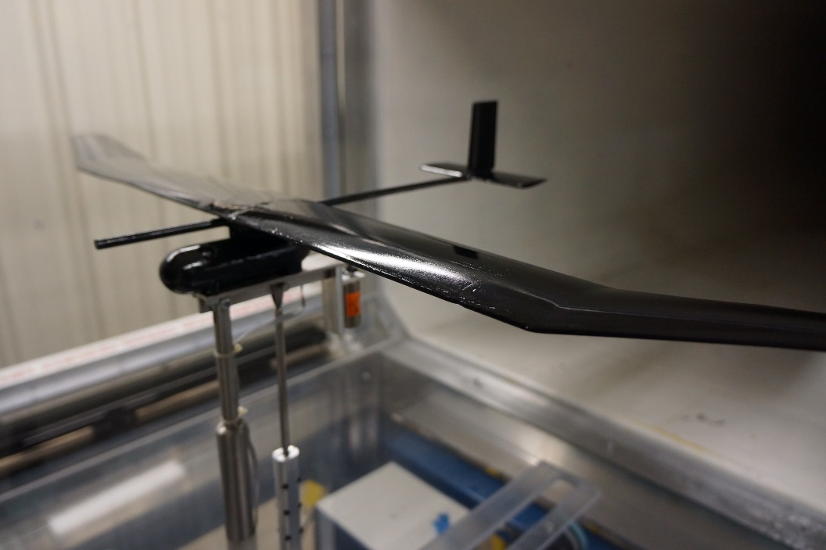
Wind Tunnel
A wind tunnel model was used to verify C_{L} and C_{D} data for the baseline model
Wind Tunnel vs. CFD
Data Here

Slide 12
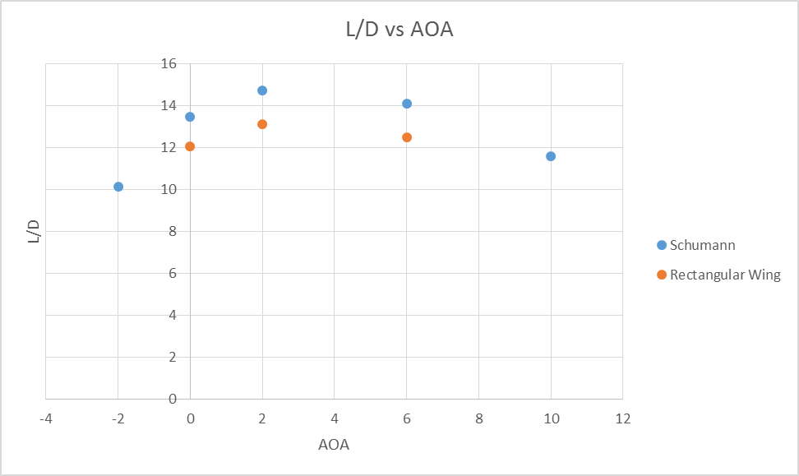
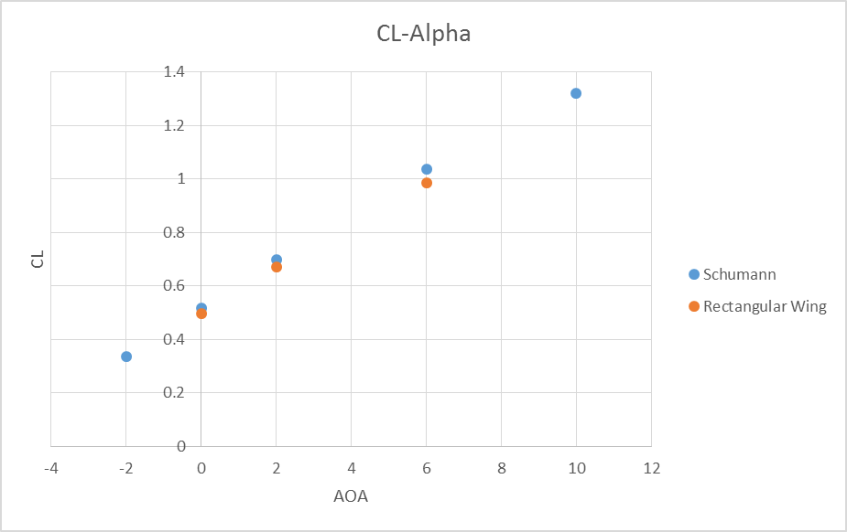
Results

Slide 13
Conclusion
Schumann tips reduced induced drag cause by wingtip vortices. C_{L}/C_{D} increased at each AOA
Variable wingtip conclusion here

Slide 14








Acknowledgements
Dr. Shigeo Hayashibara, ERAU
Joe Becar, Brigham Young University
Boeing AerosPACE Program

