Slide 1
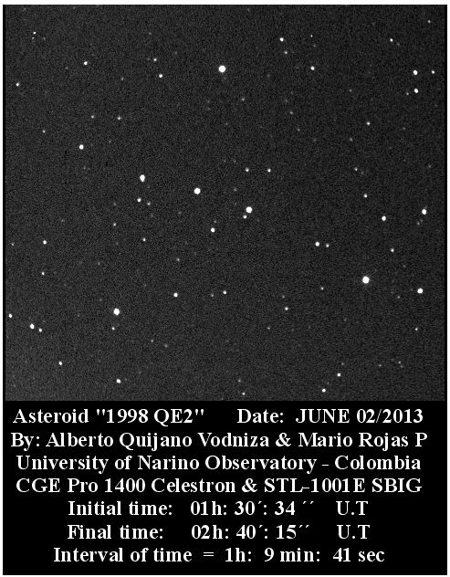
Can you find the Asteroid?
Notes:
Tell audience we are going to do a quick demonstration
Ask them if they can find the asteroid
Say it’s nearly impossible with one picture

Slide 2
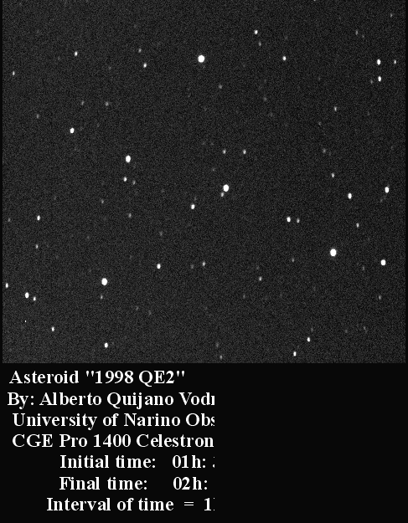
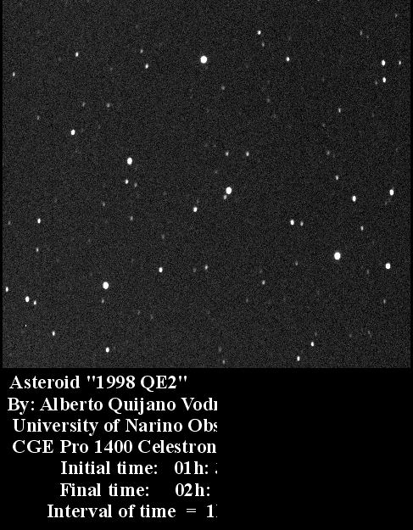
Notes:
Show them blinking video.
If you have ever stumbled across an OSIRIS-REx Ambassador event, it is very likely you would see this exact same demonstration

Slide 3



OSIRIS-REx Asteroid Sample Return Mission:
The Ambassador Outreach
Program
Andrea Parber
Arizona Space Grant Symposium
Phoenix, AZ
April 18, 2015
Notes:
Introduce topic: STEM Outreach, me

Slide 4

Acknowledgements
P.I. Dante Lauretta
Anna Spitz
Dolores Hill
Notes:
Thank you the Dante Lauretta the Principal Investigator of the OSIRIS-Rex Mission
Thank you to Anna Spitz for creating the foundation of the Ambassador program
A special thank you to my mentor Dolores Hill, for guiding me through the year

Slide 5
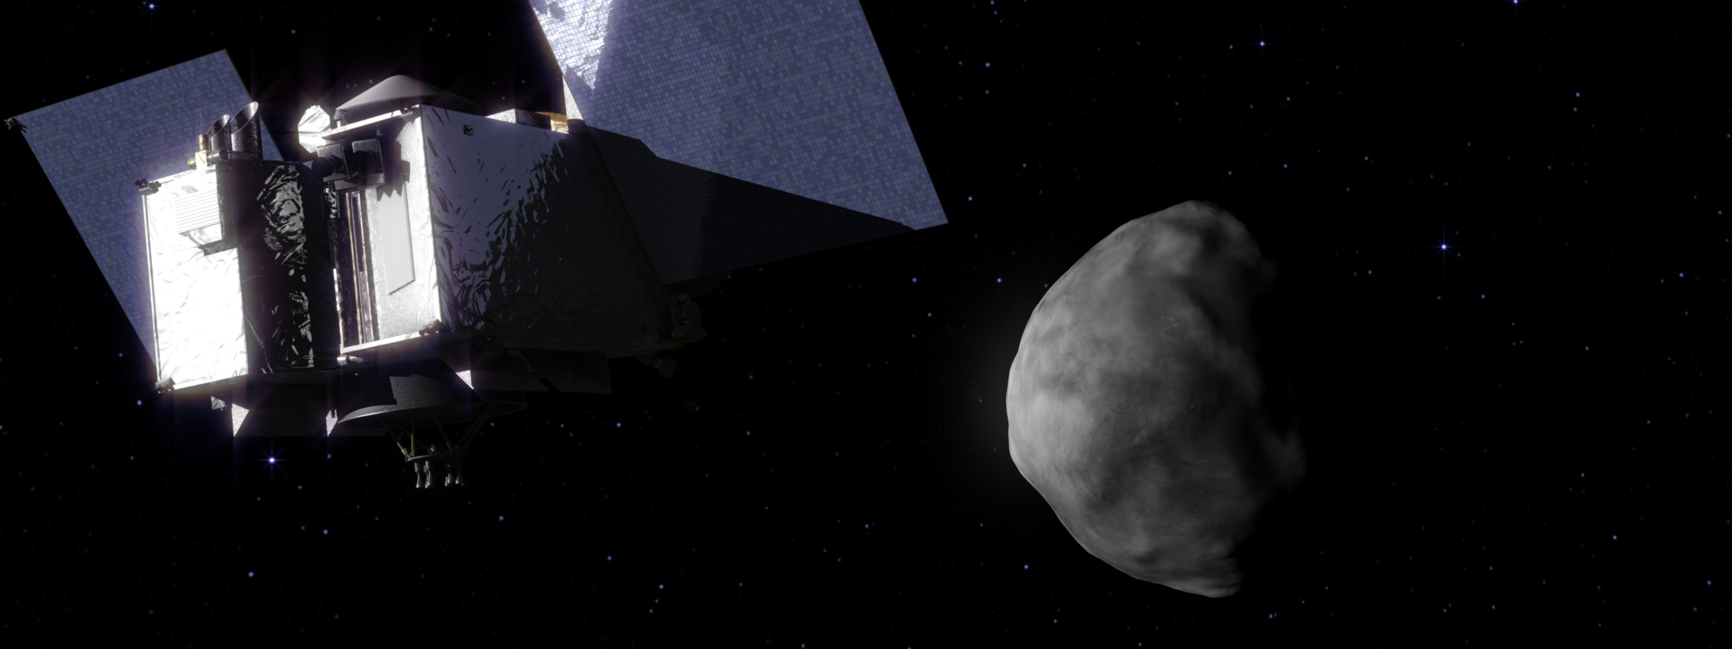
What is OSIRIS-REx?
Why is it important to get the word out?
Notes:
The OSIRIS-REx Asteroid Sample Return Mission is set to launch in 2016, and will travel to asteroid Bennu to retrieve a sample. the mission to Bennu, a carbonaceous near-Earth asteroid. This mission will help us understand the origin and evolution of the early Solar System.

Slide 6
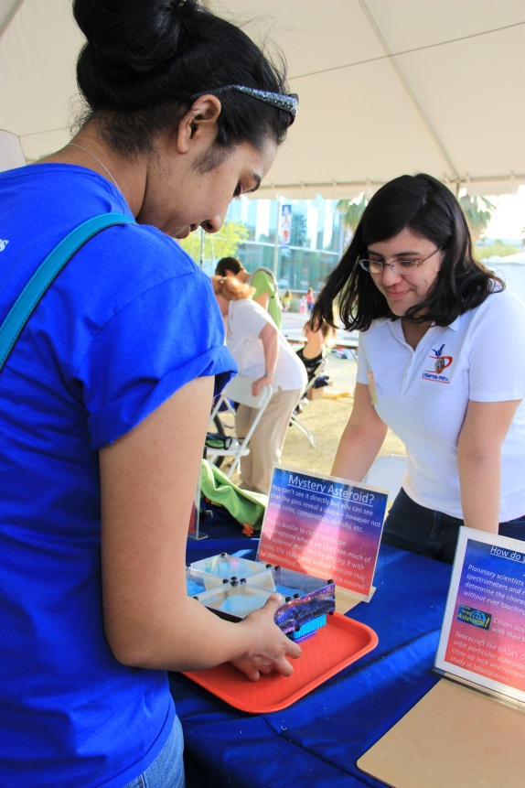
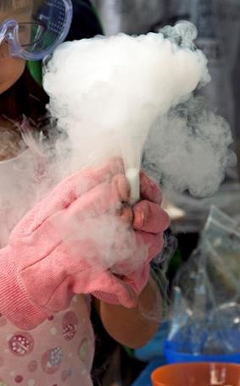
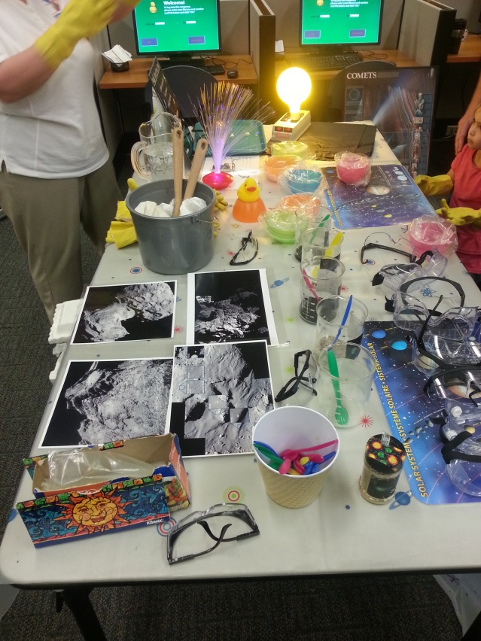
What does the Ambassador Program do?
Connie Tran
Dolores Hill
Notes:
The OSIRIS-REx Ambassador Program engages and informs the community about this mission through informal education. Ambassadors from a variety of backgrounds are recruited and trained to understand aspects of the mission. The program reaches all ages, with an emphasis on youth, to inspire excitement about space exploration, innovation, and general STEM fields.

Slide 7
33 Active Ambassadors
Since Sept. 2014,
we have reached over 50k people
Main Events:
    U of A College of Science Lecture Series
    Tucson Festival of Books
    South X Southwest
Notes:
Read bullet points

Slide 8
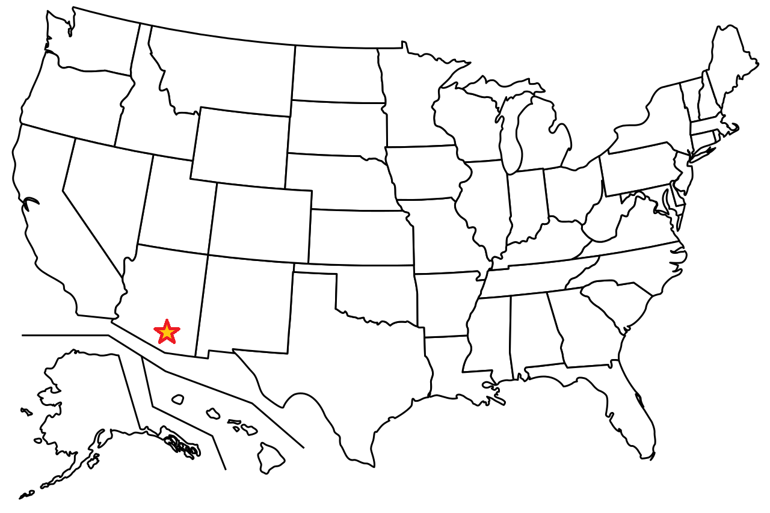
Based in Tucson, AZ
Notes:
The program originated in Tucson, AZ at the University of Arizona branch of OSIRIS-Rex.
In previous years, has left us limited to the Tucson Community.
However, this year we focused on ways of mainstreaming our program and making it smoother and easier to run

Slide 9
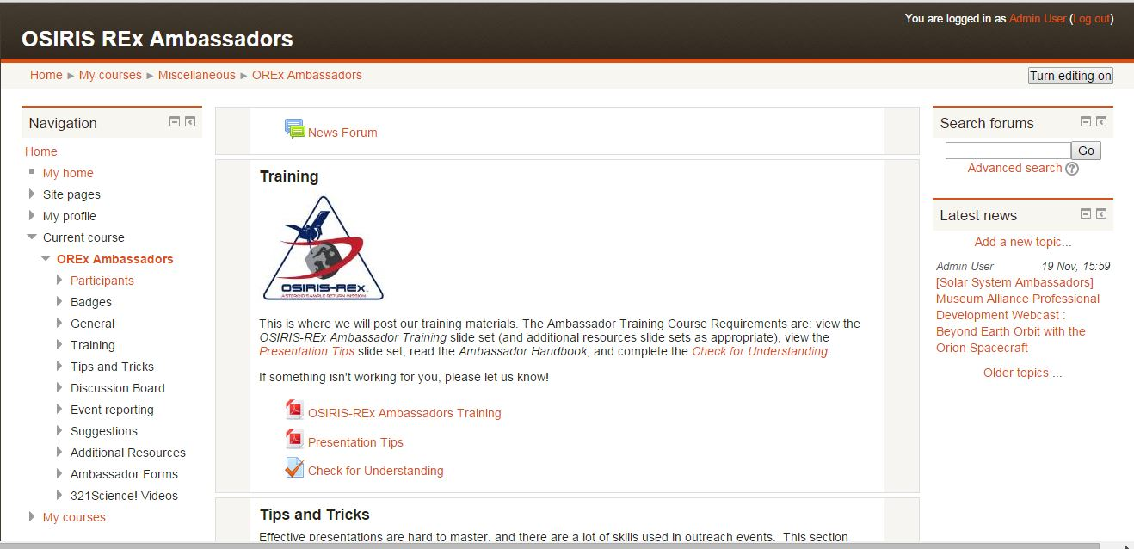
New Online Training Module
Notes:
The past winter we developed a training module that can be accessed anywhere with a computer.
This gave us the ability to expand our outreach and who can get involved

Slide 10
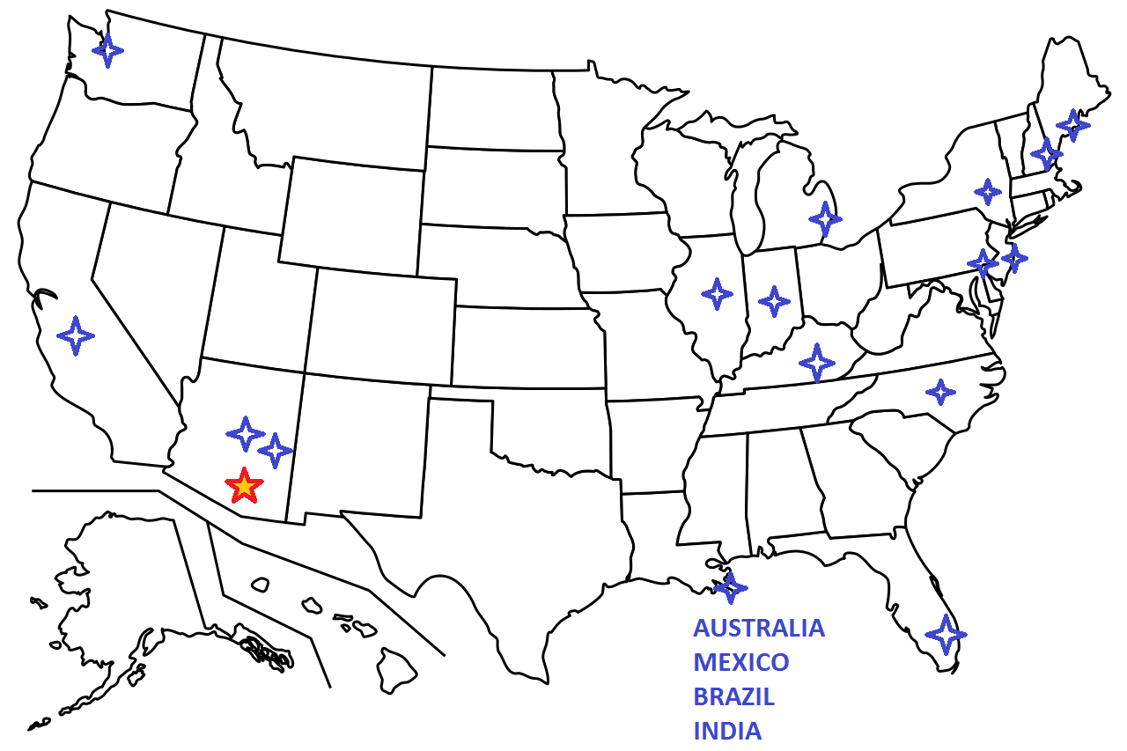
After Online Training
Notes:
As a result, Ambassadors can now be out of state and still help us get the word out!
These are all locations where we have gotten inquiries from recently, now all able to train from the comfort of their own state.

Slide 11
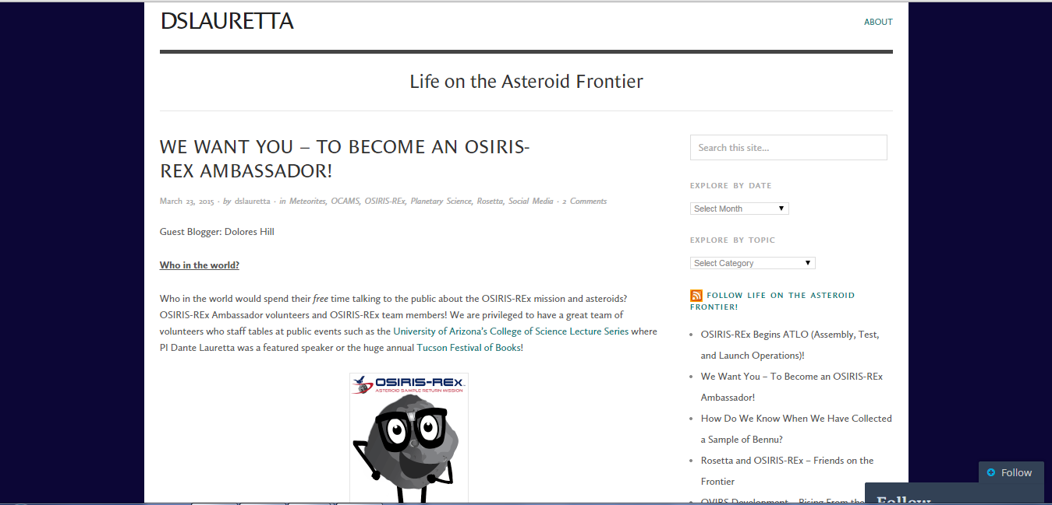
Reaching Out: Blog Posts
24 Inquiries the week following the post
Notes:
For the first time, we posted a guest blog on the Principal Investigator’s personal blog.
The blog post has been viewed over 814 times
The Facebook post reached 35,664 people and the tweet was viewed 3,210 times.
And with in the first week of posting we received 24 inquiries of people who wanted to become Ambassadors from all across the country.
We learned that if you reach out to people instead of just waiting for them to inquire themselves and hit the “contact us” button, we see a great response

Slide 12
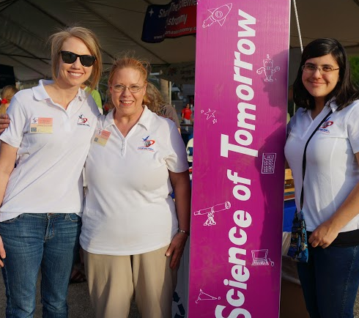
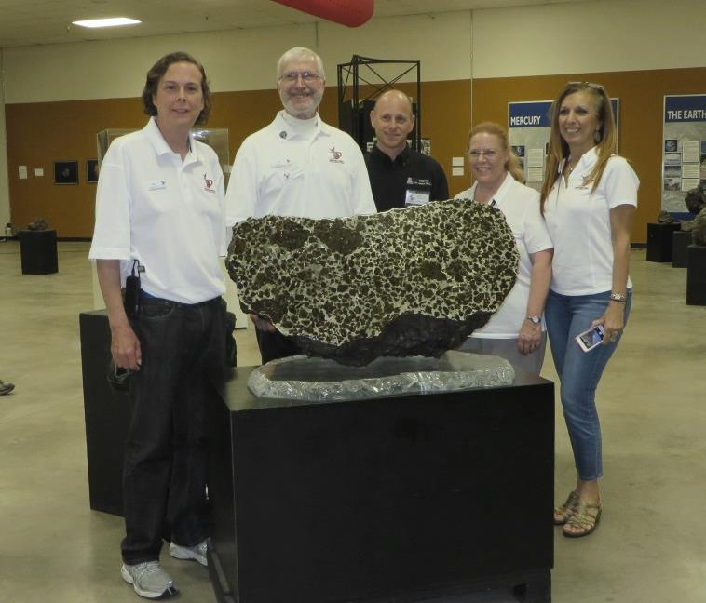
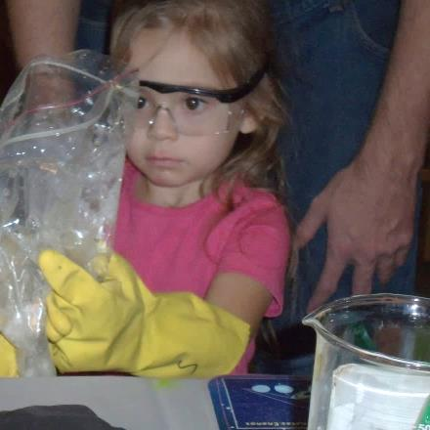
Looking to the Future: the Importance of Ambassadors
Cathy Tran
Dolores Hill
Rich Hill
Notes:
For the future, we want to work to improve out of state correspondence-make it easier for out of state ambassadors to run their own outreach events. We also want to find a way to honor those veteran ambassadors who have worked their butts off for us. They truly deserve it. Ultimately, we are here to inform the public; let them know how their support is going to good use. We want to get youth excited about science! we are teaching our public how STEM fields directly impact their lives and to ask questions about the universe we live in.

Slide 13
Thank you!
Notes:
Questions?

