Slide 1
Sparking an Interest in STEM
Erin Bailey
Northern Arizona University
Mentor: Maggie Vanderberg, Ph.D

Slide 2
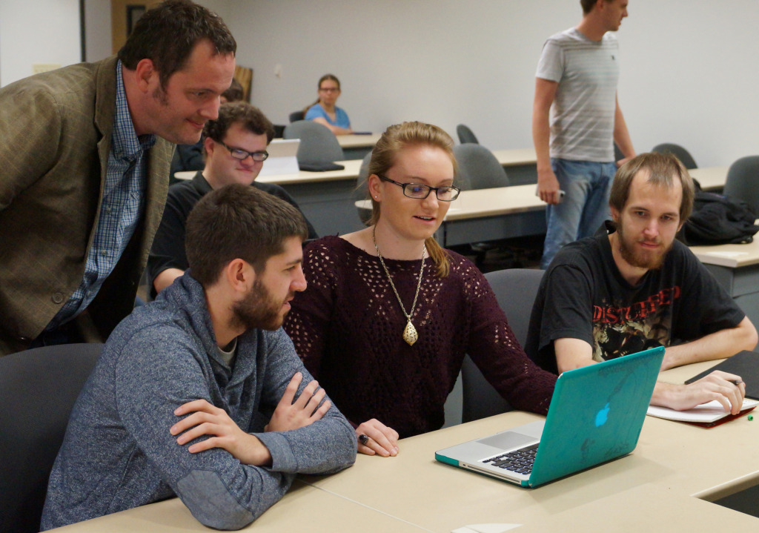
Problem Statement
Large gender gap in STEM-related degrees
Computer Science classes rarely offered for young students

Slide 3
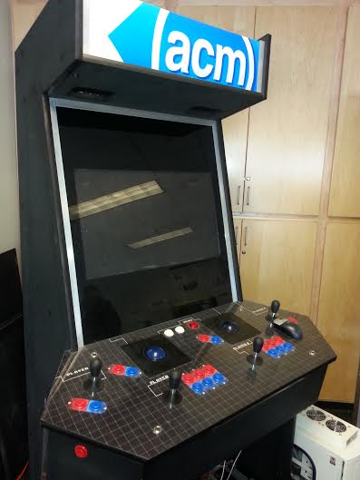
Solution
Help introduce Science,
Technology, Engineering,
and Math to young women
Incorporate these skills into a
videogame
Introduce Computer Science
to young women

Slide 4




Tools
CS 413: Virtual Worlds
Sublime text editor
ActionScript/Flash -> Haxe/Starling

Slide 5
Challenges
Choosing the wrong tools to start with
Learning new languages
Streamlining work to be more efficient
Finding young women who were interested in participating

Slide 6
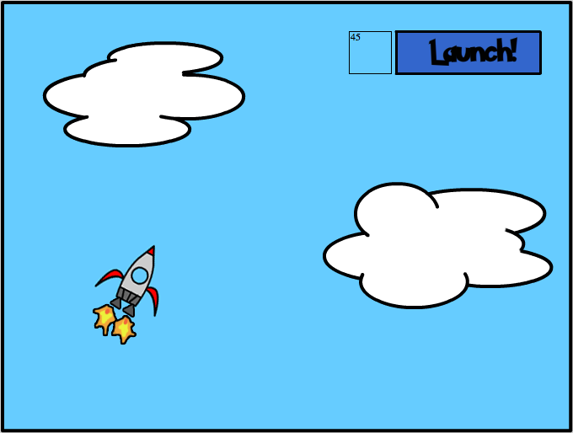

Slide 7

Analysis
User testing is currently being done
Gathering information via survey

Slide 8




Conclusion
Data still has to be analyzed
I’m prepared for either outcome regarding my hypothesis
Moving forward, I hope to implement new features

Slide 9

“If we knew what we were doing, then it wouldn’t be called research”
-Albert Einstein

