Slide 1

Modeling Quasar Light Curves in the Near Infrared (NIR)
By Kathleen Novoa-Perry
Mentor: Dr. Nathaniel Butler
Arizona Space Grant Symposium
Sheraton Phoenix Airport Hotel
April 18, 2015

Slide 2
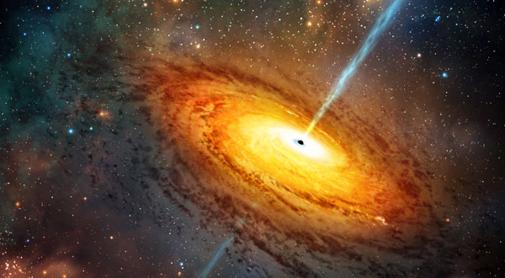
Problem/Objective
Light curves can provide us with substantial information on not only the object itself we are viewing, but also the environment it is in. We obtained over two years worth of data that needed to be reduced and analyzed.
The objective of my project was to complete a time-series analysis, using Python, for several quasars in the visual, infrared and, most importantly, near infrared wavelengths.

Slide 3
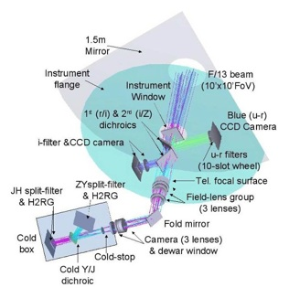
Instrument Used
The RATIR camera is mounted on the 1.5m Harold Johnson telescope in San Pedro Martir, Baja CA, Mexico
It is a simultaneous 6-Band Optical/NIR camera
The bands the camera images in are: i, r, Z, Y, J, and H
Two of the detectors operate at optical wavelengths with a field of view of 5.3 x 5.3 arcmin²
Two of the detectors operate at NIR wavelengths with a field of view of 10 x 10 arcmin²
The camera has three dichroics splitting up the incoming light and passing it through to four different detectors at wavelength ranges of 0.3 – 1.8 micrometers
Above image: RATIR camera diagram

Slide 4
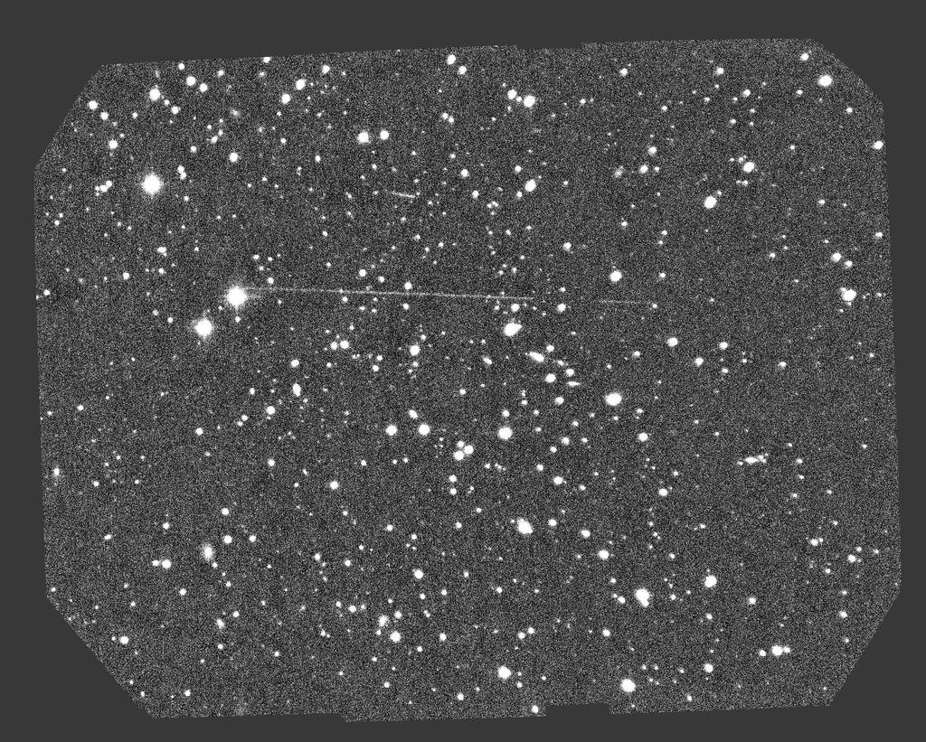
Data
To the right is a sample image of one of the over 1200 images taken
There were 27 target quasars imaged from Nov. 2012 to June 2014
Using catalogues such as USNO, 2MASS, and SDSS, we were able to properly identify a good number of the light sources in each of our images
A text file was then created containing each source’s magnitude and error in magnitude data
Using this text file, Dr. Butler extracted the data and I created a light curve of each of the wavelengths over a small amount of time, for all of the quasars, using Python
Above Image: RATIR ZY Band Image:20130815/2013B-1006/1326030033

Slide 5
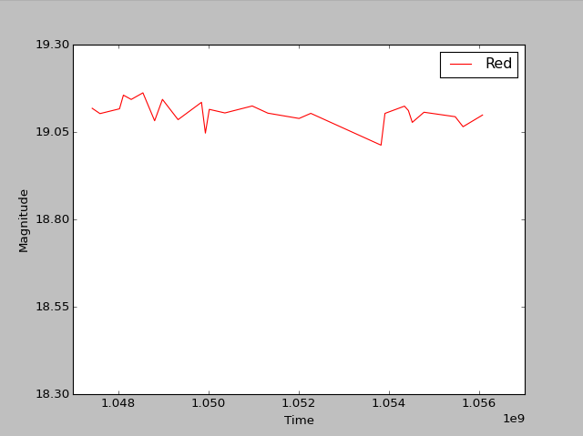
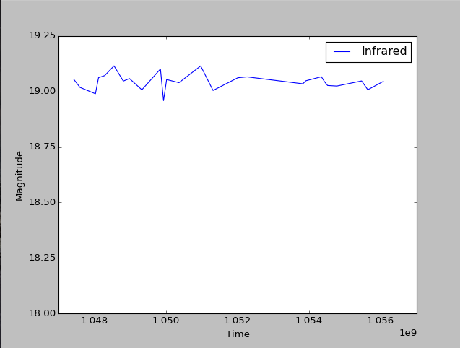
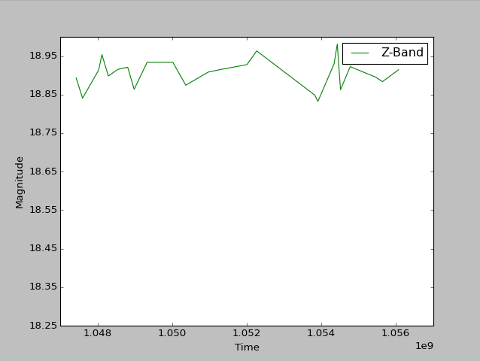
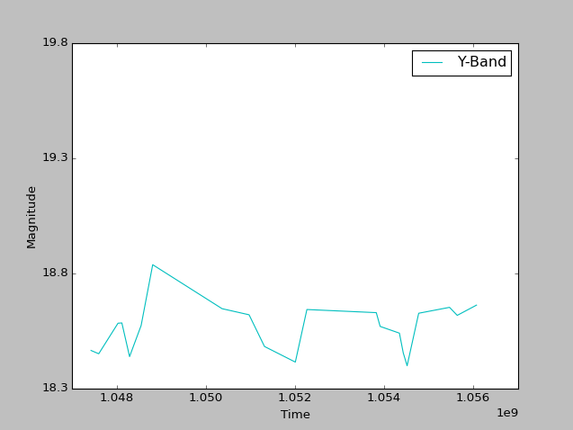
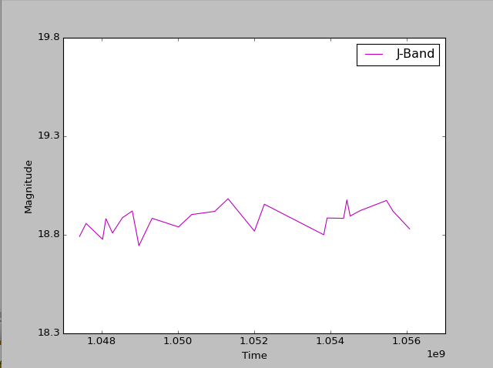
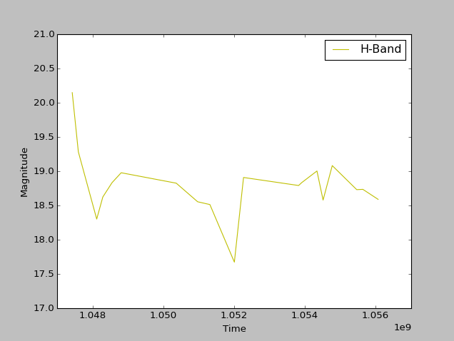
Light Curves for Quasar 19
These are light curves in each of the 6 wavelengths for one quasar
While the range is small, you can clearly make out some variability, especially in the H-Band wavelength where there is not only a sizeable dimming, but also a good brightening in the quasar

Slide 6
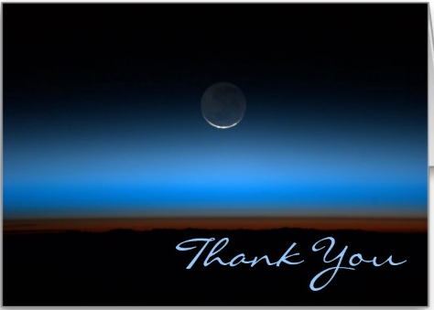
Special Thanks
A sincere thank you to Dr. Butler for all of his help and guidance during this internship
Thank you to Craig Ignatowski for his help in programming
Finally, thank you to everyone at ASU/NASA Space Grant for providing me with an incredible opportunity to work on an exciting research project with a great mentor!

