Slide 1
Globular Cluster Populations In Spiral Galaxies
Kelsey McCabe
University of Arizona
Advisor: Dennis Zaritsky
Department of Astronomy
University of Arizona
Arizona Space Grant Symposium
Arizona State University
Tempe, AZ

Slide 2
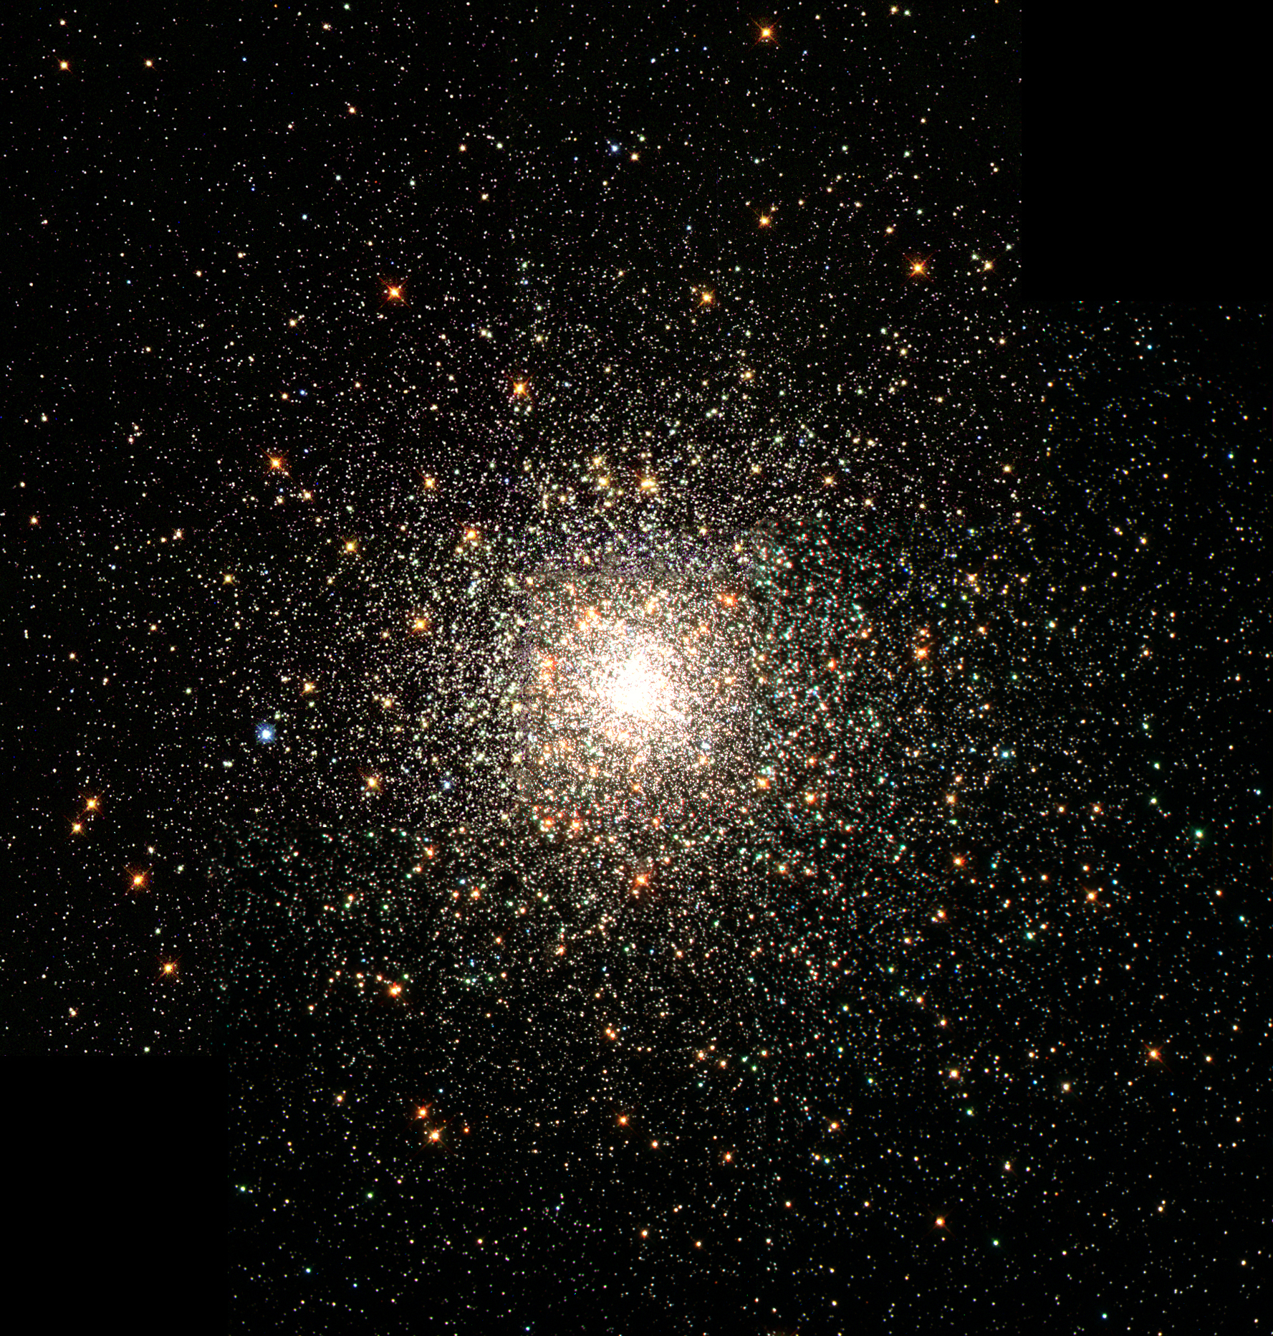
Outline
A Brief Overview
Methodology
Creating the Catalog
Processing the Image
Counting the Clusters
Results
“A Swarm of Ancient Stars” via Great Images in NASA

Slide 3
A Brief Overview
Globular clusters: hundreds of thousands of stars bound by gravity
We need to understand how cluster populations vary between galaxies
Purpose: determine relationship between the number of globular clusters and the mass of the galaxy
Specific frequency (T_{n}) = $\frac{number of clusters (N_{cl})}{Parent galaxy stellar mass (M_{∗})}$
Compare globular cluster populations in spiral vs elliptical galaxies

Slide 4
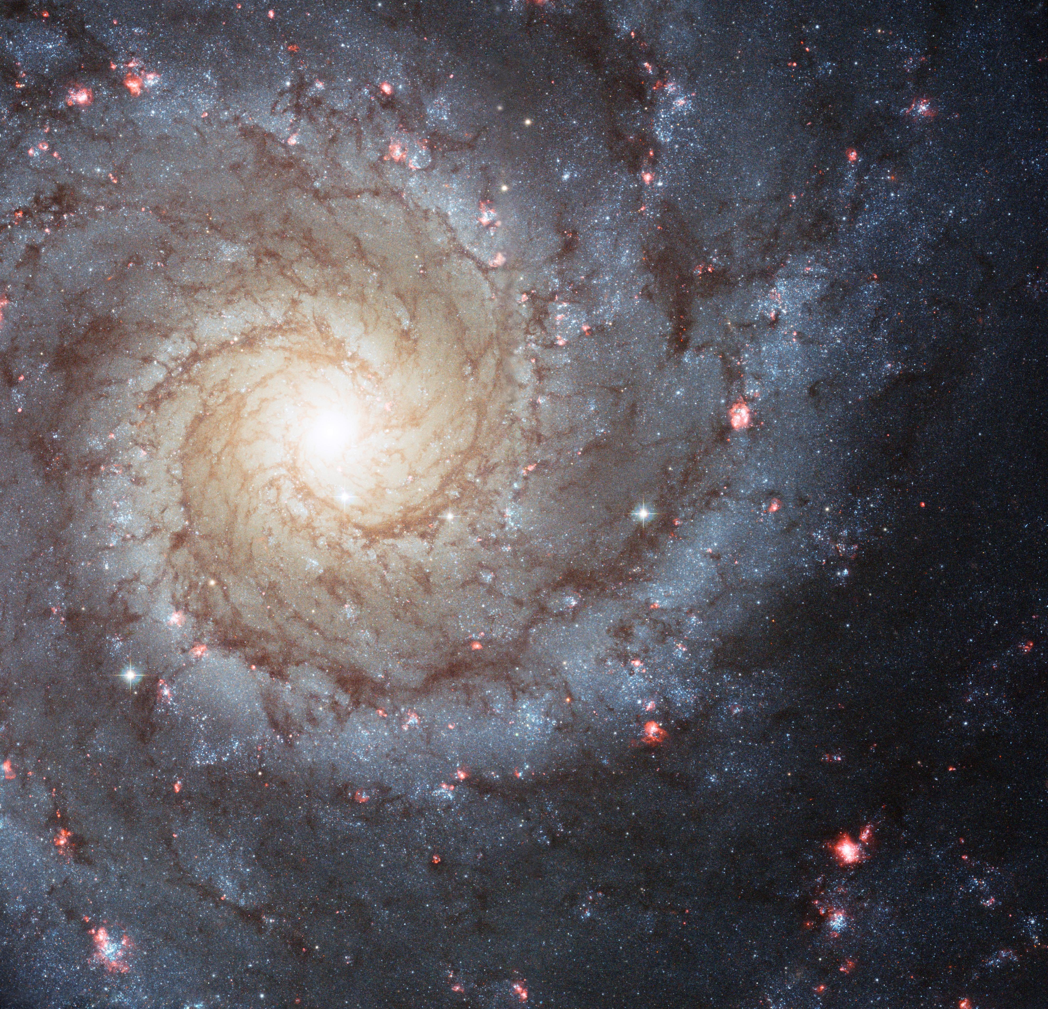
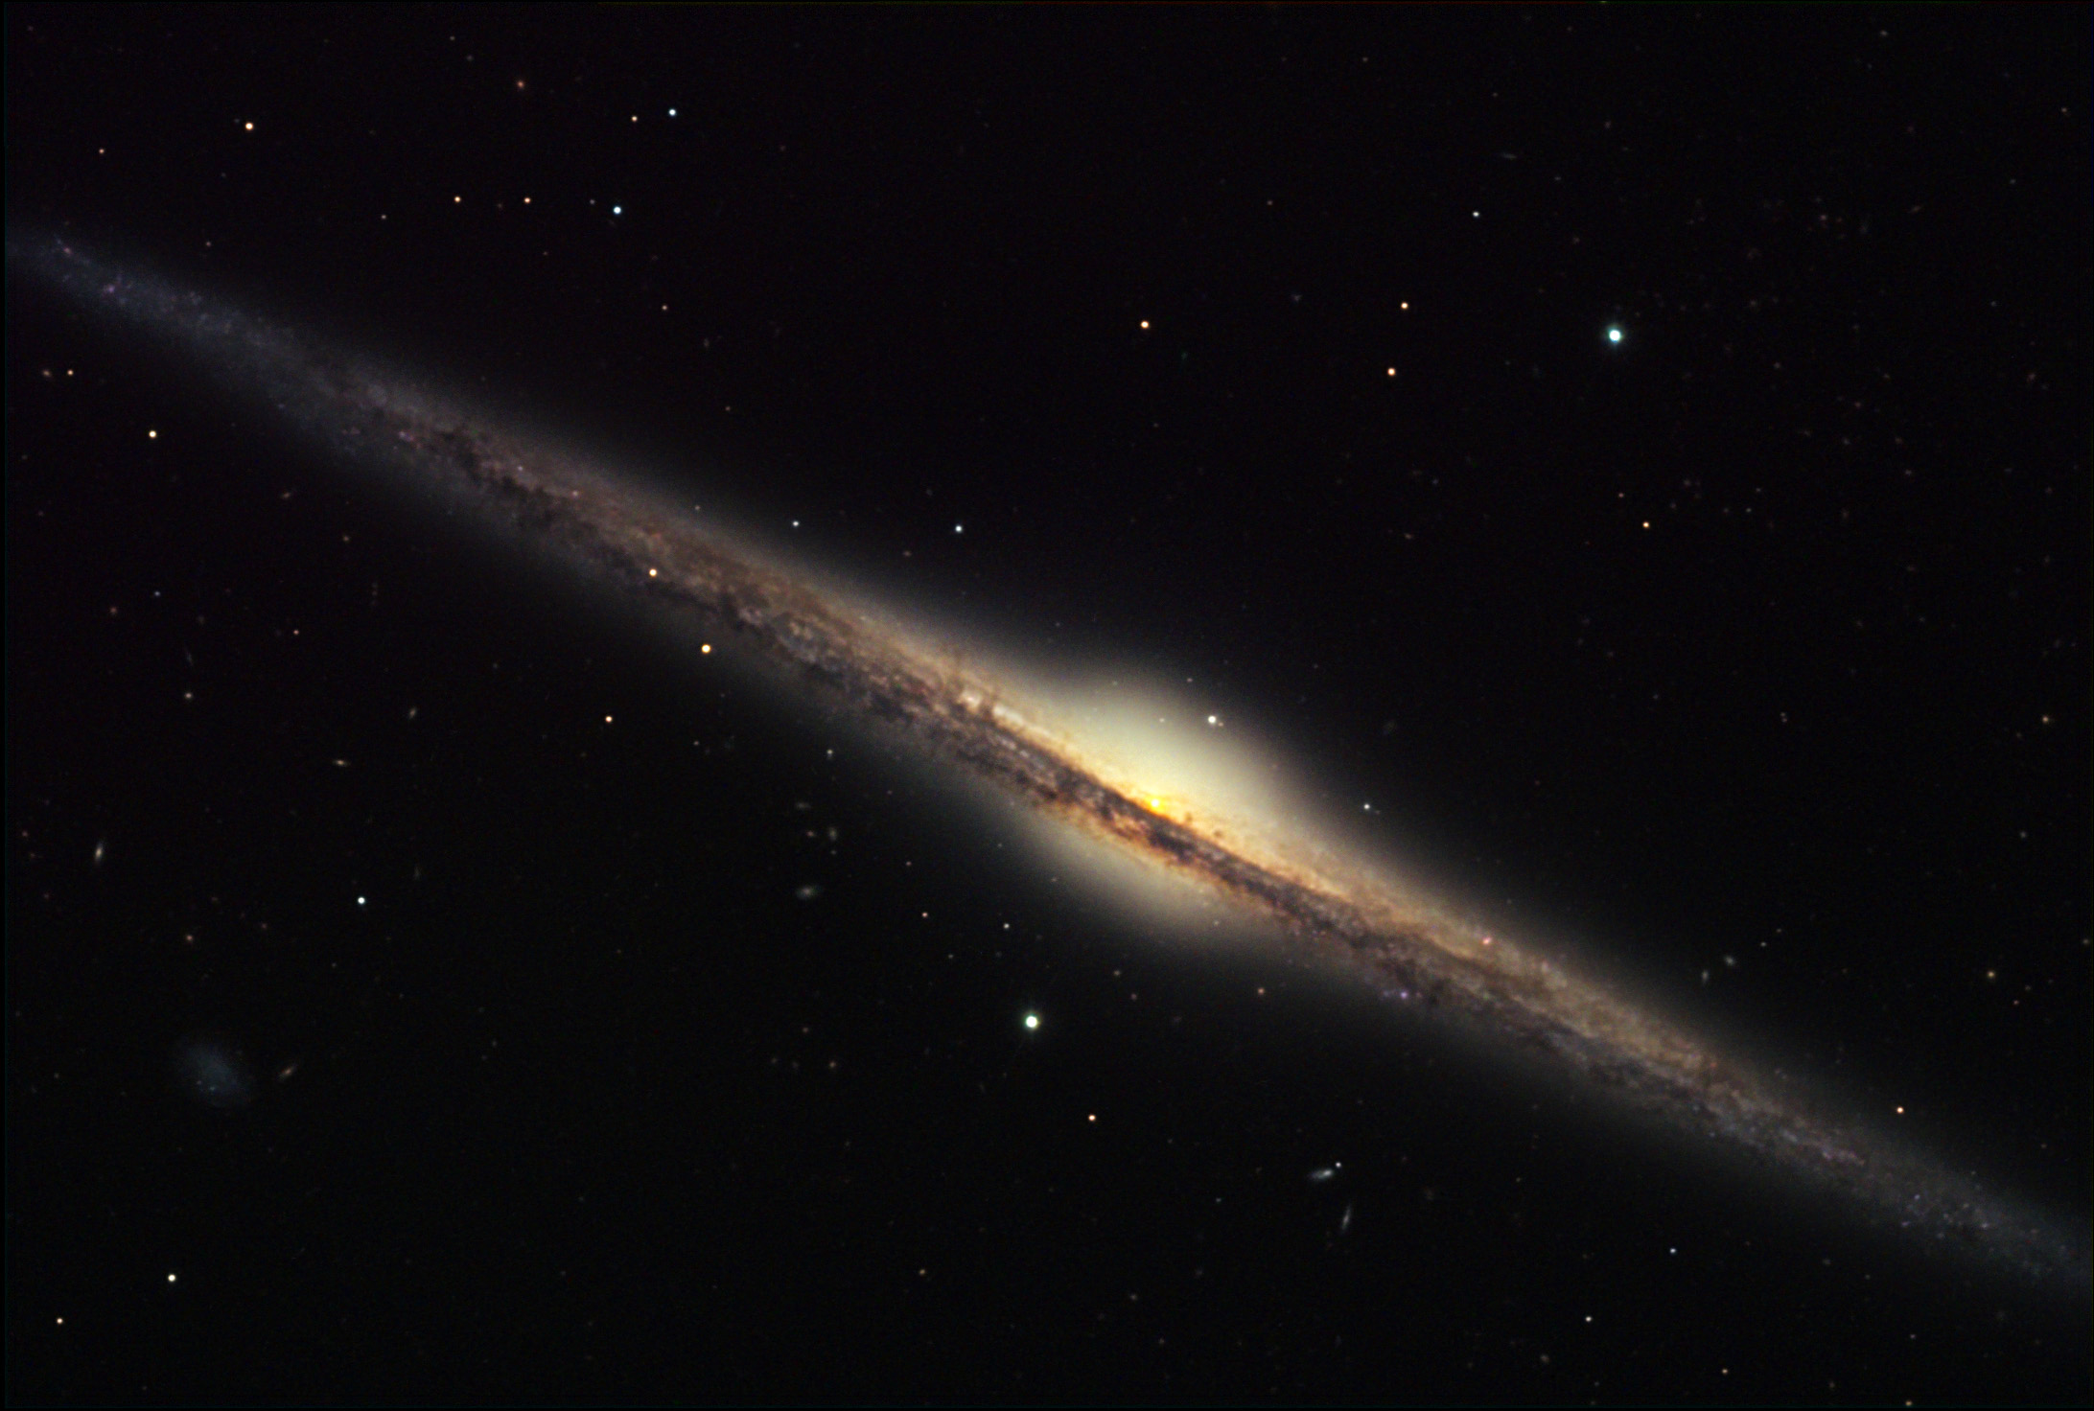
Creating a Catalog
76 edge-on images of spiral galaxies from the S⁴G Survey
Initial inclination of at least 80°
Must be at least 11.2 Mpc from our galaxy but not more than 30.1 Mpc
Good physical resolution and sufficient background
Messier 74
NGC 4565

Slide 5
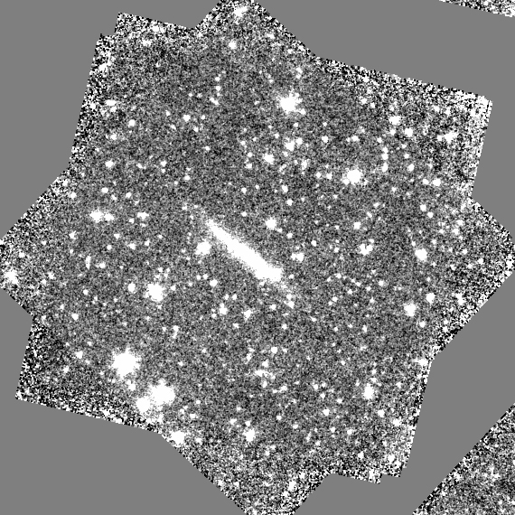
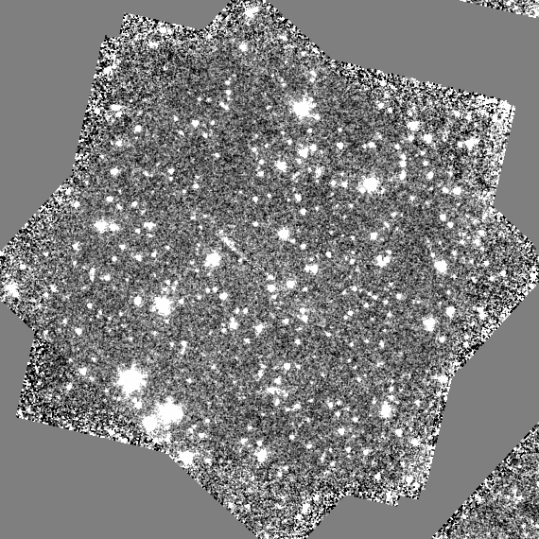
Processing the Image
UGC 10194
We subtract the galaxy light from the image
Left is original image, right is galaxy subtracted image

Slide 6
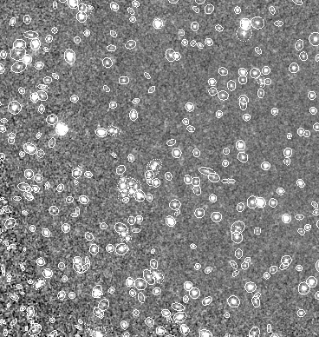
Processing the Image cont
Identify point sources
Remove sources that are too bright or too faint
Convert the observed number to a surface density
UGC 9977

Slide 7
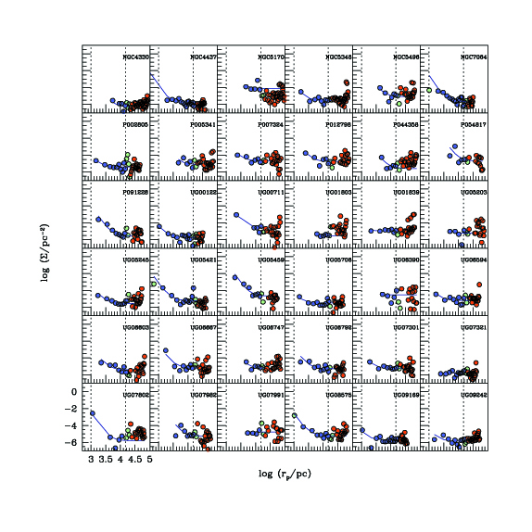
Counting the Clusters
We fit a power law model to build a profile for each galaxy

Slide 8
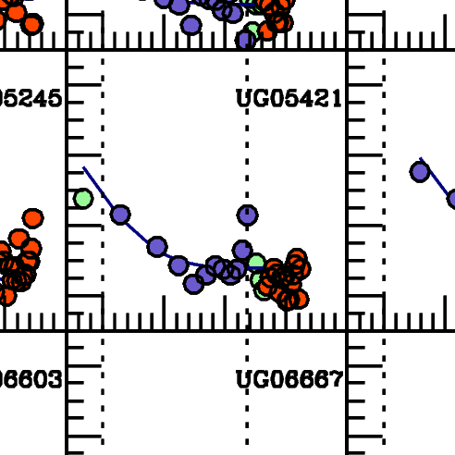

Slide 9
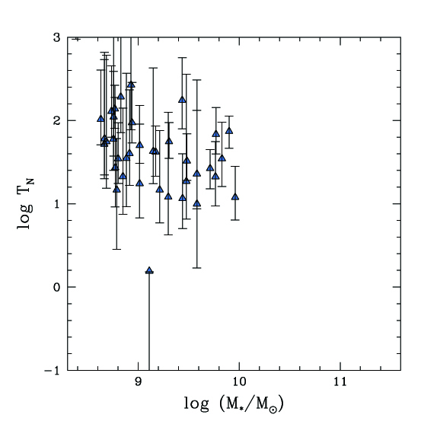
Results

Slide 10
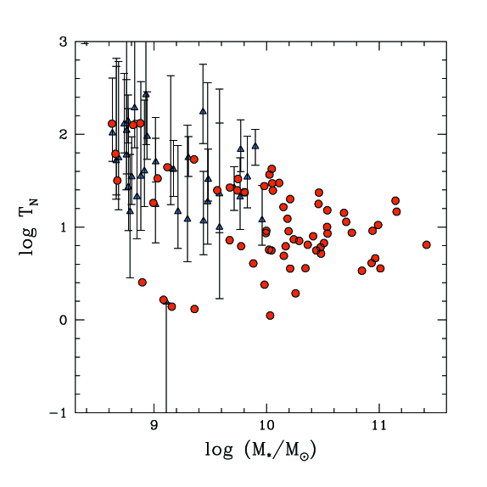
Results cont

Slide 11
Image Citations
NASA, The Hubble Heritage Team, STScI, and AURA. A Swarm of Ancient Stars. Digital image. Great Images in NASA. NASA, n.d. Web.
NASA, ESA, and The Hubble Heritage (STScI/AURA)-ESA/Hubble Collaboration. Messier 74. Digital image. NASA. NASA, n.d. Web.
Bruce Hugo and Leslie Gaul/Adam Block/NOAO/AURA/NSF. NGC 4565.

Slide 12
Acknowledgements
Barron Orr, UA/NASA Space Grant Program
Susan Brew, Arizona/NASA Space Grant Program Manager
Dennis Zaritsky, Mentor, University of Arizona, Department of Astronomy

Slide 13
Thank you!

