Slide 1


Energy-Optimal Path Planning for
Multi-Goal Six-Rotor Missions
Kevin Vicencio and Iacopo Gentilini
Aerospace and Mechanical Engineering Department
Embry–Riddle Aeronautical University
NASA Space Grant Symposium
April 18, 2015
Notes:
DON’T MENTION UNDERGRAD

Slide 2
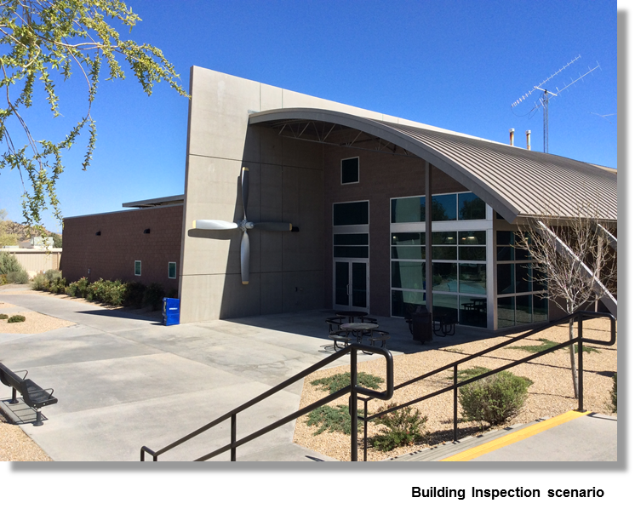


Motivation
Objective:
Minimize energy consumption for six-rotor multi-goal missions.
Bridge inspection scenario
Rescue mission scenario
Notes:
Generalized tsp defined on graphs;

Slide 3
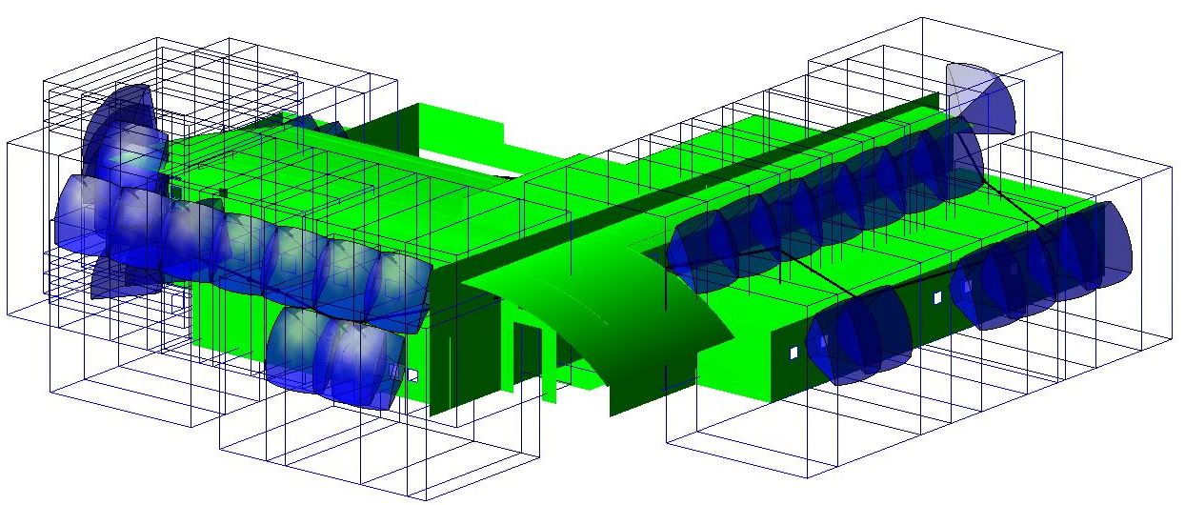
Previous Methods
TSP with Neighborhoods (TSPN) [3]:
Minimize path length
Nodes can move within given domains (neighborhoods)
Limitation:
  TSPN does not account for UAV attitude
  Minimum distance does not result in minimum energy consumption
Notes:
Generalized tsp defined on graphs;

Slide 4
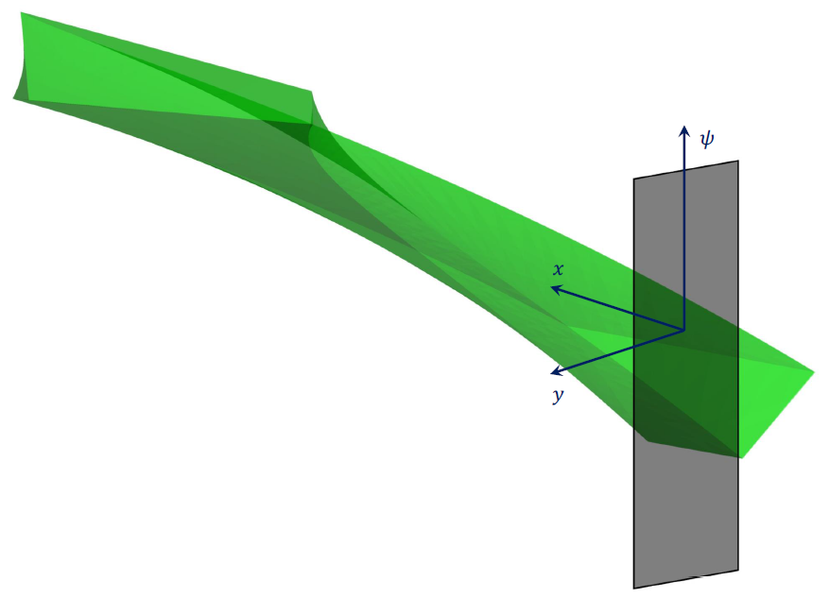
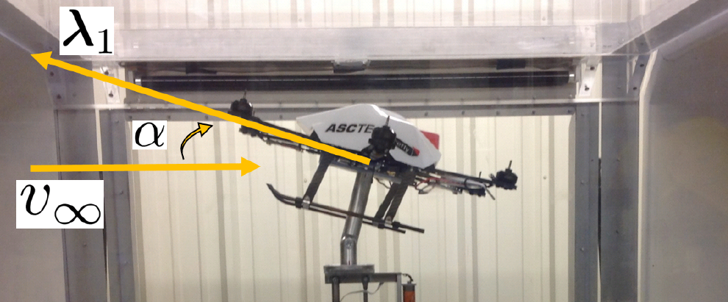
Contribution
Variable Yaw UAS Inspection Neighborhood:
Neighborhood is 4-D, non-convex region
Model neighborhood by splitting into convex regions using the Generalized TSPN (GTSPN) [1]
Energy-based Cost Function
Six-rotor dynamic model simulates path trajectory
Utilizes experimental drag forces and moments data
Returns required energy consumption
Incorporated into Hybrid Random-Key Genetic Algorithm (HRKGA)
Notes:
Generalized tsp defined on graphs;

Slide 5
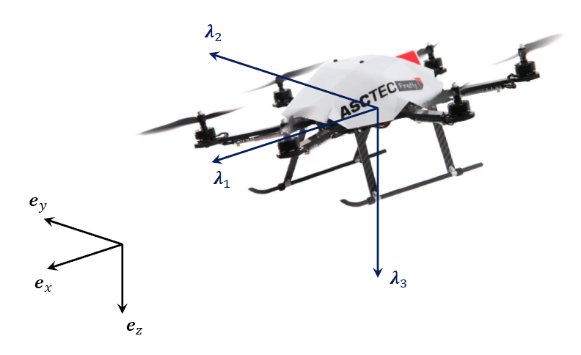




Variable Yaw UAS Inspection Neighborhood Formulation
Coordinate Systems:
Inertial Frame:
Body Frame:
Camera Field of View
Camera fixed at center of six-rotor
Polyhedron measured in body frame
Feasible camera configuration:
Notes:
Generalized tsp defined on graphs;

Slide 6



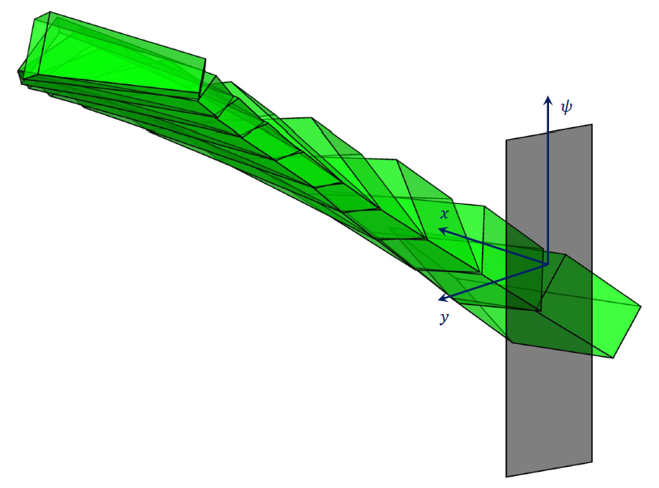
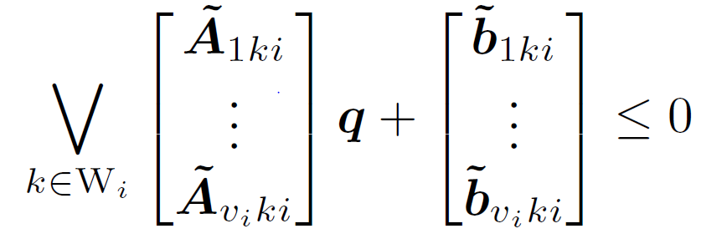
Variable Yaw UAS Inspection Neighborhood Formulation
Inspection Neighborhood:
Measure feature convex hull vertices with respect to inertial frame origin
  Rotate into body frame
Function of six-rotor configuration:
Non-linear system constraint
  Linearize about a configuration:
Notes:
Generalized tsp defined on graphs;

Slide 7
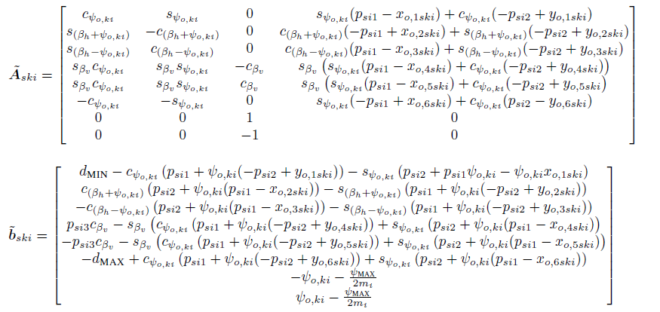
Variable Yaw UAS Inspection Neighborhood Formulation

Slide 8
Numerical Results
Proposed vs. Previous Methods
Variable-Yaw, energy-based GTSPN method compared to fixed-yaw, minimum distance TSPN method
35 randomized instances, HRKGA executed 15 times per instance
Consistency:
  GTSPN: 1.2%
  TSPN: 3.2%
GTSPN method calculates tours that are up to 11% and on average 5.8% more energy efficient

Slide 9
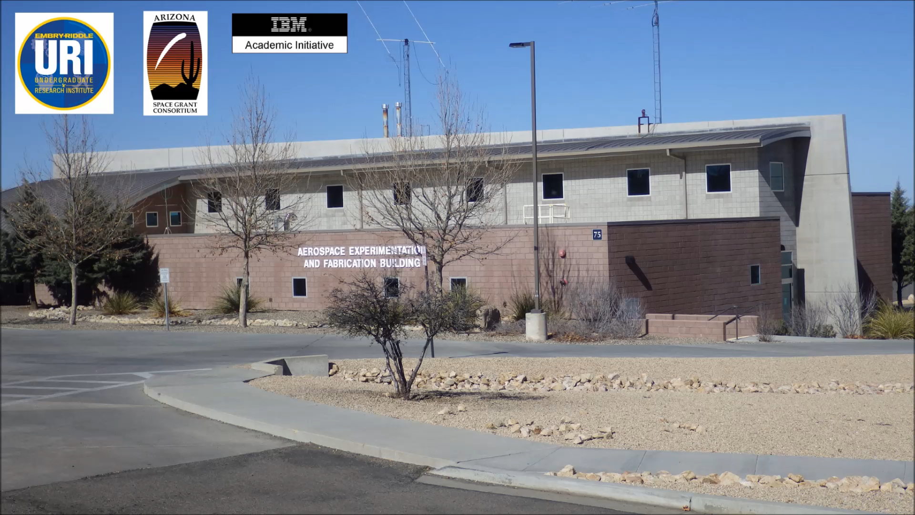
Realistic Scenario

Slide 10
Published Work
K. Vicencio, B. T. Davis, I. Gentilini. Multi-Goal Path Planning based on the Generalized Traveling Salesman Problem with Neighborhoods. Proceedings of the IEEE International Conference on Intelligent Robots and Systems (IROS 2014), Chicago, Illinois, USA, September 14 – 18, 2014.
K. Vicencio, I. Gentilini. Energy-Optimal Path Planning for Multi-Goal Six-Rotor Missions. (IROS 2015 Submitted). 2015.

Slide 11

Acknowledgment
Embry–Riddle Aeronautical University:
Dr. Iacopo Gentilini
Dr. Brian Davis
Dr. Ken Bordignon
Dr. Gary Yale
ERAU: Ignite Research
Arizona Space Grant Consortium
IBM Academic Initiative
Notes:
Add ignite logo

