Slide 1




Power System
David Riddle

Slide 2
Overview
Power Board
Energy Budget of ERAU Eagle Satellite
TASC Solar Panel Test
TrisolX Soler Cells

Slide 3
Power Board
TrisolX solar cells to charge an Array of Super Capacitor
Charge and discharge faster than most rechargeable batteries
Have more charge and discharge cycles
Larger than equivalent battery

Slide 4
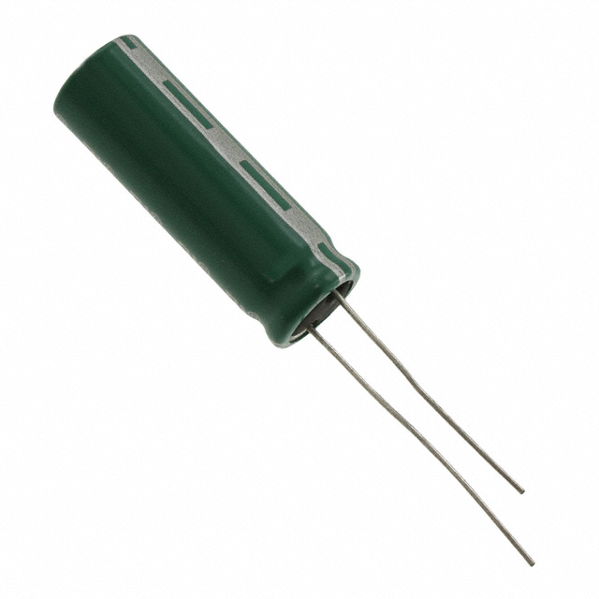
Super Capacitors
Eaton Bussmann HV1030-2R7106-R
Capacitance of 10F
Voltage rating of 2.7V
Operating Temp range
  -40 to 65 °C
Radial leads

Slide 5
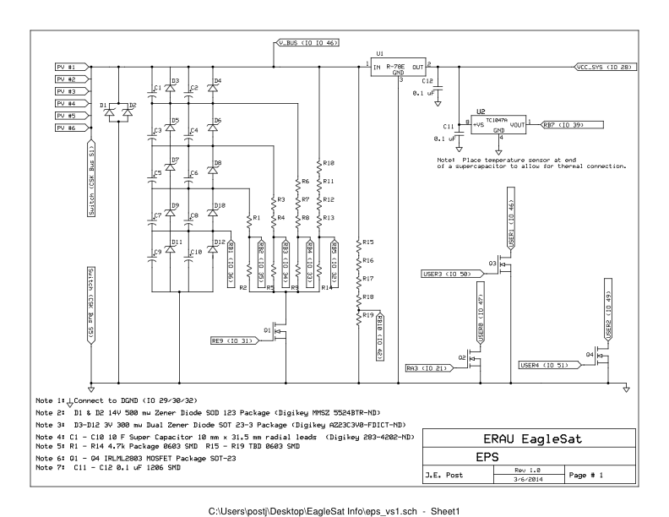
Super Capacitor Array

Slide 6
Energy Budget
Component | Voltage (V) | Current (mA) | Power (mW) | Duty Cycle (%) | Orbit (min) | Eff. (%) | Dis. Energy (J) | Charge Energy (J)
PV Panel |  |  | 1300 | 100 | 60 | 60 |  | 2808
EPS |  |  | 156 | 100 | 60 | 80 | -561.6
OBC | 3.3 | 20 | 66 | 100 | 60 |  | -237.6
OBC (Eclipse) | 3.3 | 1 | 3.3 | 100 | 20 |  | -3.96
Receiver | 7.2 | 45 | 324 | 100 | 60 |  | -1166.4
Transmitter | 7.2 | 290 | 2088 | 5 | 60 |  | -375.84
GPS Ant | 3.3 | 30 | 99 | 10 | 60 |  | -35.64
GPS | 3.3 | 303.03 | 1000 | 10 | 60 |  | -360
Memory | 3.3 | 20 | 66 | 10 | 60 |  | -23.76
Total |  |  |  |  |  |  | -2764.8 | 2808

Slide 7
Solar Panel Test
40 Watt Tungsten Light Bulb
Using the Top Solar Panel with GPS hole
21 TASC Solar Cells

Slide 8
TASC Solar Cell
Triple-junction gallium arsenide
Area 2.277 cm² (0.353 sq. in.)
Isc= 31 mA
Imp= 28 mA
Voc= 2.52 V
Vmp= 2.19 V
Pmp= 0.027 W/cm²
Cff= 80 %
Efficiency= 27 ± 3% Absolute
Temp. Coeff. Vmp = -6.2 mV/°C

Slide 9
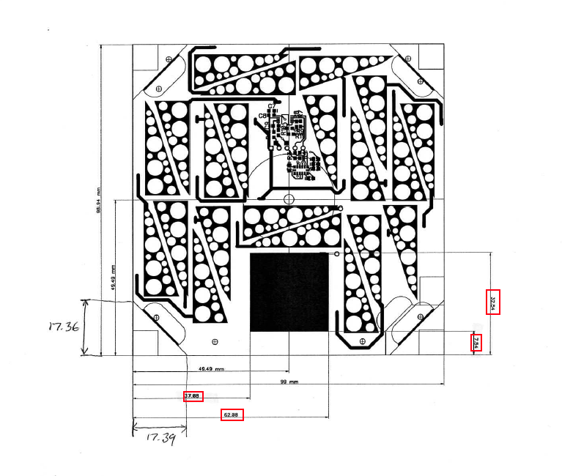
Solar Panel

Slide 10
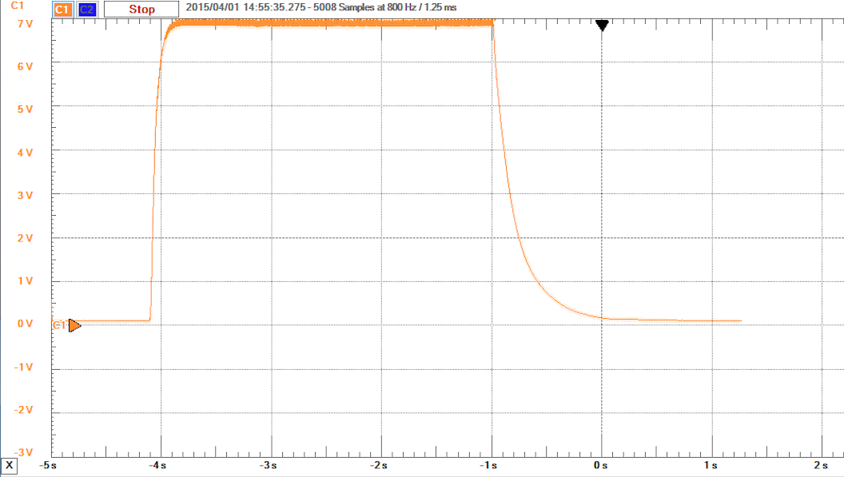
Solar Panel Test

Slide 11
TrisolX Solar Cells
Triple-junction gallium arsenide
Area 1.3 cm² (0.353 sq. in.)
Imp= 14.6 mA
Voc= 2.62 V
Vmp= 2.33 V
Pmp= 34 mW
Efficiency= 28 %
Temp. Coeff. Vmp = -6.1 mV/°C

Slide 12
Questions

