Slide 1
Designing an Antenna for use with the EagleSat CubeSat Communications System
Lisa Ferguson
Dr. Gary Yale, Dr. Ed Post
Arizona Space Grant Symposium
April 18, 2015

Slide 2
Overview
Communication between on-board computer and EagleSat ground station
Current research
Antenna design & materials
Antenna position & radiation plotting
Monofilament deterioration
Prototyping & integration

Slide 3
Signal Flow Diagram
D to A
Antenna
RF
Transceiver
Modem
Digital
TNC
Packets
OBC
A to D
A = Analog Signal
D = Digital Signal
TNC = Terminal Node Controller
OBC = On Board Computer

Slide 4
Power Flow Diagram
VCC SYS
(System Power)
VCC BATT
(Capacitor Power)
DGND
(Digital Ground)
Radio
Radiation Shield
System Components
(Resistors, Capacitors)
Modem
TNC

Slide 5
Materials Research -
Overview and Rejected Design
Previous design: microstrip
Circularly polarized quad beam antenna
Impedance mismatch with circuit board
Conducted a trade study of currently flown CubeSat antennas
Materials conclusion: Tape measure antenna with printed circuit board (PCB) mounting plate and ground plane

Slide 6
Monopole Design
Definiton: Straight rod conductor mounted perpendicularly to ground plane
Quarter wave monopole
Same radiation pattern as dipole in free space with twice the voltage
Operates at a single frequency
Non-attitude control
Notes:
Monopole antenna: Straight rod conductor mounted perpendicularly to ground plane
Commonly used: A lot of research has previously gone into the tape measure design

Slide 7
Printed Circuit Board (PCB) & Mounting Techniques
Antenna connects directly to PCB
Reduces impedance mismatch
Allows for easily measured anetenna length
Grounding tabs
Common ground between ground plane, ground of coaxial antenna cable, and satelite structure
Grounding tabs connected to ground plane through series of vias
Notes:
Printed circuit board: Mechanical support and electrical connection for electronic components such as an antenna
-etched from copper sheets and laminated onto a non-conductive surface

Slide 8
Printed Circuit Board (PCB) & Mounting Techniques
PCB Components
Ground Plane
Mounting Slot
Grounding Slot
Grounding Tabs
Coaxial antenna cable with BNC connector used for testing

Slide 9
Antenna Positioning
Different mounting positions result in different radiation patterns
Center mount
Side mount
Corner mount
Goal: Most average loss of gain
No null extrema
Notes:
-Most average loss of gain: We’d rather have a uniform distribution of small loss than extremes where we would get no signal at all
-More reliable

Slide 10
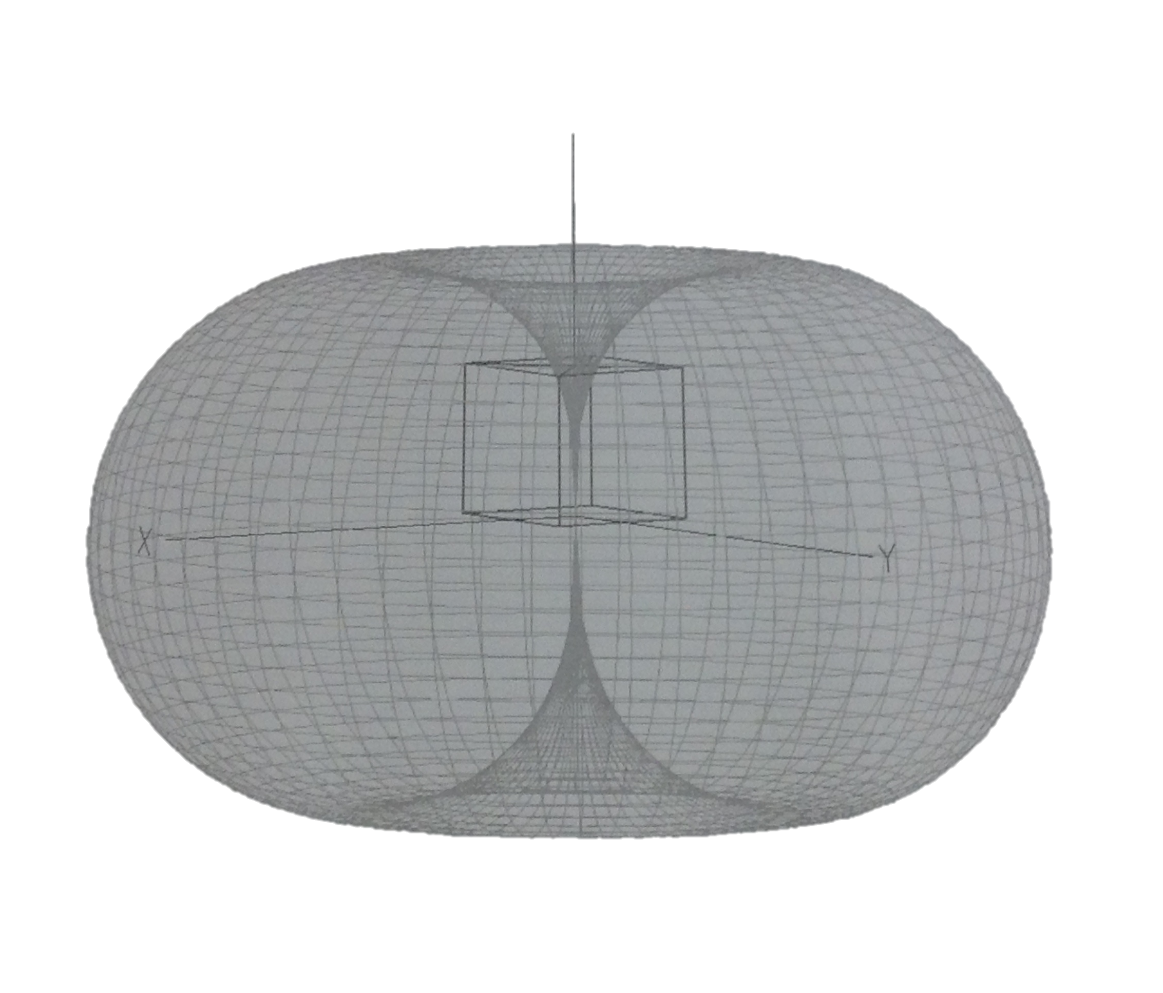
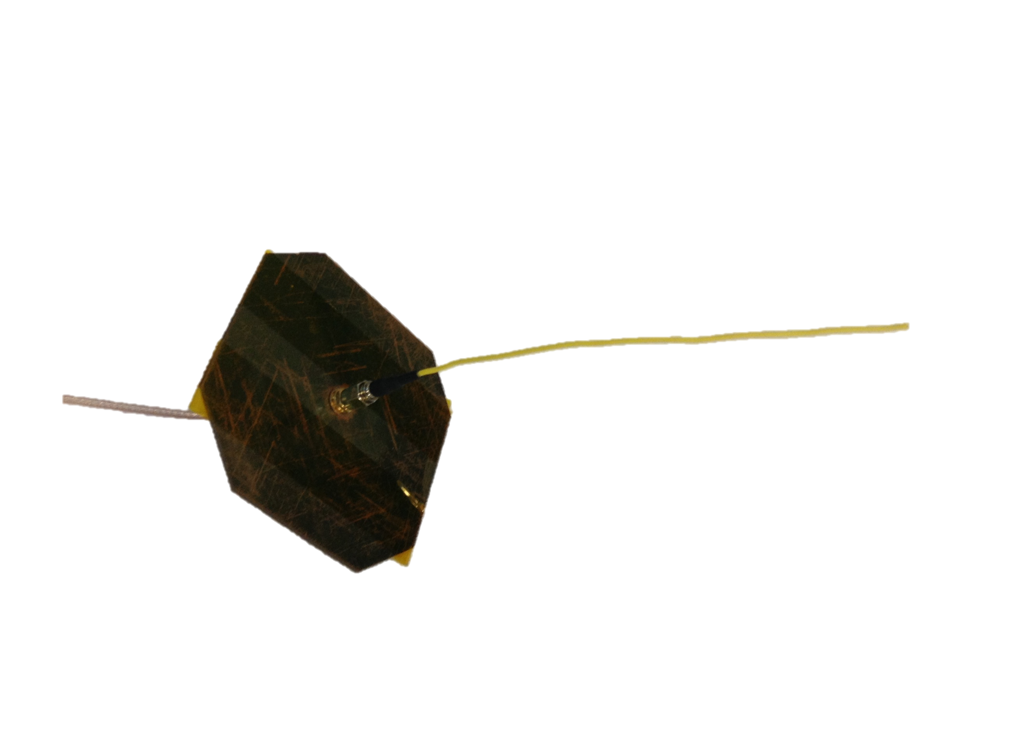
Antenna Position #1: Center Mount

Slide 11
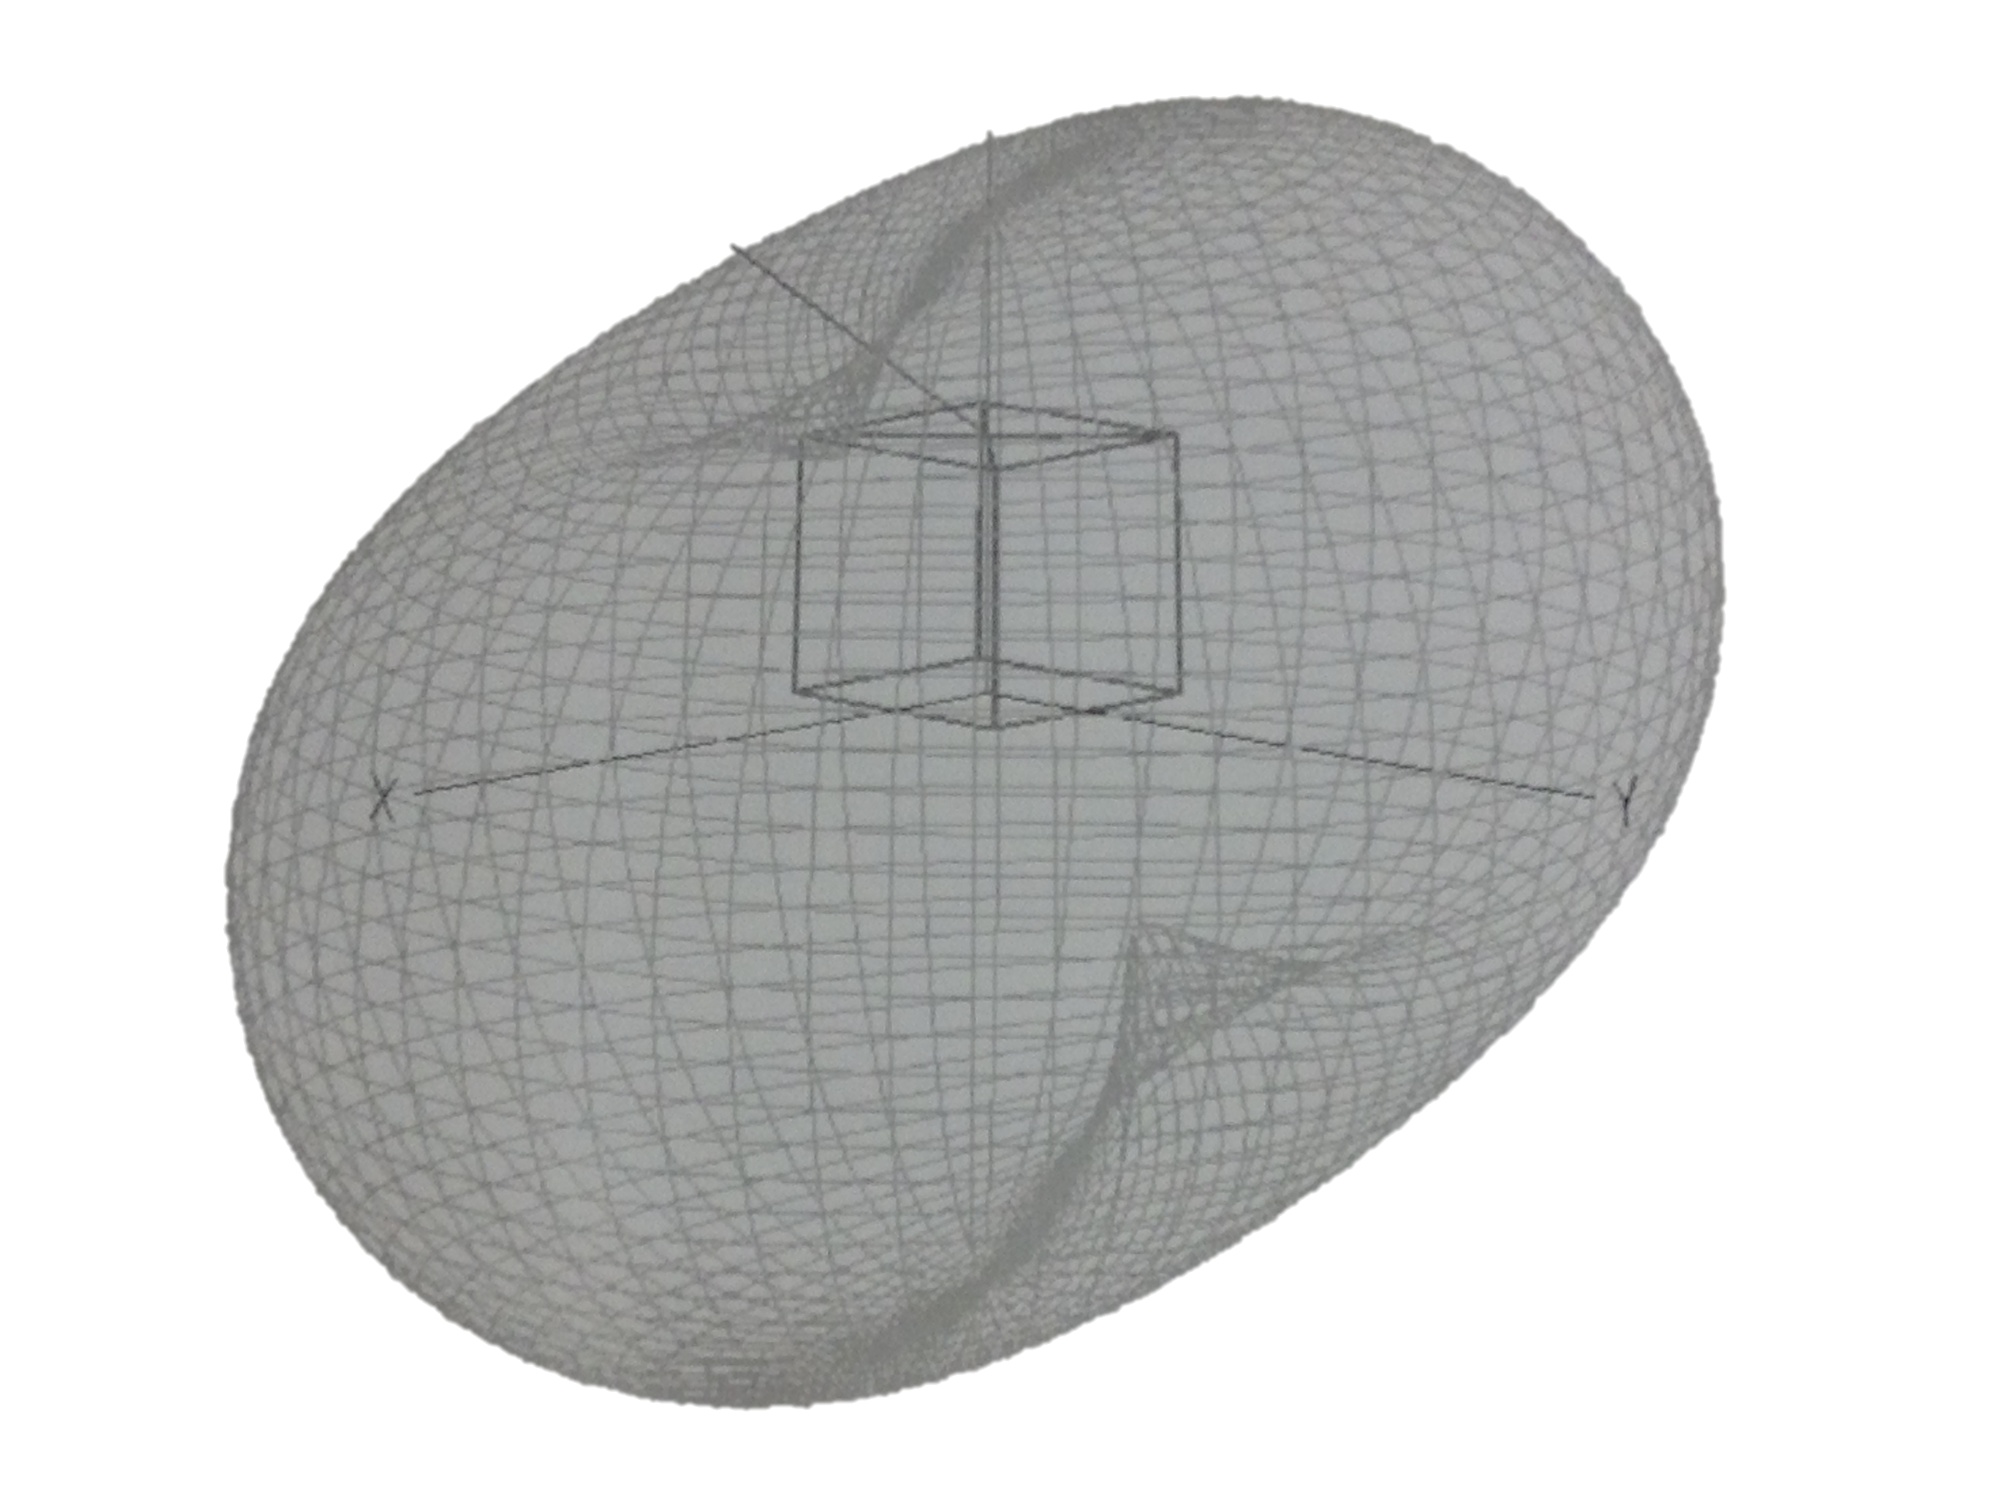
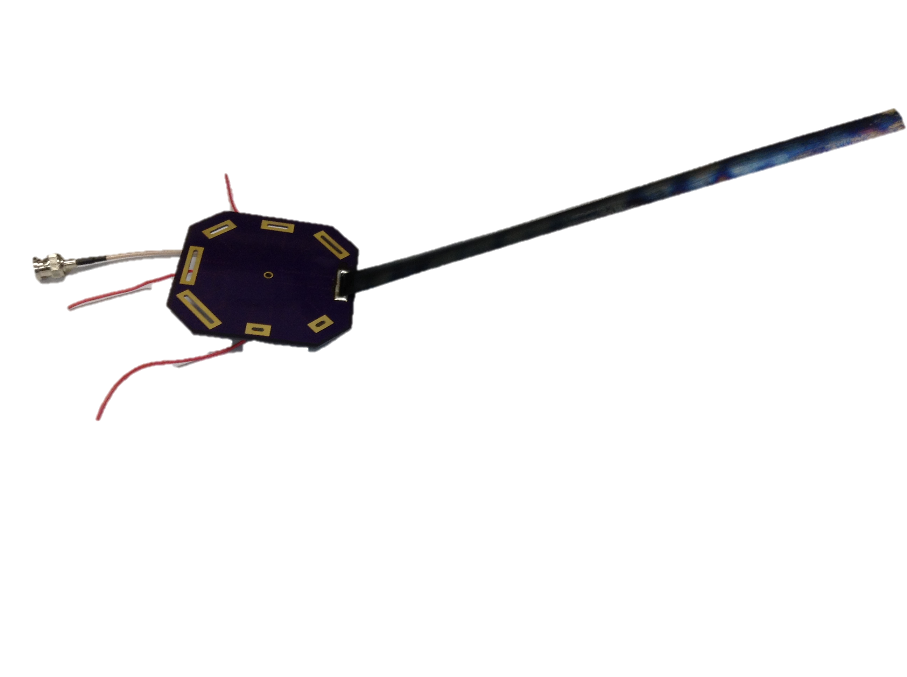
Antenna Position #2: Side Mount

Slide 12
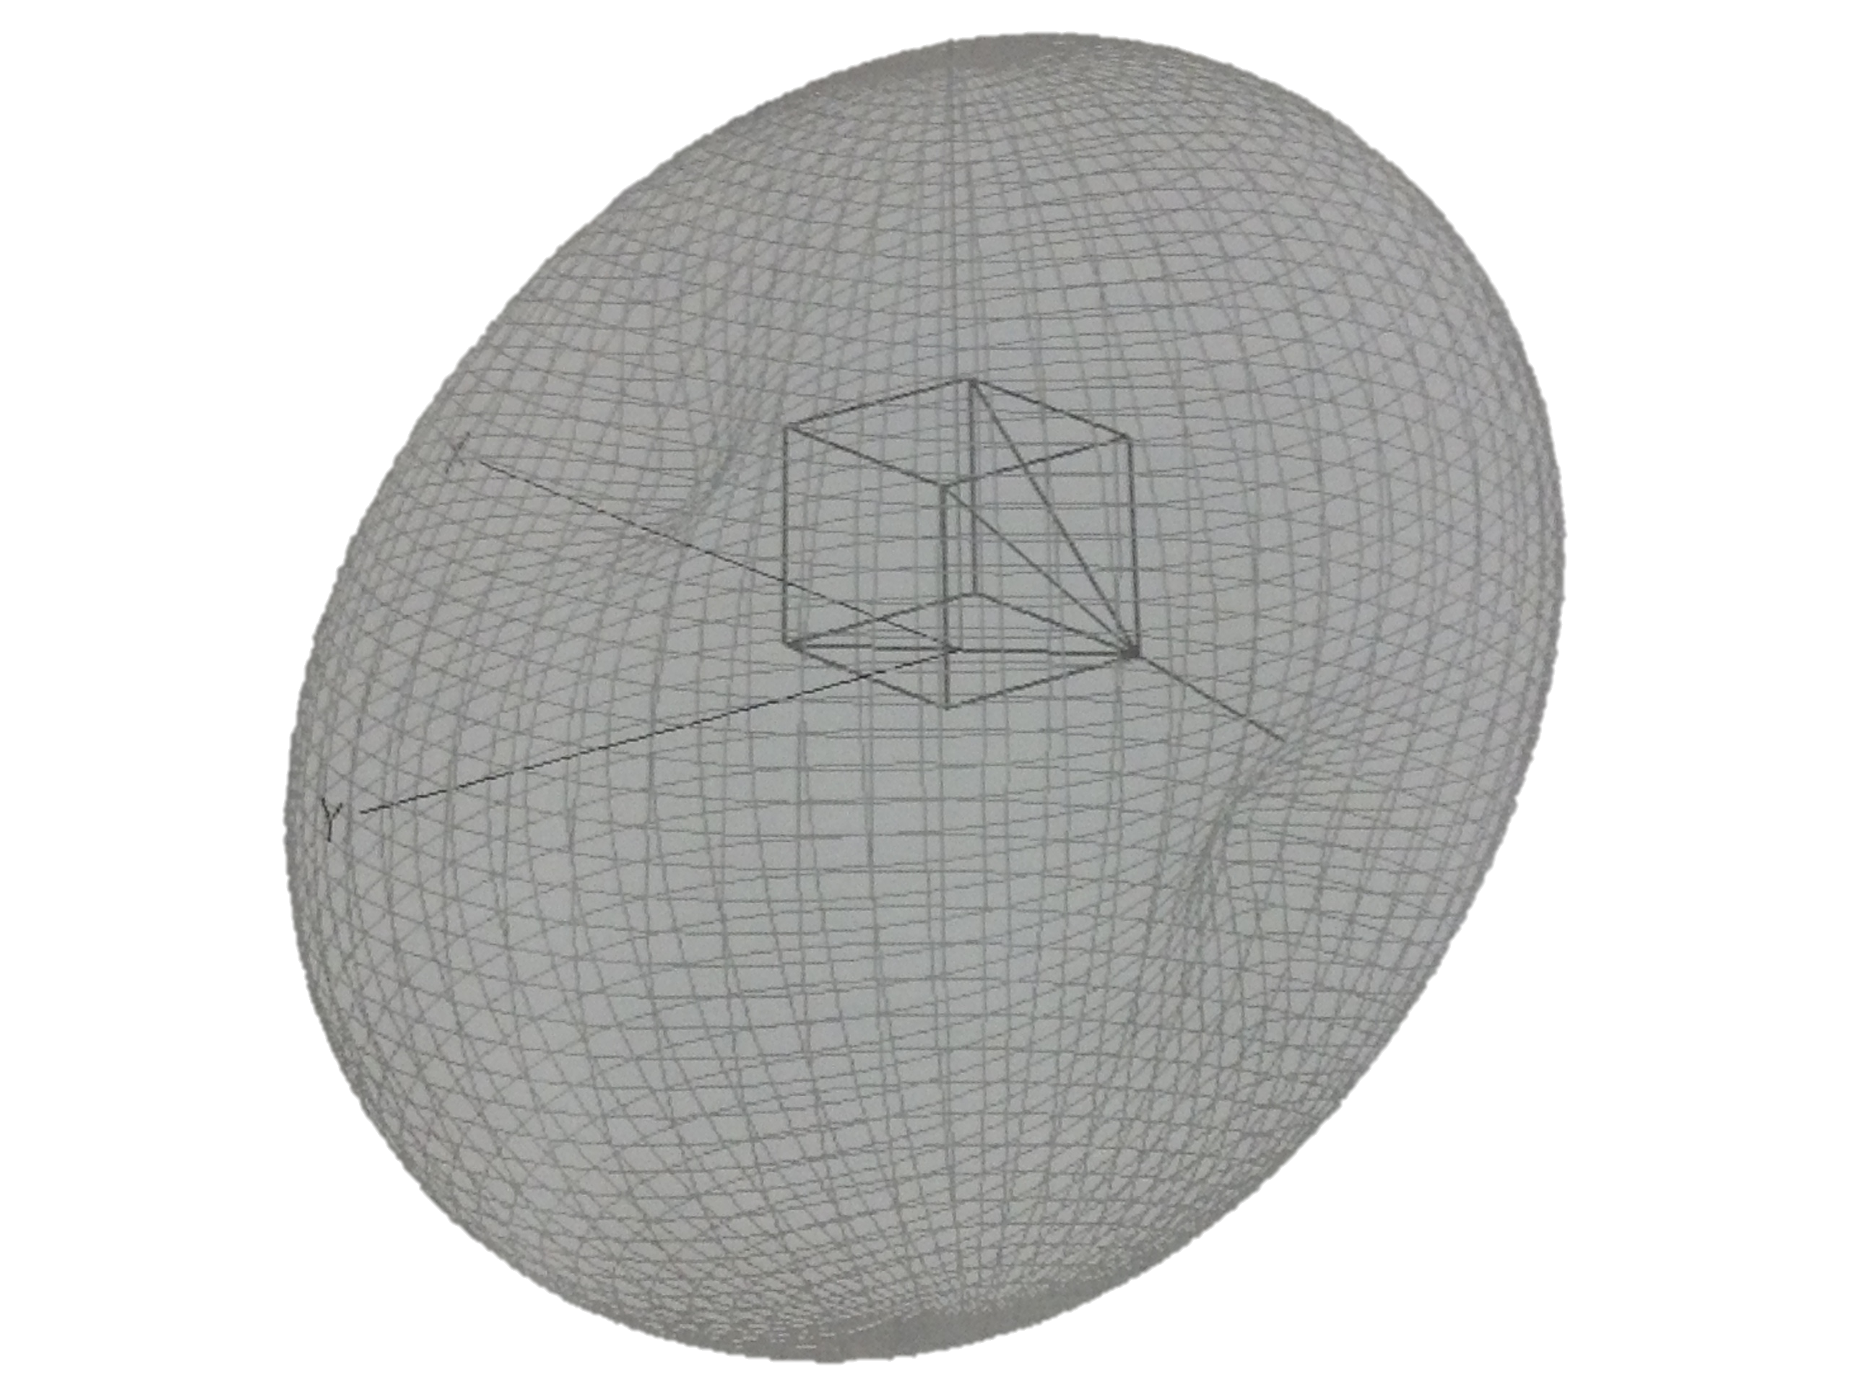
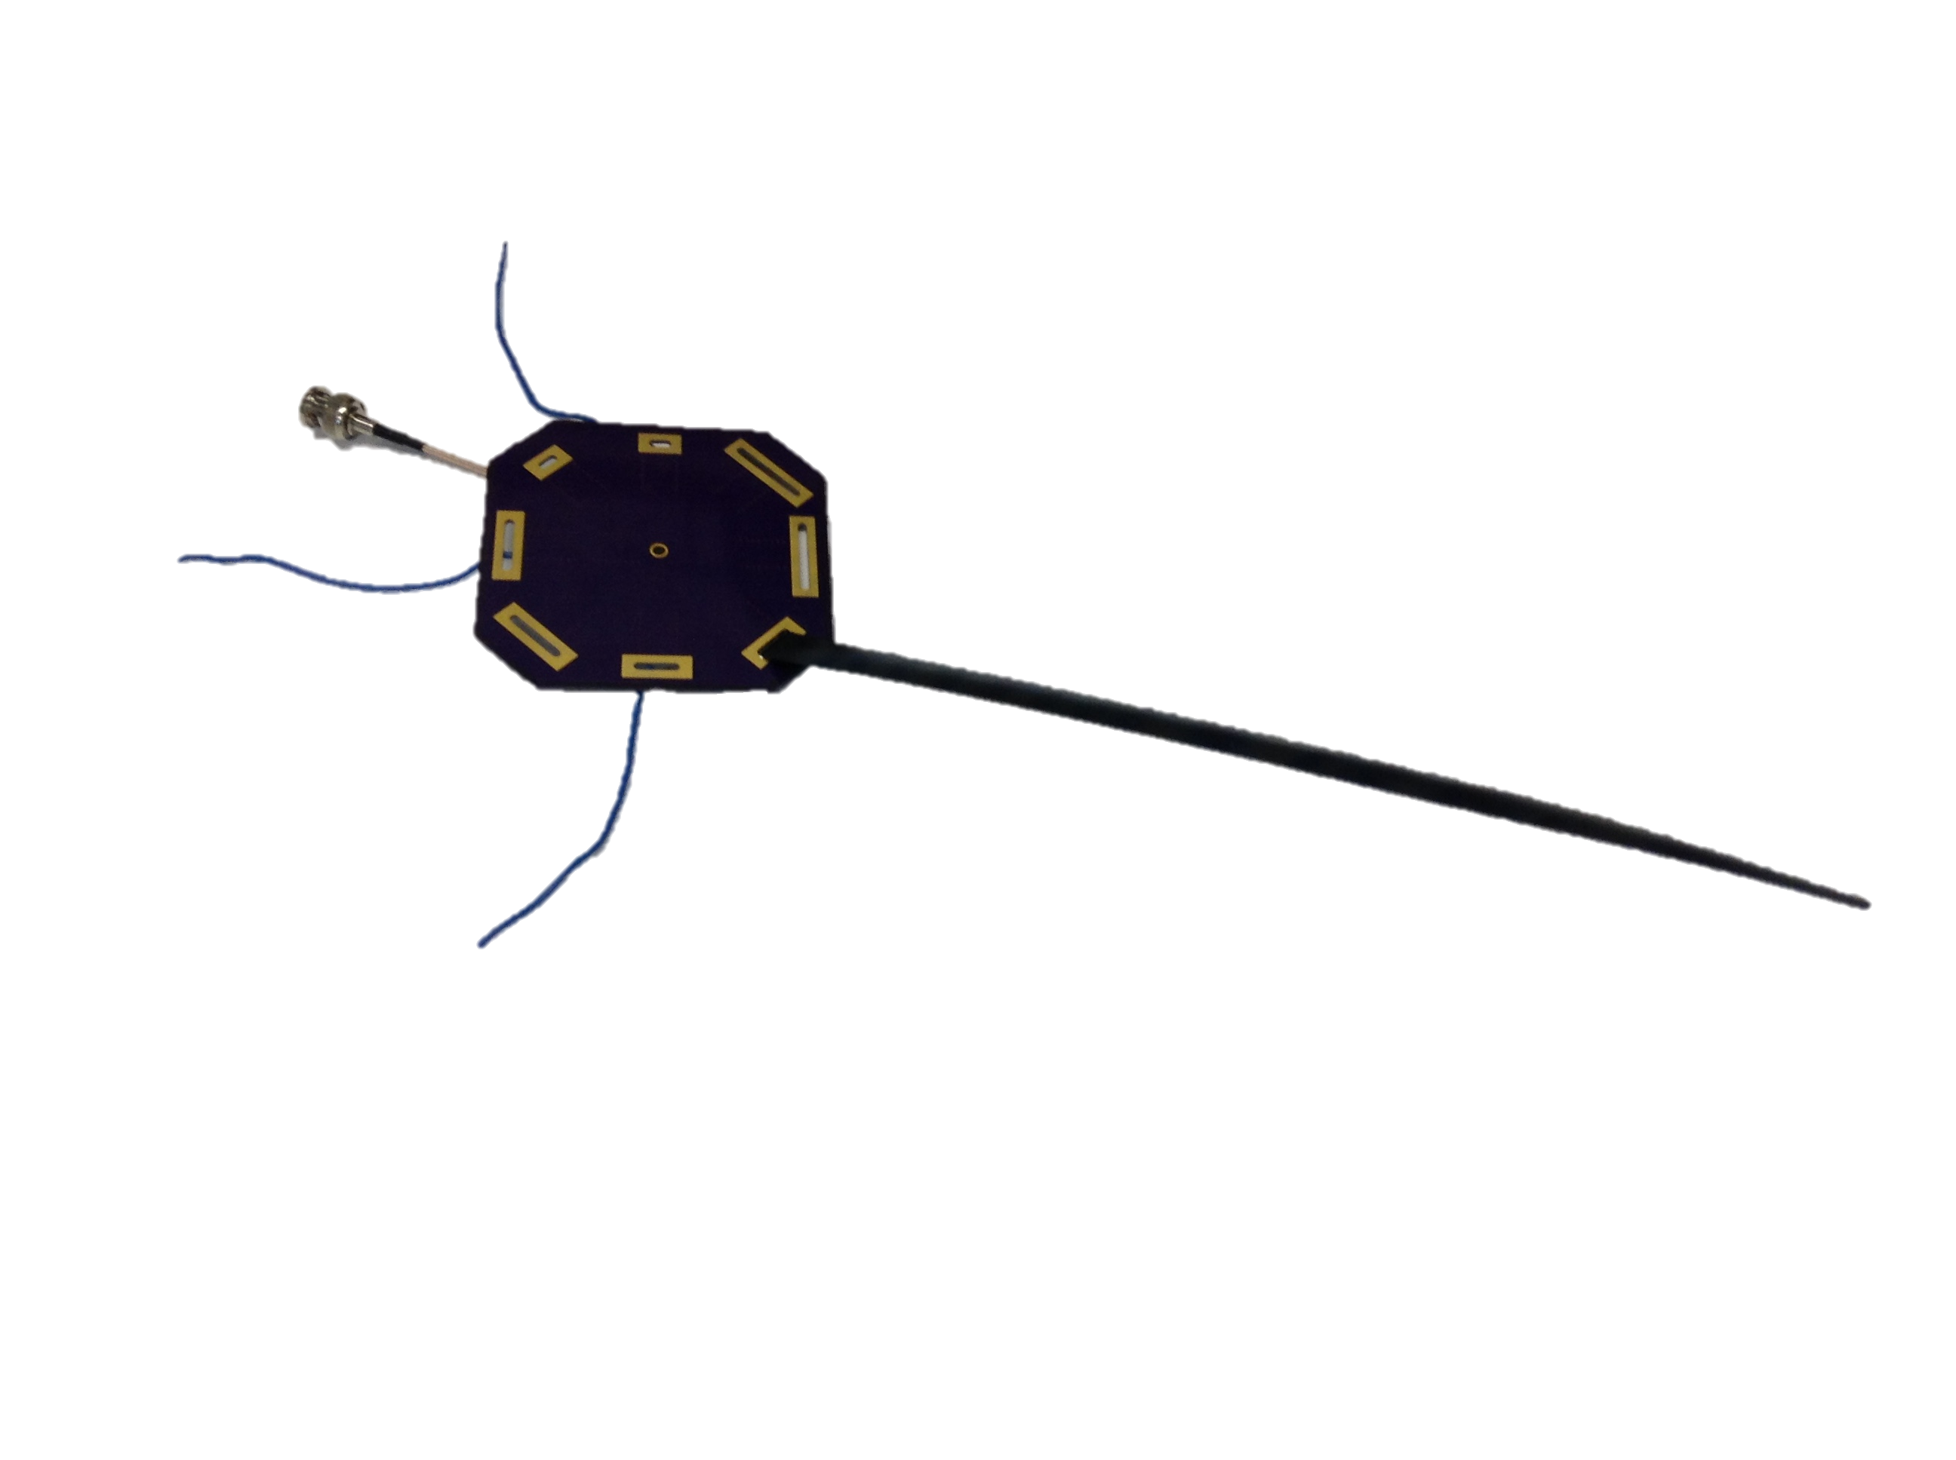
Antenna Position #3: Corner Mount

Slide 13
Antenna Position #3: Corner Mount
Most difficult to attach, but best radiation pattern
May interfere with rail clearance in the launcher

Slide 14
Monofilament Deterioration Overview
Purpose: Deployment mechanism
Monofilament to hold down antenna before deployment
Goal: Deterioration under ultraviolet radiation in case of failure of nichrome wire burn system
Materials & Testing
4-12 lb Test Monofilament Fishing line
96 Watt UV light source to simulate space radiation

Slide 15
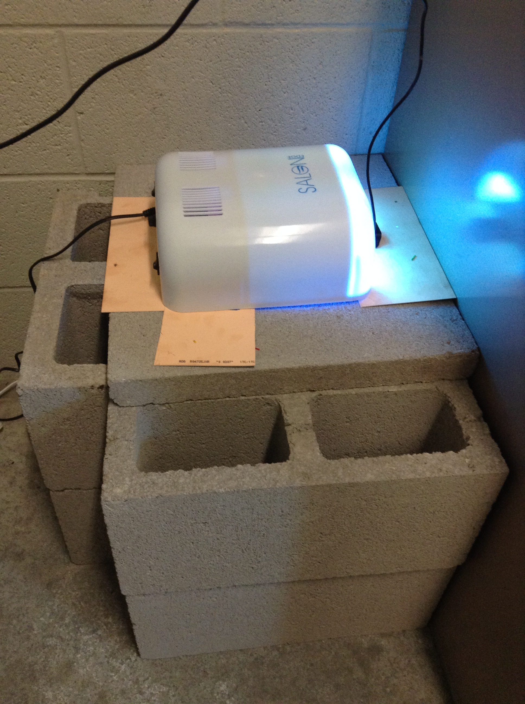
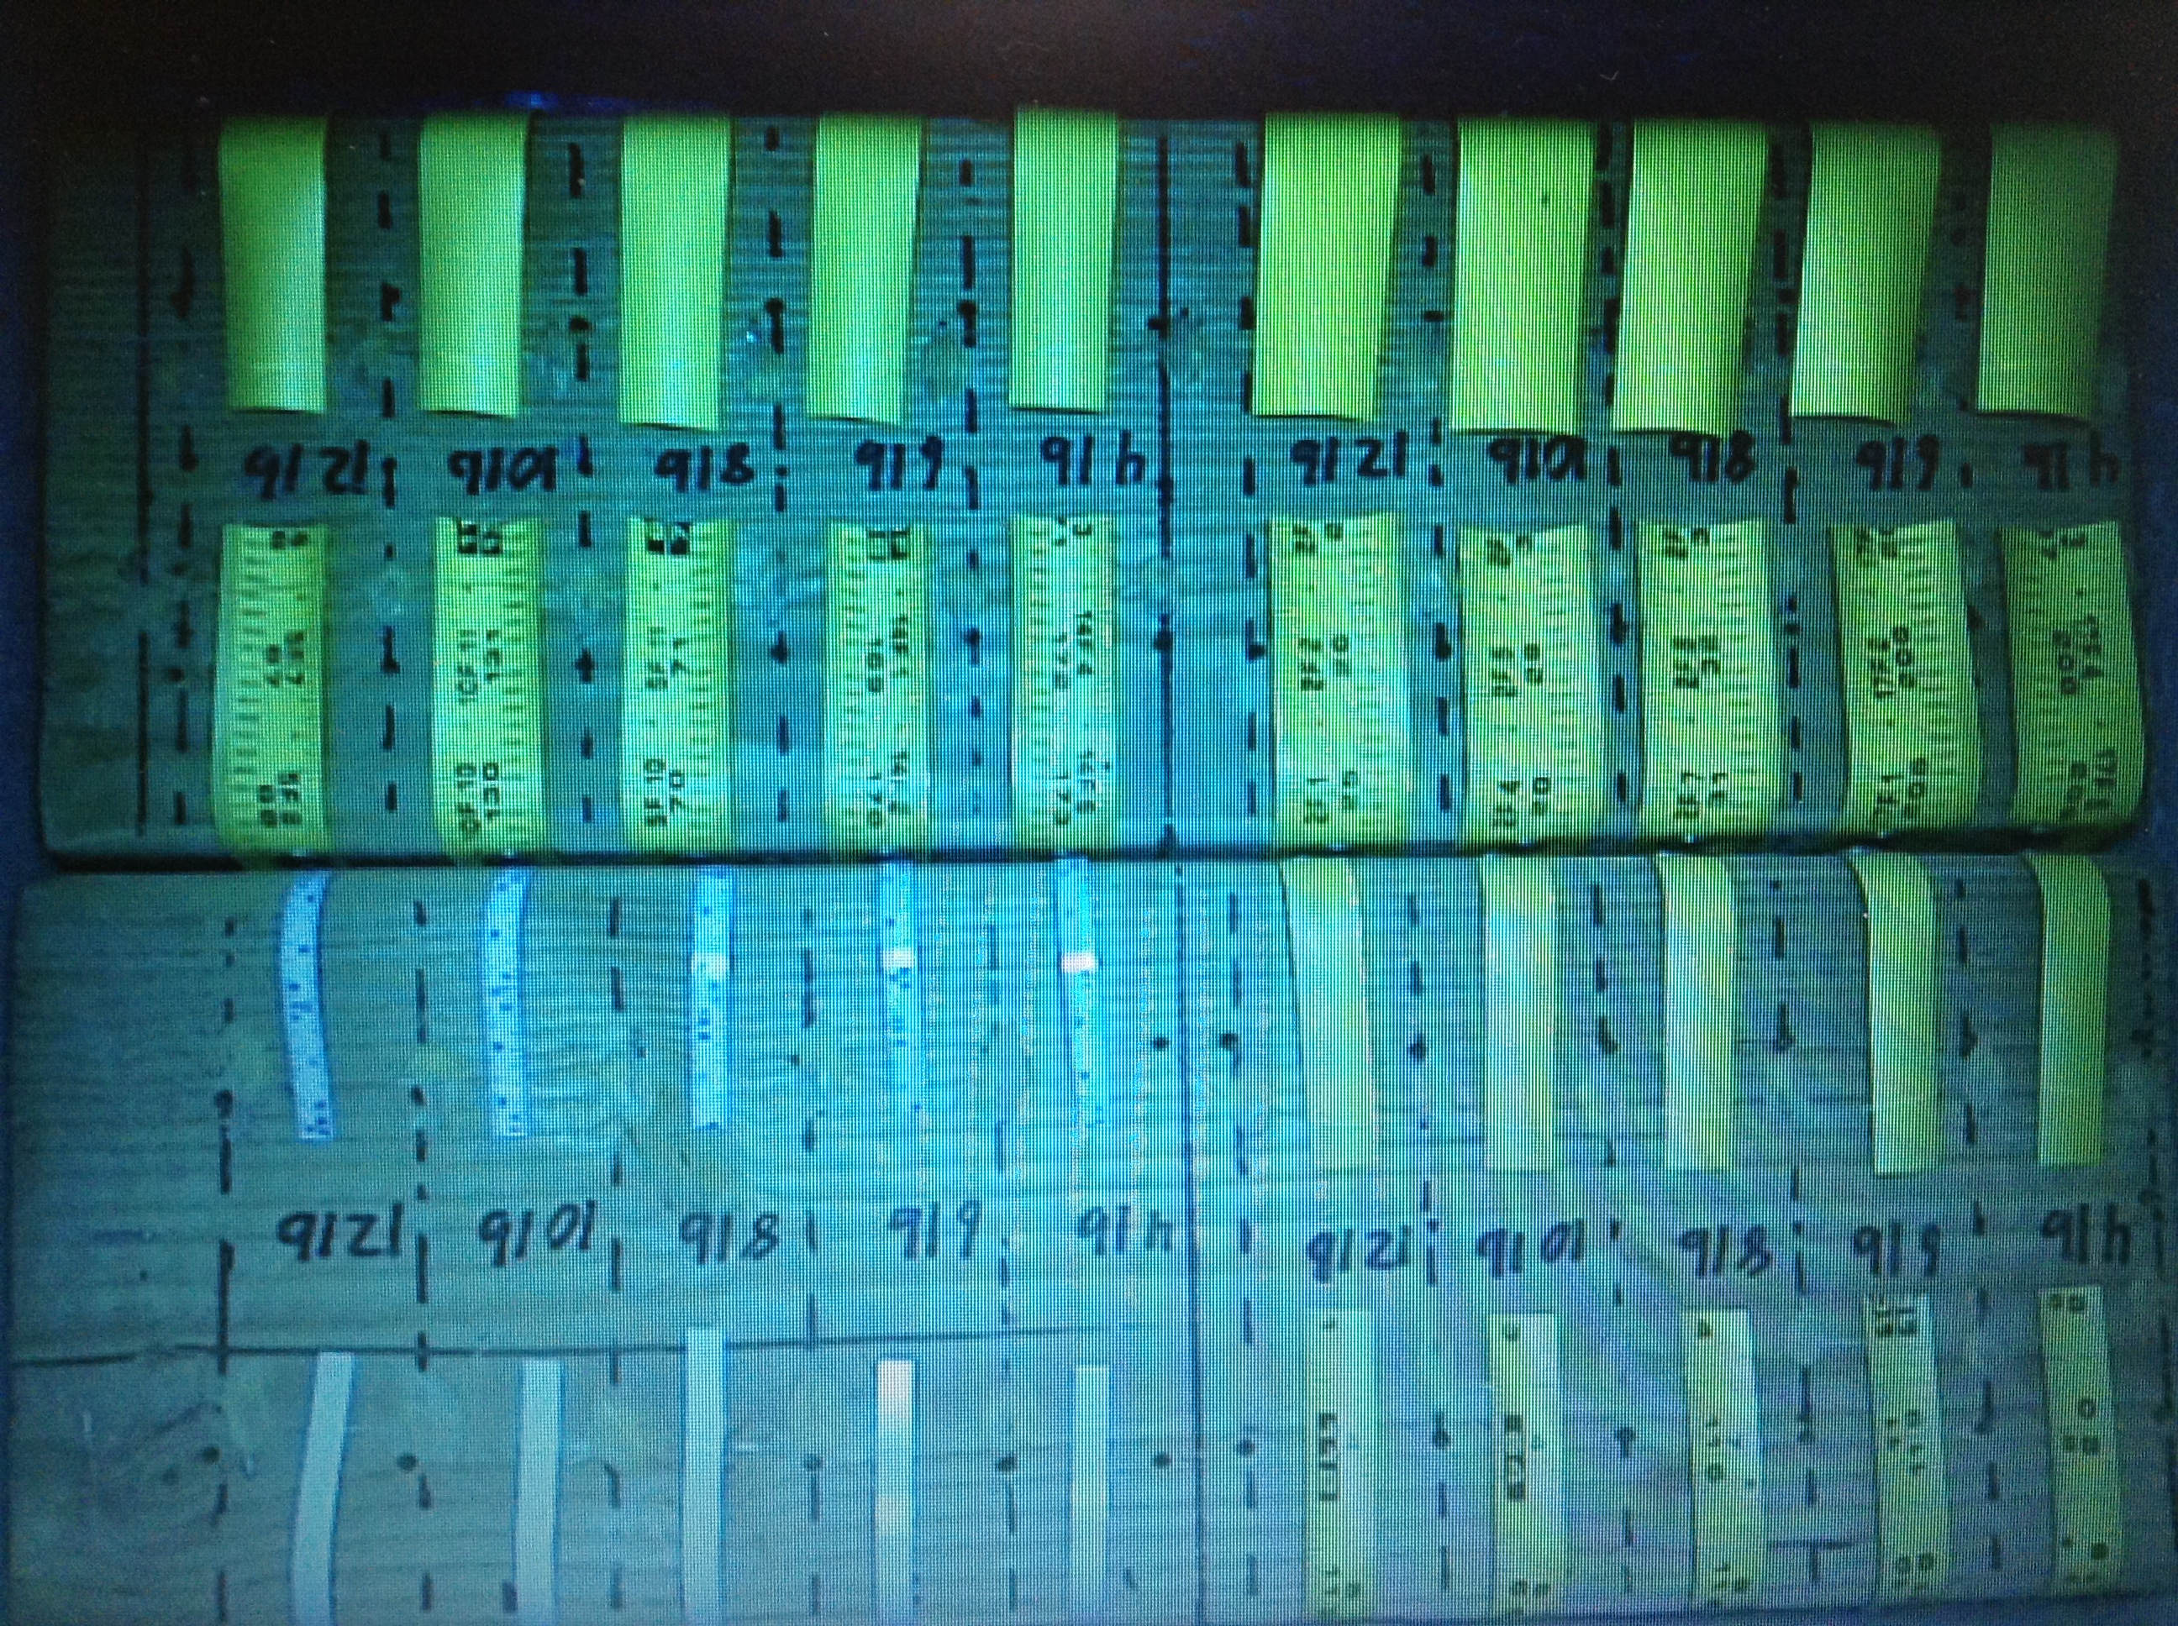
Testing Setup

Slide 16
Monofilament Deterioration Testing & Results
Current testing status
Monofilaments holding down different widths of antenna tape measure in different orientaions
UV radiation light source currently active
Testing results
No results on deterioration yet
Testing continuing
Notes:
Testing results: Hopefully some of the wires will snap

Slide 17
Current Progress - Antenna Prototyping
Monopole antenna
27.20175 cm quarter wavelength
436 MHz radio center frequency
Tape measure design
1”, ¾”, ½”, ¼”
Varied widths result in varied bandwidth
Wider tape measures allow for easier tuning

Slide 18
Current Progress - Antenna Testing and Integration
Standing Wave Ratio Testing
Used to determine effectiveness of antenna at frequency and offset
Signal Strength Testing
Field Test conducted by taking signal strength measurements 360° around the antenna at 10’ increments out to 100’
Satellite mounted in center of plot 10’ off the ground

Slide 19
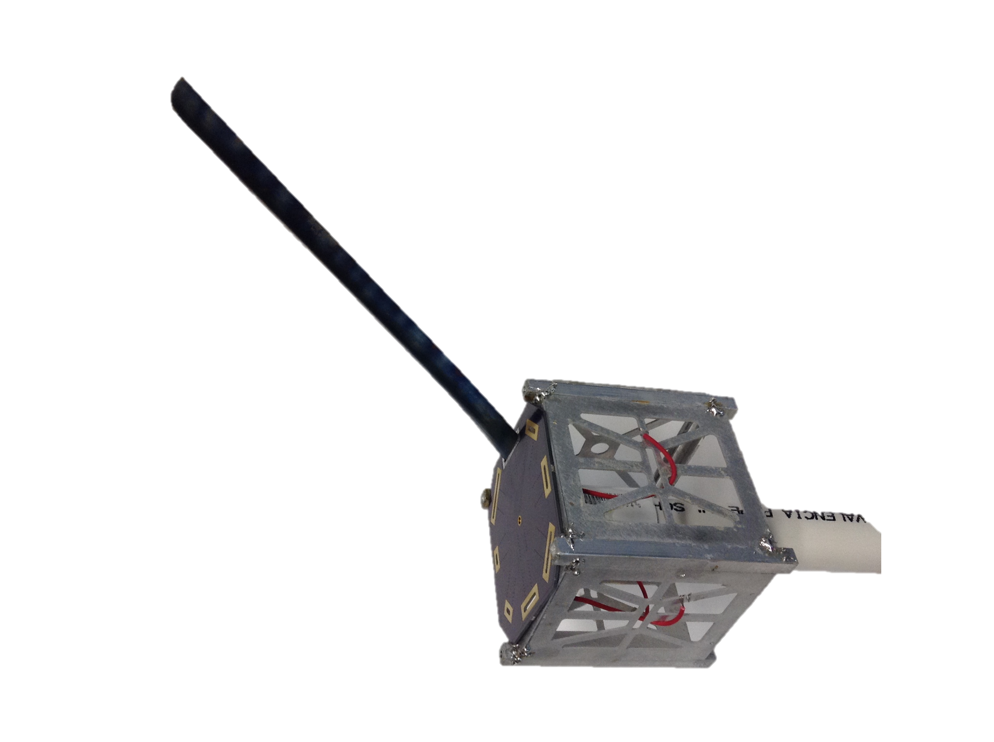
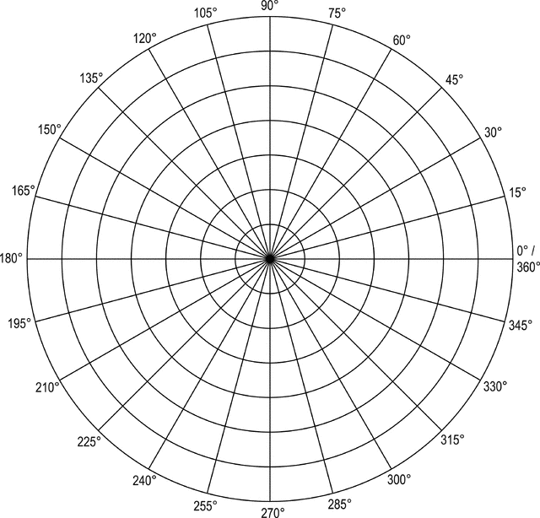
Antenna Testing Rig & Ground Simulant

Slide 20
Space Readiness
Structural Testing
Thermal Testing
Vibration Testing
Complete System Integration
High altitude balloon (HASP)
Complete communications system antenna
Support HASP field testing

