Slide 1
ASU ASCEND Sensors and Visuals
By
Mason Denney
Mentored By
Thomas Sharp

Slide 2
Chandler
Gila River
Maricopa
Casa Grande Copper Mine
Nissan Testing Course

Slide 3
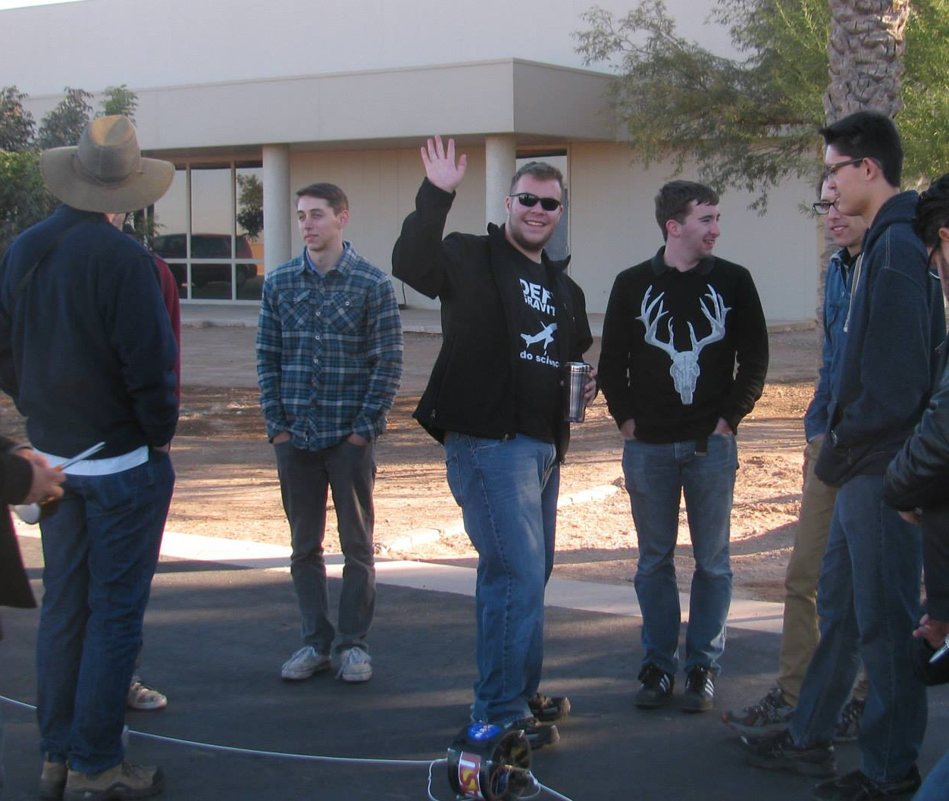
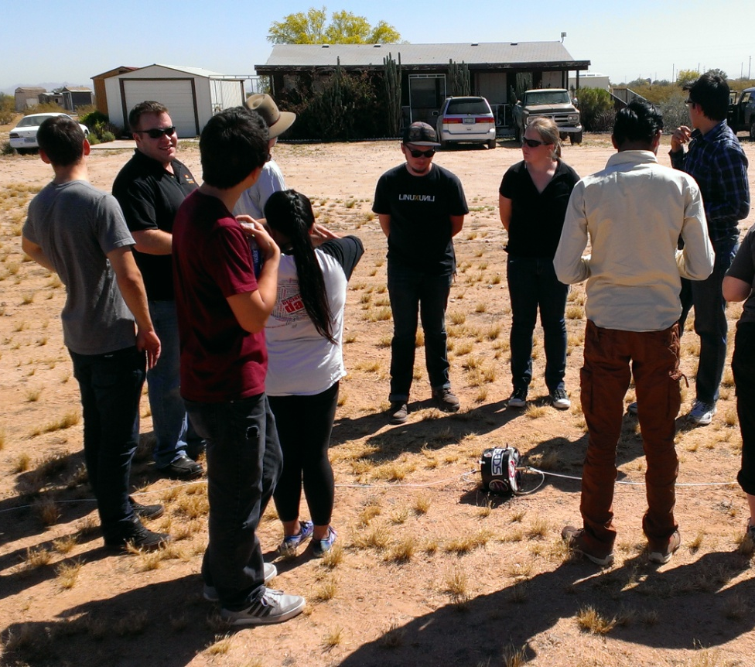
The Team
~12 Members

Slide 4
Recent Flight History
Fall(2012)
Flip camera failure, sensor success, bike seat fuselage
Spring(2013)
Hack HD success, sensor failure, box fuselage
Fall(2013) &
Hack HD failure, sensor success, teardrop fuselage
Spring(2014)
Hack HD failure, sensor success, teardrop fuselage

Slide 5
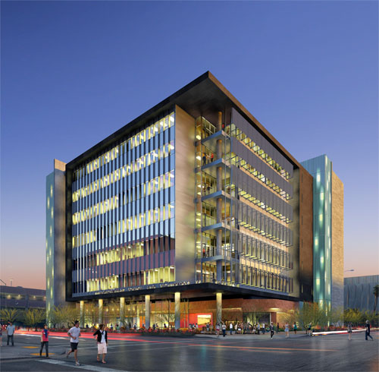
2014-15 Objectives
Fuselage comparison
Teardrop vs. Cylinder
Add new types of environmental data
Geiger Counters, UV
Reliable cameras
360° Panorama
Outreach at ISTB4

Slide 6
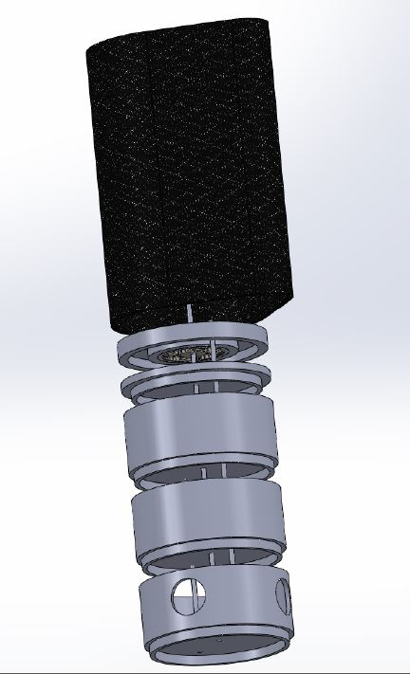
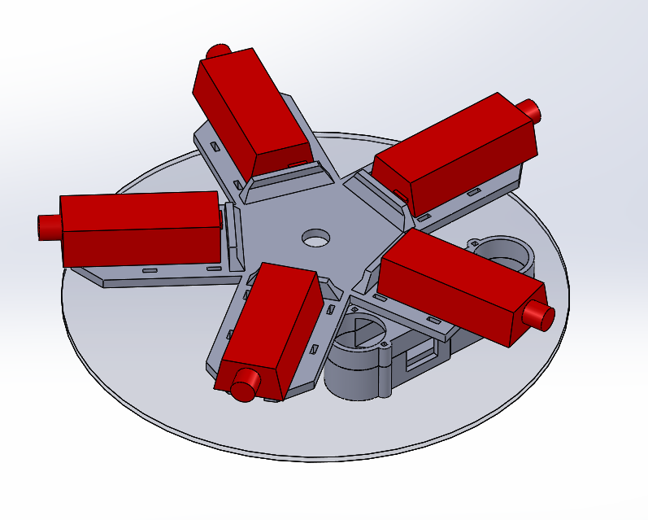
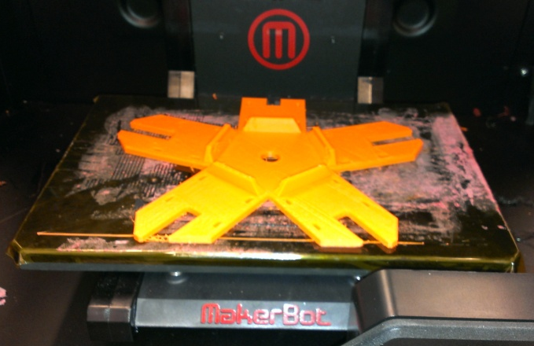
New Fuselage and Support
Wind Stabilization
Unobstructed Panorama
Dependable Materials
3D Support Structure

Slide 7
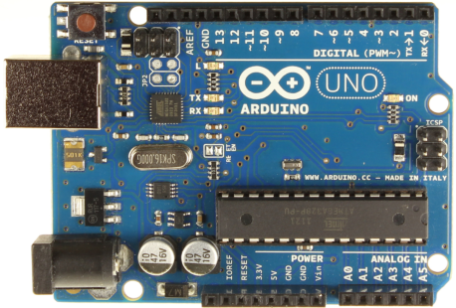
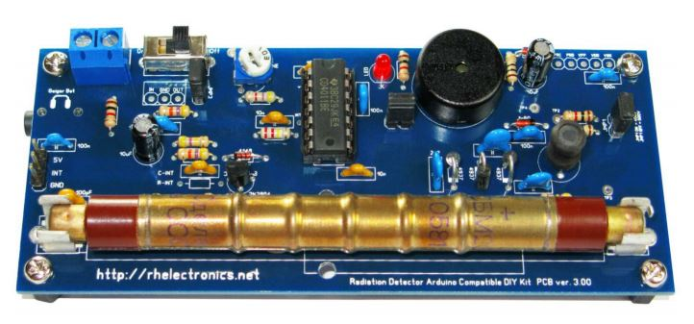
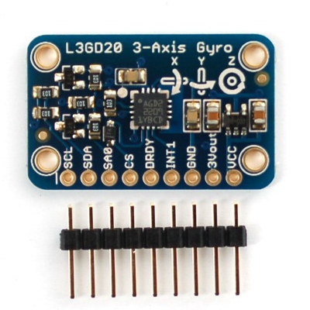
Sensors
Arduino Uno
Barometer
Altitude
Temperature
Air Pressure
Accelerometer
Gyroscope
UV Sensor
Geiger Counter
SBM-20

Slide 8
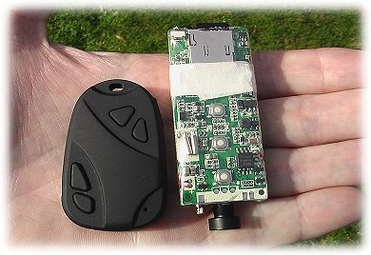
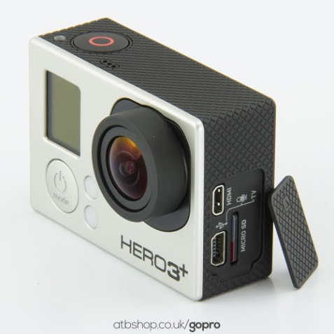
Cameras
Hack HD replaced by HD Wing
GoPro Hero3+ Black

Slide 9
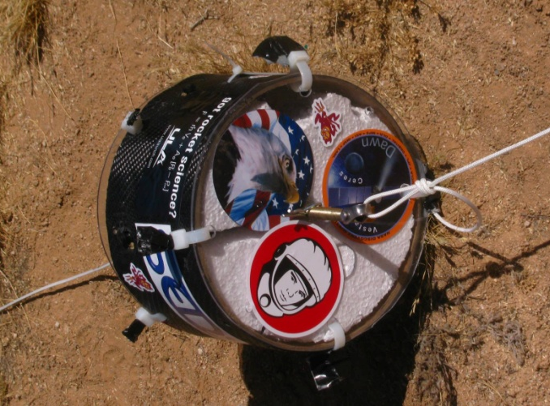
The Payload

Slide 10
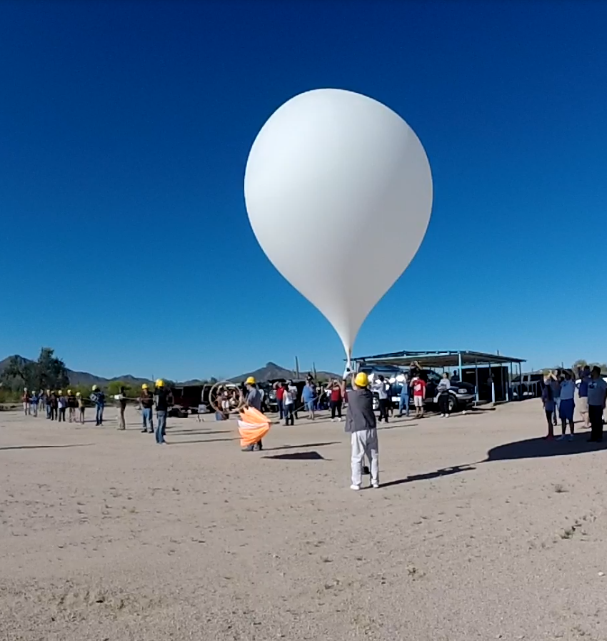
Launch and Retrieval

Slide 11
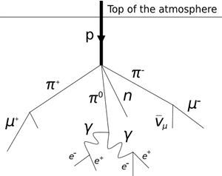
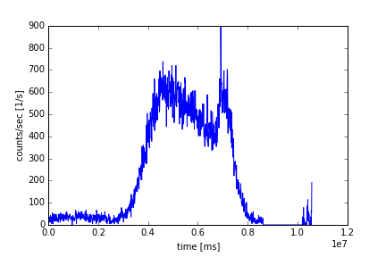
Data Processing - Geiger Counter
with Python

Slide 12
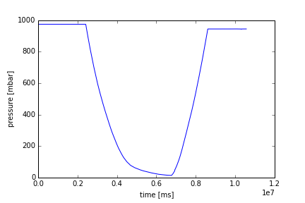
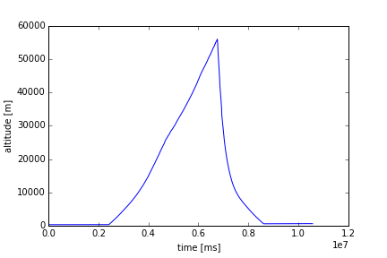
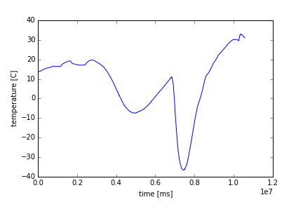
Data Processing - Barometer

Slide 13
Camera Footage
Visual cameras worked!
Youtube: ASU/NASA Space Grant
Processing panorama

Slide 14
Conclusion
2014-15
Success!
Processing data
2015-16
New Sensors
More 3D printed parts

Slide 15
Thank You!
Questions?

