Slide 1
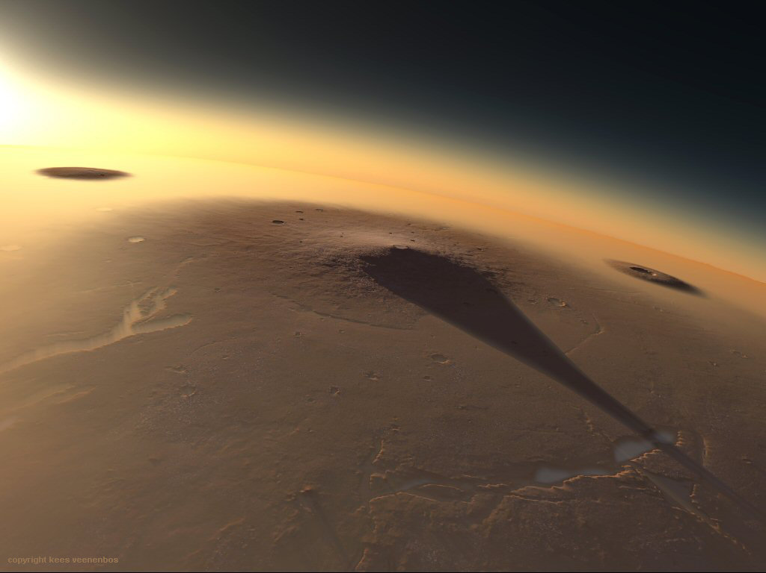



Estimating the Age of Lava
Flows on Mars
Mark Buxton, University of Arizona

Slide 2
Background:
Thermal Evolution of Mars
Volcanic eruptions on Mars are expected to be larger than those on Earth
  Relative to the Earth, Mars’ lower gravity, lower lithospheric bulk density, and thicker crust would favor larger magma chambers located at greater depth
  Volcanic eruptions on Mars are expected to have magma effusion rates that are five times larger than on the Earth (Wilson and Head, 1994)
  Consequently, martian lava flows should be more infrequent, but larger than on the Earth
Notes:
Volcanic eruptions on Mars are expected to be larger than those on Earth
Relative to the Earth, Mars’ lower gravity, lower lithospheric bulk density, and thicker crust would favor the accumulation of larger magma chambers at greater depth
Volcanic eruptions on Mars are expected to have magma effusion rates that are five times larger than on the Earth (Wilson and Head, 1994)
Consequently, martian lava flows should be more infrequent, but larger than on the Earth

Slide 3
Study Area:
Cerberus Fossae 2 Unit
The Cerberus Fossae 2 Unit is:
  Located within Elysium Planitia
  The second youngest major flood lava on Mars
  (125 Ma ± a factor of 2 uncertainty)
  It’s area and total volume is comparable to that of large igneous provinces on Earth (475,000 km², 14,000 km³)
            For comparison the Deccan Traps cover 512,000 km²
            with a total volume of 512,000 km³; however, these lava
            were emplaced during numerous eruptions

Slide 4
Testable Hypothesis:
Cerberus Fossae 2 Unit
Hypothesis:
  The Cerberus Fossae 2 unit is composed of a single lava flow, comparable to the area of the Deccan Traps, but much thinner (~30-m-thick). Nonetheless, as a single flow, the large volume of this unit would imply a large magmatic source and high lava effusion rates
Counter-Hypothesis:
  The Cerberus Fossae 2 unit is composed of numerous lava flows, each smaller in volume than the overall dimensions of the unit. This would imply a smaller magmatic source region and lower lava effusion rates.

Slide 5
Method of Testing the Hypothesis
The population density of impact craters generally increases with time
Variations in the spatial density of impact crater and their size-frequency relationships may therefore be used to assess the distribution of surface ages within a region
The goal of this work is therefore to digitally map the distribution of impact craters (D > 100 m) within the Cerberus Fossae 2 unit to determine if its surface has a single age

Slide 6
Adding Value to Impact Crater Mapping
In addition to mapping crater locations and sizes, they were classified into four classes:
  Primary: craters created by the first impact of the meteoroid with the surface, these craters tend to be symmetrical and isolated (i.e, randomly distributed)
  Secondary: craters made by the debris that is ejected by primary impacts, these secondary craters tend to be irregular in plan-view and occur in groups
  Mantled: Primary impact craters that wwere “draped” by younger lava flows
  Older craters: Primary impact craters surrounded by younger lava flows (i.e., kipuka)

Slide 7
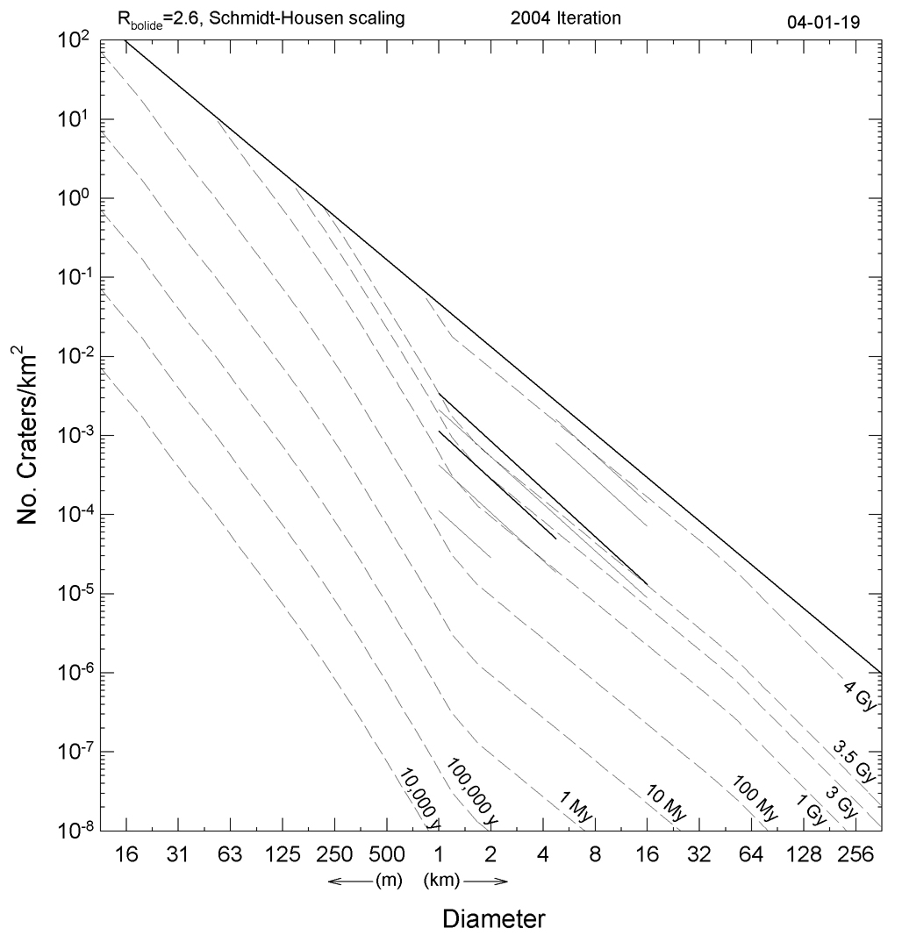
Crater Isochron Diagrams:
Theory
Source: Hartmann

Slide 8
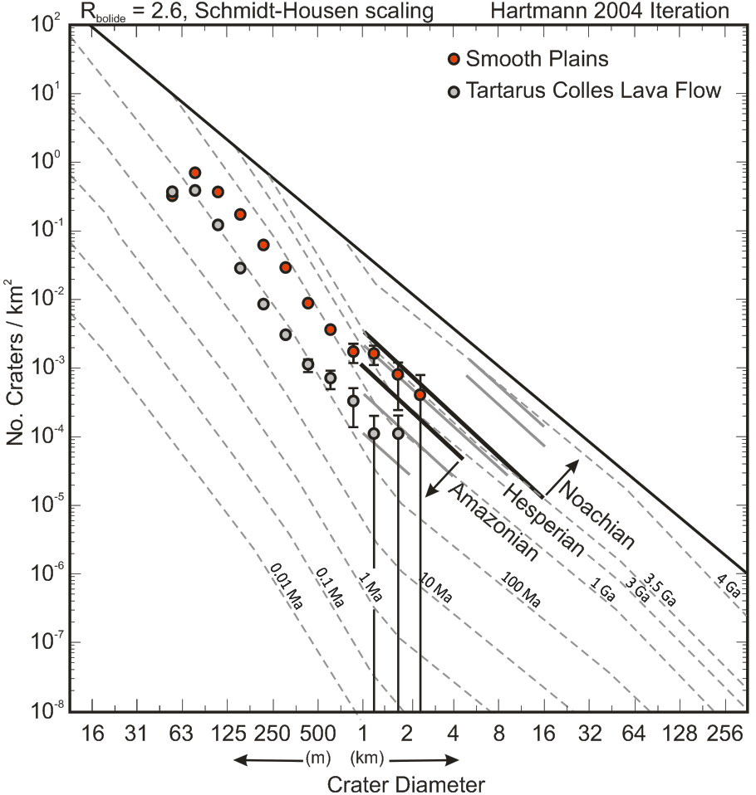
Crater Isochron Diagrams:
Results
Cerberus Fossae 2 unit (62.5–250 Ma)
Elysium Rise unit
Early Amazonian to Early Hesperian

Slide 9
Mapping Using Context Camera (CTX) Images
Used ArcGIS and USGS Crater Helper Tools to map impact craters within the Cerberus Fossae 2 unit
  This has helped to move the rolloff point in the crater size-frequency distribution to smaller crater diameters
  Once mapping is completed we will be able to assess whether or not the crater size-frequency distribution includes “steps” that would imply multiple surface ages
  We will also map the spatial variation (if any) in the crater surface retention ages within the region to determine if the unit includes one or more lava flows

Slide 10
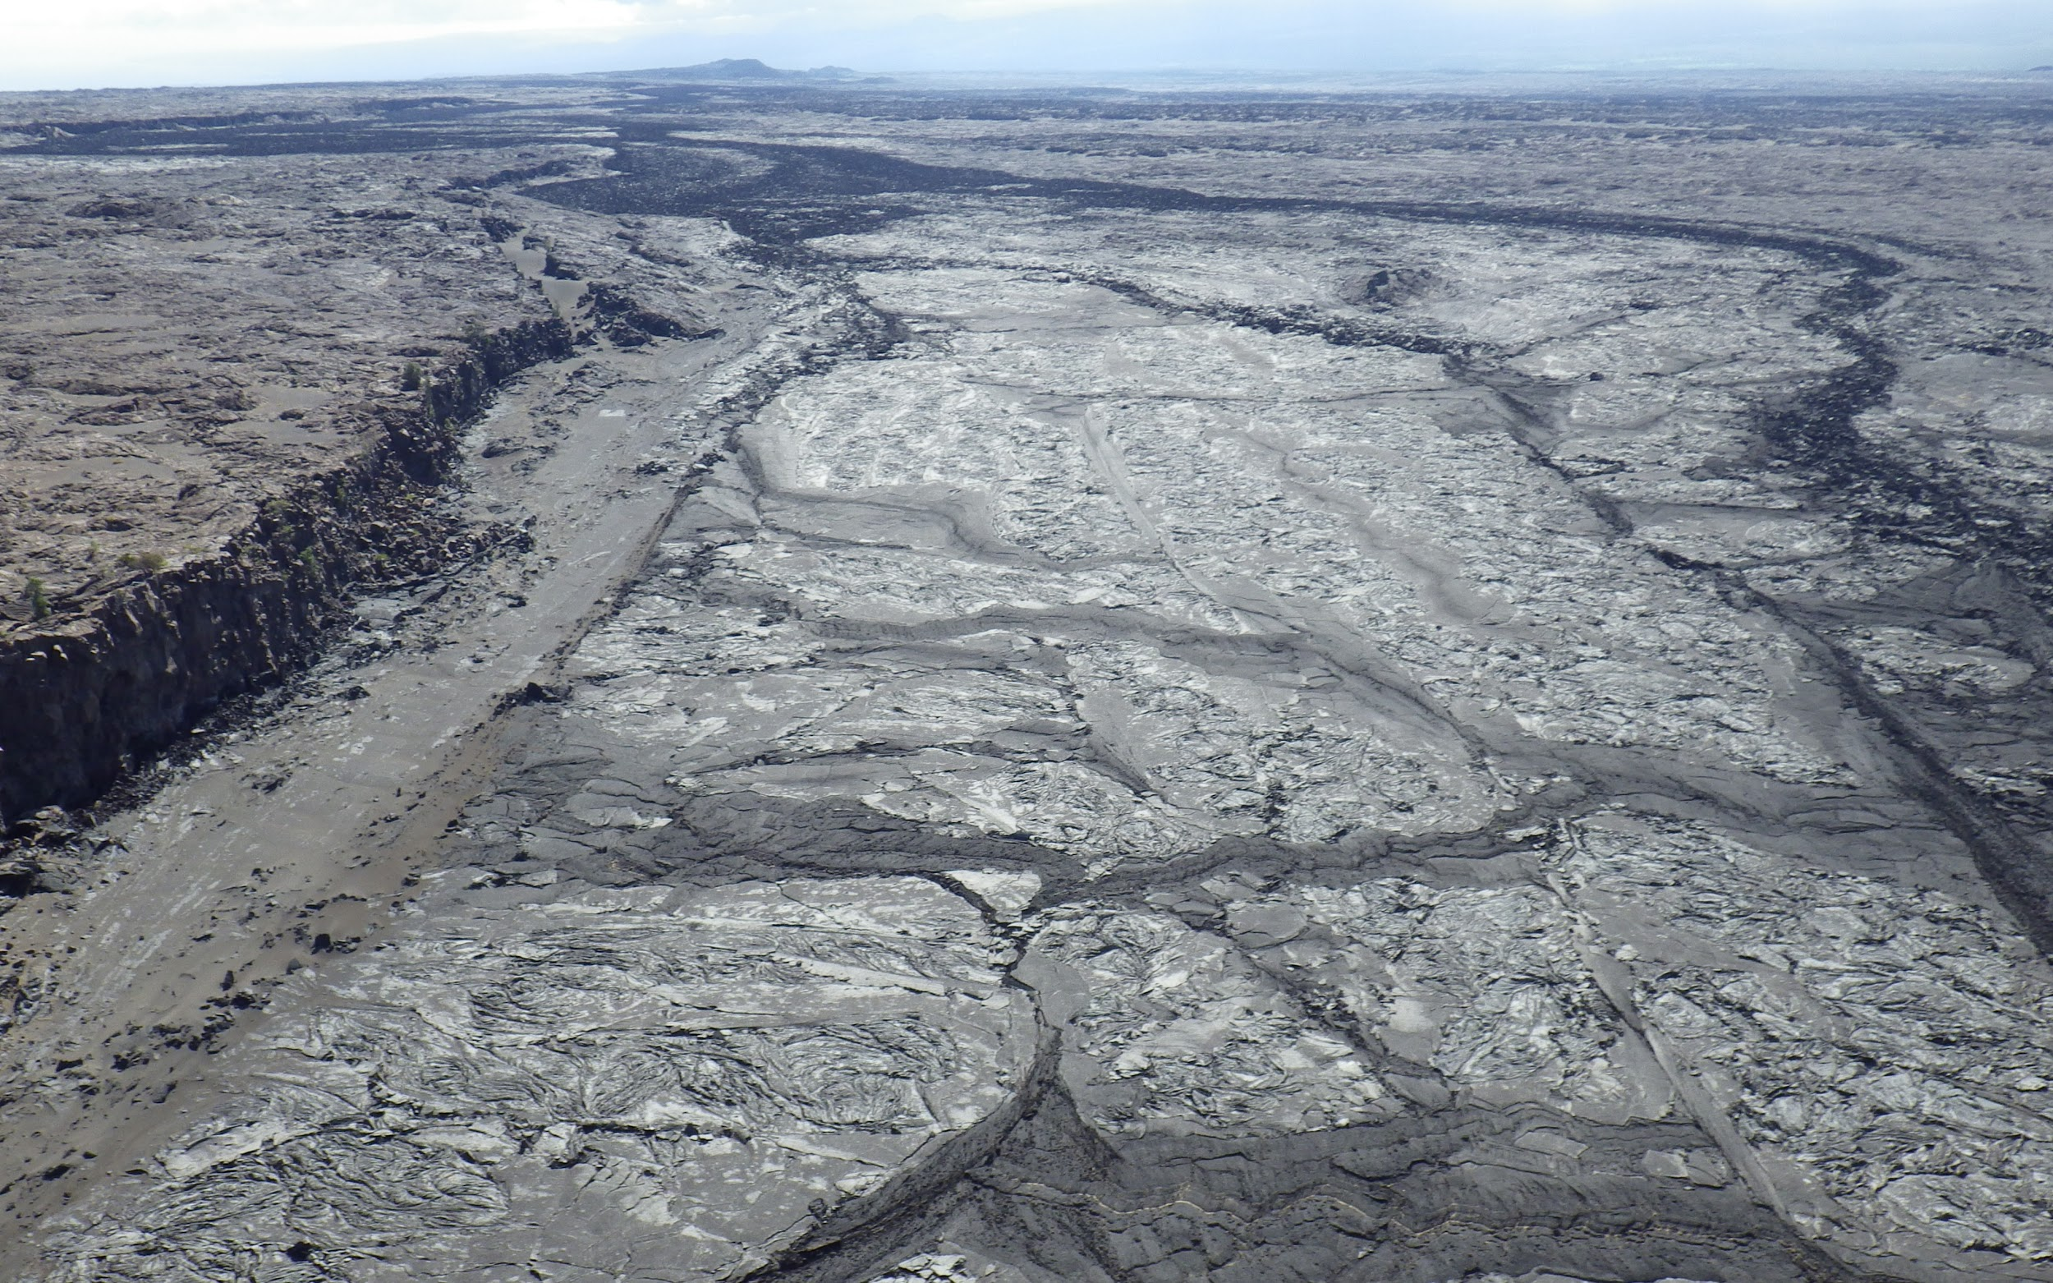
Data Visualization
Lava Flow in Hawaii
Source: Stephen Scheidt

Slide 11
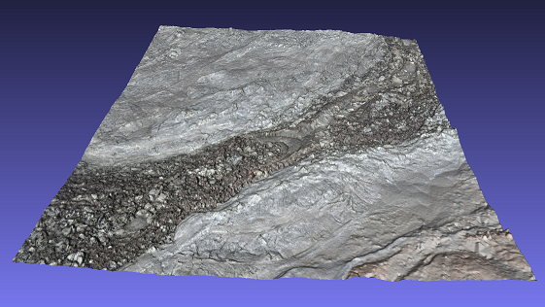
Data Visualization: 3D renders
3D render of area inside Hawaii Lava Flow

Slide 12
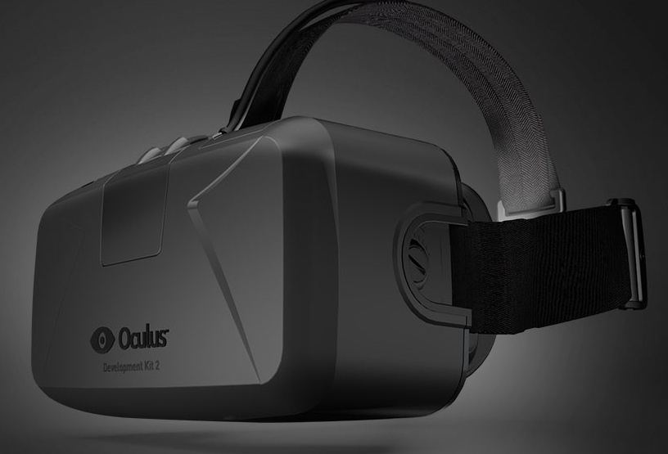
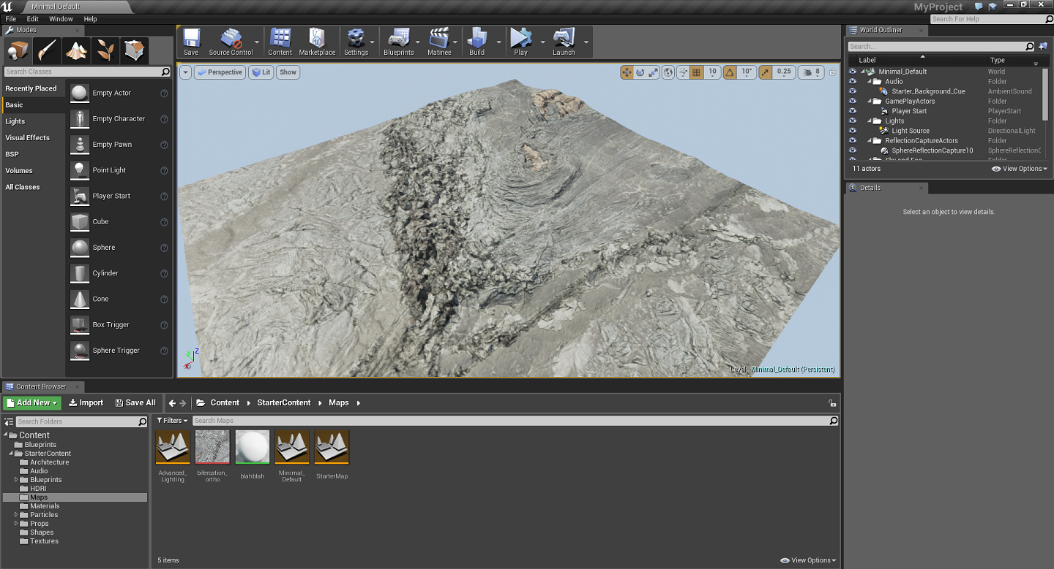
Data Visualization Using Oculus Rift and Unreal 4
Source: Oculus Vr

Slide 13
Acknowledgements
Selena Valencia, University of Arizona
Christopher Hamilton, University of Arizona
Shane Byrne, University of Arizona
Stephen Scheidt, University of Arizona
Leon Palafox, University of Arizona
Susan Brew, University of Arizona / NASA Space Grant Program

