Slide 1
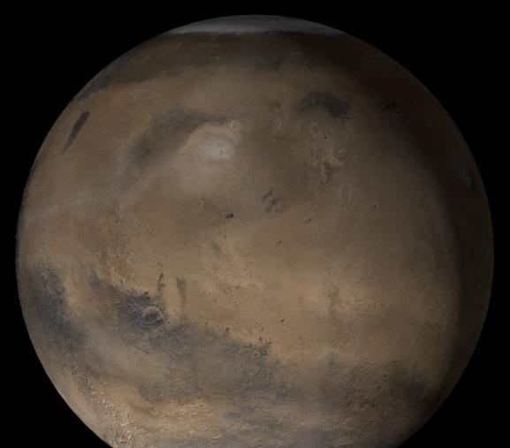



Age Estimation on Mars: Using Digital Surveying of Impact Craters
Selena Valencia, University of Arizona
Photo Courtesy of Tuts Photography, Envato Pty. Ltd.

Slide 2
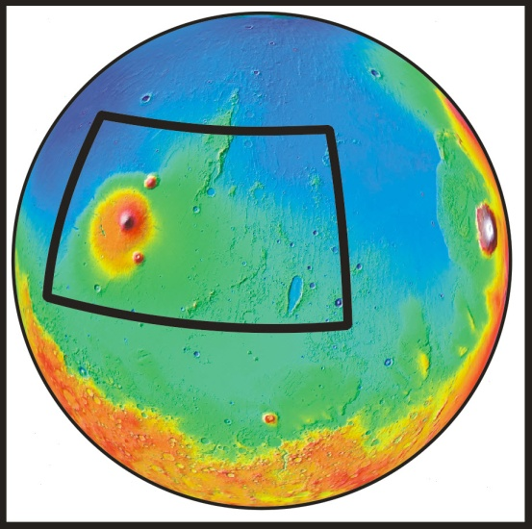
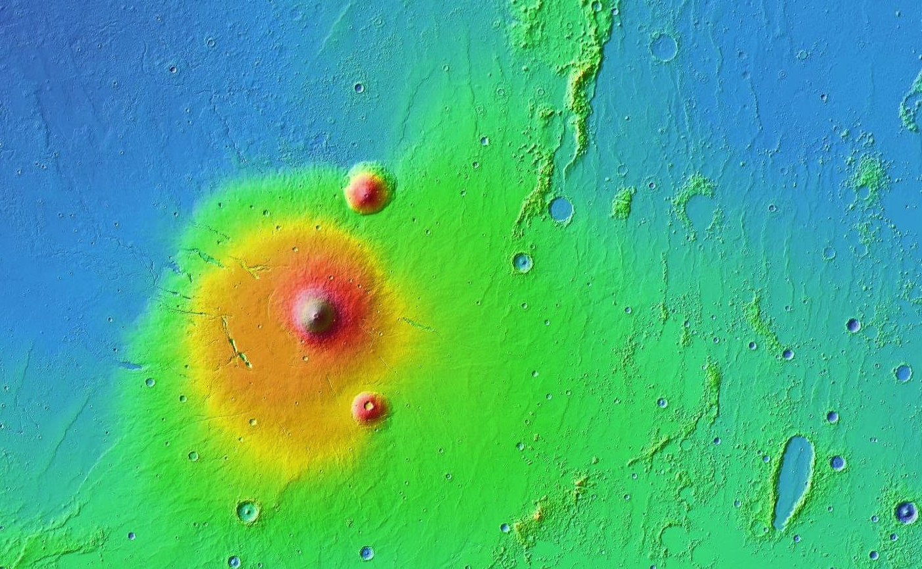
Elysium Volcanic Province
1000 km
9 km
Elevation
0 km
-9 km
MOLA Digital Terrain Model of Elysium Planitia, Mars

Slide 3
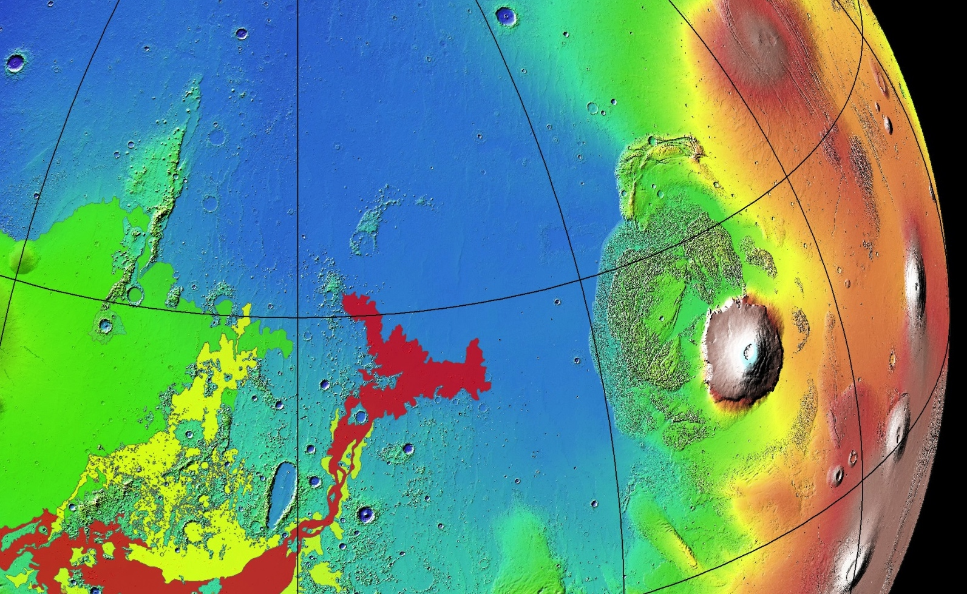
Elysium Volcanic Province
Elysium Rise unit
Cerberus Fossae 2 unit
Cerberus Fossae 3 unit
The Cerberus Fossae 2 unit is the second youngest major flood lava unit on Mars

Slide 4
Motivation
Cerberus Fossae 2 Unit covers ~475,000 km² and has a volume of ~14,000 km³
This volume is nearly five times larger than the largest flood lava unit with Columbia River Basalt Group on Earth
This raises two important questions:
  Is the Cerberus Fossae 2 unit really composed of just one major lava flow?
  If so, why is this flood lava unit so large?
Notes:
Cerberus Fossae 2 Unit covers ~475,000 km² and has a volume of ~14,000 km³
This volume is nearly five times larger than the largest flood lava unit with Columbia River Basalt Group on Earth
This raises two important questions:
Is the Cerberus Fossae 2 unit really composed of just one major lava flow?
If so, why is this flood lava unit so large?

Slide 5
Goals
Instead of considering the size-frequency distribution of impact craters within the Cerberus Fossae 2 unit as a whole, the goals of this project are to:
  Digitize all craters in the region larger than D >100 m
  Categorize all of the craters into one of 4 classes: primary, secondary, lava-mantled, or an exposed older surface
  Determine the spatial variability in crater retention ages within the unit to determine if it is composed of one or more lava flows
Notes:
Instead of considering the size-frequency distribution of impact craters within the Cerberus Fossae 2 unit as a whole, the goals of this project are to:
Digitize all craters in the region larger than D >100 m
Categorize all of the craters into one of 4 classes: primary, secondary, lava-mantled, or an exposed older surface
Determine the spatial variability in crater retention ages within the unit to determine if it is composed of one or more lava flows

Slide 6
Methods
ArcGIS − A Geographic Information System (GIS) program used for geologic mapping
USGS Crater Helper Tools − A plug-in for ArcGIS
A regional base-map of Mars Reconnaissance Orbiter (MRO) Context Camera (CTX) images (6 m/pixel resolution)
CraterStats 2 − A program used to estimate surface ages using crater size-frequency relationships

Slide 7
Results
Previously 30,000 Craters had been digitized
I digitized 4,129 craters
My colleague, Mark, digitized 3,761 craters
Mark will present the preliminary age estimates
Future work will involve continued digitization of craters throughout the region with the goal of mapping all craters larger than D > 100 m

Slide 8
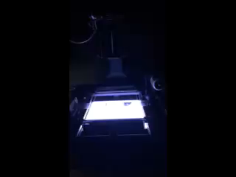
Digitizing and archiving of Surveyor Moon Mission Data Images

Slide 9
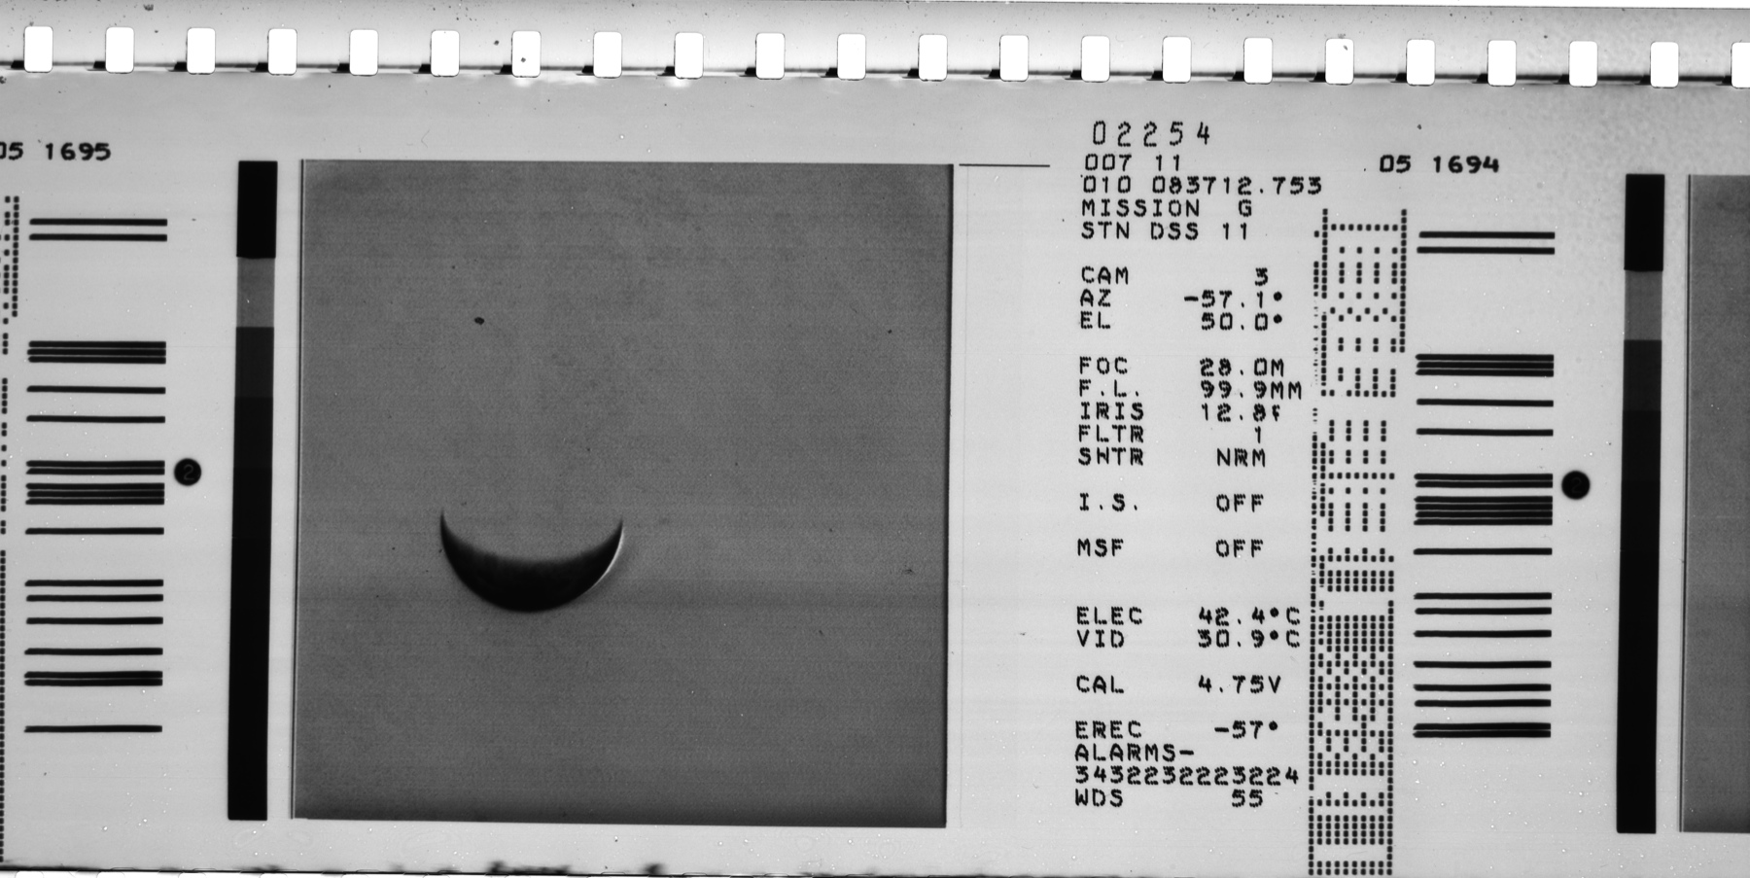
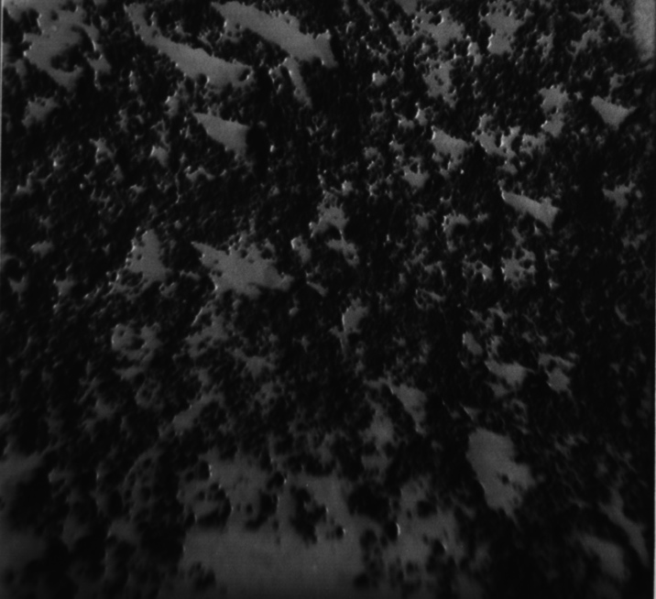
Original Images Courtesy of NASA, JPL

Slide 10
Acknowledgements
Mark Buxton, University of Arizona
Christopher Hamilton, University of Arizona
Shane Byrne, University of Arizona
Stephen Scheidt, University of Arizona
Leon Palafox, University of Arizona
Susan Brew, University of Arizona / NASA Space Grant Program

