Slide 1
The Effect of Cryogenic Freezing on Chymotrypsin
Sheamus John Carbone
Institutions: Northern Arizona University and Coconino Community College
Mentors: Bryan Bates and Dr. Matthew John Gage

Slide 2
Introduction
Enzymes are naturally and technologically subjected to extreme environments.
Freezing conditions influence an enzyme’s lifetime
Freeze human tissues

Slide 3
Freezing and Cryoprotectants
Why Cryogenically freezing enzymes? Preservation?
Cryopreservation of human tissue → technological intervention
Snap freezing in liquid nitrogen vs gradual freezing in freezer
Various cryoprotectants that exist in nature (frogs/glucose, insects/sugars, salamanders/glycerol) and manmade/DMSO

Slide 4
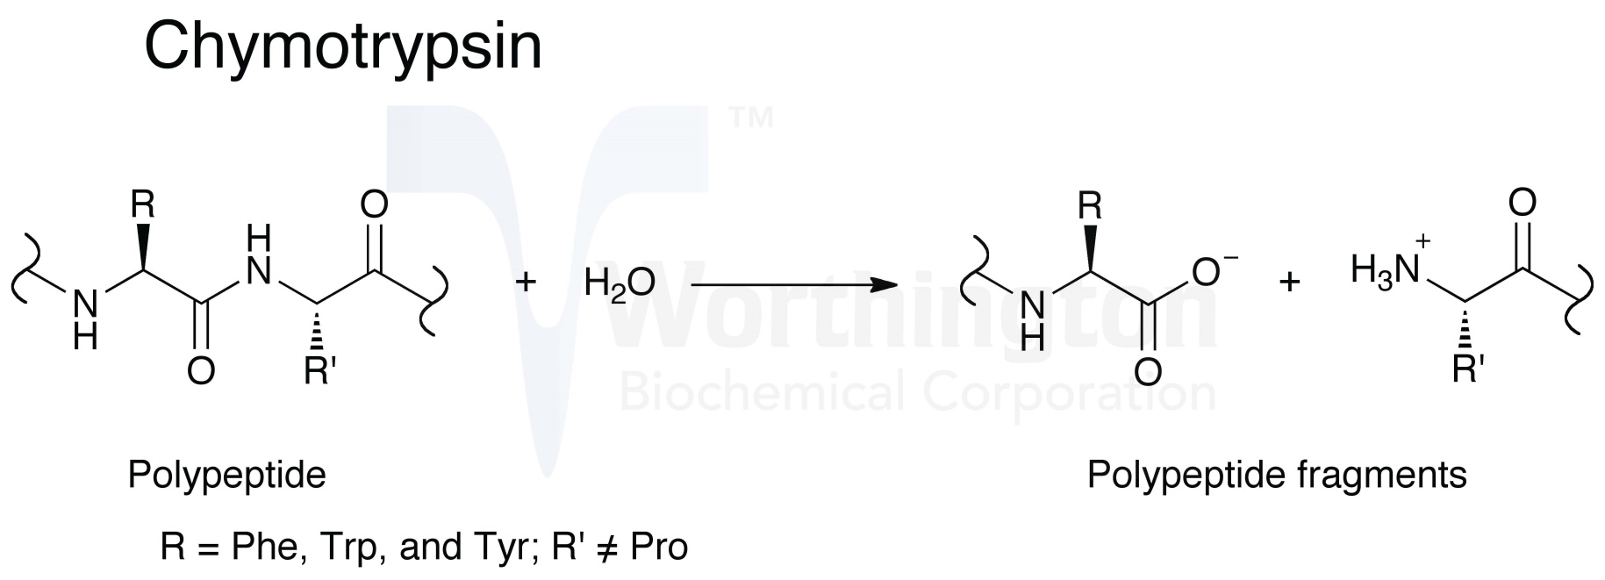
Chymotrypsin
Chymotrypsin is a digestive enzyme that is used to break down proteins into amino acids (organic compound) and polypeptides (organic polymer forming protein molecules) in the body.
http://www.worthington-biochem.com/chy/default.html

Slide 5
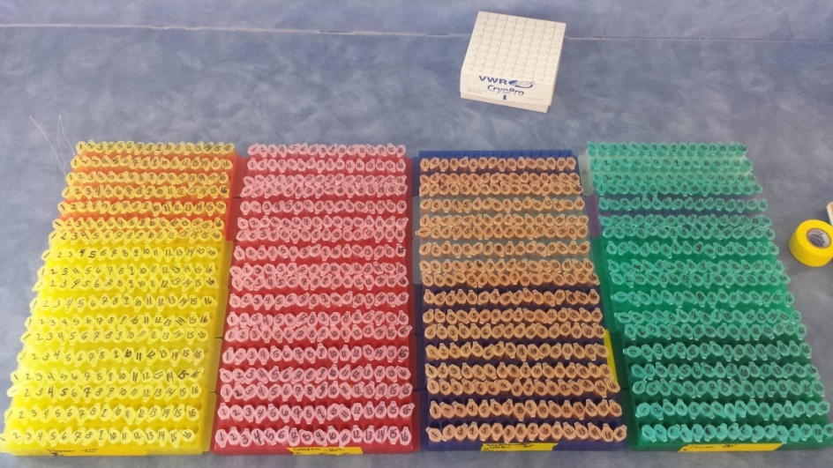
Data
16 different solutions (6 wells/samples each)
2 freezing conditions (snap and freezer) each at 2 freezing temperatures (-80*C and -20*C)
Thawed tor 30 minutes and heated to target temperature of 37*C
The data was taken over a 12 week period by putting each solution in 6 wells of a tray and mixing it with a potassium phosphate solution (7.4 pH buffer). After, it was put into a spectrophotometer light for reading (absorbance of light over time)

Slide 6
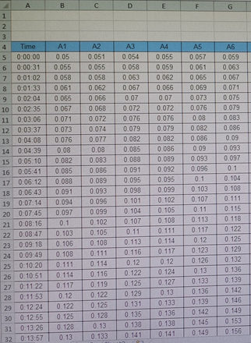
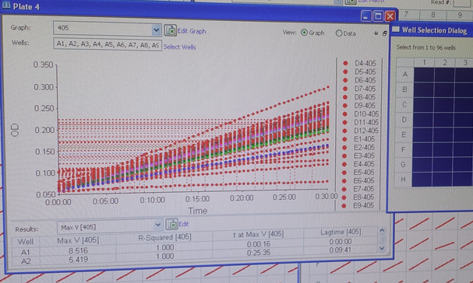
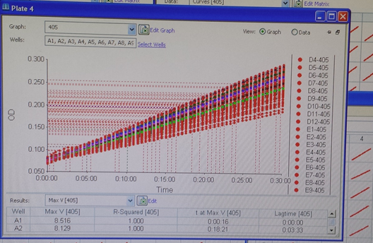
Charts and Graphs

Slide 7

Analysis
After data collection
Roughly, 131,000 data points were taken in relation to time
Calculated the maximum velocity, the average, and the standard deviation of each sample (slope of the tangent line) and compared to the similar plates over time
Burst Phase vs Burst Phase

Slide 8
Conclusions
Some enzymes have a large change in activity after six months of freezing
Enzymes more involved in the brain as they react differently than other enzymes in the body
Potential cell isolation
Data analysis is ongoing, but initial analysis shows

Slide 9



Acknowledgements
Any Questions?
Arizona Space Grant Consortium
NAU/NASA Space Grant Program
Northern Arizona University
Coconino Community College
Kathleen Stigmon
Dr. Nadine Barlow
Dr. Matthew John Gage
Bryan Bates
Kevin Mullins
Dr. Andrew Koppisch
https://nasa.asu.edu/2014-2015-symposium-presentation-submission?destination=node%2F493

