Slide 1



Repeat-Accumulate Codes with Modified Iterative Decoding Algorithms
Presented by: L. Patrick Peshlakai
Mentor: Dr. Sheryl L Howard
Northern Arizona University
Electrical Engineering
Notes:
· March 25th and 26th – 2nd presentation meeting – (your PowerPoint should be 95% complete at this point and within the 7 minute maximum)
· April 3rd – PowerPoints will be due to ASU and once again, we’ll forward the link as soon as we receive it.

Slide 2
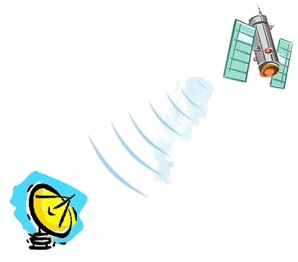

Earth bound
Station
Noise within communications are costly in power and time
Error correcting codes (ECC) are used to correct errors
Ex. Hamming Code and low-density-parity-check (LDPC) codes
Notes:
Noise in the communications channel between an earth-bound station and satellites orbiting the earth, or exploring space station, can be a significant problem. The data transmitted to earth becomes corrupted with noise that randomly flips bits in the code word.
Factors- distance, weather, using minimum bandwidth

Slide 3

Min-Sum
Decoder
Transmitter
Noise
Sum-product
Decoder
Running simulations to evaluate the Bit Error Rate (BER) performance

Slide 4
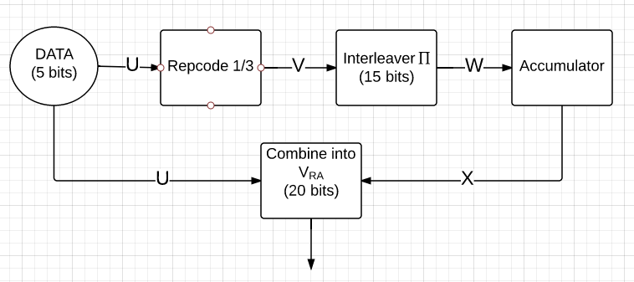
Transmitter
Codeword
Systematic Repeat Accumulate (RA)
Note this is a binary codeword

Slide 5
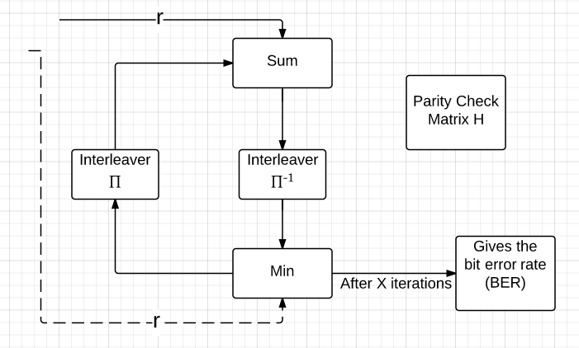
Min-sum Decoder
Codeword
Using Min-sum because of low complexity

Slide 6
Before changes to min-sum decoder
Min-sum decoder failed

Slide 7
After changing the min-sum decoder
Min-sum decoder
Sum-product decoder

Slide 8
Conclusions
Min-sum with out random offset worse then no decoding
Min-sum with random offset is much better BER, not as good as sum-product
Sum-product best BER but complex to implement

Slide 9
Acknowledgements
My mentor Dr. Sheryl L Howard
Dr. Nadine Barlow – Associate Director of NAU NASA Space Grant Consortium
Kathleen Stigmon - Senior Program Coordinator

Slide 10
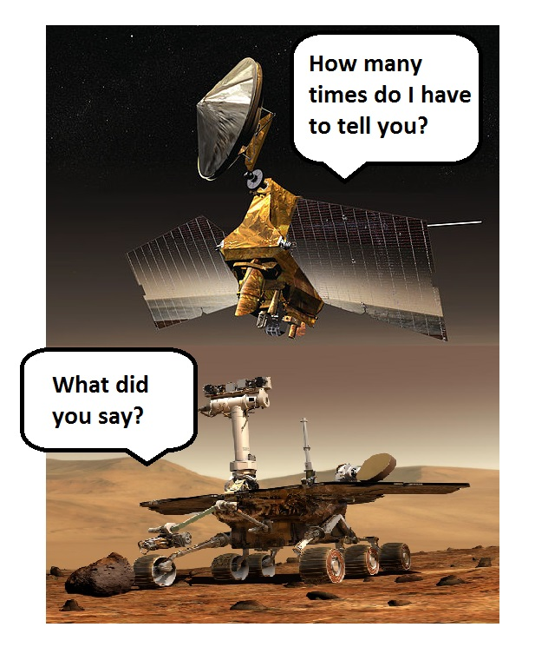
Questions?
Thank You

Slide 11
Work Cited
http://www.nasa.gov/audience/forstudents/k-4/stories/what-is-mars-k4.html#.VPbbm_nF-Sp
http://www.telecom.tuc.gr/~alex/papers/ryan.pdf
Notes:
March 23 another one

Slide 12
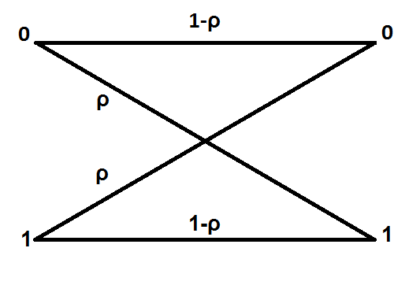

Noise
$λ=\log\left(\frac{P\left(y_{i}|x_{i}=0\right)}{P\left(y_{i}|x_{i}=1\right)}\right)$
The range of noise is ρ =[ 0.2, 0.1, 0.05, 0.02, 0.01]

Slide 13
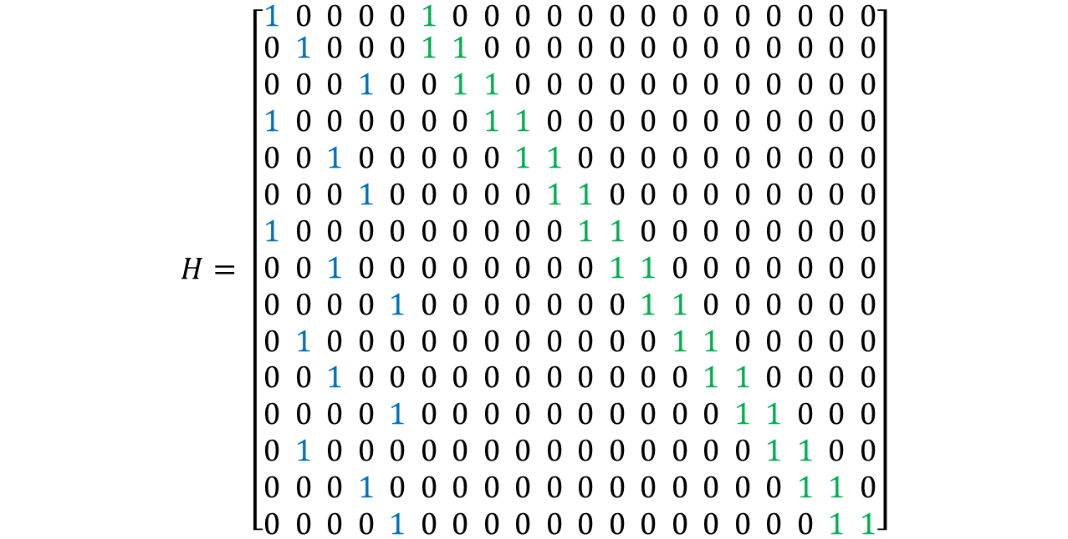
H matrix
$$H= \left[\begin{matrix}1 0 0 0 0 1 0 0 0 0 0 0 0 0 0 0 0 0 0 0 \\ \begin{aligned}0 1 0 0 0 1 1 0 0 0 0 0 0 0 0 0 0 0 0 0 \\ 0 0 0 1 0 0 1 1 0 0 0 0 0 0 0 0 0 0 0 0 \\ 1 0 0 0 0 0 0 1 1 0 0 0 0 0 0 0 0 0 0 0 \\ 0 0 1 0 0 0 0 0 1 1 0 0 0 0 0 0 0 0 0 0 \\ 0 0 0 1 0 0 0 0 0 1 1 0 0 0 0 0 0 0 0 0 \\ 1 0 0 0 0 0 0 0 0 0 1 1 0 0 0 0 0 0 0 0 \\ 0 0 1 0 0 0 0 0 0 0 0 1 1 0 0 0 0 0 0 0 \\ 0 0 0 0 1 0 0 0 0 0 0 0 1 1 0 0 0 0 0 0 \\ 0 1 0 0 0 0 0 0 0 0 0 0 0 1 1 0 0 0 0 0 \\ 0 0 1 0 0 0 0 0 0 0 0 0 0 0 1 1 0 0 0 0 \\ 0 0 0 0 1 0 0 0 0 0 0 0 0 0 0 1 1 0 0 0 \\ 0 1 0 0 0 0 0 0 0 0 0 0 0 0 0 0 1 1 0 0 \\ 0 0 0 1 0 0 0 0 0 0 0 0 0 0 0 0 0 1 1 0 \\ 0 0 0 0 1 0 0 0 0 0 0 0 0 0 0 0 0 0 1 1\end{aligned}\end{matrix}\right]$$
The matrix H is a systematic parity check
It has a lower bi-diagonal identity matrix with Hp(i,j)=1, i=j, j+1

Slide 14
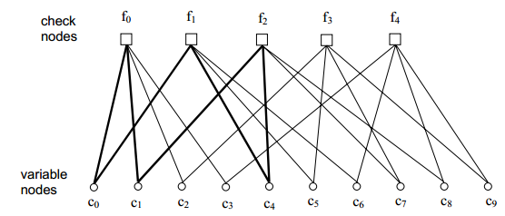
Factor Graph Representation of the H matrix

Slide 15
Data
Rho is the noise = 0.02
Number of incorrect error frames=100
Iterations | Error Rate | Errors
1 | 2.002944e-02 | 51567.00
2 | 4.151777e-03 | 10689.00
3 | 1.586679e-03 | 4085.00
4 | 5.499969e-04 | 1416.00
5 | 3.231620e-04 | 832.00
10 | 1.079796e-04 | 278.00
Notes:
Need to ask dr Howard about the error frames

Slide 16
Data
MATLAB output for Min Sum BSC:
rho=0.02
errorrate= 1.079796e-04, number of loops=128728.00, errors= 278.00
frame error rate= 7.768318e-04, incorrect frames=100 for rho=0.02, 10 iterations
raw bit error rate= 4.519549e-01, number of loops=128728.00, raw bit errors=1163585.00
errorrate= 2.002944e-02, errors=51567.00, 1 iteration
errorrate= 4.151777e-03, errors=10689.00, 2 iterations
errorrate= 1.586679e-03, errors= 4085.00, 3 iterations
errorrate= 5.499969e-04, errors= 1416.00, 4 iterations
errorrate= 3.231620e-04, errors= 832.00, 5 iterations
…
errorrate= 1.079796e-04, errors= 278.00, 10 iterations
Notes:
A portion of MATLAB text file generated to show the BER incorrect frames = 100

Slide 17
Data
Notes:
A portion of MATLAB text file generated to show the BER incorrect frames = 100

