Slide 1


ASU/NASA Space Grant
Radar system analysis & Design
Ja’Lon Sisson
Mentor: Prof.
Daniel W. Bliss

Slide 2

Table of Contents
General Information & Applications of Radar
Electromagnetic Radiation
Pulse-Doppler Radar
Doppler Effect
Simulation
  Mono-Static – Stationary
  Mono-Static – Active
  Bi-Static – Active
References

Slide 3
General Information & Applications of Radar
RAdio Detection And Ranging = RADAR
Radar is an object-detection system that uses electromagnetic radiation to determine the range, altitude, direction, or speed of objects.
Modern uses of radar include defense systems, outer space surveillance, flight control, anti-collision systems, and many other applications.

Slide 4
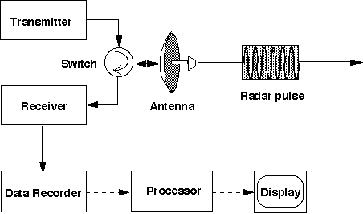
General Information & Applications of Radar
A radar system has a transmitter that emits radio waves in predetermined directions. When these come into contact with an object they are usually reflected or scattered in many directions.
Radar signals are reflected especially well by materials of considerable electrical conductivity.
Some of the scattered radio waves are reflected back and detected by a receiver. If the object is moving away or toward the receiver, there is a slight change in the frequency, caused by the Doppler effect.
Fun Fact: Illumination

Slide 5
General Information & Applications of Radar
Isotropic Antenna
Directional Antenna
P_{t}= Transmitter power
R= Range from Antenna
P_{t}= Transmitter power
G_{t}= Gain of the transmitting antenna
R= Range from Antenna

Slide 6
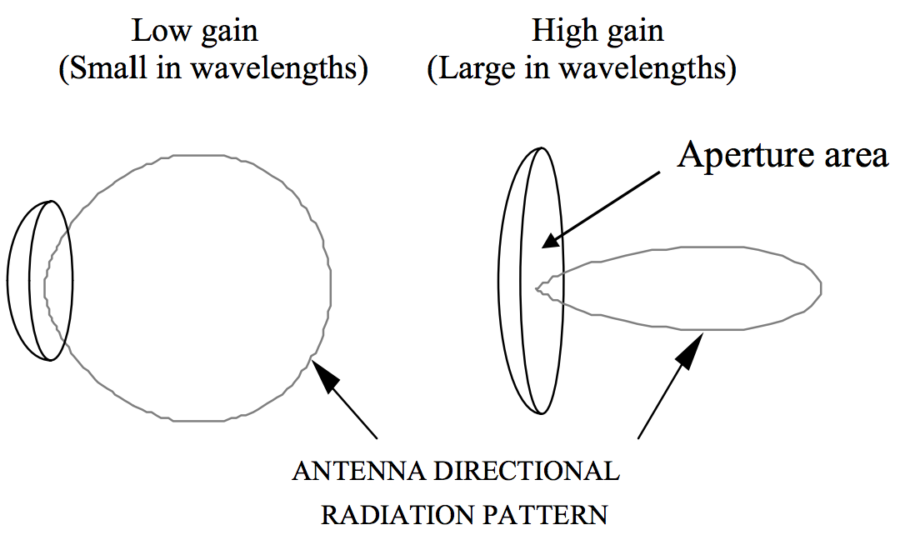
General Information & Applications of Radar
Gain is the radiation intensity relative to a lossless isotropic reference.
A_{e}= Effective Area (aperture*efficiency)
λ= wavelength (c/f)
In general, an increase in gain is accompanied by a decrease in beam width.

Slide 7
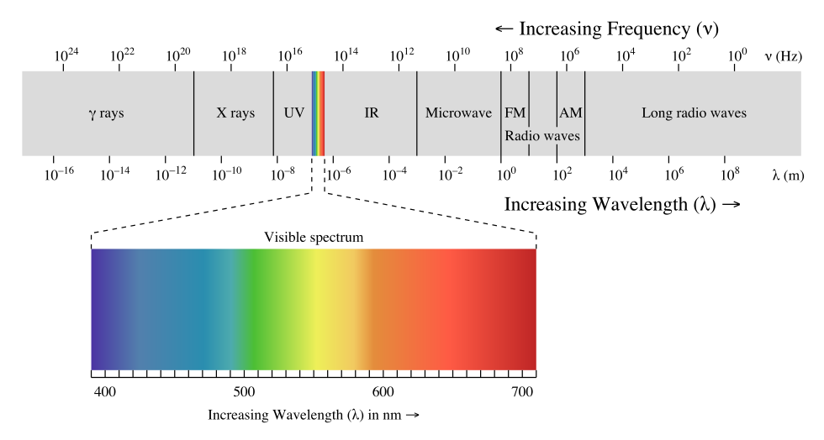
Electromagnetic Radiation
Electromagnetic Radiation is emitted and absorbed by charged particles.
Radar absorbing materials contain either resistive or magnetic substances to reduce radar reflection

Slide 8
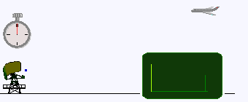
Pulse-Doppler Radar
A Pulse-Doppler radar is a radar system that determines the range to a target using pulse-timing techniques, and uses the Doppler Shift of the returned signal to determine the target object's velocity.

Slide 9
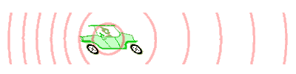
Doppler Effect
The Doppler effect (or Doppler shift) is the change in frequency of a wave for a target moving relative to an observer.
When the object of interest is moving toward the receiver, each successive reflection from the transmitted signal is emitted from a position closer to the receiver than the echo.
The time between the arrival of successive wave crests at the receiver is reduced, causing an increase in the frequency.

Slide 10
Doppler Effect
f_{r}= Shifted Frequency
f_{t}= Original Frequency
f_{d}= Doppler Frequency
c= Speed of light
v= Target velocity

Slide 11
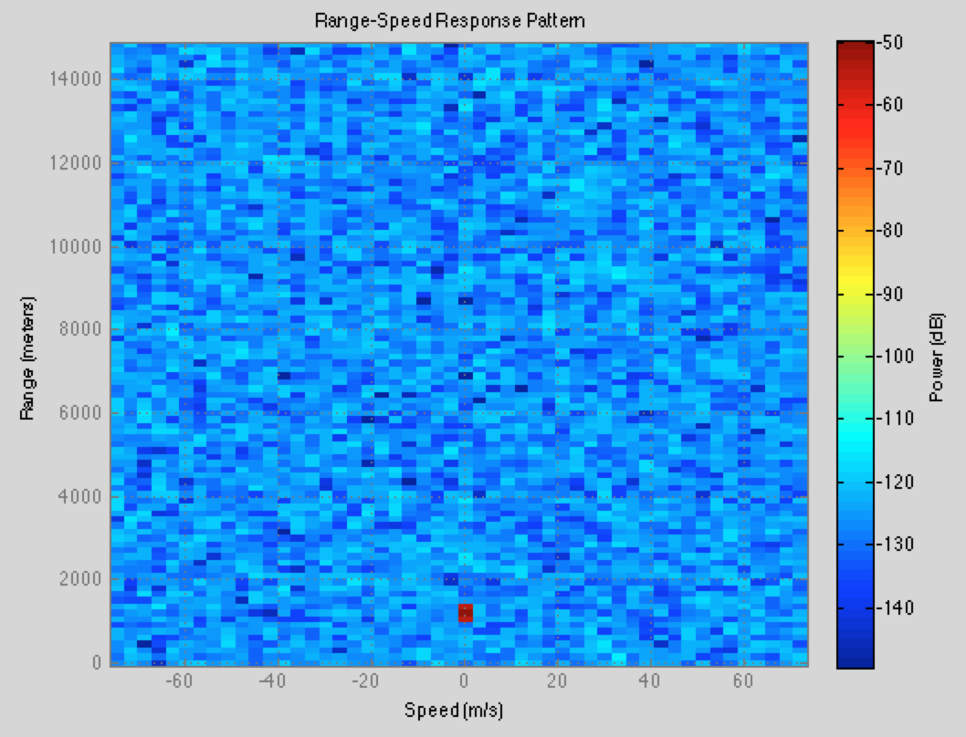
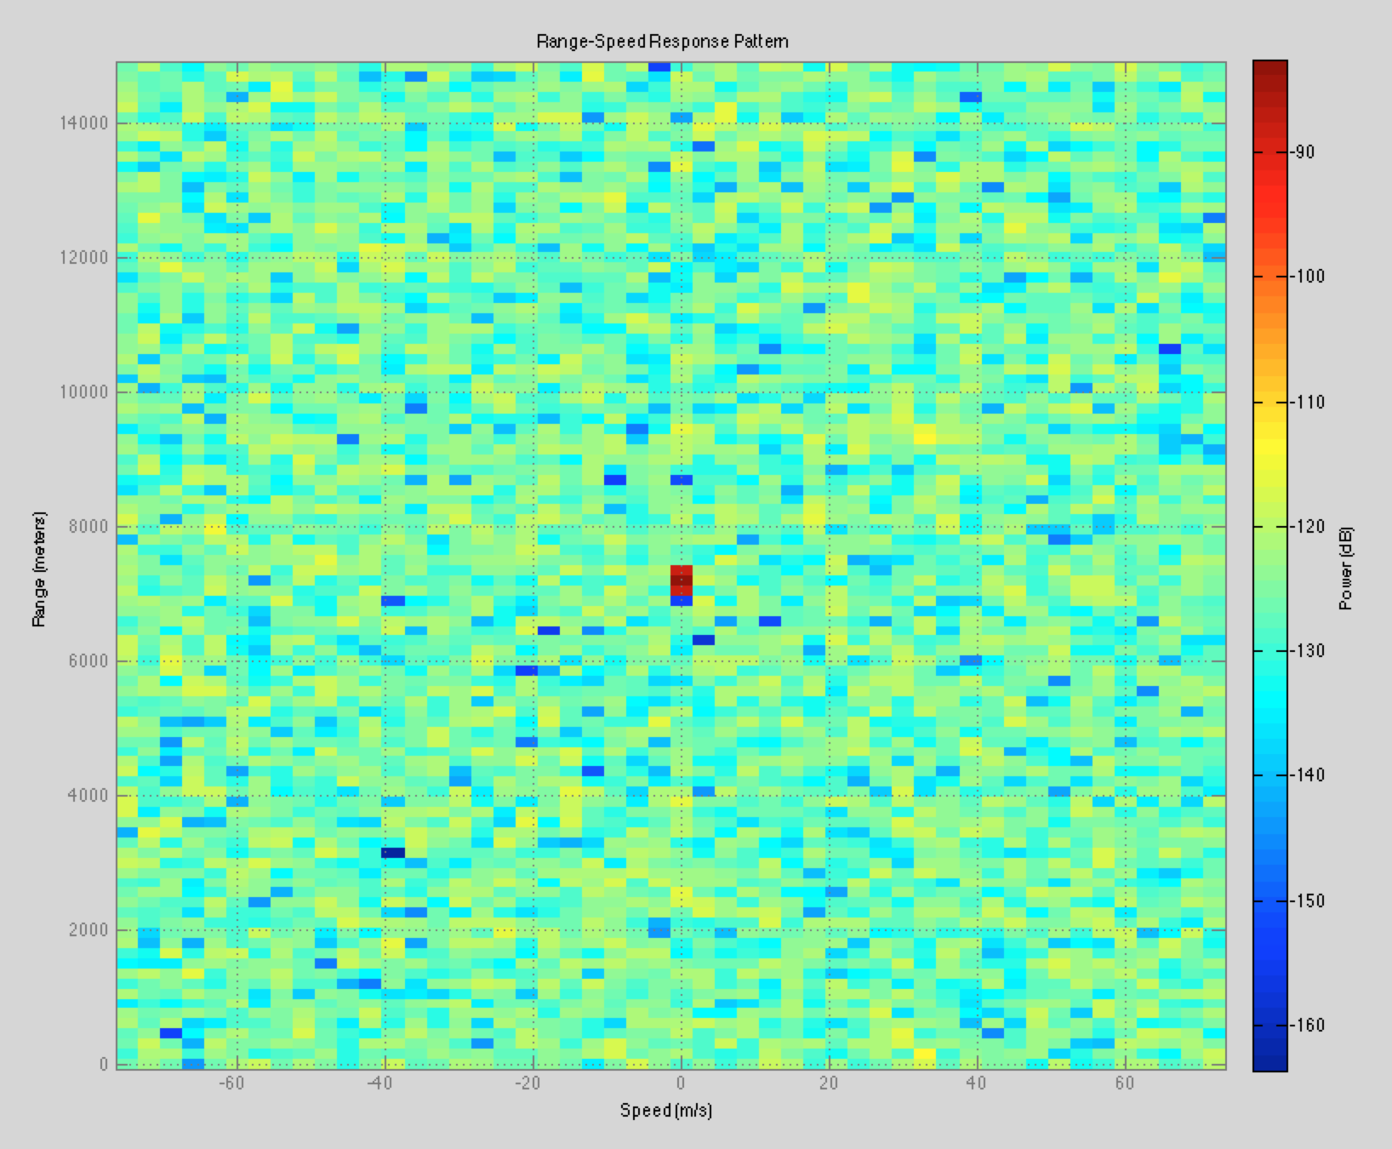
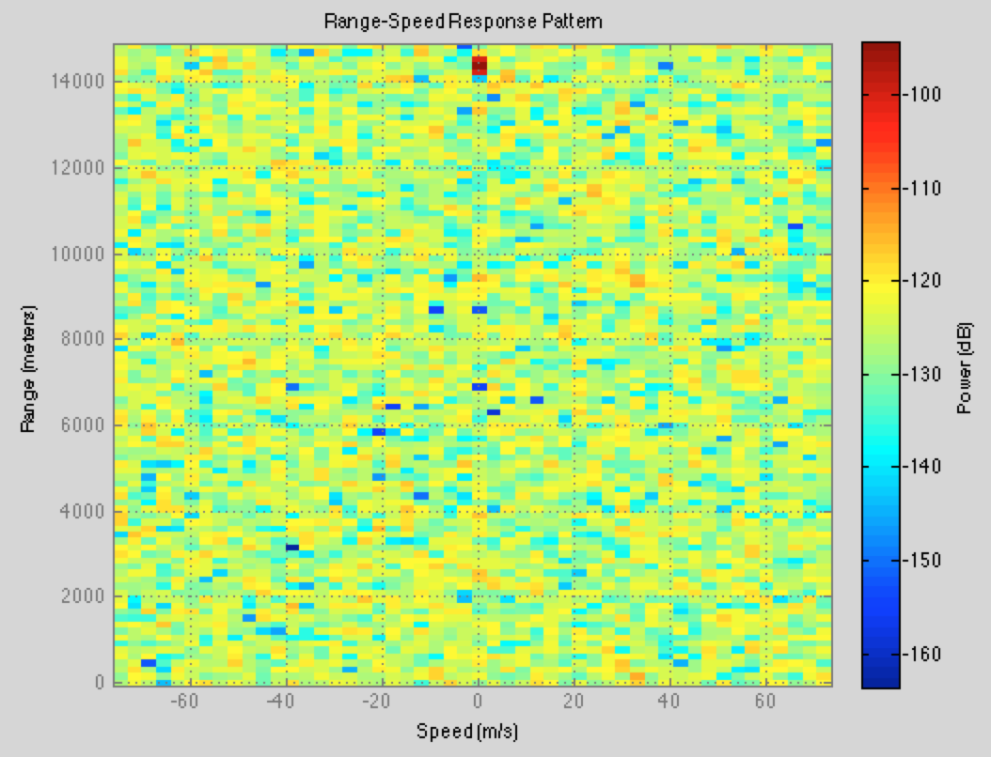
Mono-static (Stationary)
Mono-static: The transmitter and receiver are collocated (same antenna is used to transmit/receive).

Slide 12
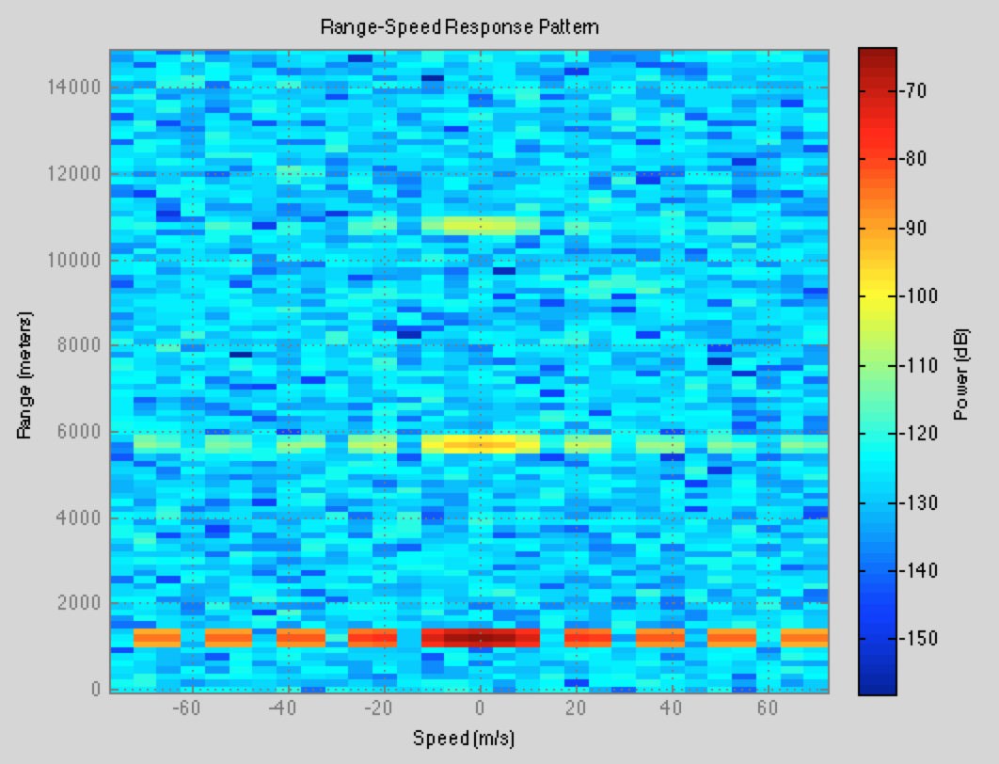
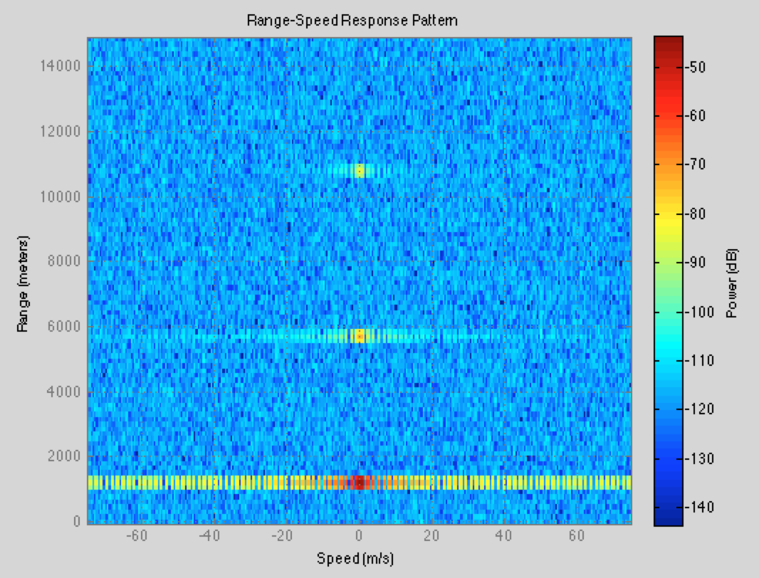
Mono-static (Stationary)
Multi-Target

Slide 13
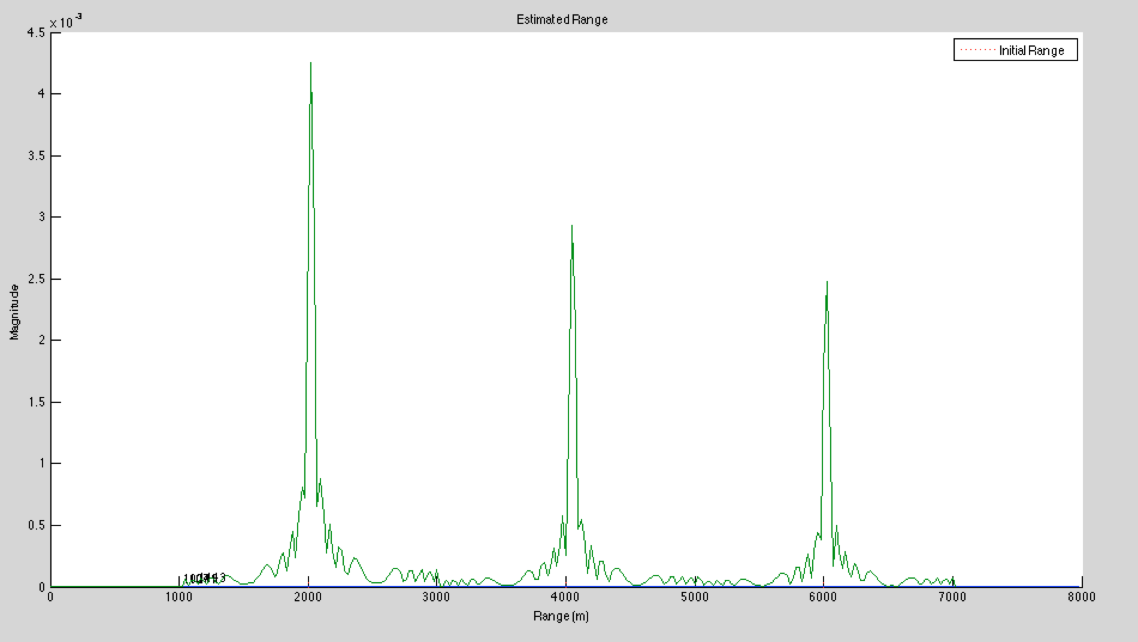
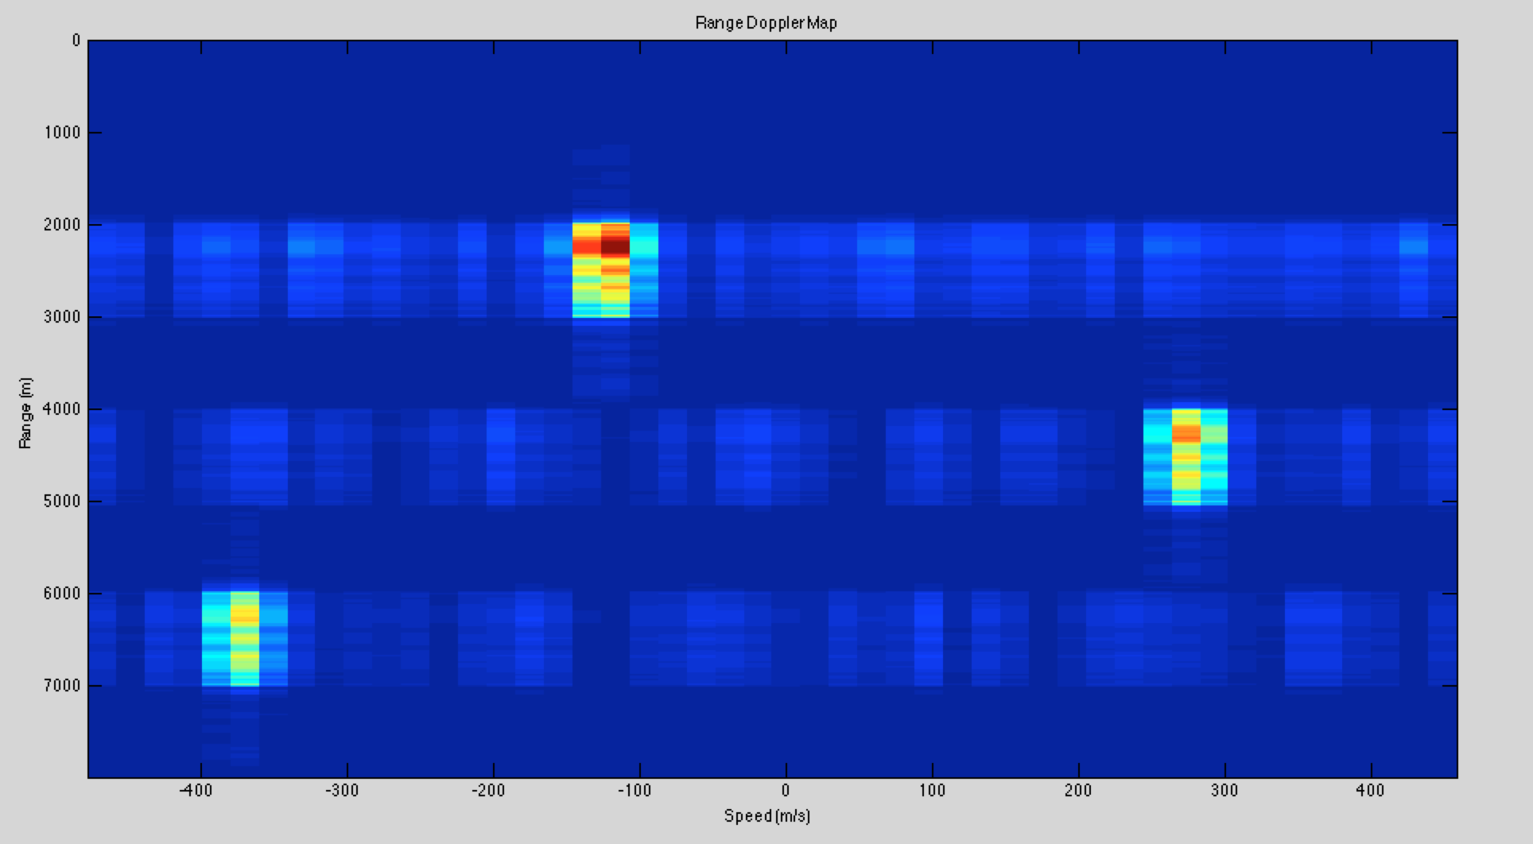
Mono-static (Active)
Multi-Target

Slide 14
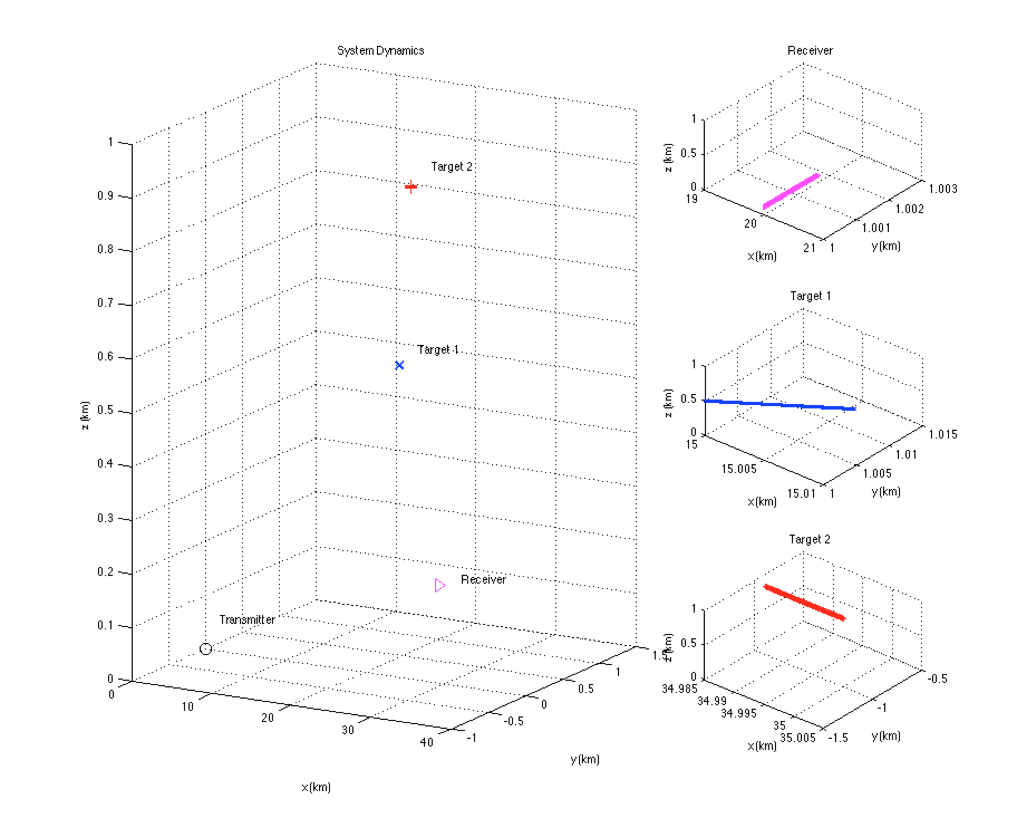
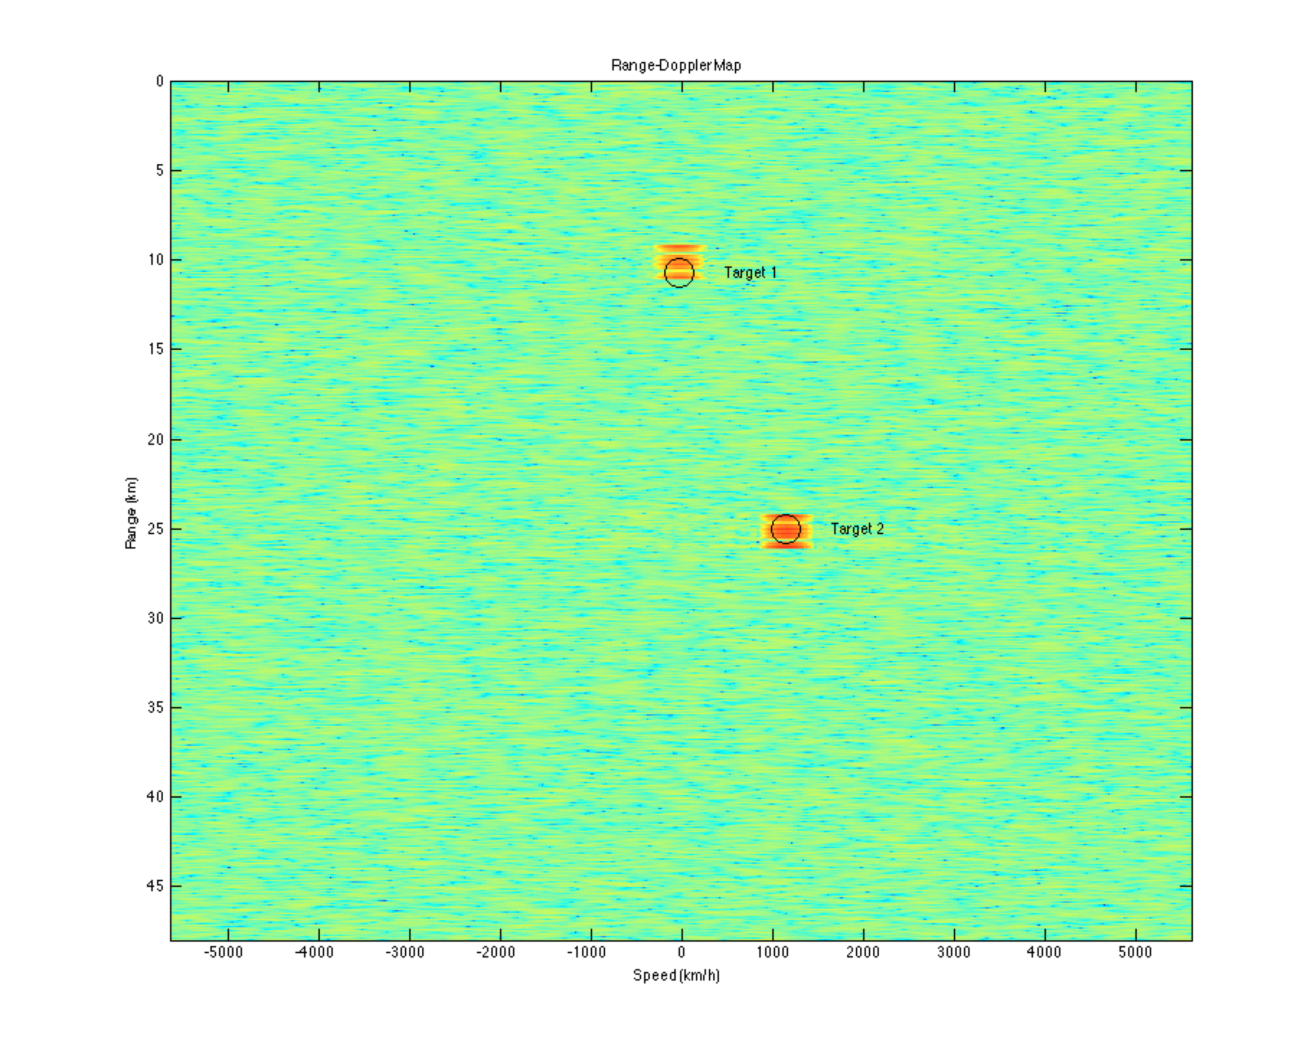
Bi-static (Active)
Bi-static: The transmitter and receiver are in different locations.

Slide 15
References
1. "Radar." Wikipedia. N.p., n.d. Web. 30 Aug. 2014. <http://en.wikipedia.org/wiki/Radar>.
2. "How Radar Works." Institute for Geophysics. The University of Texas at Austin, n.d. Web. 11 Jan. 2015. <http://www.ig.utexas.edu/research/projects/mars/education/radar_works.htm>.
3. "Radar Fundamentals." RF Cafe. N.p., n.d. Web. 11 Jan. 2015. <http://www.rfcafe.com/references/electrical/NEETS-Modules/NEETS-Module-18-1-1-1-10.htm>.
4. Pellissier, Vincent. "Radar System Design and Analysis with MATLAB." MathWorks. N.p., n.d. Web. 17 Oct. 2014. <http://www.mathworks.com/videos/radar-system-design-and-analysis-with-matlab-81917.html?form_seq=conf1092&confirmation_page&wfsid=5967586&refresh=true>.
5. "Simulating a Bistatic Polarimetric Radar." MathWorks. N.p., n.d. Web. 10 Jan. 2015. <http://www.mathworks.com/help/phased/examples/simulating-a-bistatic-polarimetric-radar.html>.
6. "A Doppler Shift Speed Gun." CFCP Work. University of Chicago, n.d. Web. 12 Jan. 2015. <http://cfcpwork.uchicago.edu/kicp-projects/nsta/2007/sherman/doppler.htm>.
7. "Electromagnetic radiation." Wikipedia. N.p., n.d. Web. 13 Sept. 2014. <http://en.wikipedia.org/wiki/Electromagnetic_radiation>.

Slide 16
Questions?
Thank you!

