Slide 1



Focal Plane Actuation to Achieve Ultra-High Resolution on Suborbital Balloon Payloads
Mentor: Dr. Paul Scowen
Graduate Student: Alex Miller
Undergraduate Students: Jake Trahan & Ravi Prathipati
Raquel Camarena

Slide 2

Motivation
High resolution planetary images
Fraction of the cost
Remove jitter movement

Slide 3
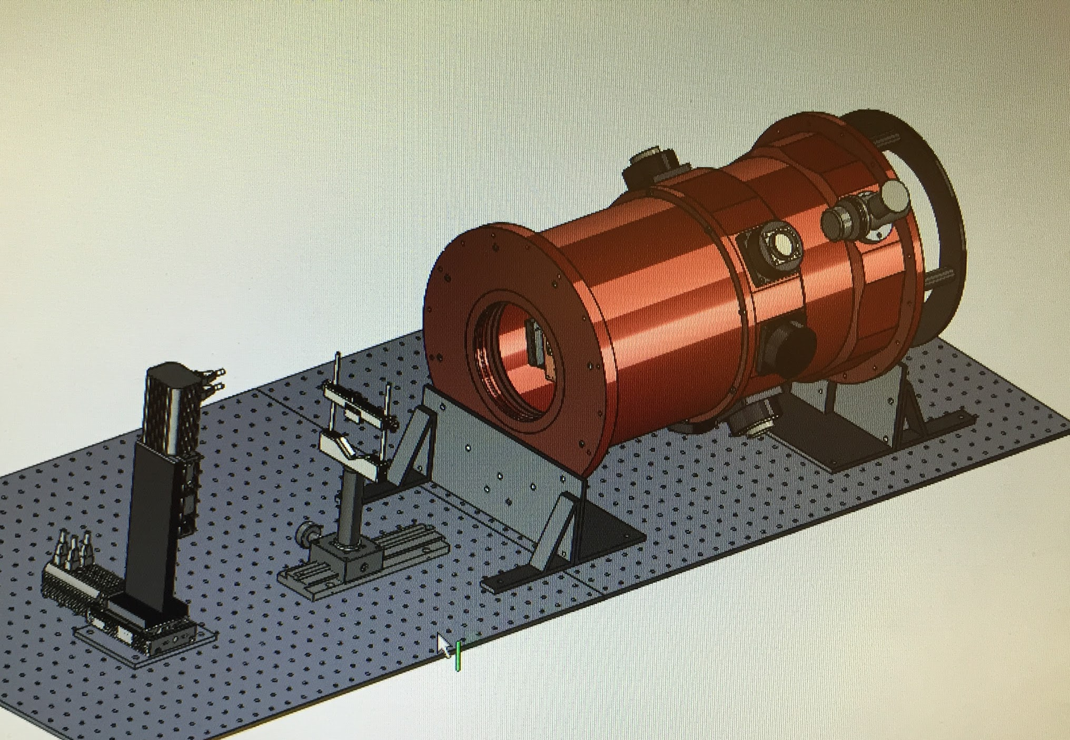
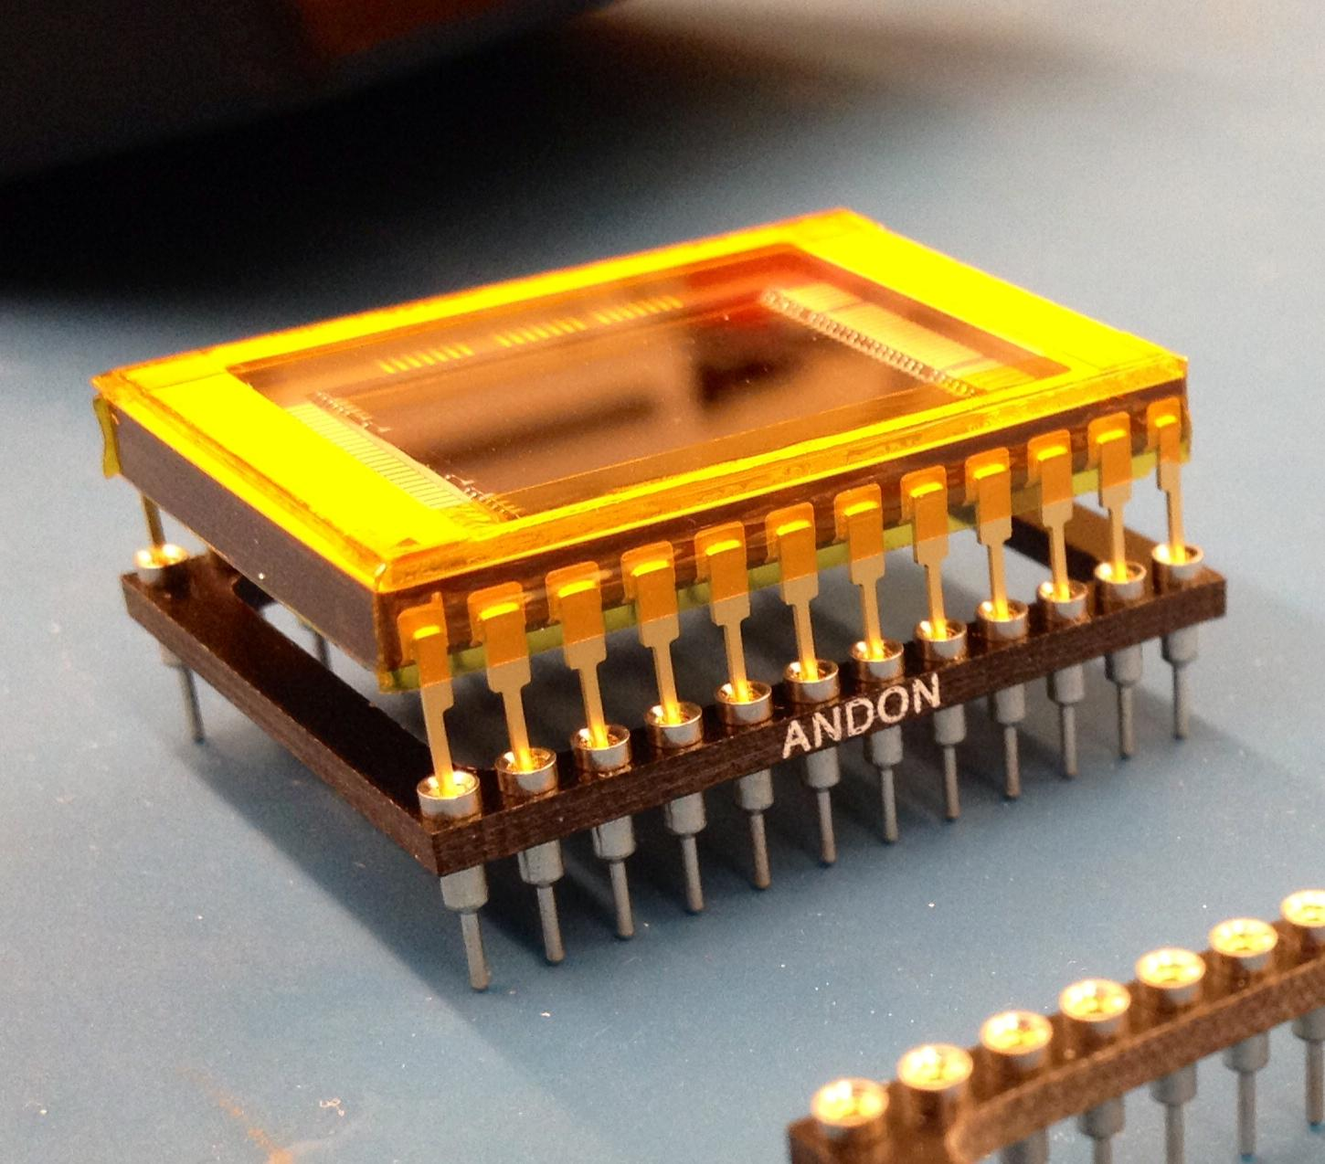
Optomechanics
Charged-Coupled Device (CCD)
  Properties
  Characterization

Slide 4
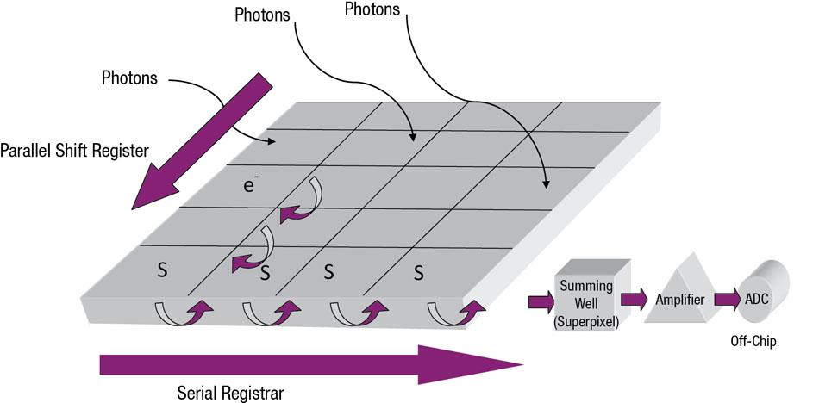
How Does a Charged-Coupled Device Work?
Signal-to-noise ratio
Sensitivity
http://apps.thermoscientific.com/media/BID/CELL/Images/Fig2-readout-CCD-03-lg.jpg
Notes:
Explain the water conveyer belt analogy and explain the characteristics of a CCD and how they differ based upon signal to noise ratio and sensitivity (amount of photons)

Slide 5
Characterization
Read noise
  Bias frames
    Electronics
Flat Field
  Pixel sensitivity
    usually 98-102%
    pixel uniformity
Quantum Efficiency
  % number of incident photons converted to recorded electrons
  Type of CCD
Notes:
I will talk about how read noise are depicted bias frames. I will then speak about the purpose of flat fields and how they represent pixel sensitivity. A normalized flat field is when all pixel values are converted to a percentage from 0-1. The normalized flat field is used to adjust the final data so that all of the pixels are uniform with respect to each other. I will then explain the importance of quantum efficiency and how it changes between each CCD and why we characterize

Slide 6
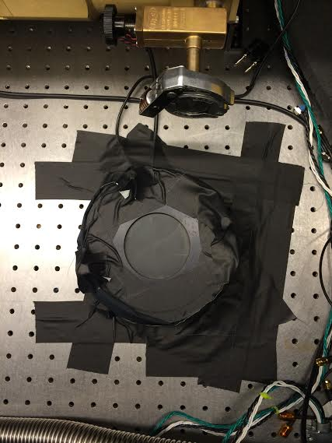
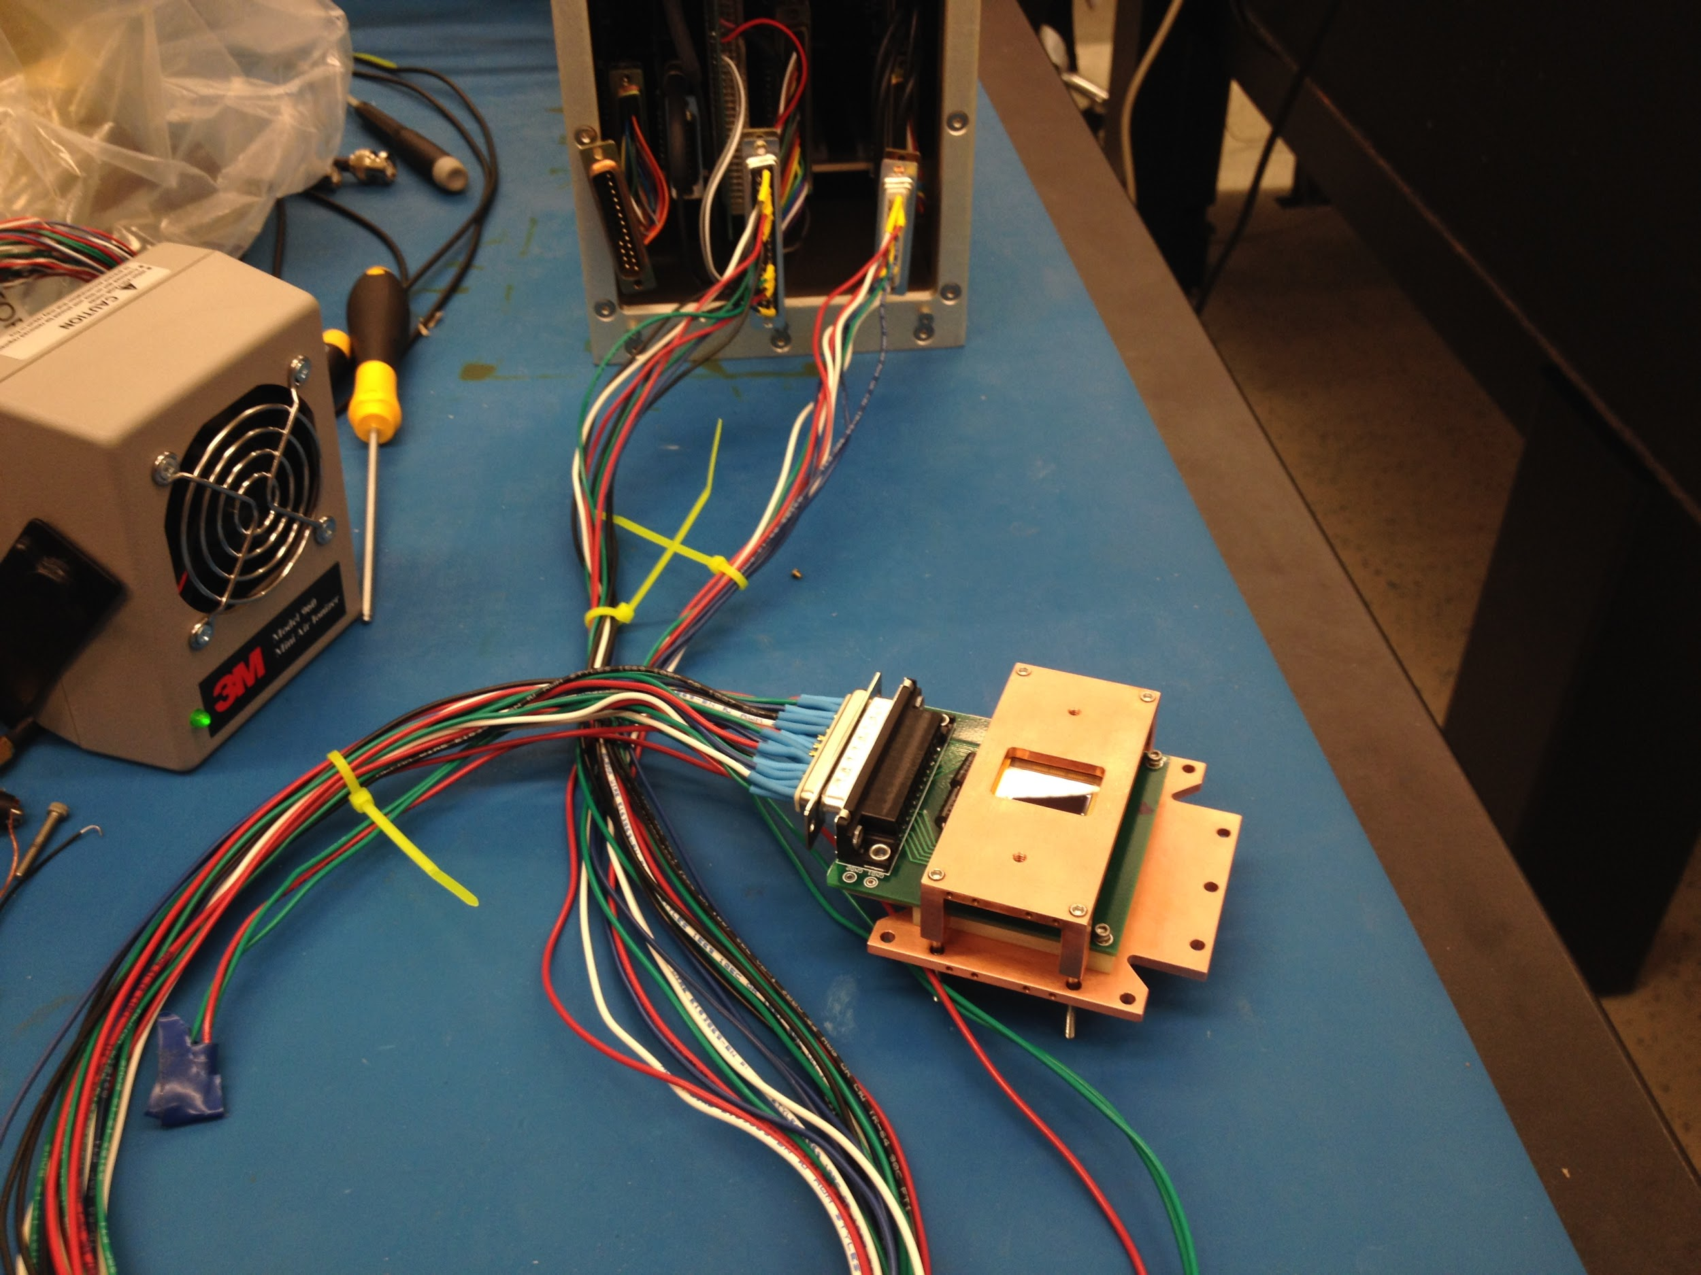
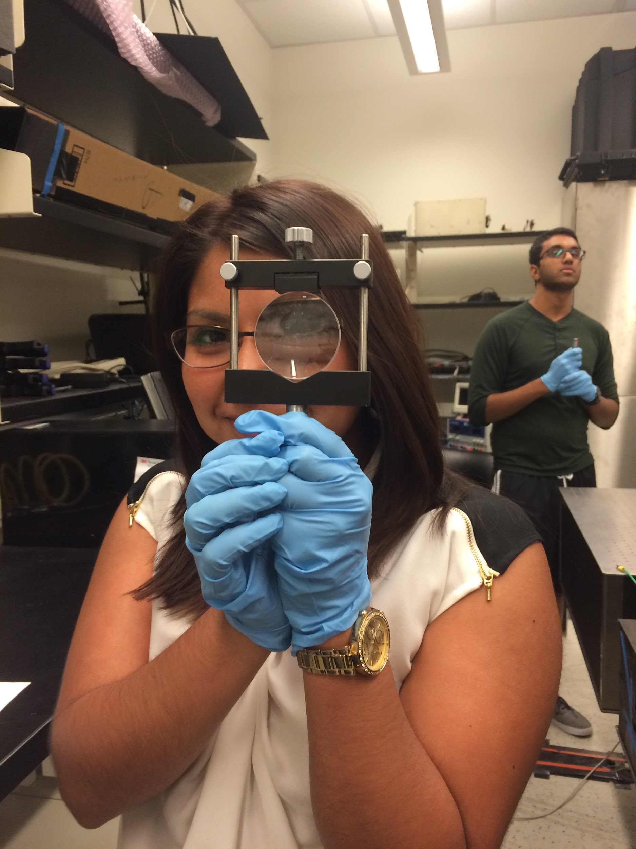
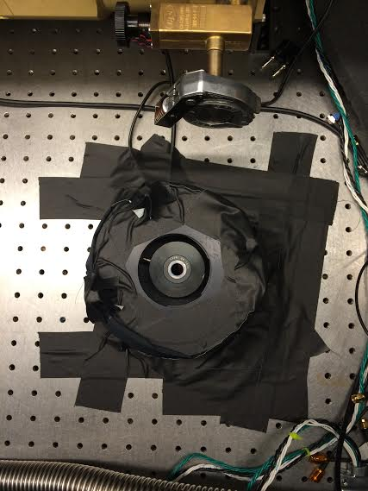
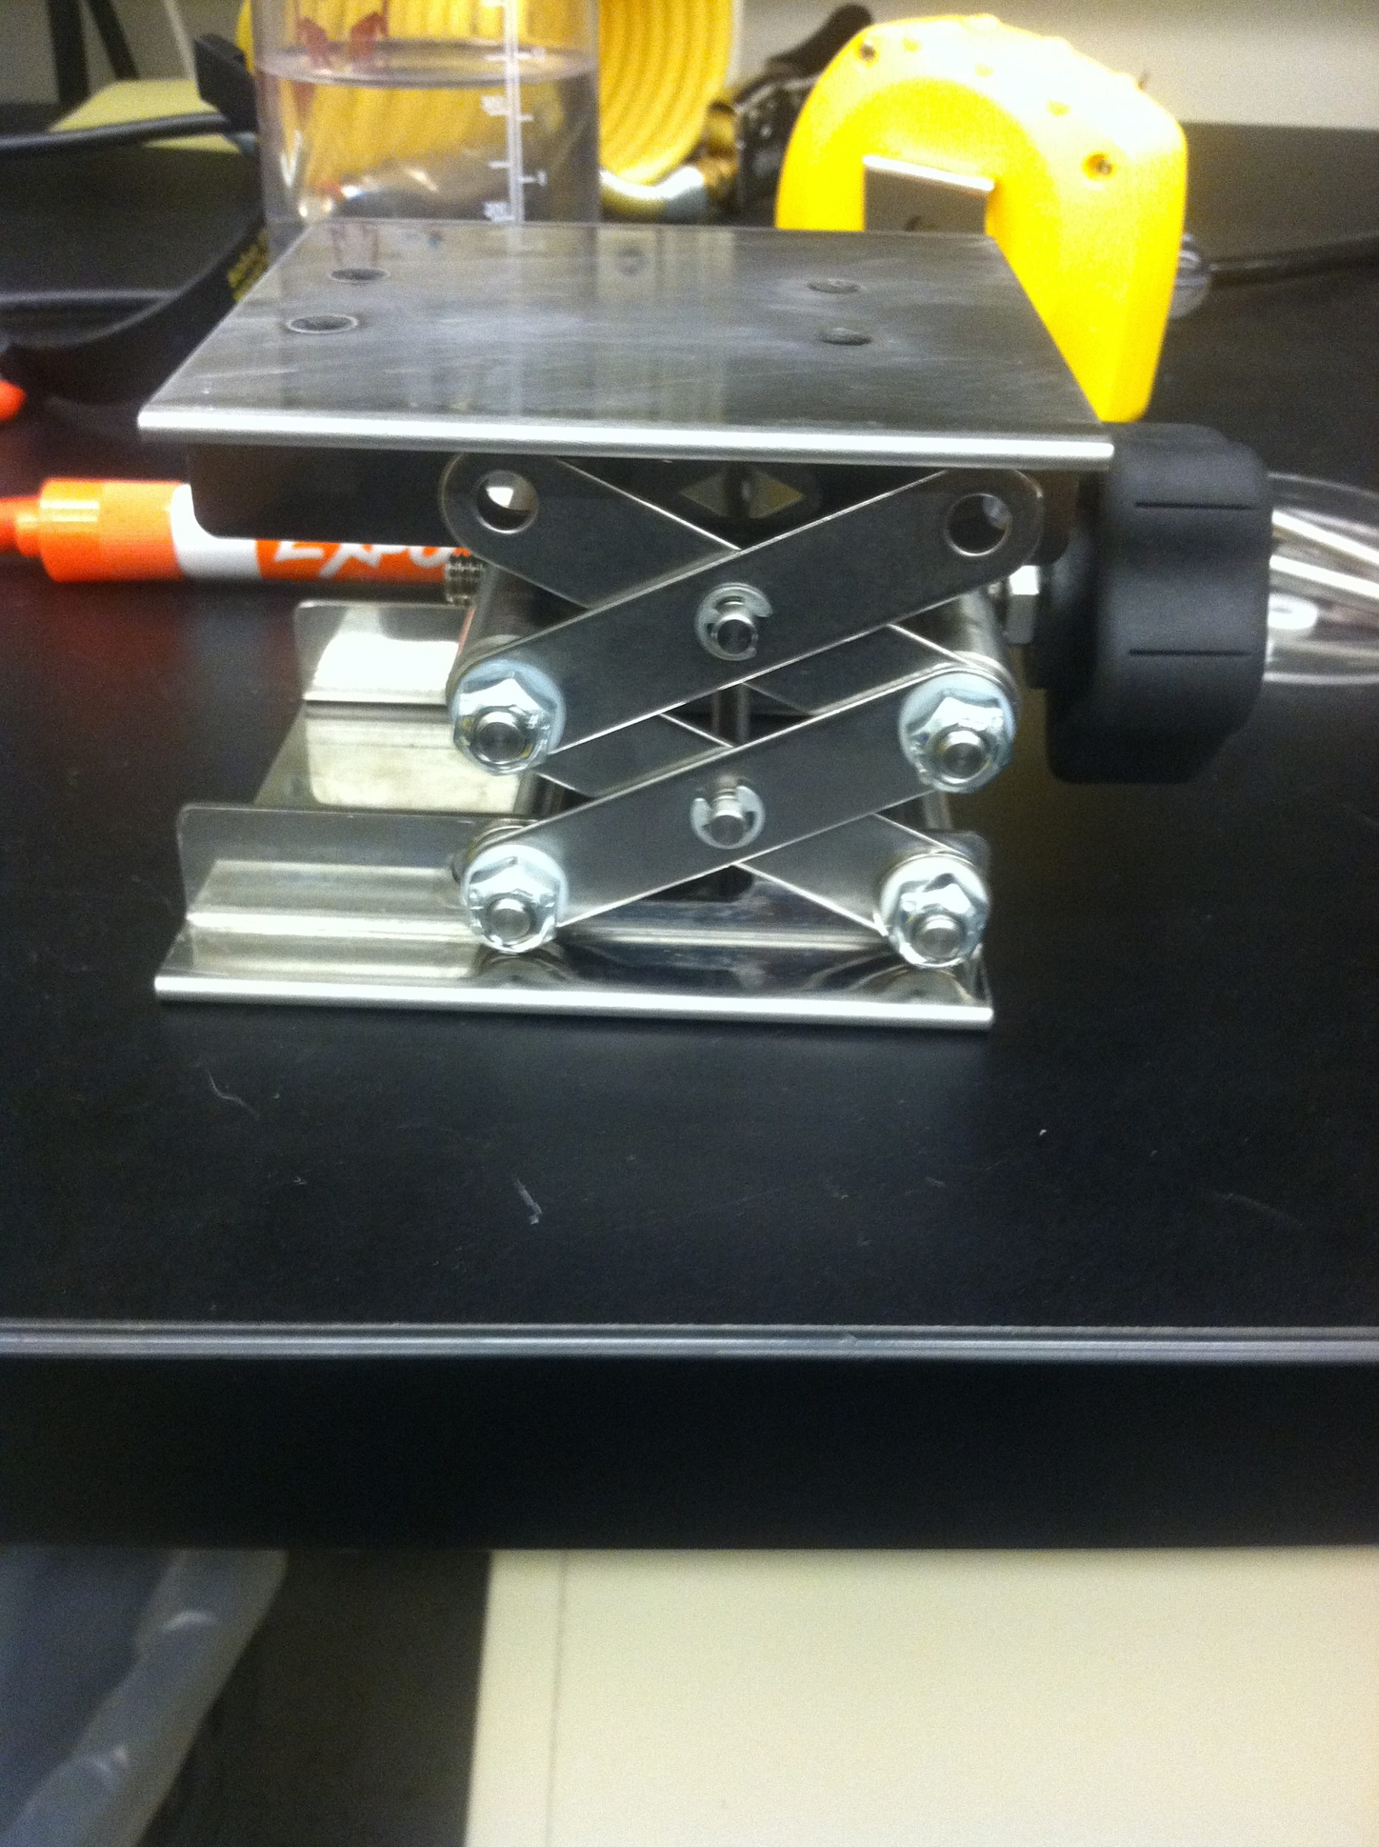
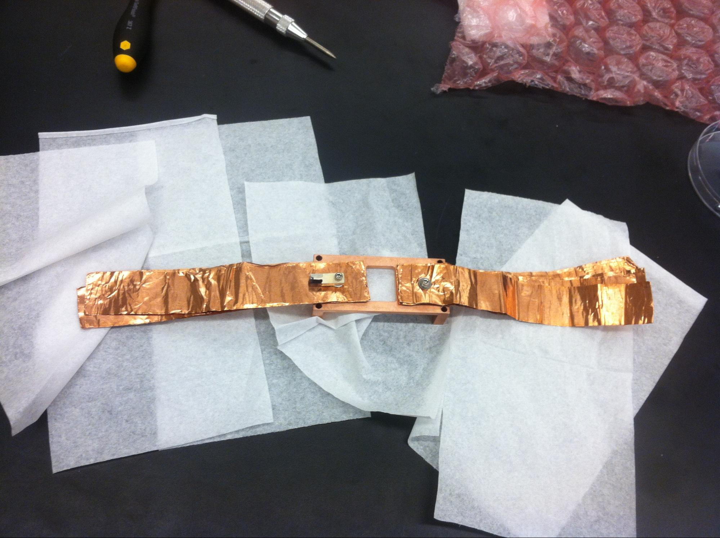
Notes:
Talk about preparation for characterization

Slide 7
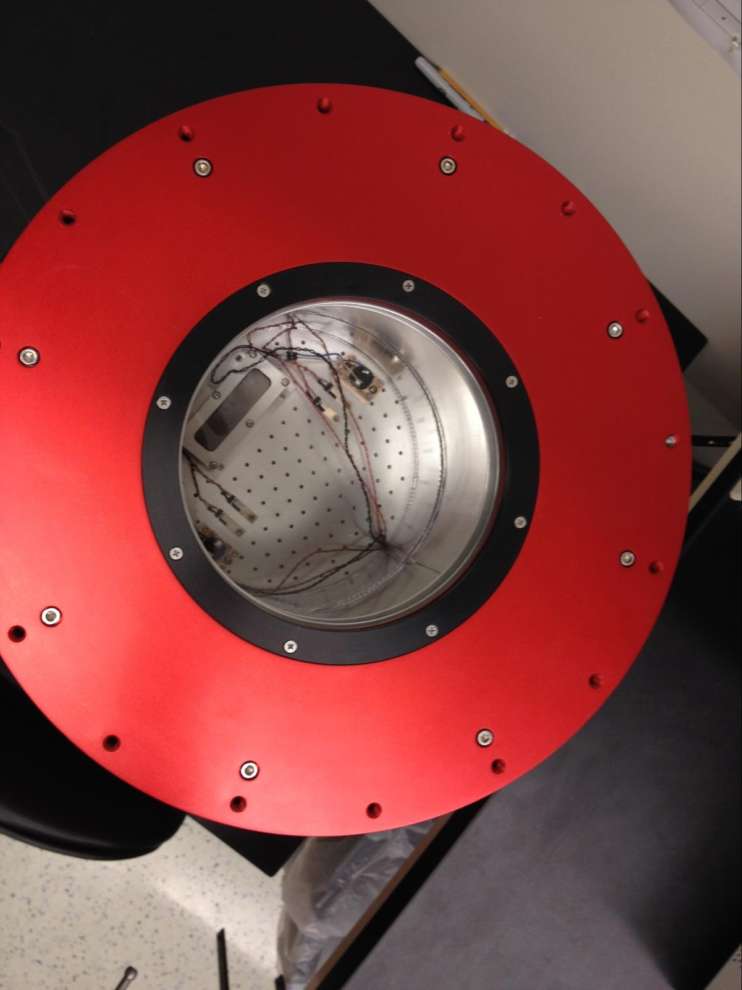
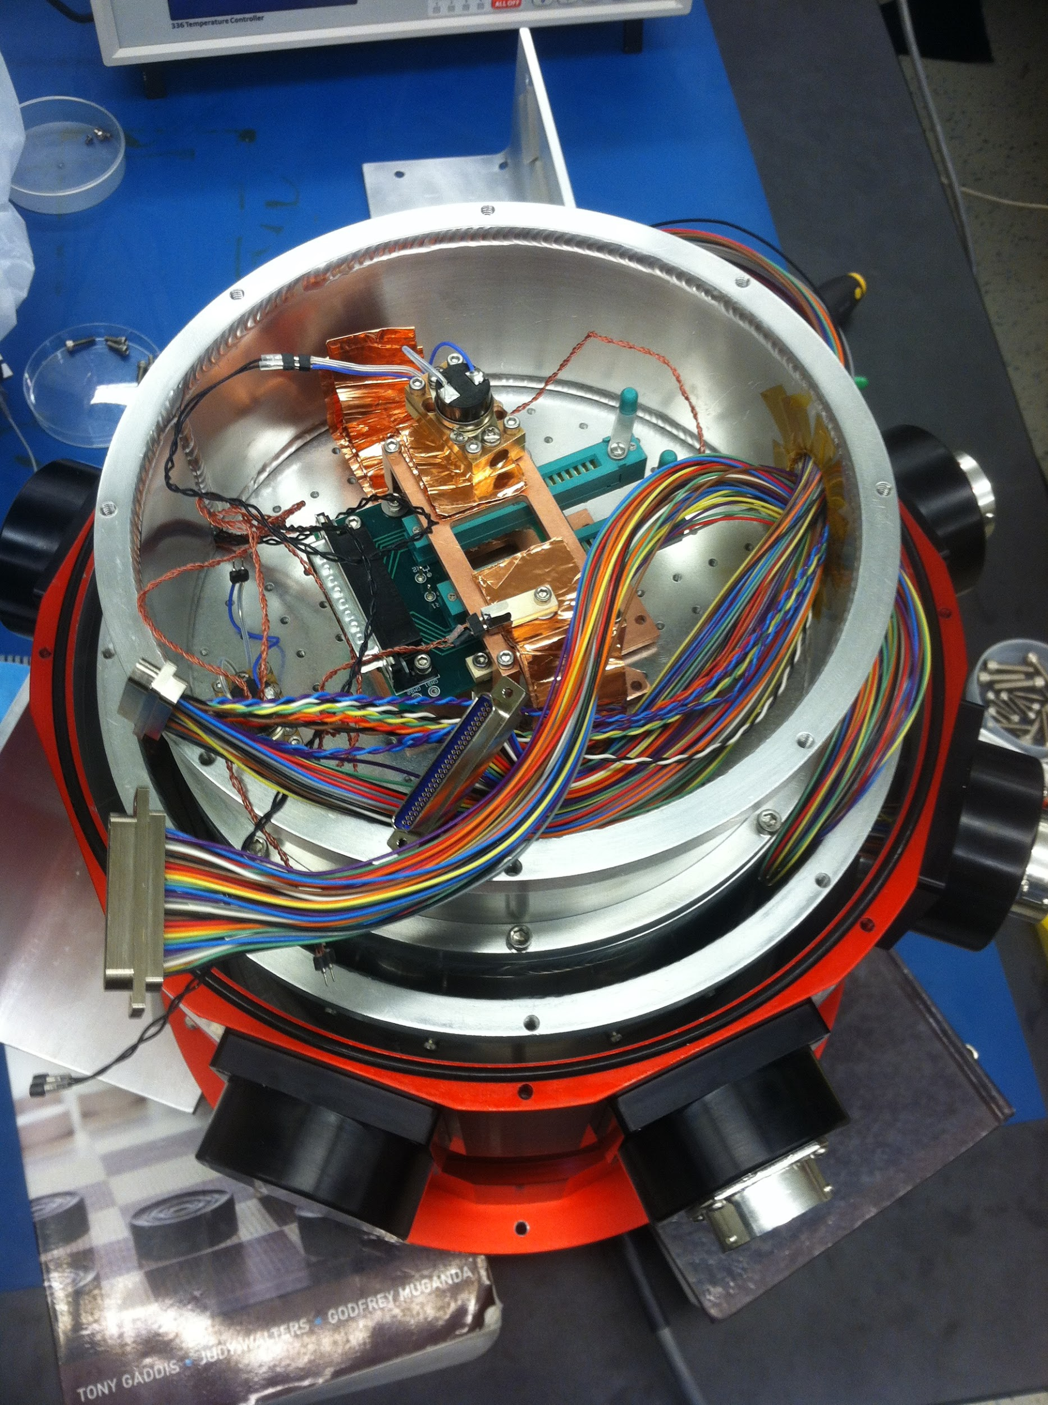
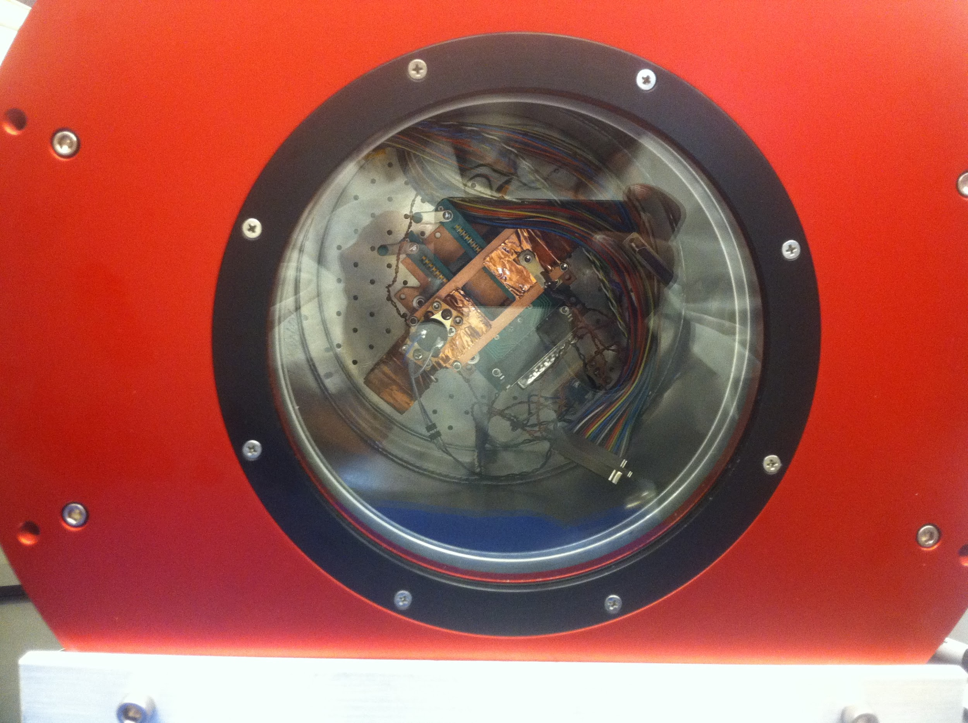
Notes:
Talk about preparation for characterization

Slide 8
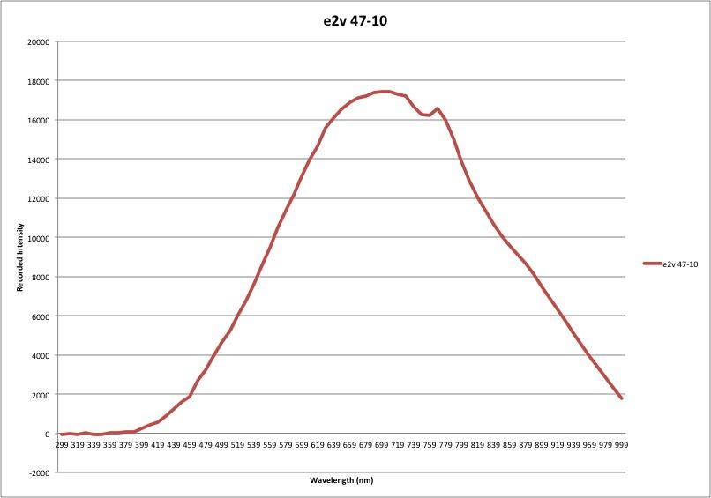
Quantum Efficiency

Slide 9
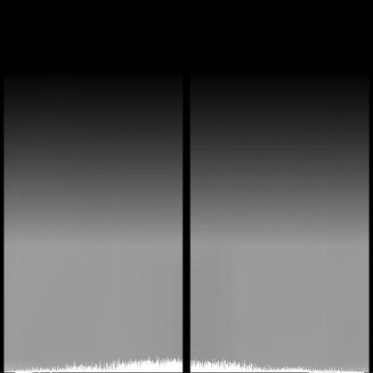
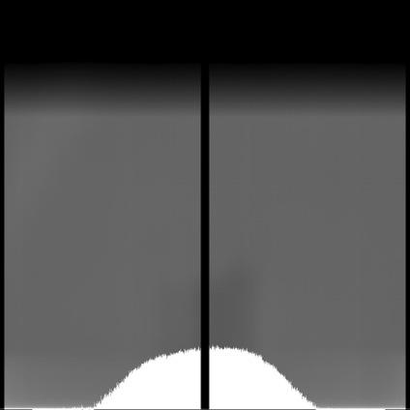
429 nm
529 nm
Flat Fields
Notes:
talk about what is considered the “good part” (square)

Slide 10
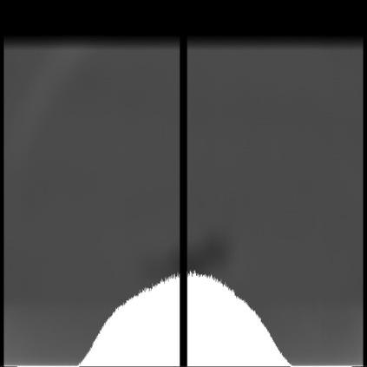
649 nm
Flat Fields
Notes:
speak about how careful one must be when taking images due to obstructions (the smudge can be seen)

Slide 11

Frame | Frame Average
1 | 634.725
2 | 634.491
3 | 633.725
4 | 633.69
5 | 633.84
6 | 634.2
7 | 634.964
8 | 634.134
9 | 634.313
10 | 635.218
Superbias Average: | 634.33
1st Data of Bias Frames

Slide 12

Frame | Frame Average
1 | 627.483
2 | 627.323
3 | 627.476
4 | 627.578
5 | 628.395
6 | 627.958
7 | 628.689
8 | 628.736
9 | 628.812
10 | 627.682
Superbias Average: | 627.564
2nd Data of Bias Frames

Slide 13

Frame (sec) | Frame Average (after bias sub)
0.5 | -45.7408
0.5 | -45.2706
0.5 | -46.8533
0.5 | -47.0185
0.5 | -47.0009
0.5 | -46.8878
0.5 | -46.8605
0.5 | -45.5151
0.5 | -45.3363
0.5 | -44.7712
30 | -68.1196
60 | -305.739
1st Data of Dark Frames

Slide 14
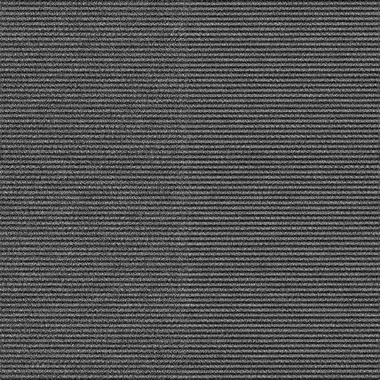
Frame (sec) | Frame Average (after bias sub)
0.5 | 0.856396
0.5 | -0.157764
0.5 | -0.60657
0.5 | -0.34984
0.5 | -1.49175
0.5 | -1.99268
0.5 | -1.68962
0.5 | -1.68268
0.5 | -0.823135
0.5 | -0.578164
30 | -3.70106
60 | -3.98557
2nd Data of Dark Frames

Slide 15
Further Work
Continue to characterize
Work with Hexapod and CCD in Dewar
Notes:
Mention that Hexapod is used to remove jitter as I did in 2nd slide

Slide 16
Thank you for listening!
Questions?

Slide 17
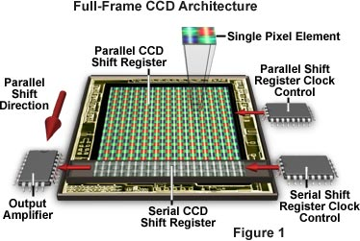
http://micro.magnet.fsu.edu/primer/digitalimaging/concepts/interline.html
Notes:
Backup slides (further explain CCD and electrical components)

Slide 18
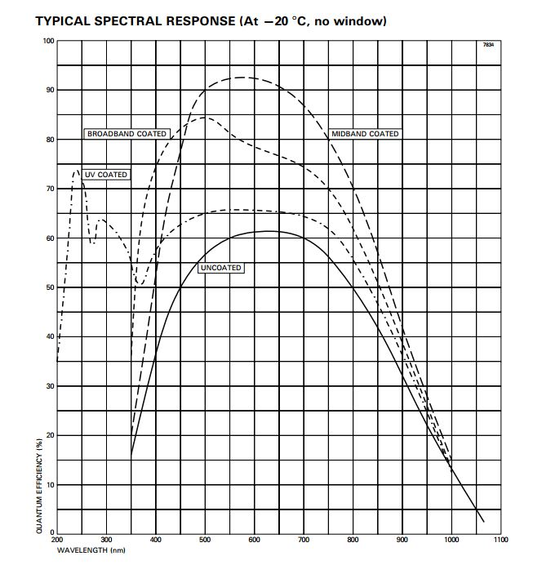
Notes:
Backup slides (compare to QE curve from our own data)

Slide 19
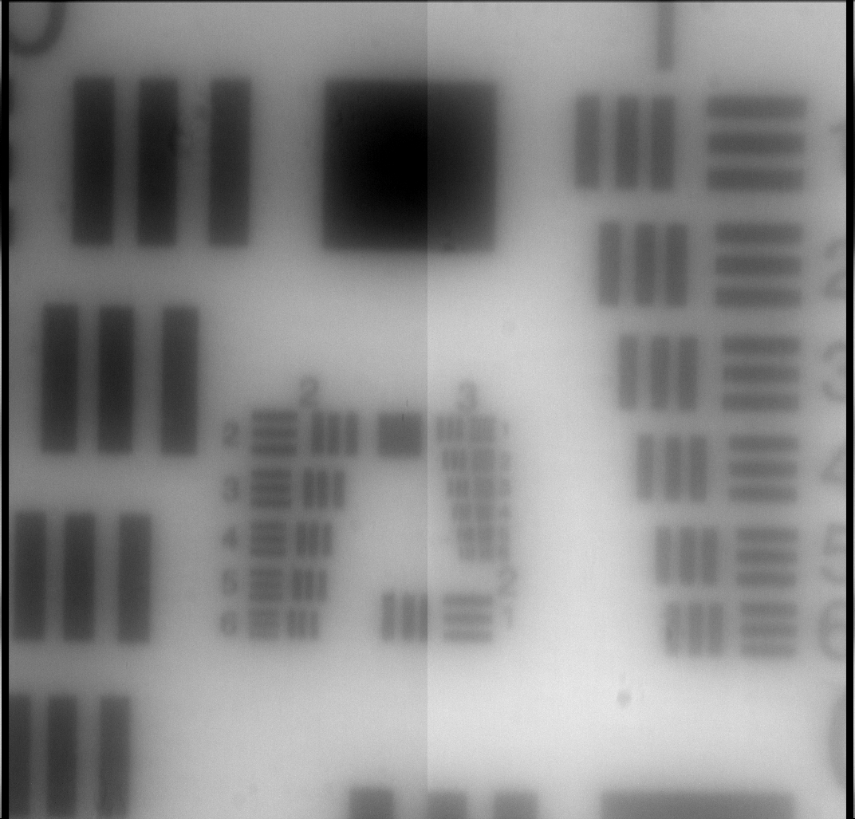
Notes:
Backup Slides (show further development with resolution)

