Slide 1
Using Model-Based Systems Engineering at Osiris-ReX
Stephania Vasilieva
University of Arizona
Advisor: Roberto Furfaro
Assistant Professor, Department of Systems and Industrial Engineering, University of Arizona
Arizona Space Grant Symposium
April 18th, 2015

Slide 2
Background
Osiris-Rex
Ground Systems
Systems Engineering
Requirement management
System-modeling
CORE

Slide 3
Objectives
Ameliorations
Flow of information
Consistency between teams

Slide 4
Methods
Flow of information
Use CORE throughout organization
Import and export requirements from/into CORE
Consistency between teams
Inter-team logic diagrams

Slide 5
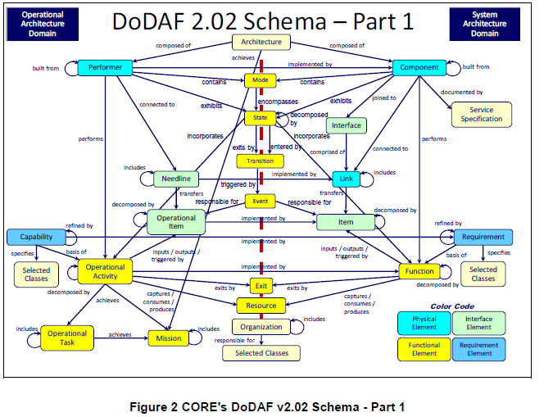
"CORE's DoDAF V2.02 Schema - Part 1.
" Architecture Definition Guide.
Blacksburg: Vitech Corporation, 2014.
N. pag. Print.

Slide 6
Impact
Updated requirements
Compare requirements from science team
System modeled
Logic diagrams implemented
Software Team
Instrument data

Slide 7
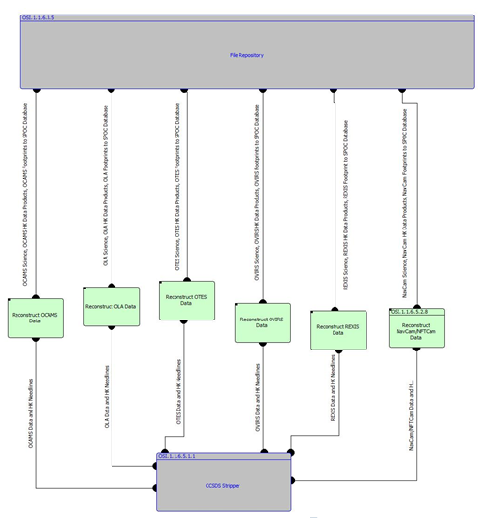

Slide 8
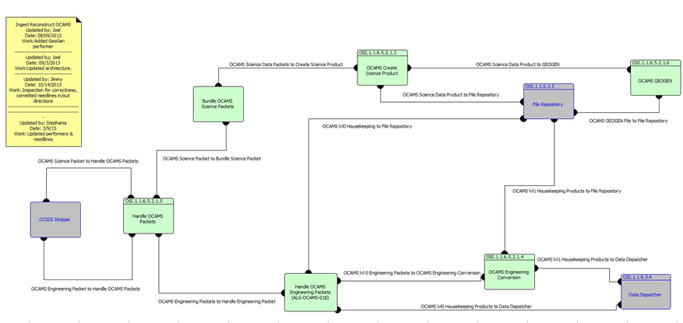

Slide 9
Conclusion
Requirements captured
Ground System modeled
Greater understanding
Project better recorded
Teams’ involvement
Collaboration

Slide 10
Next Steps
Never-ending
Always need to update
Model other parts of the system

Slide 11
Acknowledgements
NASA Space Grant Manager: Susan Brew
NASA Space Grant Symposium
Advisor: Roberto Furfaro
Graduate team:
Dan Wibben
Joel Mueting
Sean Gellenbeck
Research group
Lindsay Small

Slide 12
Thank you!

