Slide 1







Analysis of Carbonaceous Airborne Particulate Matter at Mining Sites in Southern Arizona
Solianna Herrera
Research Supported by:
NIEHS Superfund Research Program
The National Science Foundation
NASA Space Grant Consortium 2014

Slide 2
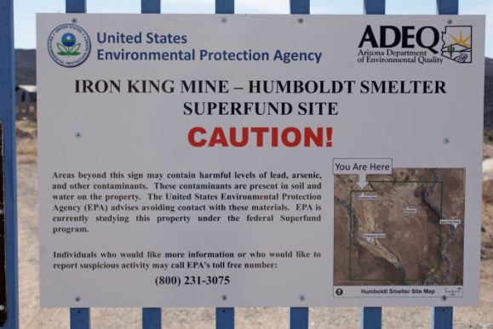
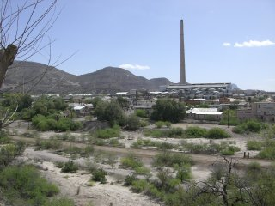
“Superfund”
Dewey-Humboldt AZ:
Ex-Ferrous Mining Site
Hayden AZ:
ASARCO owned Copper Smelting Site
Soil Concentrations (ppm)
Arsenic: 6,460
Lead: 5,910
Soil Concentrations (ppm)
Arsenic: 14.0
Lead: 46.4
Notes:
Source:http://www.epa.gov/superfund/sites/docrec/pdoc1779.pdf

Slide 3
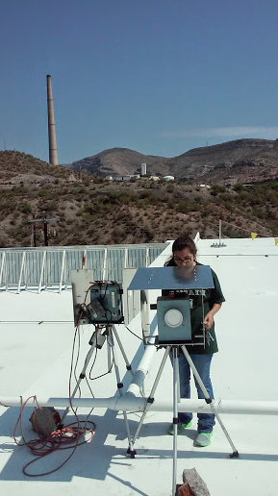
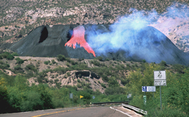
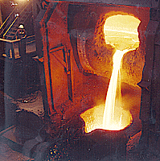
Project Background
Smokestack
Potential Sources of Carbonaceous Aerosols
Grinding
Smelting
Refining
Mine tailings management
Converter Furnace
Slag

Slide 4
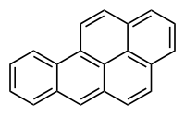
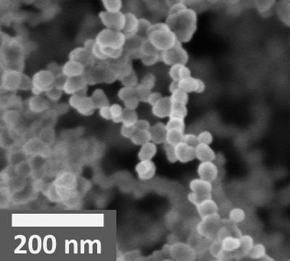
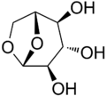
Contaminant Characterization
Organic
Elemental
Benzo[a]pyrene
Levoglucosan
Soot
Hexadecane
Notes:
Talk about the combustion sources of these contaminants

Slide 5
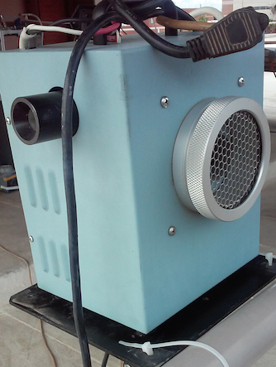
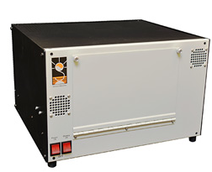
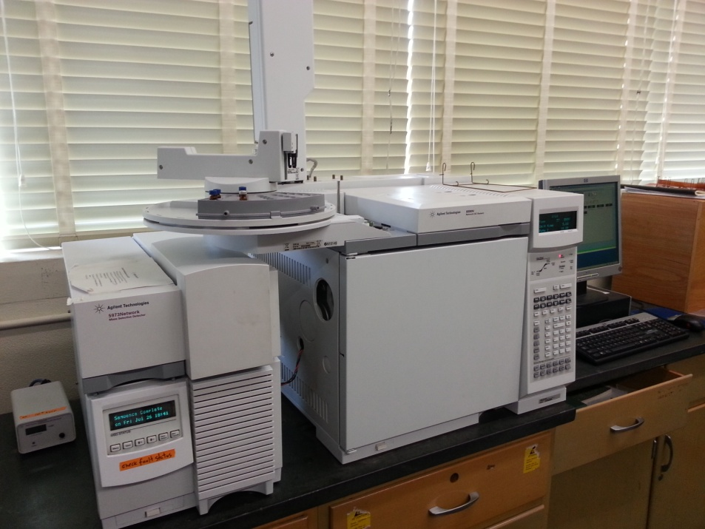
Instruments & Collection
Total Suspended Particulate
Collector
OC/EC Analyzer
Gas Chromatography/ Mass Spectrometry

Slide 6
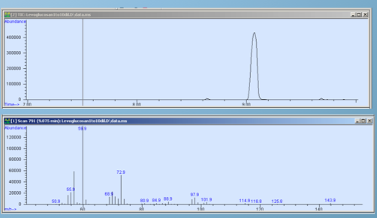
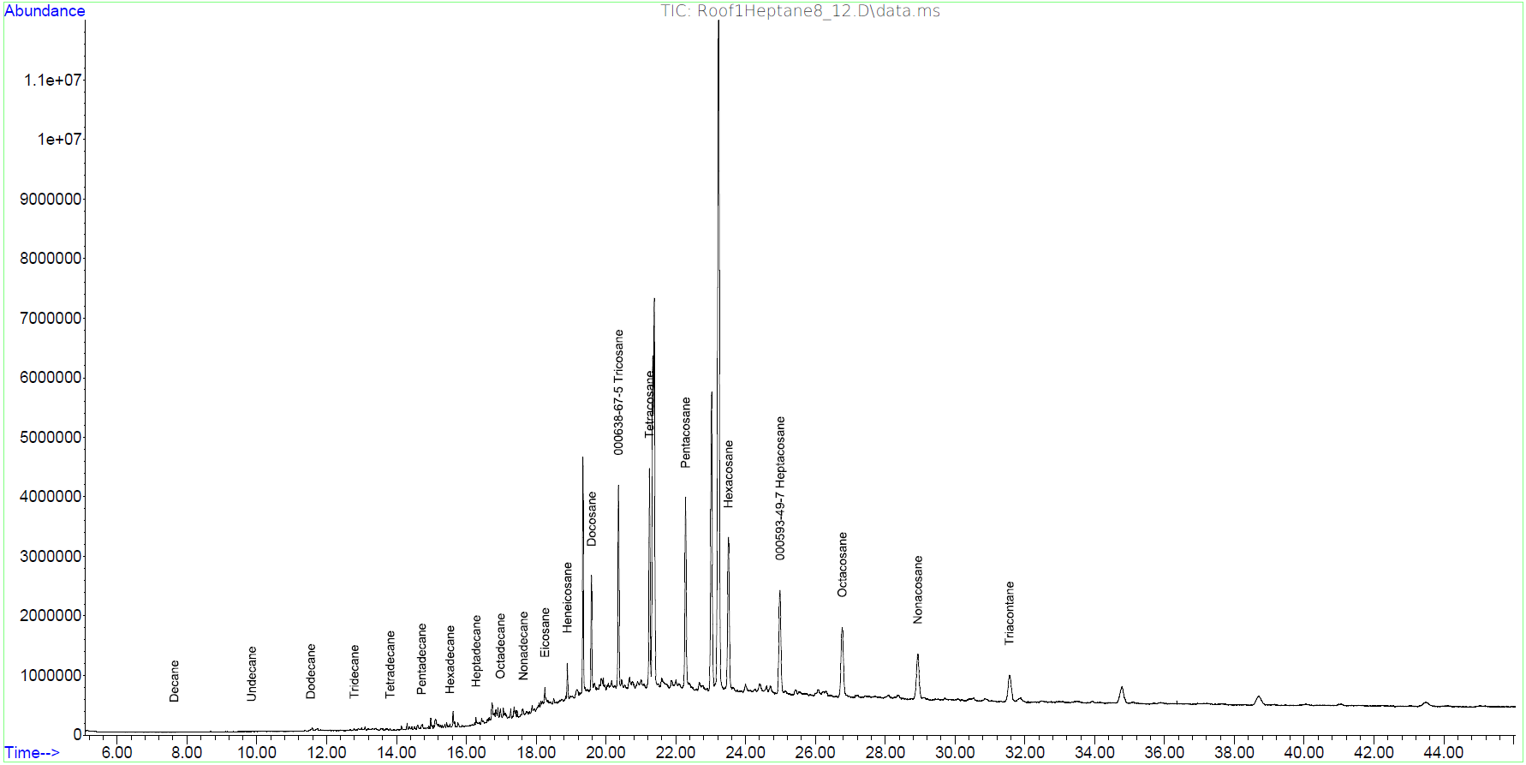
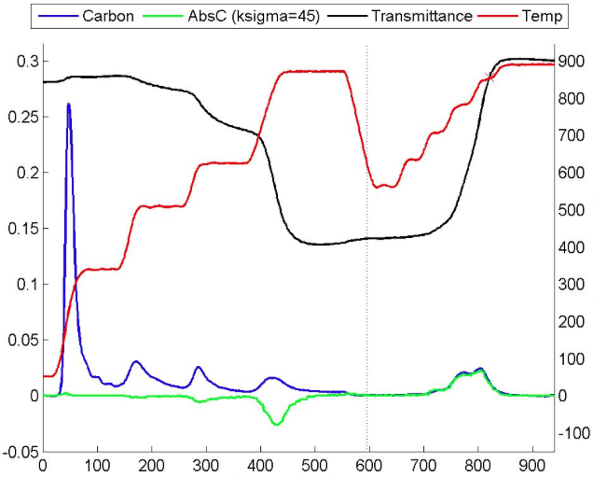
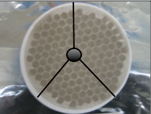
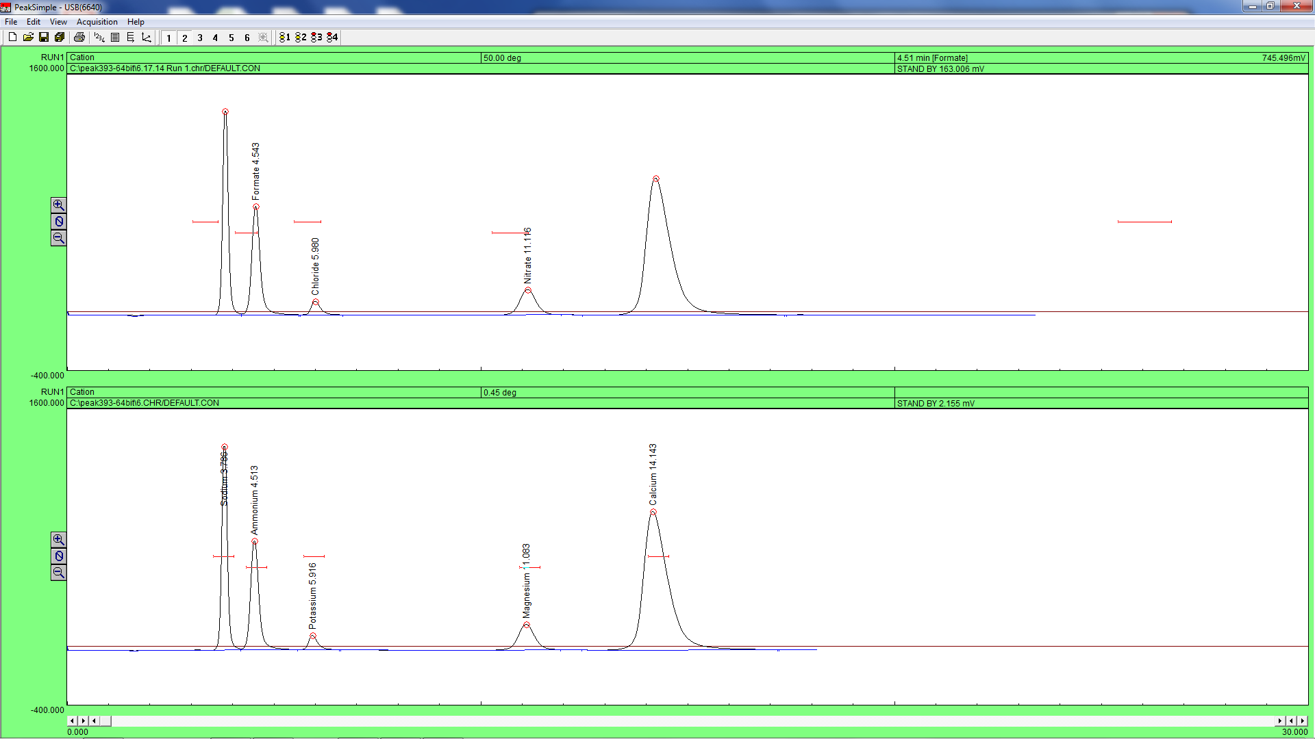
Intensity (arbitrary units)
Intensity (arbitrary units)
Retention time (sec)
Retention time (sec)
Non-Polar
Carbon Release ug/cm²/sec
OC/EC
Polar
Temperature C
IC
Analysis time (sec)
μS/cm
Retention time (min)

Slide 7
OC/EC Ratios
4.5

Slide 8
Organic and Elemental Carbon Breakdown
Hayden
OC
4.2
Hayden
EC
0.9
GV
OC
6.4
GV
EC
0.6
Iron King
OC
3.6
Iron King
EC
0.5
PAS
OC
17.1
PAS
EC
1.0
Notes:
Explain magnitude of the ratios
*Error bars are really range bars

Slide 9
Conclusions
Analysis shows amount of OC and EC present in samples
Hayden EC levels similar to PAS urban site
2013 Hayden Population=650
2013 U of A Student body= 42,236
Chemical reduction of trace/residual copper oxide to metallic copper by natural gas
Future research will focus on PAH characterization
Notes:
Carbon Aerosol Particulate Analysis shows the amount of elemental carbon and organic carbon that are present in the samples collected by the filter.
Haden elemental carbon numbers similar to the PAS roof urban site.
Interesting because in 2013, Haydens population totaled 650 people, and the population of the student body of the U of A alone stands at 42,236.
Future research will focus on characterization of PAH’s from the sites we collected samples from.

Slide 10
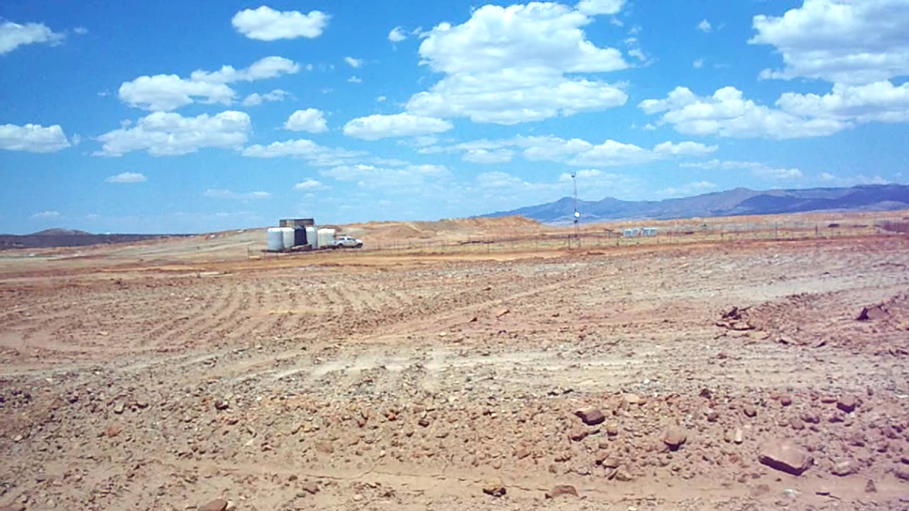
Questions?
Acknowledgements
K.P Rine, Mary Jones, Victoria Raught, Chad Smith, Matthew King, Omar Felix, Michael Stovern, Jong-Sang Youn, Armin Sorooshian, E.A. Saez, Eric A.Betterton

