Slide 1



Biomass and Carbon Residence Time Estimation by Remote Sensing and Direct Measurements at the Santa Rita Experimental Research Station
Theodore Jones
University of Arizona Space Grant Intern
Joel Biederman, Russ Scott
USDA Agricultural Research Service
Notes:
Map into anouther slide
Methods first
Scale bar

Slide 2

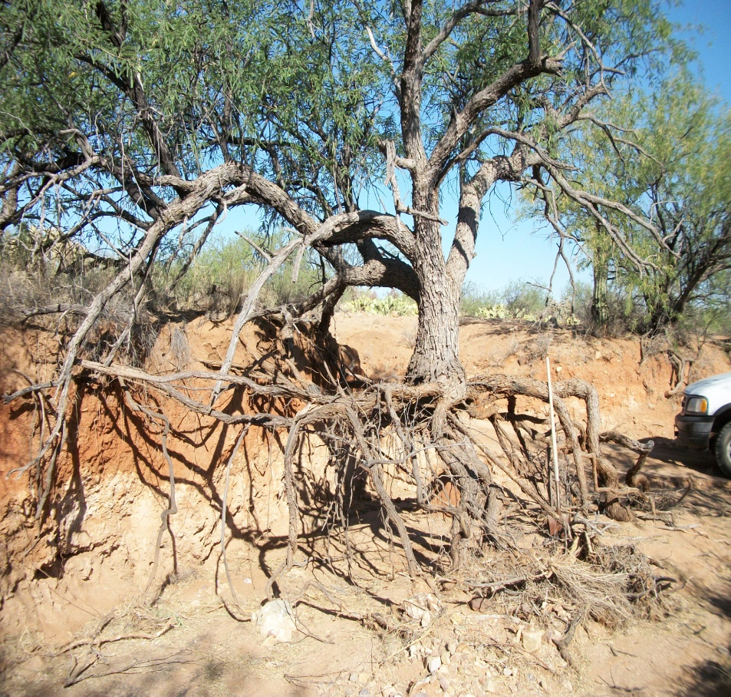


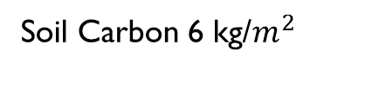
Why Measure Carbon Residence Time?
tr= carbon stored / photosynthesis
role of an ecosystem in climate change
stored carbon can account for decades worth of photosynthesis
changes in the environment can release quickly
Above Ground Biomass
Below Ground Biomass
Soil Carbon 6 kg/$m^{2}$
Notes:
The carbon stored includes soil carbon and biomass. In my work, Im focused on biomass, which is more variable in space and time
Eddy flux measures photosynthesis, which how C gets into the ecosystem
Devide sign into slash

Slide 3
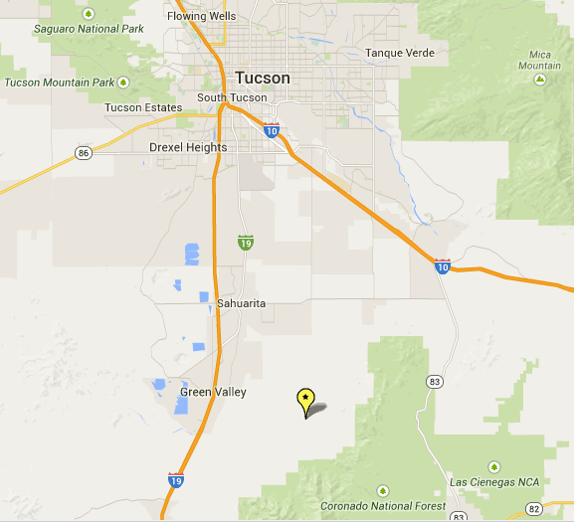
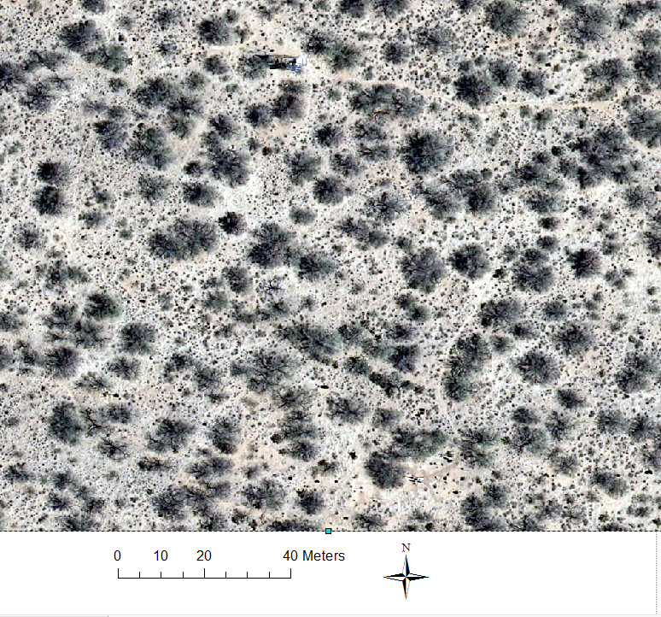
Santa Rita Experimental Research Station Flux Tower Site

Slide 4
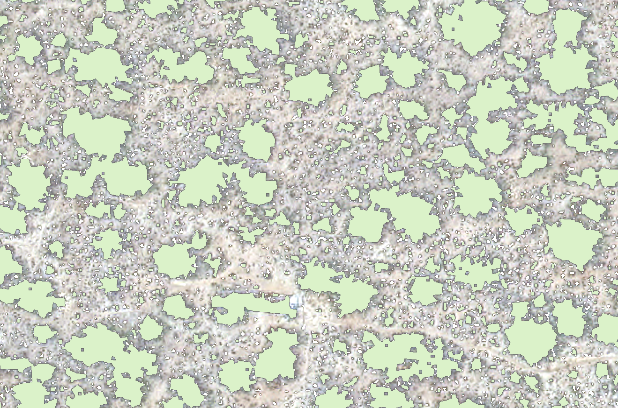


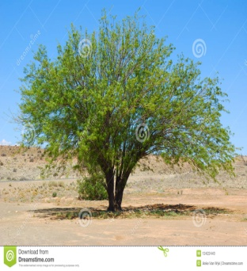
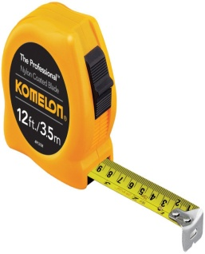

Measuring Biomass
Biomass = carbon contained in the plants
Biomass
Allometric Relationships
Tree crown areas (Aerial photographs)
Diameter/Height
Percent Cover Estimates
LIDAR/Wavelet Method Based Height
Manual Measurements
Notes:
Biomass – The mass of the carbon contained in the various plants in the ecosystem.
Allometrics – relationships between plant measurements such as height,diameter and area with biomass
Lidar is:
Manual measurements of:
Note pima county data set
* Colors instead of spelled out range

Slide 5
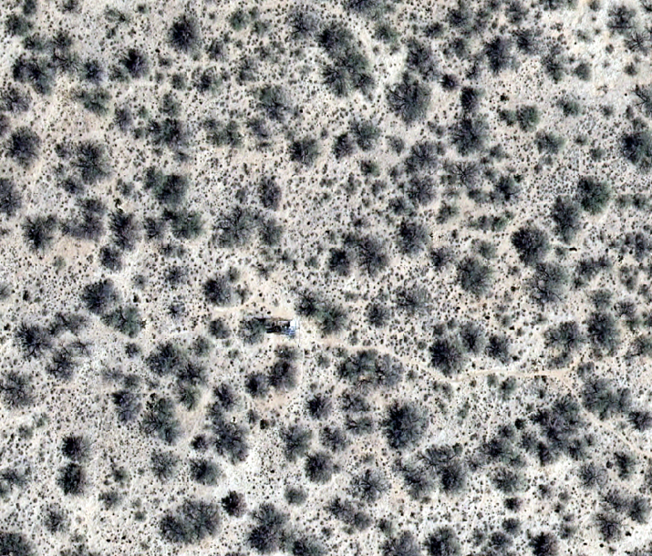
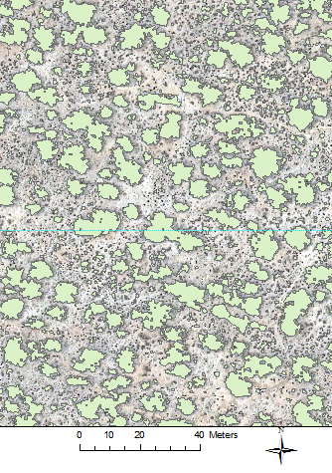
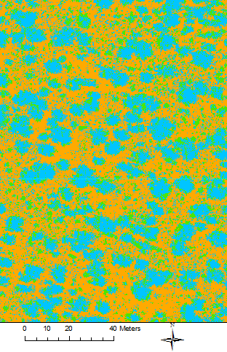
Aerial Photo-based Methods
Visual photography
Bare soil
Tree
Mixed/grass
Estimates of individual tree crown areas
Percent of the terrain covered by vegetation
Flux tower
tree canopy
Notes:
Say where the datasets come from
Polygon method merges trees and may overestimate
We can use liDar to address this. . . .

Slide 6
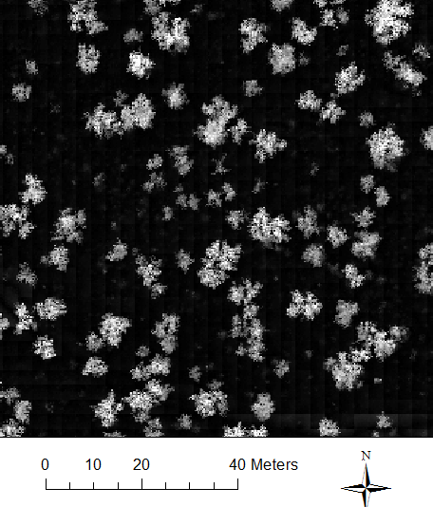
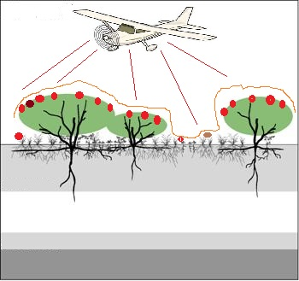
Airborne LiDAR Method
Lidar Dataset
Wavelet Method Results (Swetnam et. al. 2014)

Slide 7
Biomass
Biomass estimation method
Notes:
Polygon method merges trees and may overestimate
Wavelet method omits smaller trees due to threshold, we need threshold because. . . .

Slide 8
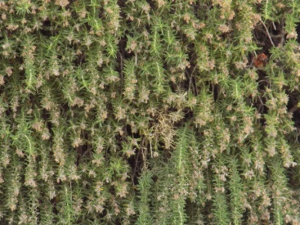
Total Biomass and Residence Times
Above ground biomass --1.7 kg m² to 3.1 kg m²
Mean Carbon Residence Time 25 to 35 years
Below Ground Biomass 0.82 kg m²
Input Photosynthesis 0.3 kg/m² per year
tr= carbon stored / photosynthesis
Notes:
Give a range of calculated residence times based on your 4 estimates
Repeat eqn and note rate

Slide 9
Conclusions
The estimated biomass varies from 1.7 kg/m^2 to 3.1 kg/m^2 among the methods.
Mean carbon residence time is 25.4 to 34.6 years in spite of 45% uncertainty in aboveground biomass
Future steps for this project will include:
  estimating the biomass of understory plants
  expanding the analysis to other sites and ecosystem types

Slide 10
Biomass and Carbon Residence Time Estimation by Remote Sensing and Direct Measurements at the Santa Rita Experimental Research Station
Theodore Jones
University of Arizona
tjones2@email.arizona.edu
Notes:
Map into anouther slide
Methods first
Scale bar

