Slide 1
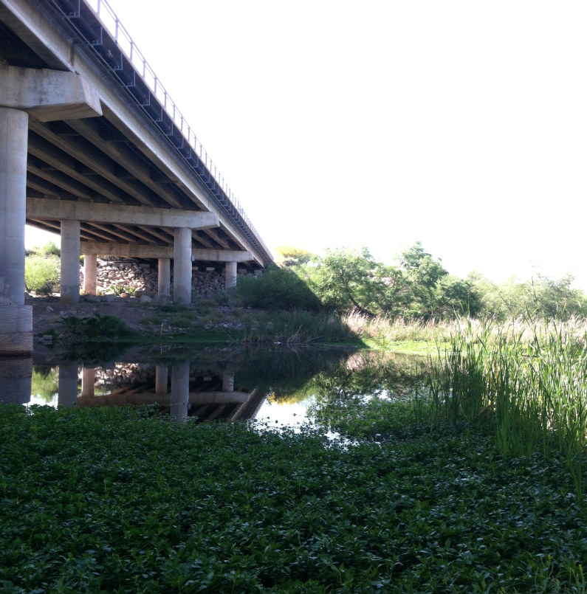




Characterization of DOC in Accidental Urban Wetlands
Stephanie Bone
Co-authors:
Dr. Hilairy Hartnett, Dr. Monica Palta
Acknowledgments:
'CANDY Lab' (CArbon and Nitrogen Dynamics), Dr. Enrique Vivoni,
ASU/NASA Space Grant, School of Earth and Space Exploration

Slide 2
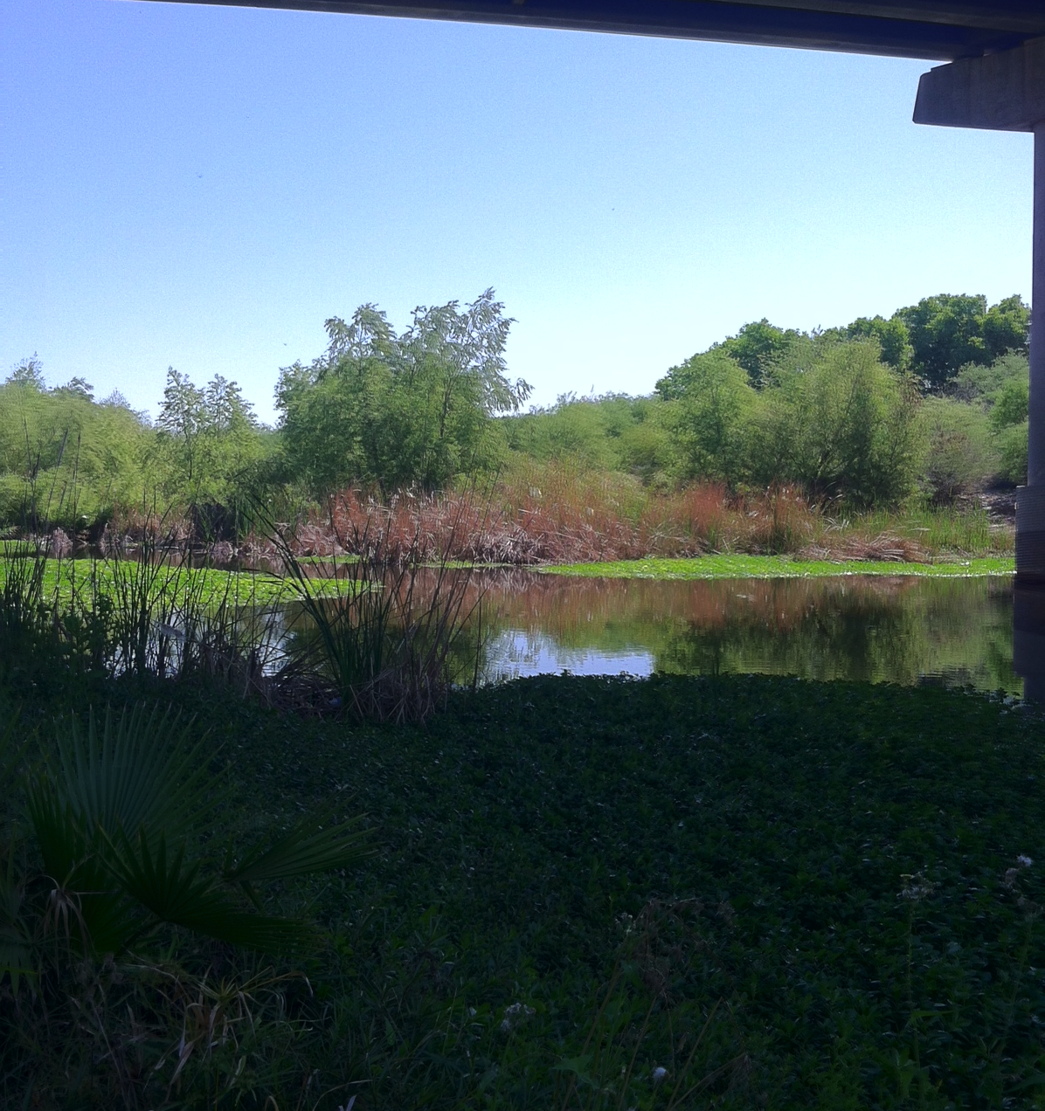
Why is it important ?
Dissolved organic carbon (DOC) is an important intermediate in the global carbon cycle
Determine current and future effects of land use and land management on stream biochemistry
Implications for water quality and nutrient processing capacity in the channel
What am I going to do?
Quantify and characterize DOC
Sample water from Salt River during base and storm flow
Notes:
DOM- composed organic matter from terrestrial, atmospheric and autochthonous sources
DOM is metabolically important in rivers as it supplies energy (carbon) and nutrients to bacteria and algae contributing to eutrophication
Wetlands- important transitional zones from terrestrial and aquatic environments

Slide 3
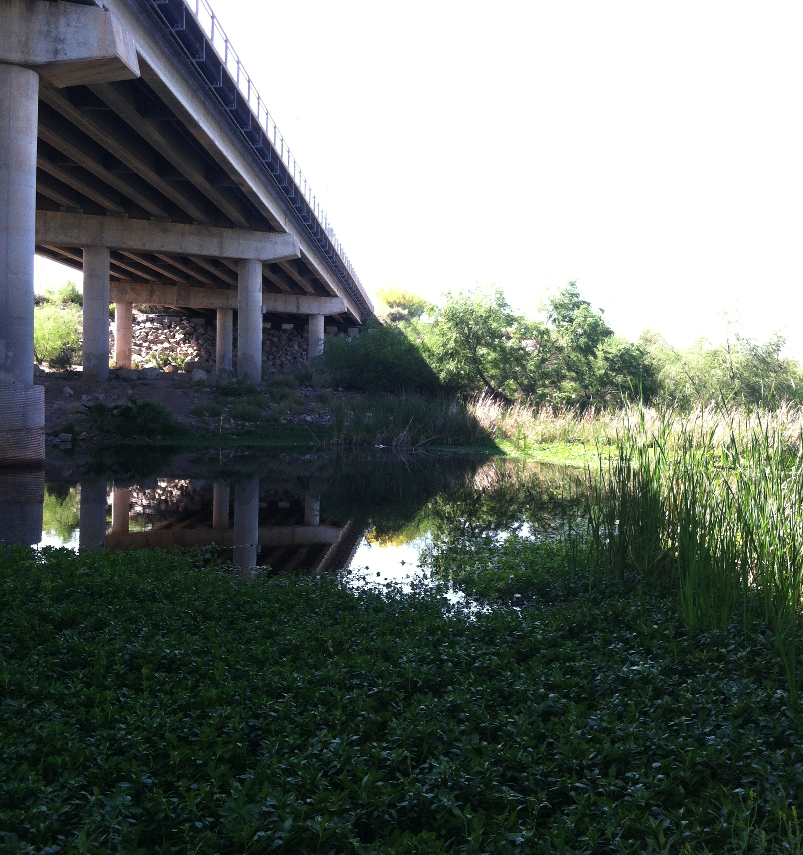
What is an Accidental Urban Wetland?
Storm and Waste water
Receive and modify materials from the city
Municipal land use and water infrastructure decisions
Urban management strategies
Soil conditions and plant communities
Notes:
They are often formed in abandoned industrial areas that are low-lying in the landscape, where overland flows from municipal water use and storms accumulate and eventually support wetland soils and plant communities. Their positioning within the urban matrix means that accidental wetlands can both receive and modify materials from cities. Accidental wetlands tend to receive high volumes of pollutant-enriched municipal, storm and rainwater. Accidental wetlands tend to receive high volumes of pollutant-enriched municipal, storm and rainwater.
environmental heat mitigation for urban low-income and homeless populations. Due to their pervasiveness and provision of ecosystem services of potential value, accidental wetlands merit consideration in urban management strategies

Slide 4
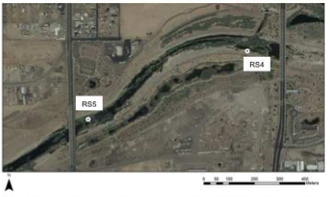
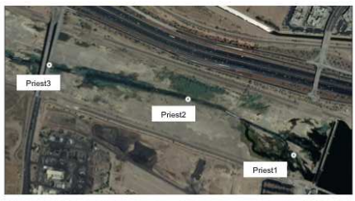
What is an Accidental Urban Wetland?
Flowpaths through wetlands
Notes:
Salt River traversing Phoenix, AZ
Construction of Tempe Town Lake
Urban Expansion
Precipitation

Slide 5
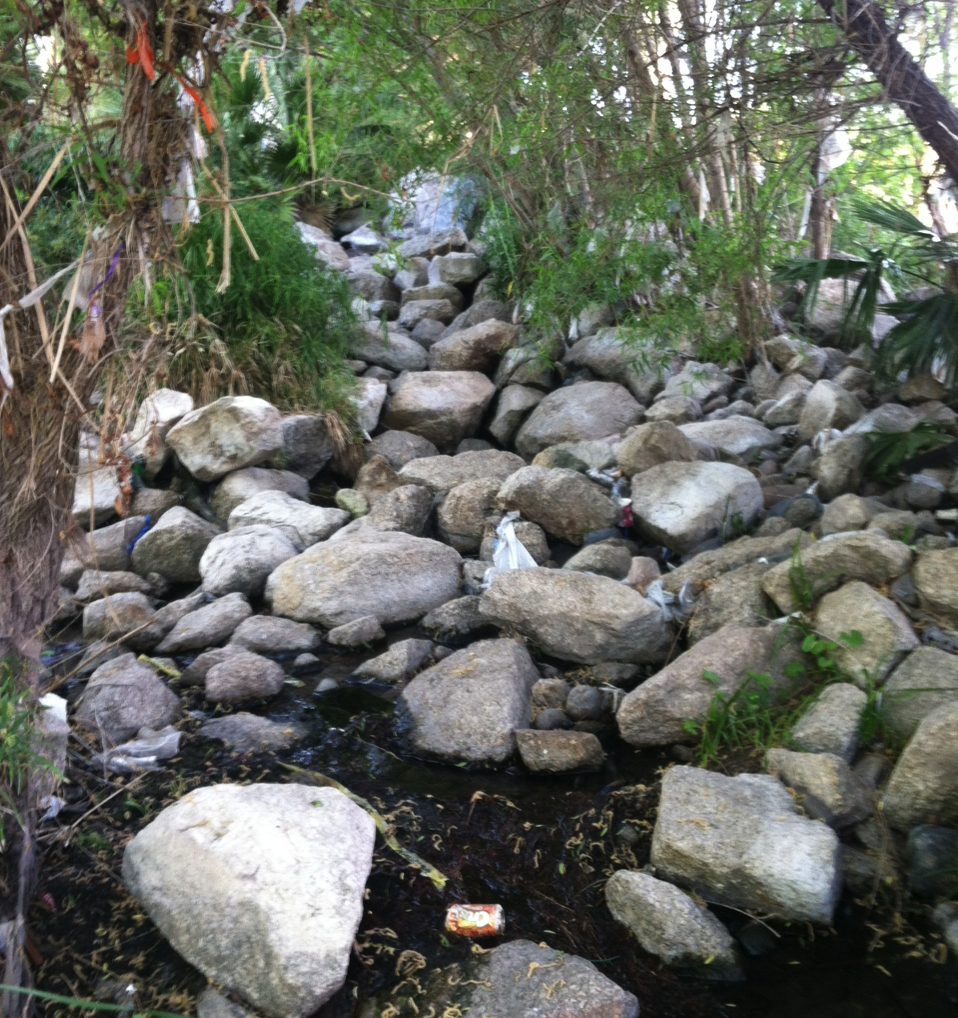
Previous Urban Wetland Studies
Dr. Palta has conducted research in northern New Jersey and Phoenix, AZ
Urban areas have high nitrogen loading from the atmosphere and from storm water
Urban wetlands remove nitrate
Little information about how much and what sources of carbon in urban wetlands

Slide 6
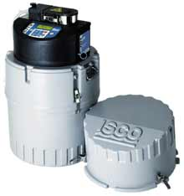
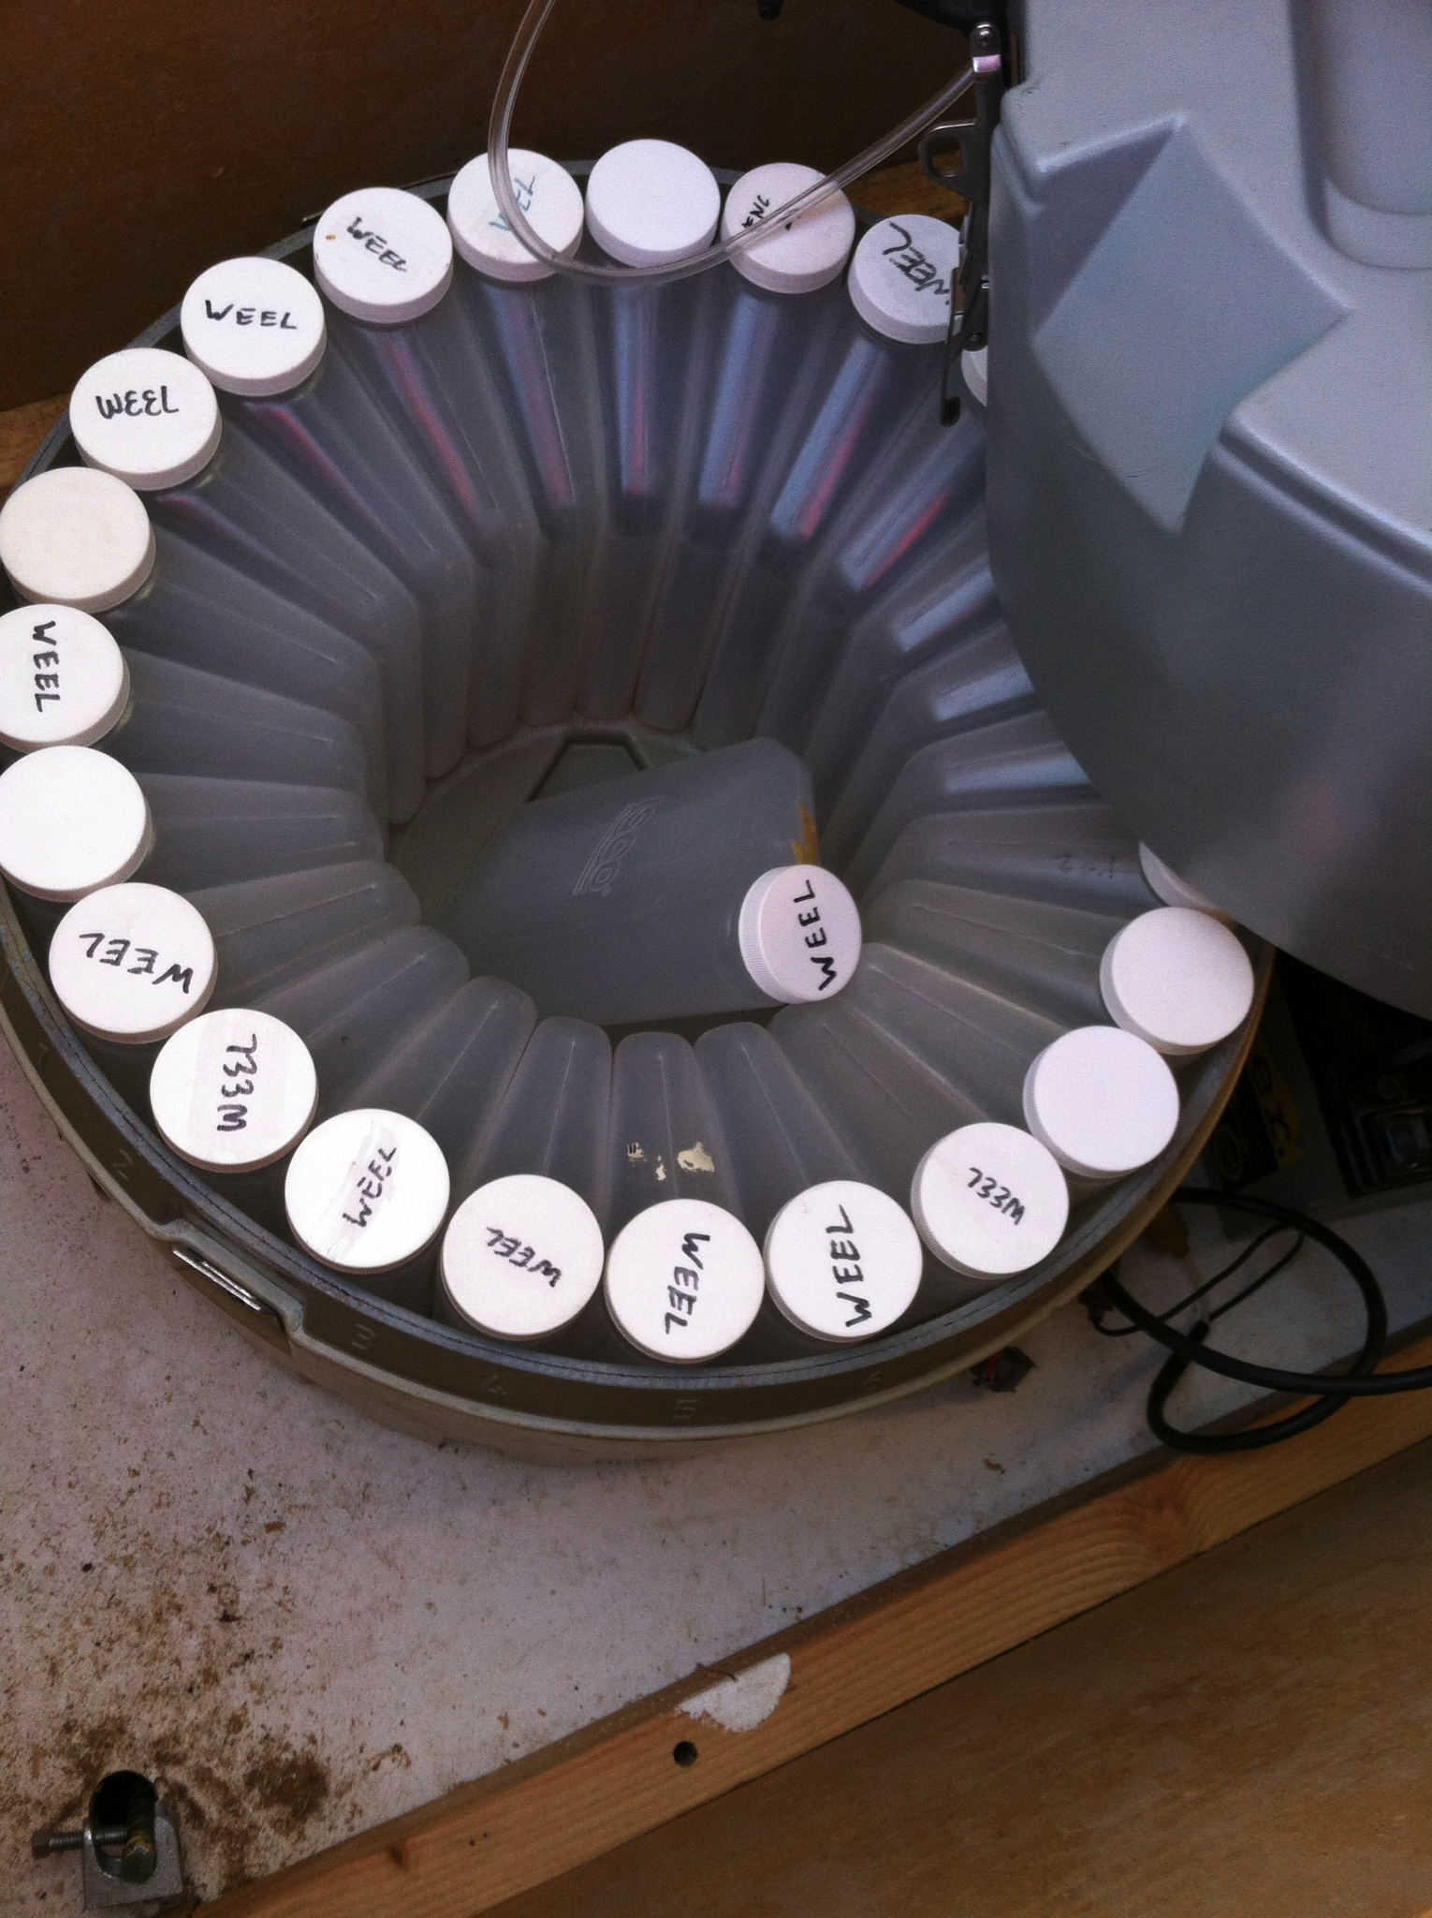
Water Sampling
Sampling will occur 3 times for storm flow and 3 for base flow
Notes:
sampling procedures that must be performed in order to ensure that the DOC measures is strictly from the sampling site and not from the environment in the laboratory
Will

Slide 7
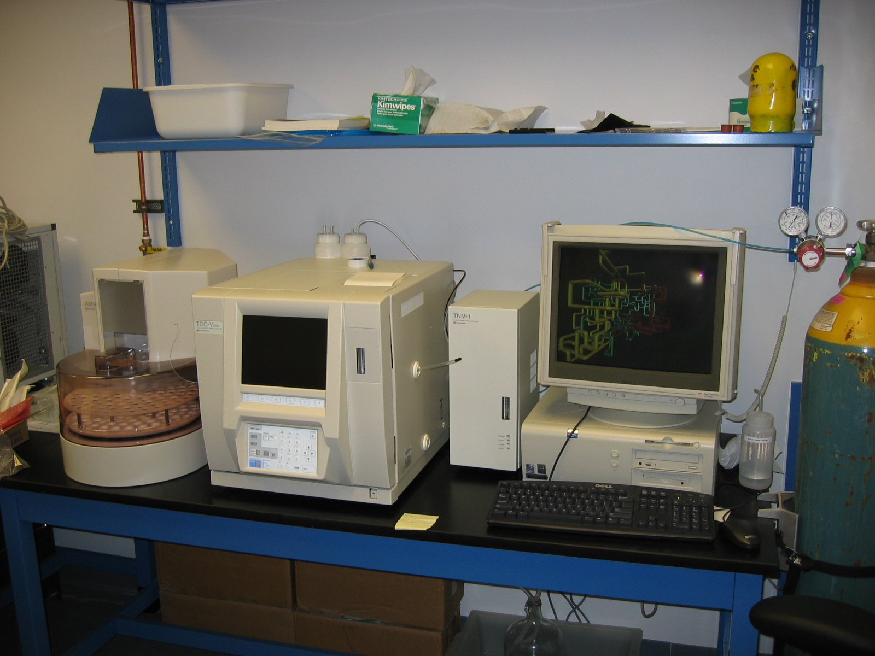
High Temperature Combustion-Oxidation (HTCO)
Tells how much carbon is in the sample
Notes:
FI (two dimensional fluorescence index) provides information about the source or degree of degradation of DOM
EEM in formation about source, degree of humification and structure complexity
PARAFAC-excitation and emission matricies can be analyzed by using modeling
Breaks down DOM into individual components and provides estimates of the relative contribution of each components to total fluorescence
Humic-like fluorescence help distinguish between terrigenous and aquatic DOM
Changes in land use may affect biochemical composition of DOM and aquatic food-web dynamics
Identify water pollution and urban catchments

Slide 8
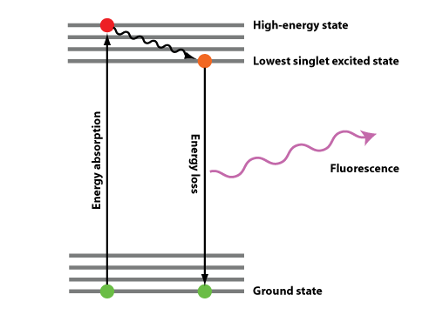
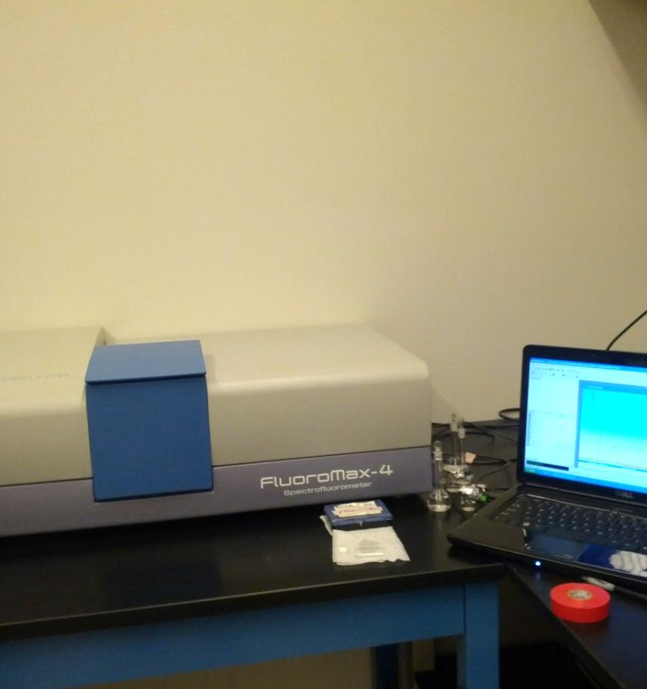
Excitation-Emission Matrix (EEMs) Spectroscopy
Fluorescence occurs when molecules absorb energy causing an electron to be promoted to an excited state; as it returns to ground state, energy is lost as light
- molecules have specific excitation & emission wavelengths

Slide 9
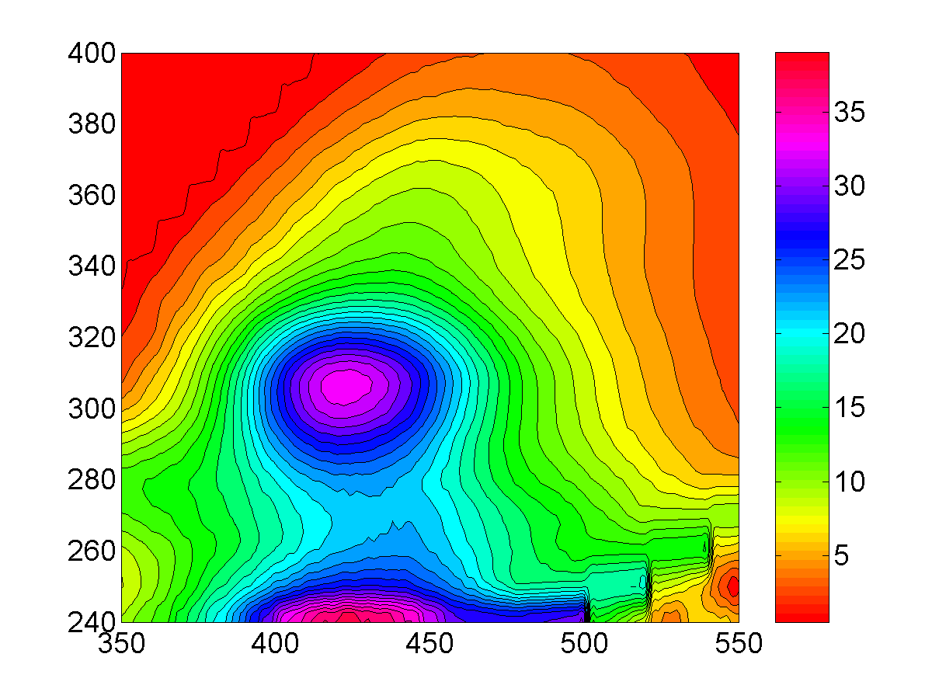
What does a DOC fluorescence spectrum look like?
Humic-like
Excitation (nm)
Protein-like
Emission (nm)

Slide 10
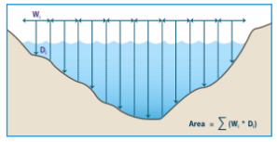
Measuring DOC
Measurements
Calculations
Lab
DOC
Fluorescence
Field
Flow rate
Water height
NWS
Precipitation
Discharge
Q=VA
Velocity varies across stream channel and from the surface to the bottom of the stream
Load
Determine carbon/ flow for each season
Q_{S}=Q_{w}C
Q_{S}=constituent discharge
Q_{w}streamflow
C= concentration
Discharge times concentration
Notes:
Varies across a stream channel and from the surface to the bottom of the stream because of friction and irregularities in cross-section and alignment

Slide 11
Predicted Results - I
Notes:
Strong relationship between protein-like fluorescence and biodegradable DOC
Humic-like fluorescence controlled by hydrological processes and protein-like fluorescence linked with biological processes
Anthropogenic and climate drivers will influence the dynamics of the aquatic ecosystem
Base vs storm flow?
Bioavaliability of wetland DOC will depend on season and anthropogenic activities

Slide 12
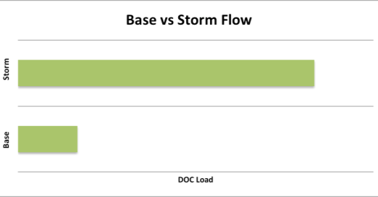
Questions that need to be answered
Predicted Results - II
Flow and concentration will determine DOC load
Differences between base and storm flow ?
Effects of season?
Effects of human activity?

Slide 13
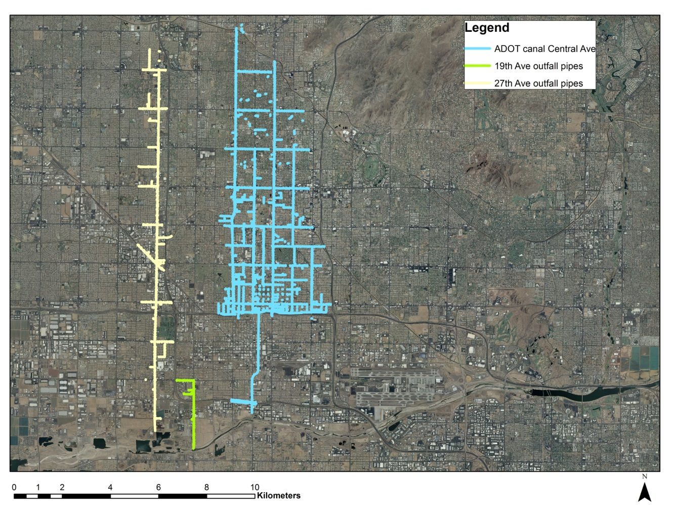
Any Questions?

Slide 14
References
Brooks, Paul. Haas,Peter. Huth, Anne. 2006. Seasonal Variability in the concentration and flux of organic matter and inorganic nitrogen in a semiarid catchment, San Pedro River, Arizona.
Palta, M. Grimm, N. Unrestored accidental urban wetlands
Seitzinger, S.P. Hartnett, H. Styles, R. 2005. Molecular-level chemical characterization and bioavailability of dissolved organic matter in stream water using electrospray-ionization mass spectrometry.

