Slide 1
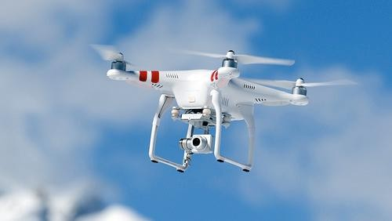
Utilizing a Quadcopter for Collecting Aerial Imagery of Environmental Field Sites
Gina Rivera
Mentor: Enrique vivoni
ARIZONA STATE UNIVERSITY

Slide 2
INTRODUCTION
Purpose
Environmental Field Sites
Methods
Results
Comparison
Questions

Slide 3
PURPOSE
The purpose of this project is to test the level of proficiency that a low-cost quadcopter (DJI Phantom Vision 2+) has in creating an orthomosaic image.
Notes:
2013 Statewide Symposium Announcements
Date & Time Announced!
The Symposium Banquet will be held at the Sheraton Phoenix Airport Hotel in Tempe, AZ. The Banquet typically begins at 6:00pm with a meet and greet. Dinner typically served at 7:00pm.This year's speaker is TBD. This year's Statewide Symposium will also be held at the Sheraton Phoenix Airport Hotel in Tempe, AZ typically from 8:30am to approximately 4:00pm. Lunch is TBD.
Information
For more information, please visit Arizona State University's Space Grant Symposium Information page.
Symposium Banquet (Friday, April 13)
The Friday night Space Grant Banquet will be held at the Sheraton Phoenix Airport Hotel at 1600 South 52nd Street, Tempe, Arizona 85281. The banquet will begin at 6:00pm. Nice business dress is in order.
Symposium (Saturday, April 13)
The Saturday Space Grant Symposium will be held at the Sheraton Phoenix Airport Hotel at 1600 South 52nd Street, Tempe, Arizona 85281. The symposium will begin at 8:30am.

Slide 4
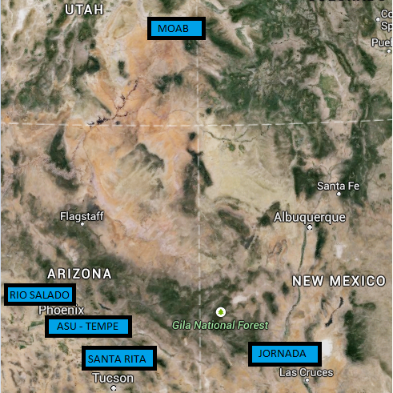
Environmental Field Sites
Moab, Utah : Moab
Tempe, AZ : Pao Verde
Tucson, AZ : Santa Rita
Las cruces, NM : Jornada

Slide 5
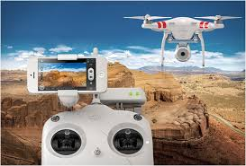
METHODS
Master the simple mechanics of flying a quadcopter
Download the APP on a smart phone
Program the quadcopter
to fly automatically
Take images throughout
its flight
Input images into Agisoft
Create an orthomasaic

Slide 6
RESULTS
MOAB, UTAH
Graduate Research student
Kritsen Whitney
Research Title
The Potential Role of biological Soil Crusts in Hydrologic Modeling of Dry Land Ecosystems

Slide 7
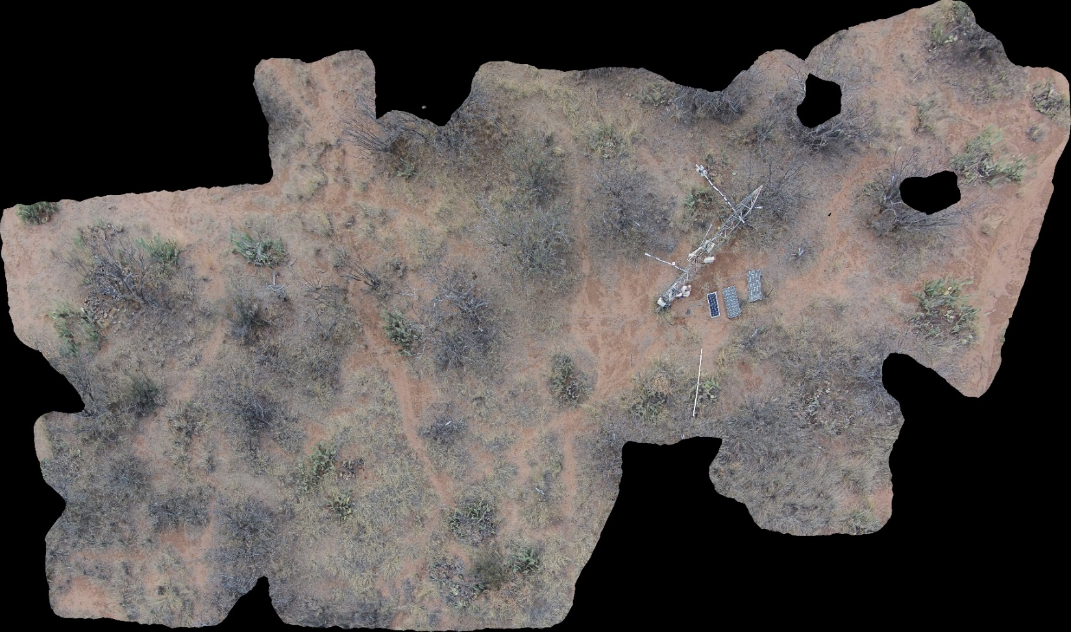
RESULTS
Tucson, AZ: Santa Rita
Graduate Research Student: Nolie Pierini

Slide 8
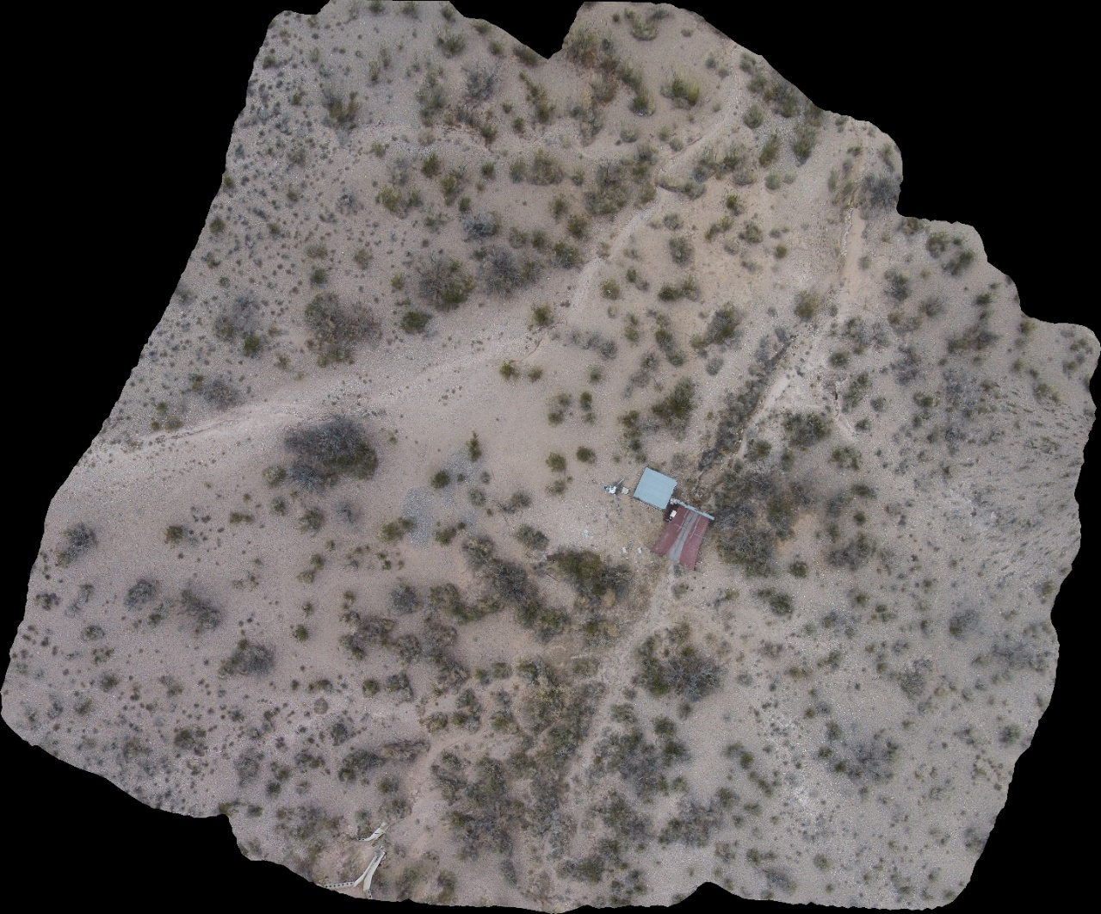
RESULTS
Las Cruces, NM: Jornada
Graduate Research Student: Adam Schreiner-McGraw

Slide 9
RESULTS
Tempe, AZ: Palo Verde
Research Title
Urban Meteorological
Flux Measurements
Using a New Mobile
Platform
Undergraduate Research
Student
Ivan Lopez-Castrillo

Slide 10
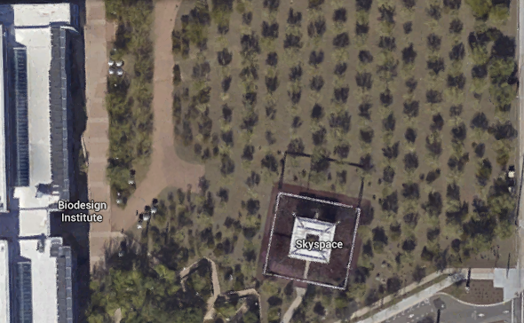
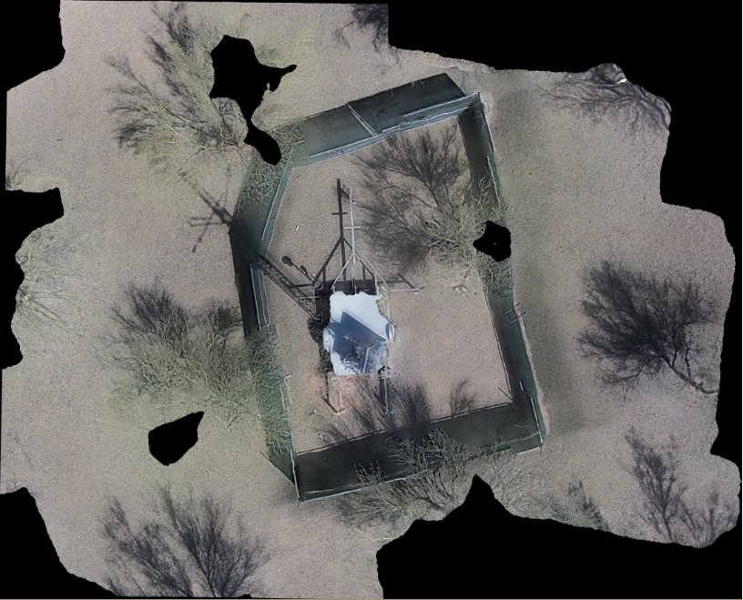
COMPARISON
Google Earth Image
Quadcopter Image

Slide 11
THANK YOU
QUESTION?

