Slide 1
VEGETATION CLASSIFICATION USING NDVI FROM UAVs
Amanda Urquiza
Mentor: Srikanth Saripalli
2015 Space Grant Symposium
Saturday, April 18th
Arizona State University

Slide 2



Acknowledgments
Dr. Srikanth Saripalli

Slide 3

Outline
Problem
Objective
Method
Results
Conclusion

Slide 4
The Problem
Currently, farmers rely on remote sensing data done from low earth orbit using instruments on satellites in order to monitor crops. This method is costly, untimely, and only provides the farmer with low resolution images.
Notes:
http://www.nss.org/settlement/ssp/

Slide 5
Objective
Take a low cost approach by using a modified off the shelf camera
Utilize unmanned aerial vehicles for aerial imagery of vegetation
Create high-resolution 3D topographic maps and overlay the NDVI data to monitor plant health conditions

Slide 6

NDVI
Normalized Difference Vegetation Index
NDVI is a tool used to analyze remote sensing data in order to monitor vegetation
Measures the amount of plant life in an area, as well as the state of plant health by forming a value for how green the area is

Slide 7
Methods
NGB Converted Canon SX260 HS Camera
This low cost NDVI camera had to initially be qualified through testing in a laboratory environment
To accomplish this, samples were taken from various plant species, and imaged over time to test if NDVI could resolve the changes in plant health
Notes:
Also mention: orientation of cameras

Slide 8
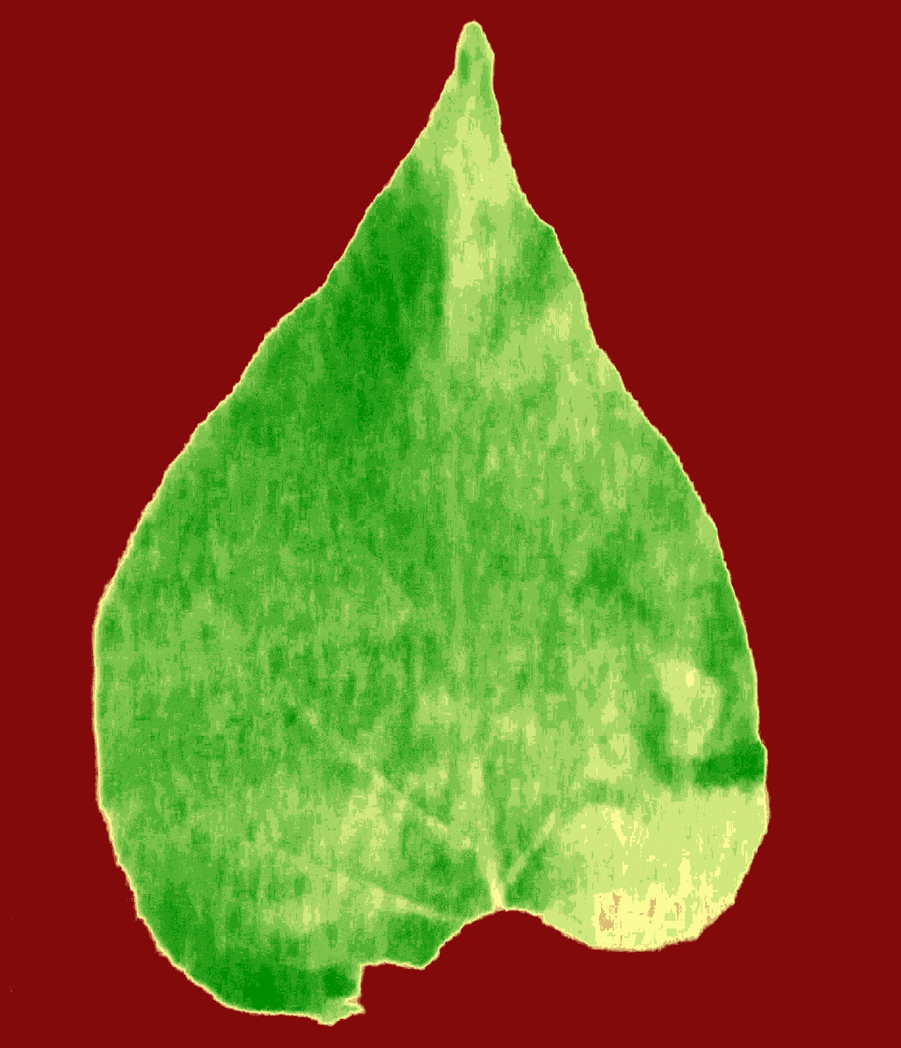
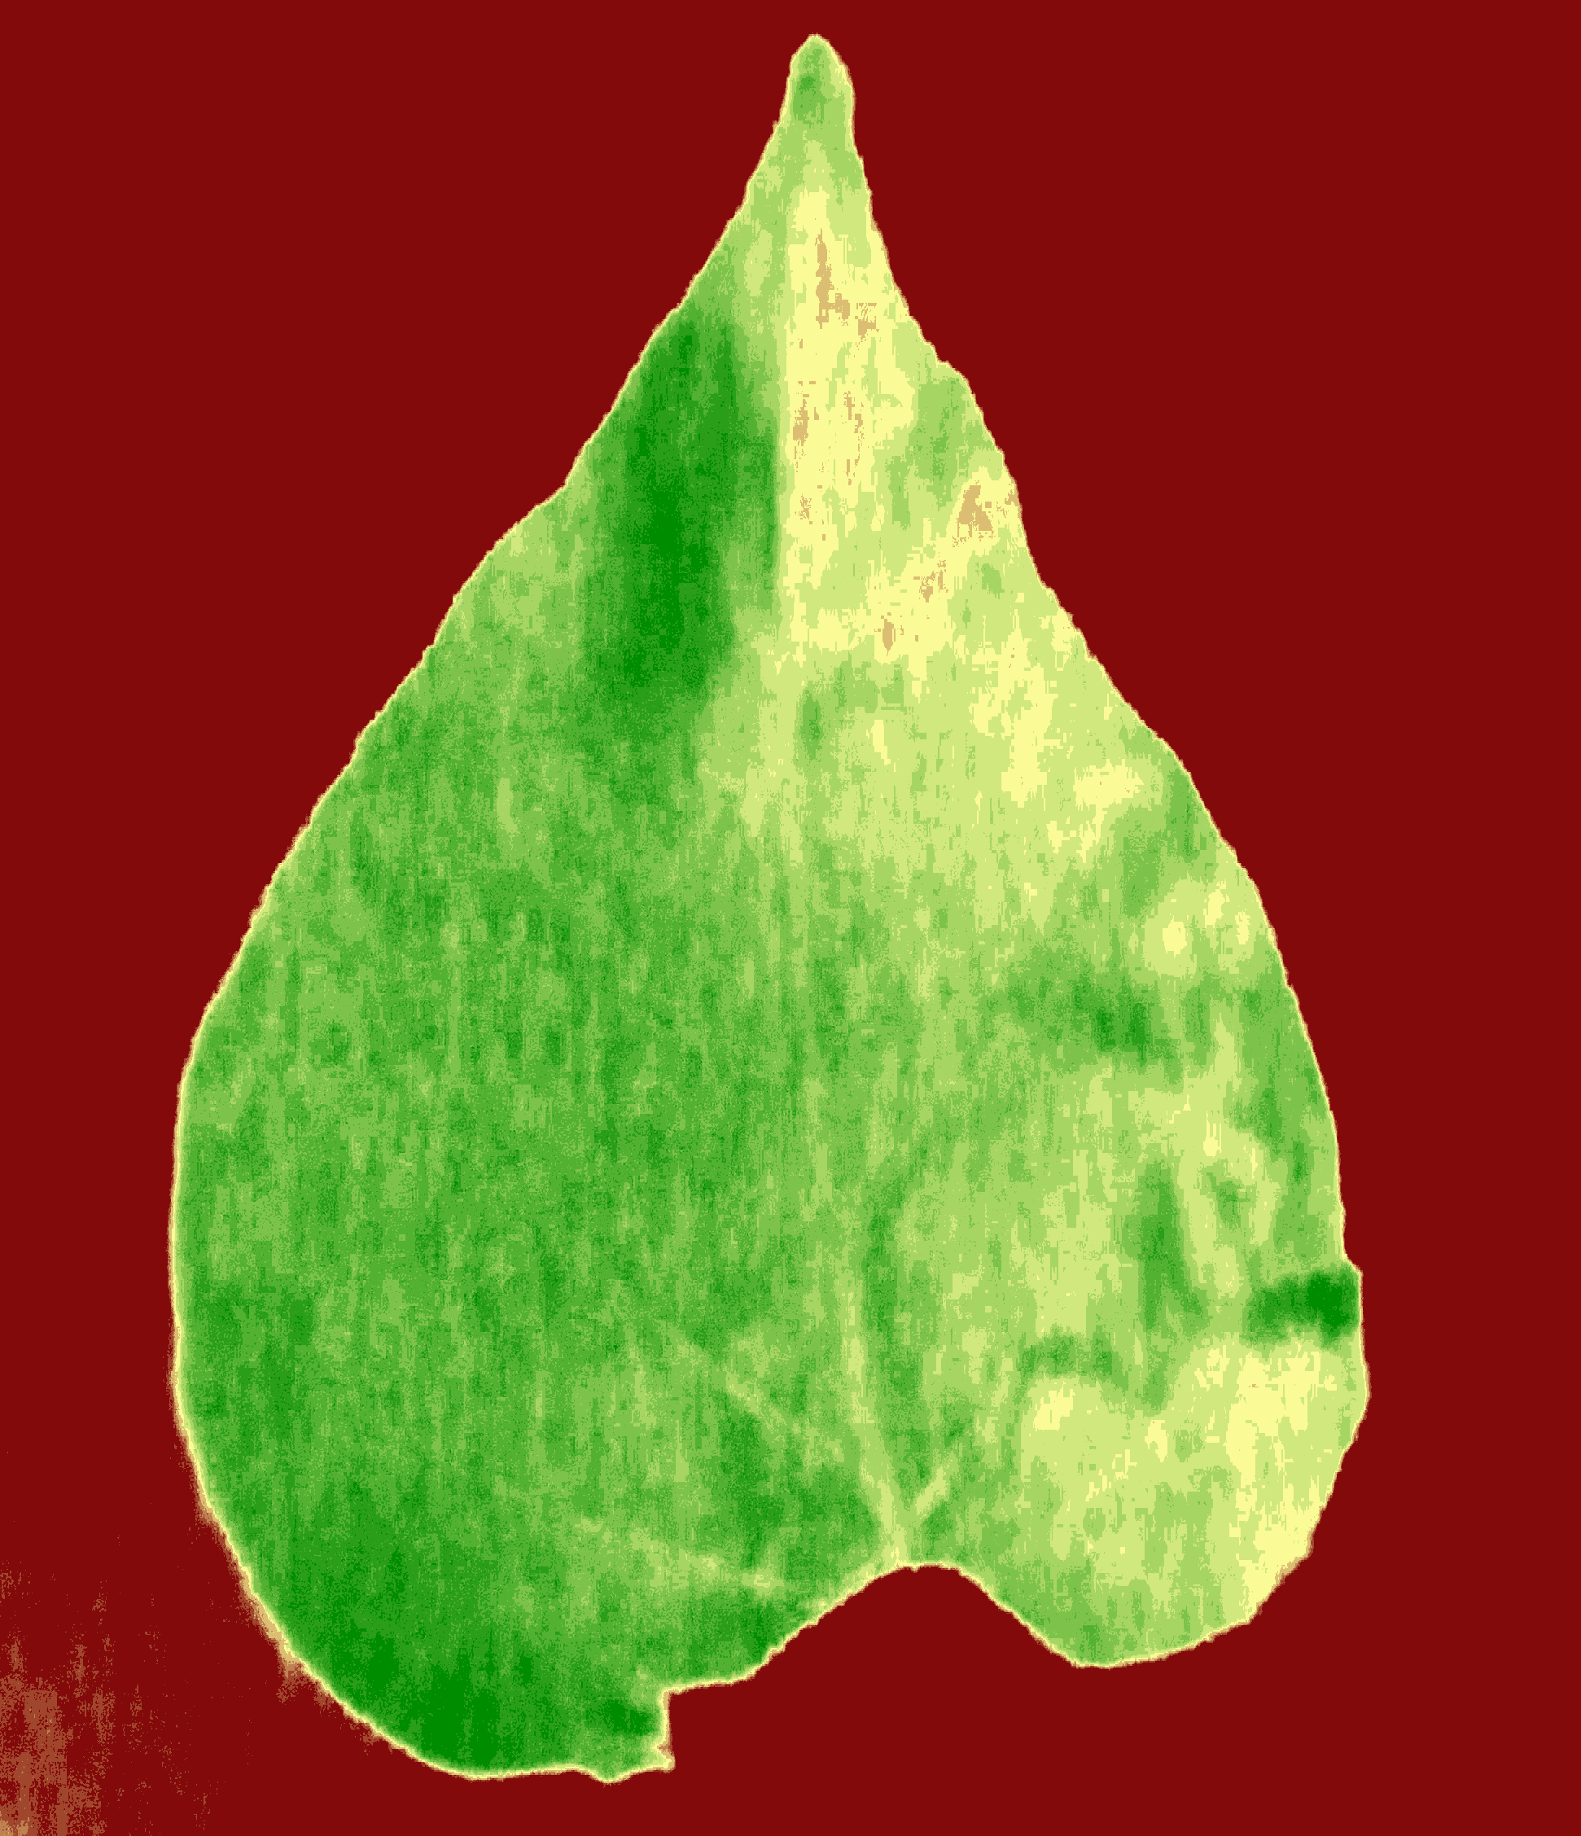
Methods
The greener areas represent good plant health. As expected, quantifiable decrease in green area occurred over time.
Post-processed image of a leaf 1 hour after separation from plant
Post-processed image of a leaf 3 hours after separation from plant
Notes:
Also mention: orientation of cameras

Slide 9
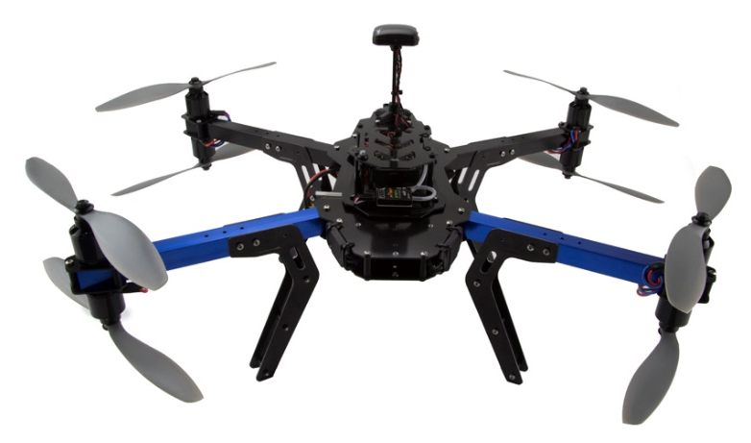
Methods
Develop an autonomous aerial vehicle capable of collecting a large data set
3D Robotics X8 octocopter utilizing the Pixhawk Autopilot System
NDVI camera mounted in a downward facing position
Flown at an altitude of 10 meters
Images and GPS data used to build a model in Agisoft PhotoScan
3DR X8 RTF heavy lift multirotor (3D Robotics Inc.)
Notes:
Also mention: orientation of cameras

Slide 10
Results
Raw aerial image composite

Slide 11
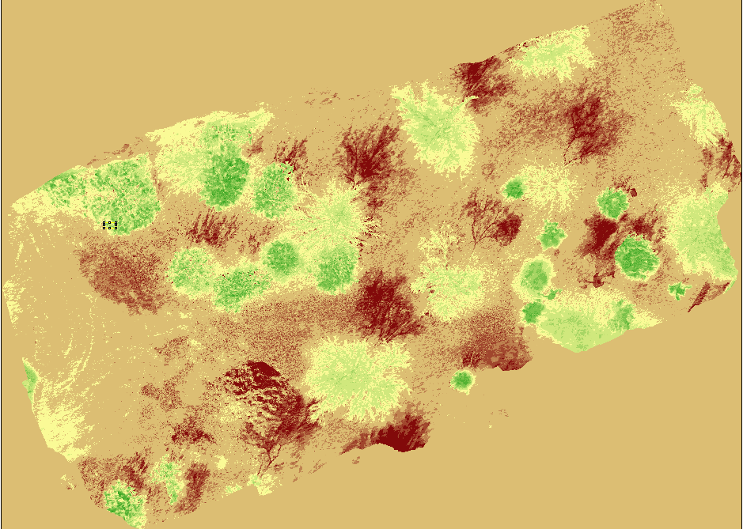
Results
Post-processed NDVI aerial image composite analysis

Slide 12
Conclusion
Using the Normalized Difference Vegetation Index and unmanned aerial vehicles proved to be a reliable method to gather quantifiable data on plant health.
Using the present work as the baseline, we intend to build 3D terrain models to better resolve the data set.

Slide 13
Thank you!

