Slide 1


Analysis of Amazon Rainfall Data Sets and the Importance of Paleoclimate Records
Anson Cheung, Luke Parsons, Julia Cole, Jonathan Overpeck
April 18, 2015
Sheraton Phoenix Airport Hotel, Phoenix, Arizona

Slide 2
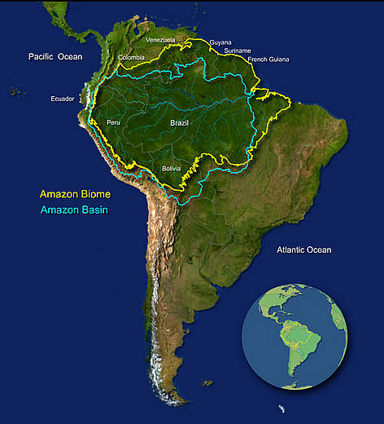
Background
Source: (World Wide Fund for Nature)

Slide 3
Background
Tropical Rainfall Measurement Mission Data
Source: (World Wide Fund for Nature)

Slide 4
Background
Tropical Rainfall Measurement Mission Data
Source: (World Wide Fund for Nature)

Slide 5
Is the Amazon always wet?

Slide 6

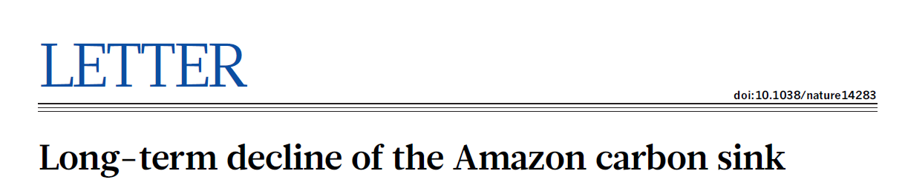

Slide 7
What is the rainfall variability in the Amazon?

Slide 8
Methodology
Climate data set analysis
  CMAP (Climate Prediction Center Merged Analysis of Precipitation)
  CRU (Climate Research Unit, UK)
  GHCN (Global Historical Climate Network)
  GPCC (Global Precipitation Climatology Center)
  GPCP (Global Precipitation Climatology Project)
  PRECL (Precipitation Reconstruction over Land)

Slide 9
Are Climate Data Sets Reliable for Precipitation Analysis?

Slide 10
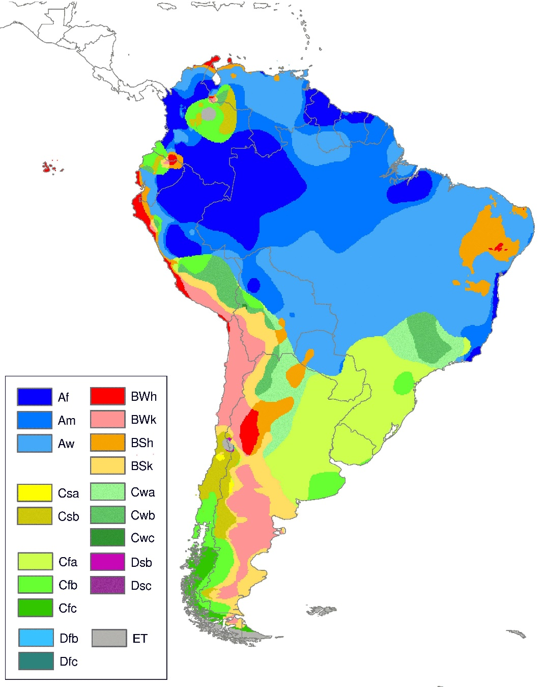
Regions in the Amazon
Eastern Amazon
Western Amazon
Central Amazon
(Peel et al., 2007)

Slide 11
Regional Difference
Climate Research Unit (CRU) Data

Slide 12
Western Amazon

Slide 13
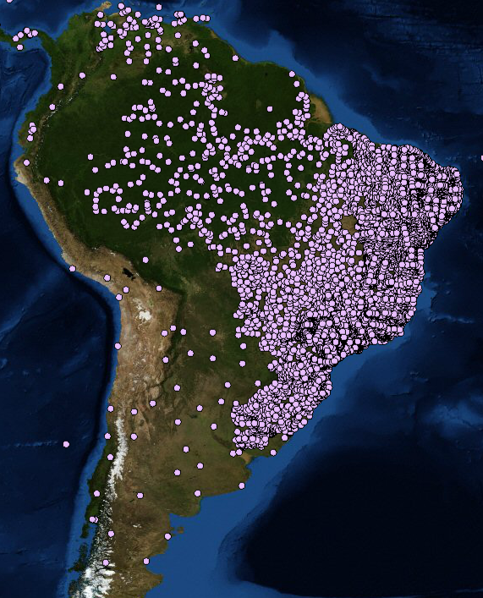
GHCN monthly station
= Historical stations
(Source: National Climate Data Center, NOAA)

Slide 14
GPCC with 90% of data present

Slide 15

Paleoclimate
(Photos Credit: Luke Parsons)

Slide 16
Station data time series

Slide 17
Correlate Station data with Data sets
= Lake Kumpak
= Station

Slide 18
Correlate Station data with Data sets
= Lake Kumpak
= Station

Slide 19
Correlate Station data with Data sets
= Lake Kumpak
= Station

Slide 20
Linear Correlation

Slide 21

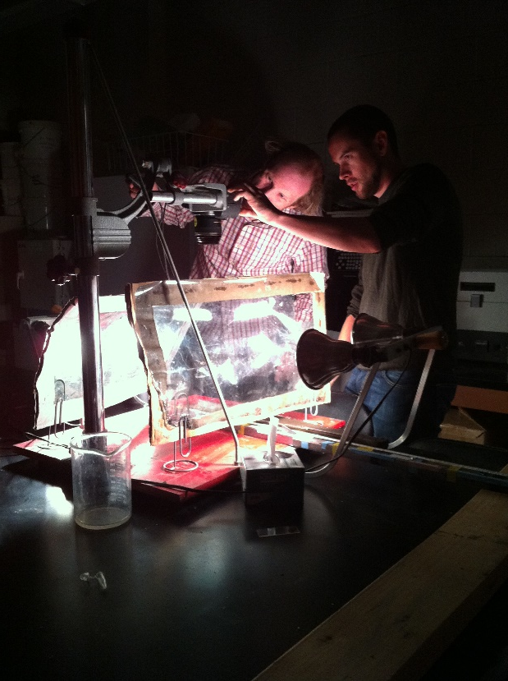
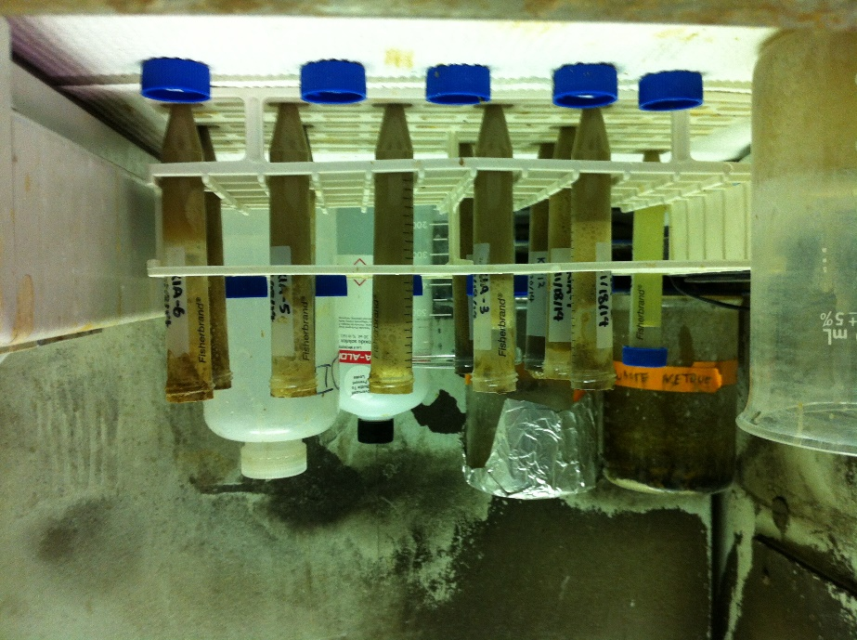
Future Work
Paleoclimate reconstruction
More paleoclimate records are needed

Slide 22
Selected References
CMAP Precipitation data, GHCN Gridded V2 data, GPCC Precipitation data, GPCP Precipitation data, PRECL Precipitation dataprovided by the NOAA/OAR/ESRL PSD, Boulder, Colorado, USA, from their Web site at http://www.esrl.noaa.gov/psd/
University of East Anglia Climatic Research Unit; Jones, P.D.; Harris, I.(. (2013): CRU TS3.21: Climatic Research Unit (CRU) Time-Series (TS) Version 3.21 of High Resolution Gridded Data of Month-by-month Variation in Climate (Jan. 1901- Dec. 2012). NCAS British Atmospheric Data Centre, 24th September 2013. doi:10.5285/D0E1585D-3417-485F-87AE-4FCECF10A992.http://dx.doi.org/10.5285/D0E1585D-3417-485F-87AE-4FCECF10A992

Slide 23
Acknowledgement
This work was supported by the Arizona Space Grant Consortium
Thanks to Luke Parsons, Drs. Julia Cole and Jonathan Overpeck

Slide 24
Thank You!

Slide 25
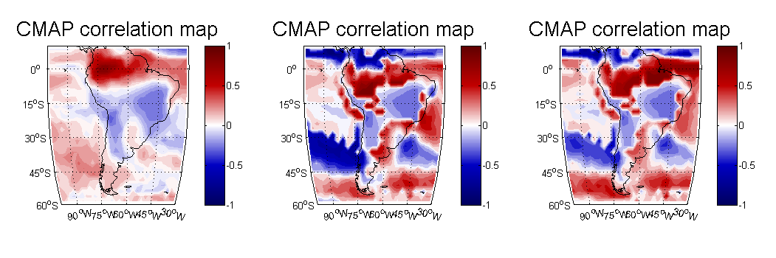
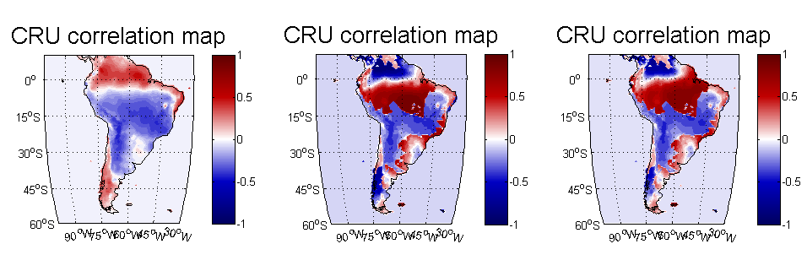
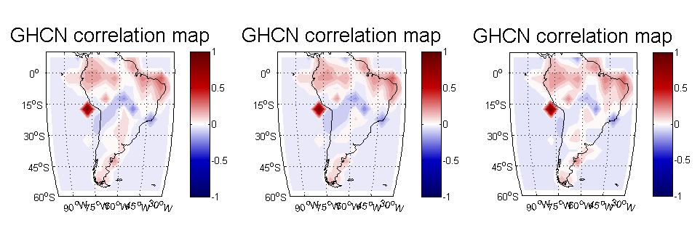

Slide 26
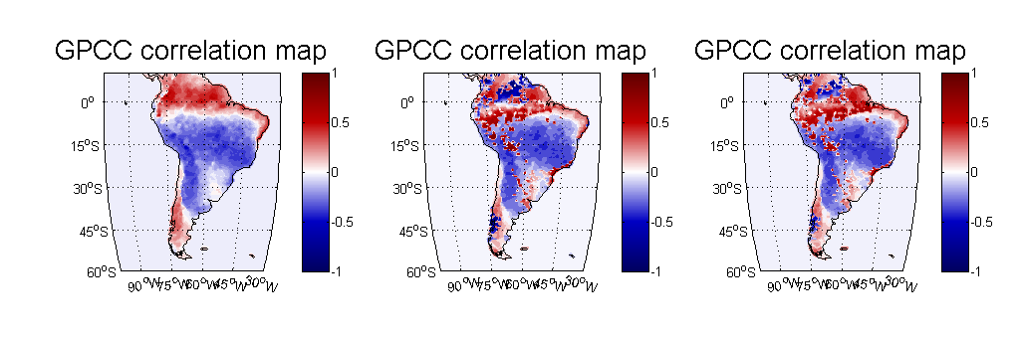
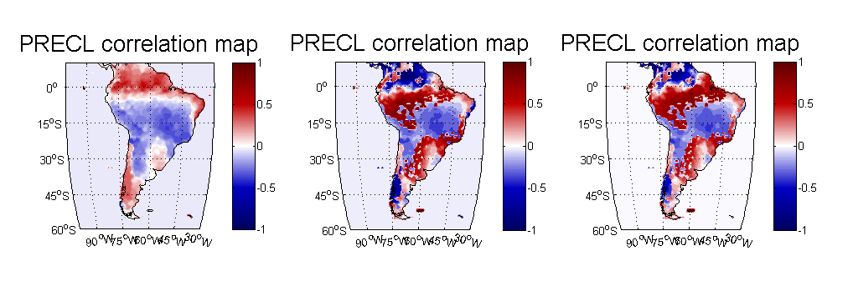
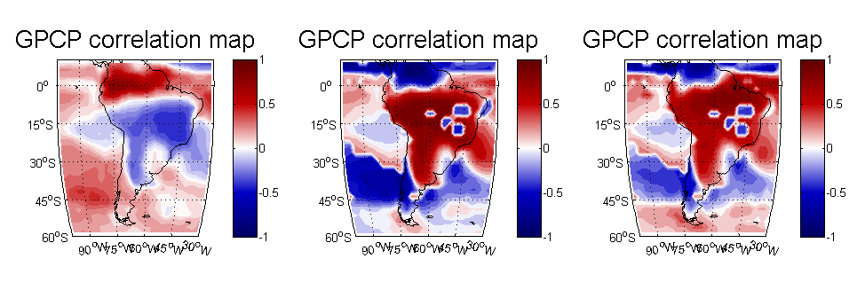

Slide 27
One gridbox

Slide 28
Lake Kumpak

Slide 29
Spectral Analysis

Slide 30
Central Amazon

Slide 31
Eastern Amazon

Slide 32
Western Amazon

Slide 33
Central Amazon

Slide 34
Eastern Amazon

