Slide 1
Investigation of vertical crustal motion using GPS
Alexandria Will-Cole and Rick Bennett
Notes:
I added my name so Geoscience people will know who you are working with.

Slide 2
Outline
Background
Analysis procedure
GPS analysis
Preliminary results
Observed vs. Theoretical
Conclusions
Future work

Slide 3
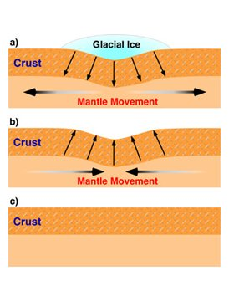
Background
GIA is the response of the solid Earth to the varying surface load brought about by melting of large-scale ice sheets and glaciers
Space geodesy allows for accurate measurements of vertical crustal motions
Notes:
----- Meeting Notes (4/2/15 15:19) -----
changing weight of ice invokes a viscous response in the mantle … mantle flow to equilibriate the column causing variations in surface

Slide 4
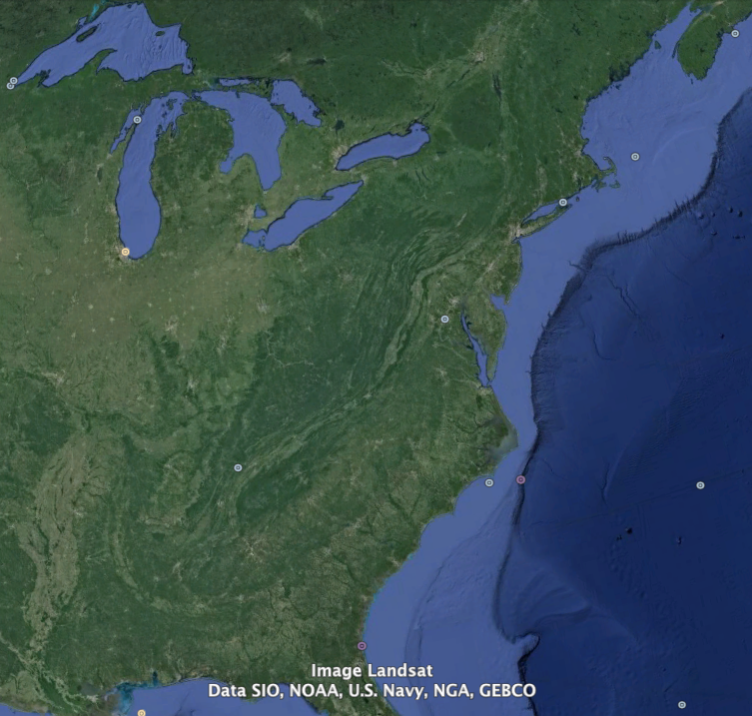
Study Area
Region of current uplift
Region of current subsidence
Study Area

Slide 5
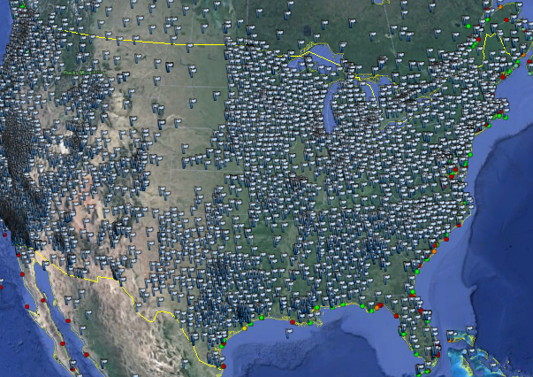
GPS Analysis
Geodetic devices installed along the coast
Devices collect spatial data using orbiting satellites
Detects E/W, N/S, and vertical adjustments
Data accessed online (13,000 archived by Reno Lab)
Notes:
The University of Nevada, Reno Geodesy Lab archives coordinate time series data form more than 13,000 stations, many of which are located along the East Coast of the United States.

Slide 6
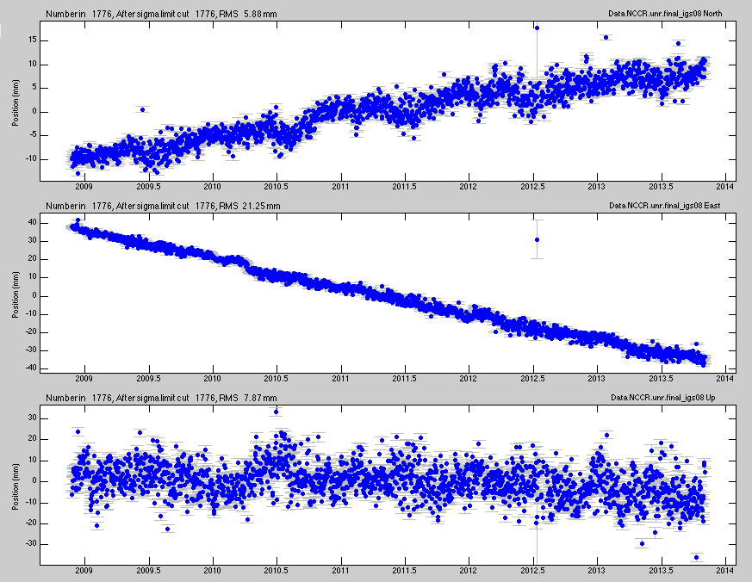
Analysis Procedure
Statistically analyze data using tsview program in MATLAB
Visually map the vertical adjustment rates
Compare previous models to experimental data

Slide 7
Results
Coast subsiding at rates in range of -0.70 to -3.50 mm/yr
±
±
±
mm/yr
Notes:
Add figure explaining region of study peripheral bulge

Slide 8
Results
Fitted surface to region of subsidence in eastern US
±
±
±
mm/yr

Slide 9
Observed vs. Theoretical
mm/yr
mm/yr
Our Smoothed Surface
SNARF GIA Model
Notes:
SNARF

Slide 10
Conclusions
East Coast is subsiding at relatively fast rates
Theory appears to over predict the magnitude of subsidence due to GIA in the mid Atlantic
Misfits illustrate the potential of GPS data for improving GIA models
Future Work
Utilize SELEN Ice Model to produce a model calibrated to GPS data
  Learn more about regional rheology
Notes:
----- Meeting Notes (4/2/15 15:19) -----
over predicts not over estimates

Slide 11
Acknowledgements
Special thanks to…
  Dr. Rick Bennett
  Kathleen Compton
  Phillip McFarland
NASA Space Grant Program
University of Arizona
References
Sella et al. (2007). Observation of glacial isostatic adjustment in “stable” North America with GPS. Geophysical Research Letters.
Herring et al. (2008). SNARF 2.0: A regional reference frame for North America. American Geophysical Union Meeting.

