Slide 1



The Effect of a Stand Replacing Fire on Ectomycorrhizal Fungi Inoculum Potential
Larrea Cottingham
Suzy Owen and Catherine Gehring
Northern Arizona University
Notes:
I am looking at small part of a big project in understanding ponderosa a pine regeneration, specifically in their regeneration after a stand replacing fire.

Slide 2
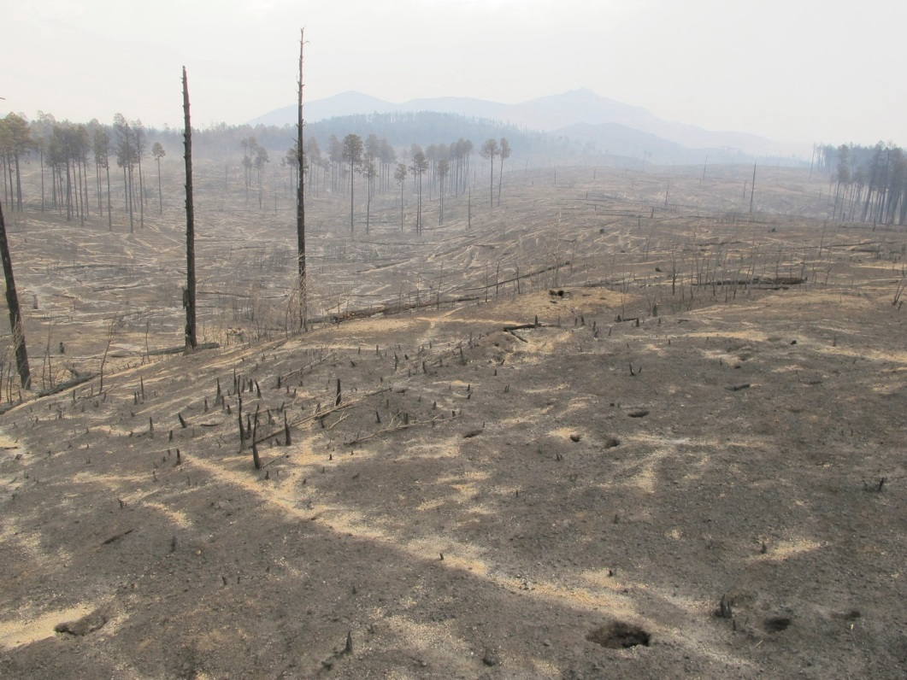
http://friendsoftheriodeflag.org/fordf_images/fire-aftermath.jpg
Notes:
Shultz fire out side flagstaff (2010) Stand replacing fires are high severity fires that kill most or all of the trees in a forest stand.
Ponderosa Pine forests are prevalent across Central to Northern Arizona
Fires are a common part of the forest ecosystem but stand replacing fires can be detrimental
Fire can hinder the regeneration of these areas and greatly impact the rhizosphere of forests

Slide 3
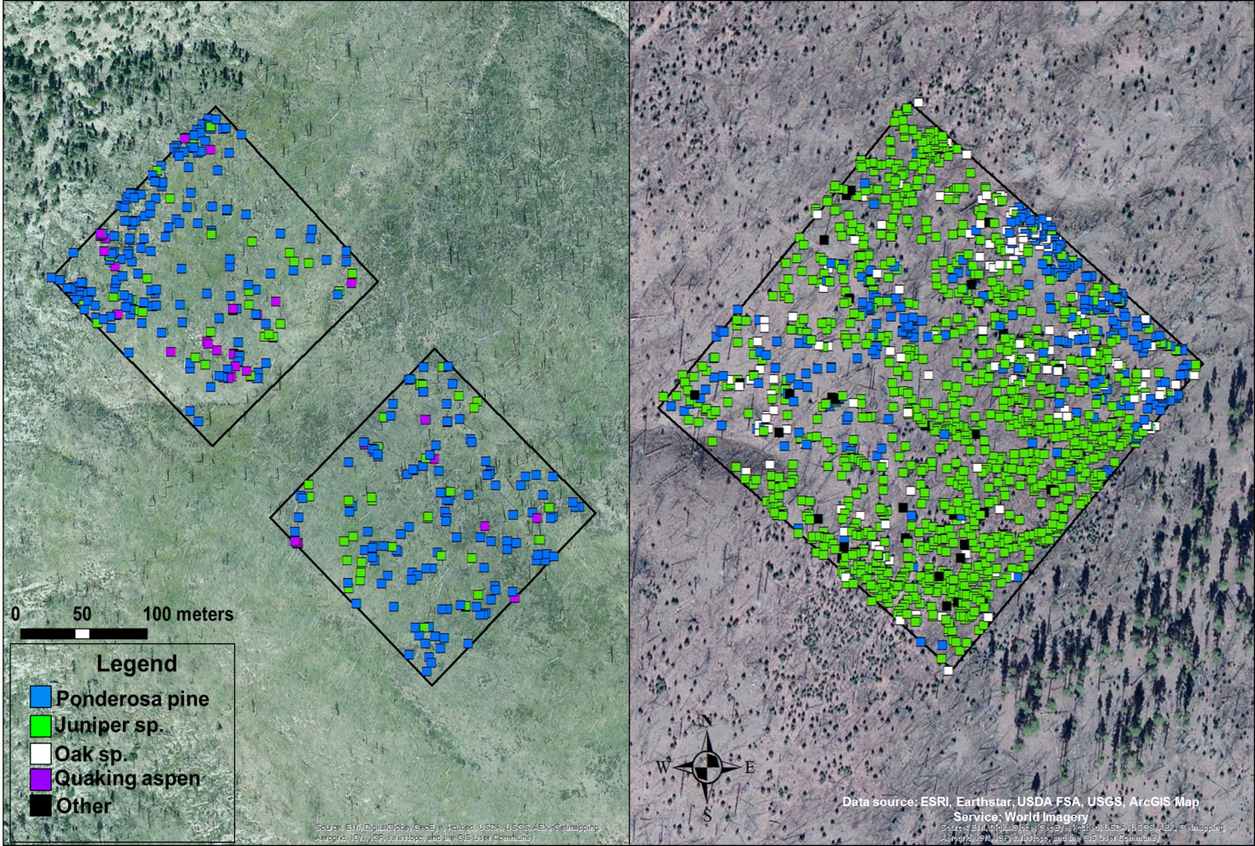
Notes:
Only reach about as far as the tree is tall

Slide 4
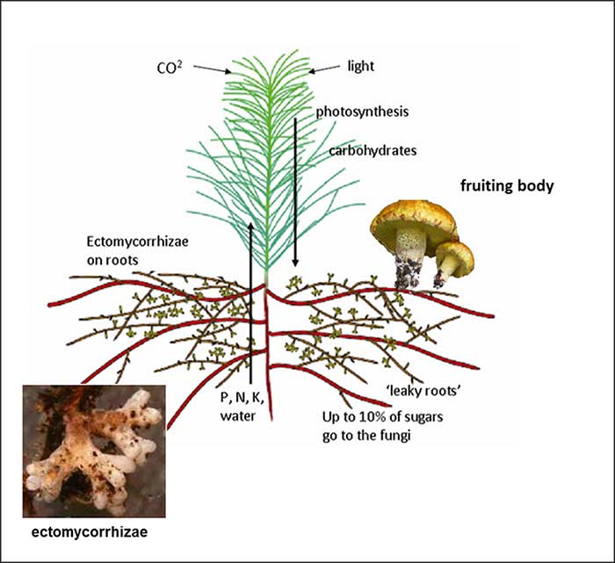
Ectomycorrhizal fungi (EMF)
Ectomycorrhizal fungi form mutualistic associations with woody plants including ponderosa pines
Ectomycorrhizal inoculum comes from the living roots of mature trees
Spores, hyphae, sclerotia
Dr. Cathy L. Cripps, americanforests.org
Notes:
Mutualistic fungi. Ponderosa pines are obligate mutualists.

Slide 5
Hypotheses
1) The amount of ectomycorrhizal inoculum will be reduced in burned areas relative to nearby non-burned areas.
2) The species composition of ectomycorrhizal fungi will differ between burned and non-burned areas.
Notes:
Species comp will tell us about successional trends—competition vs. what the trees actually have as adults. Also it is unknown what is out there.

Slide 6
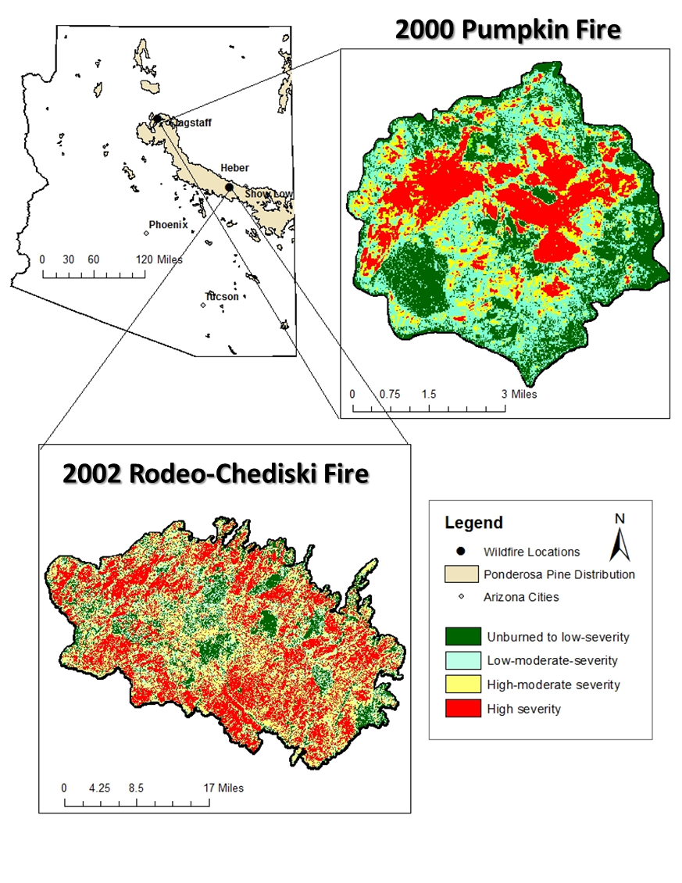
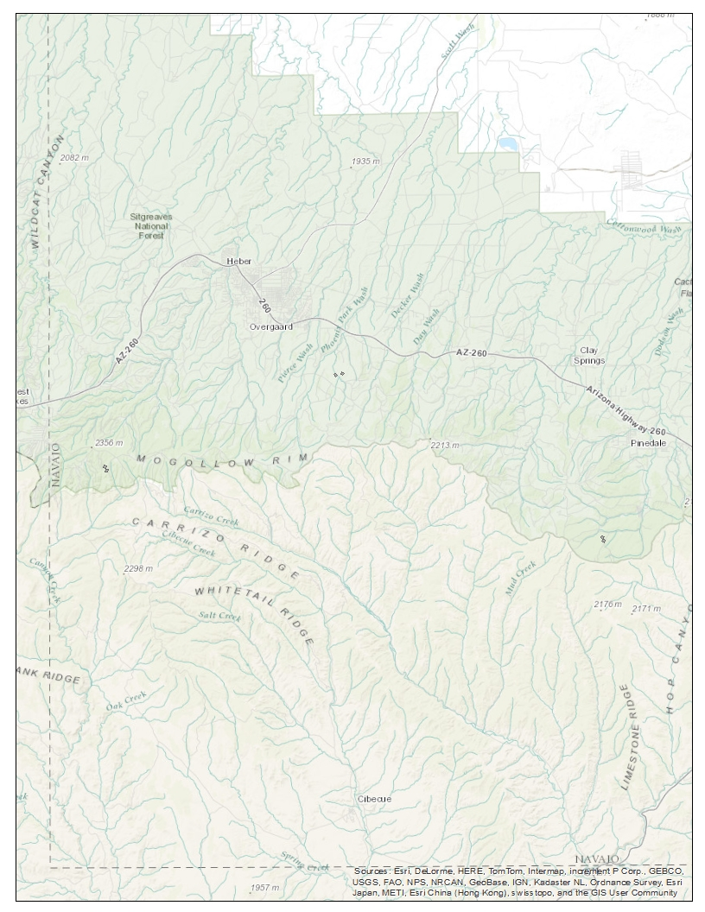
High-Severity Burn Plots on the Rodeo-Chediski Fire
Heber
Hwy 260
Central Plots
West Plots
East Plots
Map by Suzy Owen

Slide 7
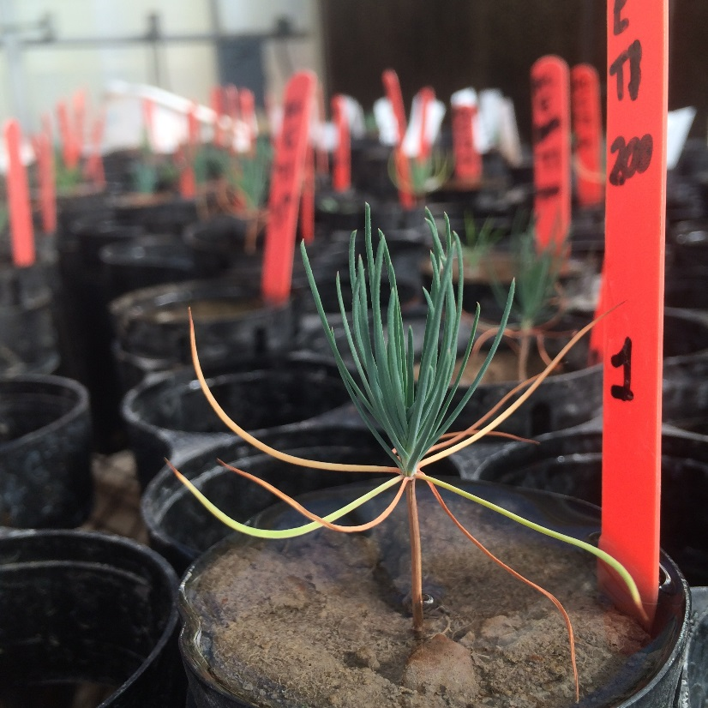
Methods in the Field
Collected Soil cores from 3 plots in the Rodeo-Chedeski burn in the Apache-Sitgreaves National Forest
Grew seeds in the soil cores at the Rocky Mountain Station Greenhouse

Slide 8
Methods in the Lab
Counted root tips using the microscope
Categorized EMF into morphotypes based on color, texture and shape
DNA extraction→PCR→Sanger Sequencing

Slide 9
Distance from Forest versus
% EM Colonization
R² = 0.010
P=0.651
R² = 0.003
P=0.807
Notes:
The red lines represent where the inoculum from the roots is expected to end…Don’t forget to include that at 50 inoculum is no linger root.

Slide 10
Community Composition
Community composition did not differ in relation to distance
East=West≠Central

Slide 11
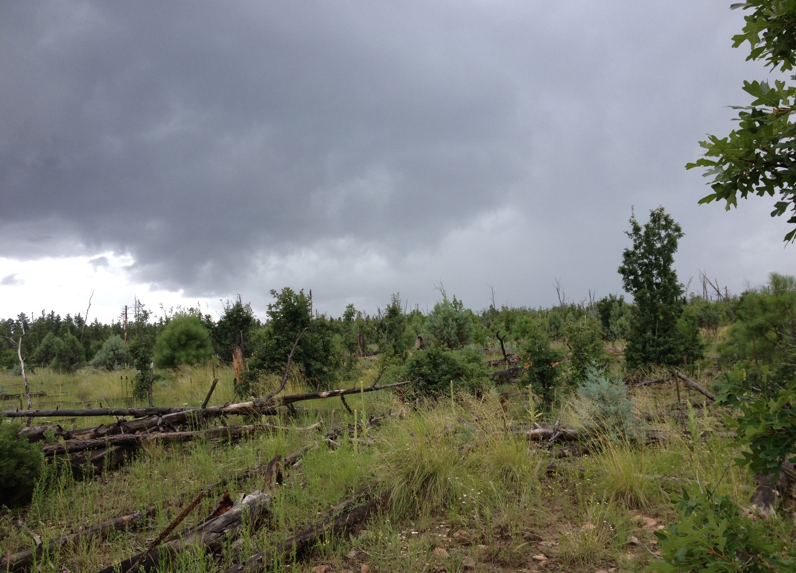
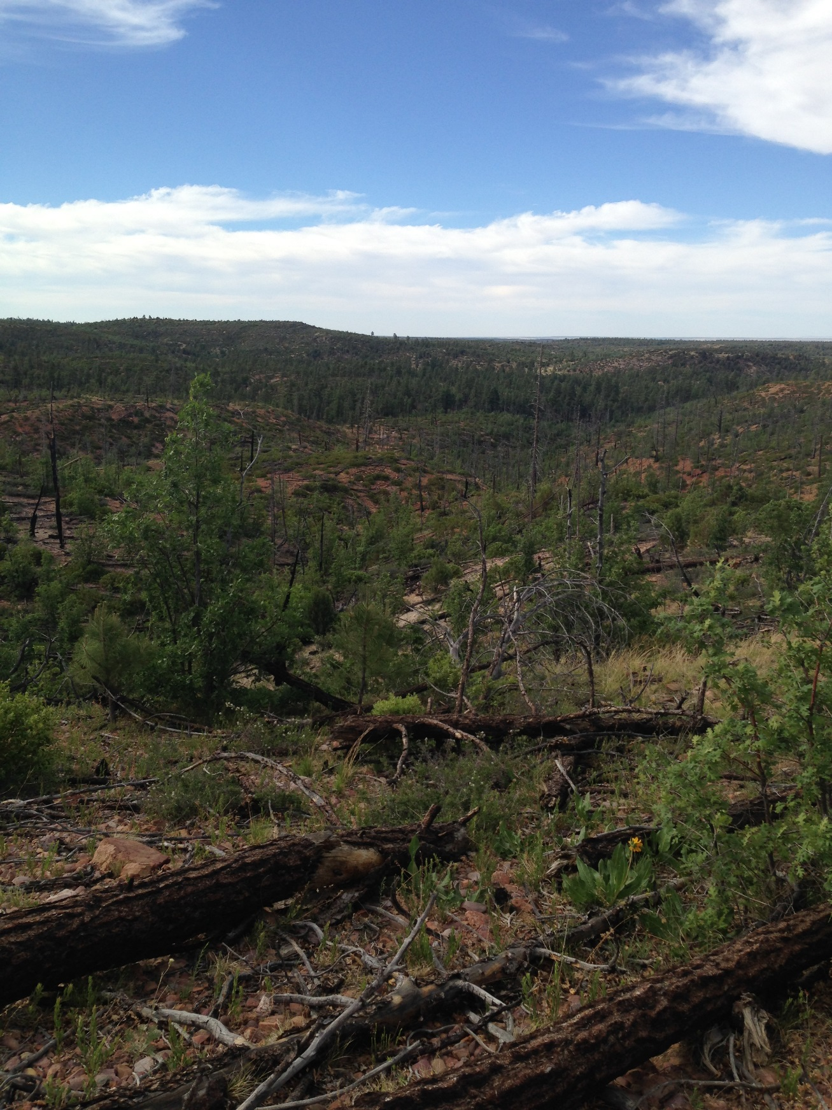
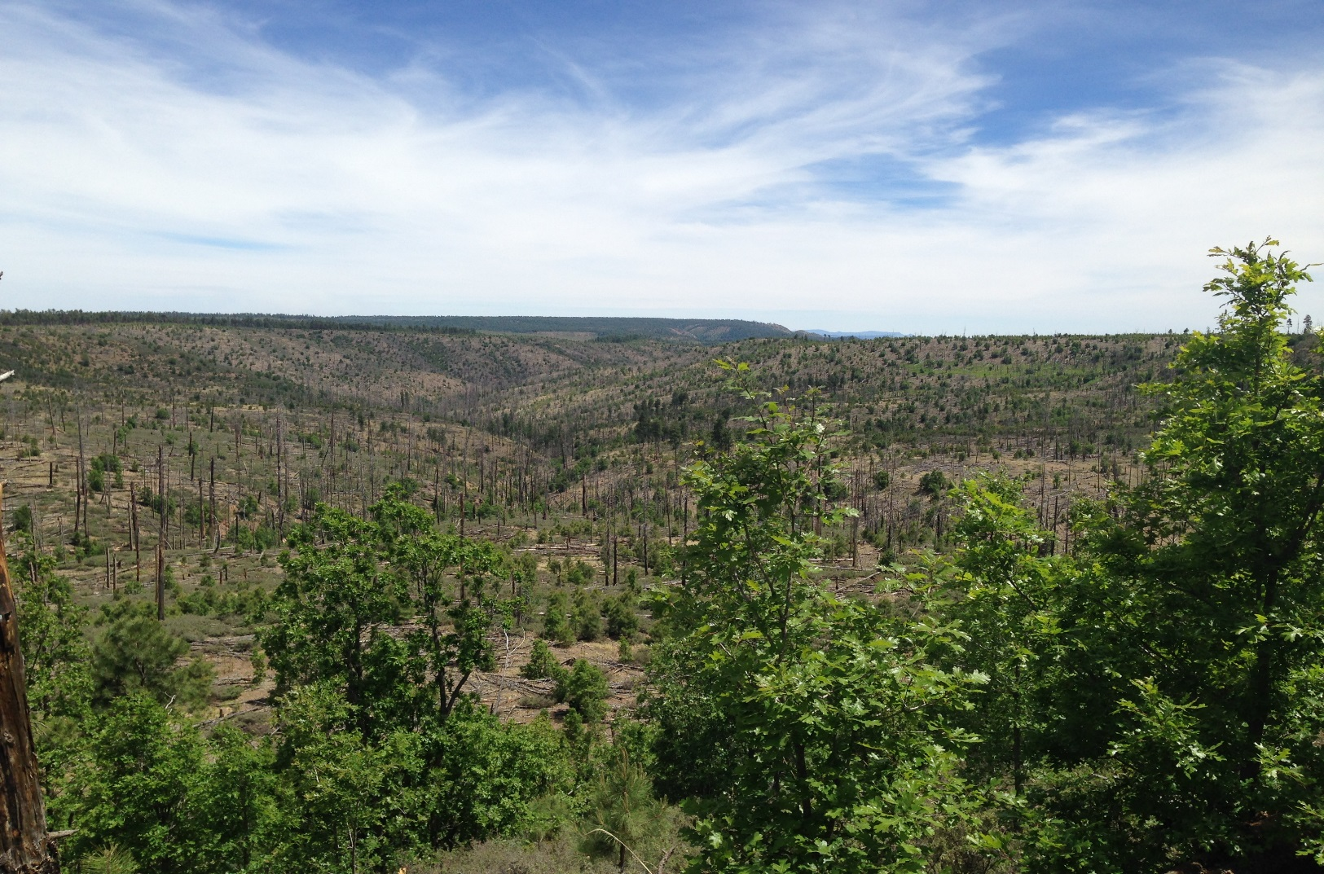
Central
West
East

Slide 12
Acknowledgements
Thank you so much for all of your help!
Catherine Gehring, PhD and Suzy Owen
Adair Patterson and Wren Winston
Andrew Krohn
Rocky Mountain Research Station
NASA Space Grant Program

Slide 13
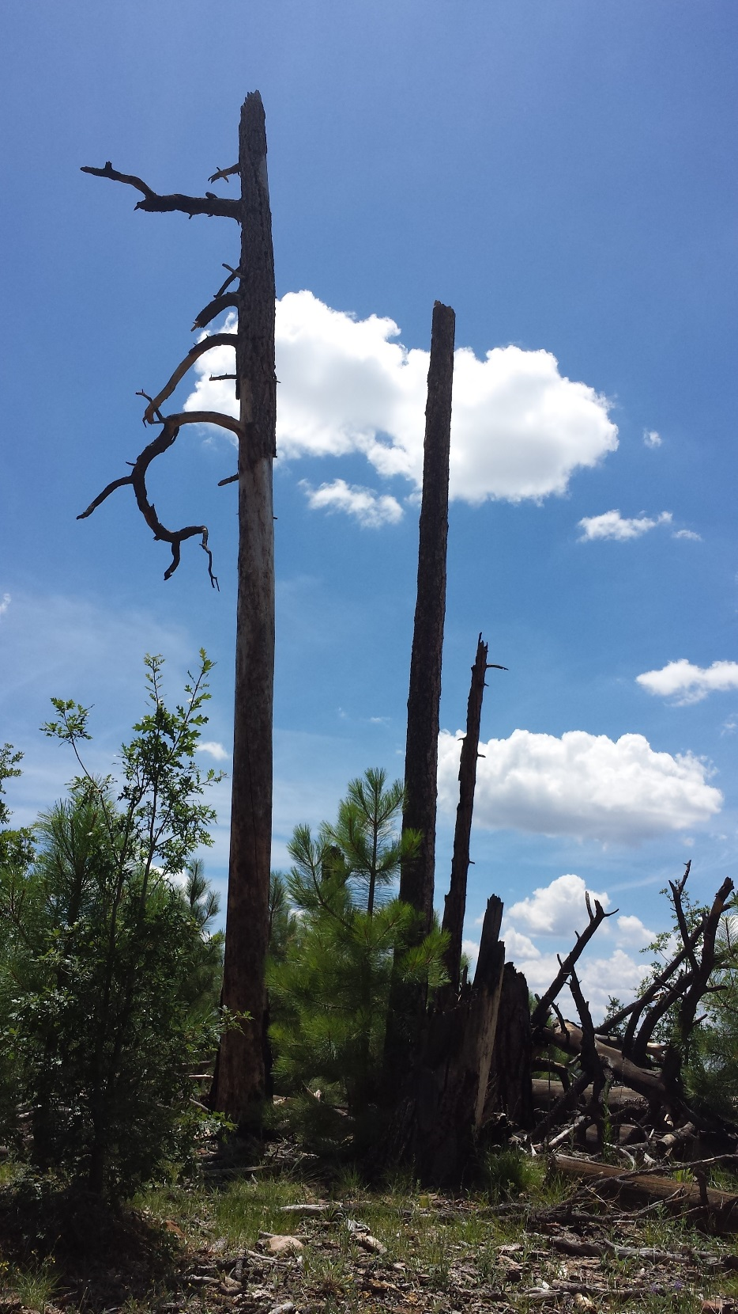
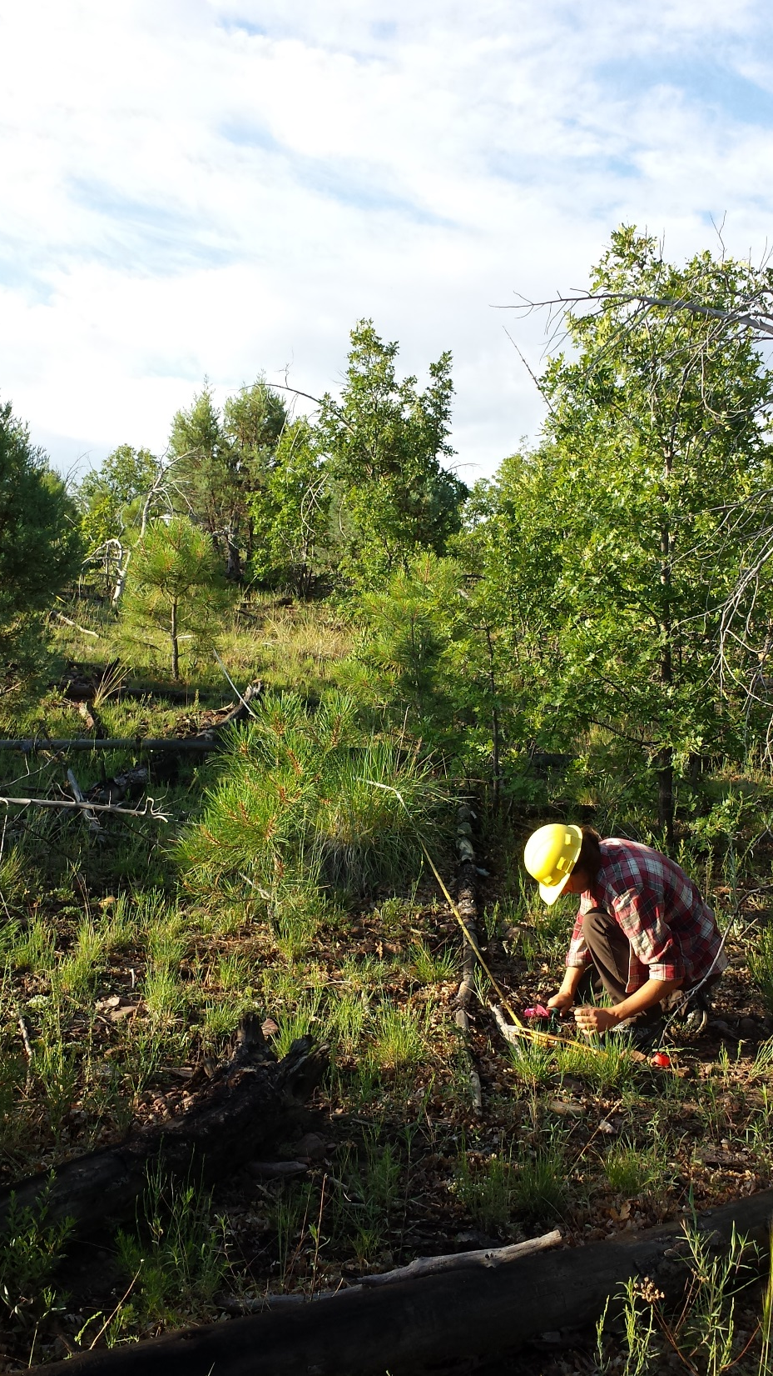
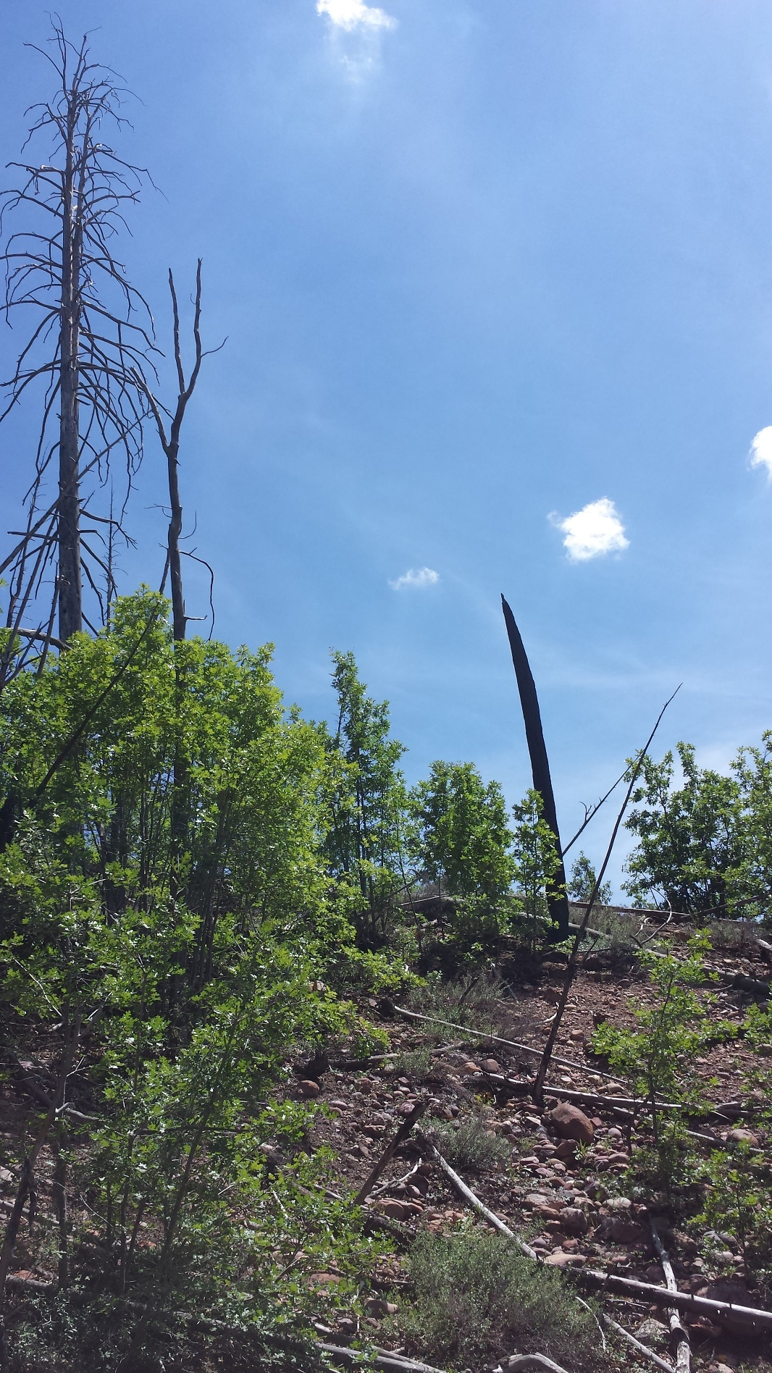
Questions?
Questions?

